Slide 1
Building a Jenkins pipeline for automated K8s cluster creation

Slide 2
Why?
How?
Demo
But...

Slide 3
Why?

Slide 4
Early feedback
  Working with a production like environment
  Testing different setups
  Observing cluster-wide implications
  No suprises on production rollout
Notes:
- local dev setups good, but differ from real world
- end-to-end testing with different version/component combinations
- load testing with production like setups
- real impact on cluster can be monitored via standard tooling
- early feedback on costs/resource requirements
- “If it hurts, do it more often” → a lot of production like deployments show errors in the deployment early, reduces number of “suprises” on real rollout

Slide 5
Autonomous teams
  Destructiv testing
  Dedicated setups under full control
  Knowledge about the cluster for the teams
Notes:
- often a central dev/test/qa etc instance, teams influence each other
- testing edge/error cases can lead to instable/broken clusters → other teams are blocked or such tests are prohibited →
- work from other teams changes the setup → unexpected versions/changed datasets/introduced errors →less meaningful results(is this my error?), more sources for error
- the teams know there cluster, not frontend →ignore everything behind, backend → don’t care what the user gets, ignore resources, monitoring etc. → enables cross functional teams working after DevOps principles

Slide 6
Less work
  „Ops“ team does not have to maintain a central dev cluster
  No „Blocking the cluster for testing“
Notes:
- dev cluster always “under pressure” by test/development → often broken, needs maintenance
- teams can block each other with “special needs” → tests, reviews, demos etc.

Slide 7
How?

Slide 8
Automate everything
  Quick and easy cluster provisioning in the public cloud
  Deployment definition via helm
  Cluster creation and deployments via pipeline

Slide 9
In Kiwigrid:
  Jenkins as ci-server
  Groovy library for pipelines
  GCloud
  Domains via GCloud DNS, (staging)-certificates via Let‘s encrypt
Notes:
- jenkins current solution, does not feel like the best solution, probably changes in the future
- groovy currently good solution, because similar to java, easy for devs → future evaluation: google deployment manager, terraform, skaffold?

Slide 10
Demo

Slide 11
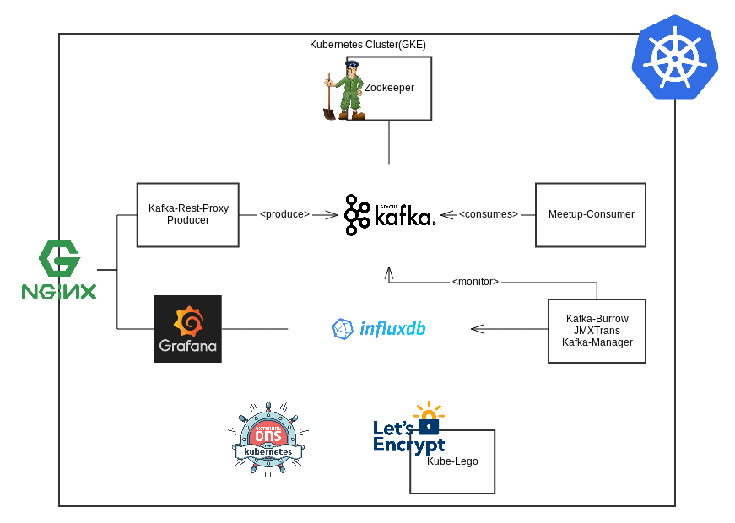

Slide 12
But...

Slide 13
Isn‘t that expensive?
  Cluster runs only as required
  Less cluster maintenance
  Cluster can be configured exactly as required
  Less „idle-time“ for the development teams
  Cost transparency allow teams to optimize
  Improved quality → less maintenance time
Notes:
- dev cluster runs always → after work, weekend, holidays etc. instead of only when required
- dev team does not need a cluster that often
- clusters with the exact required sizing, preemptible machines as option
- teams are not blocking each other → less useless “idle-time” for teams when they are blocked in there normal workflow
- teams can see the cost impact of there development and thus are able to find the optimal solution(gke vs. app engine, self hosted vs. aaS, resource footprint)
- early feedback and more realistic test scenarios improve overall code quality → less maintenance time, happy customers

Slide 14
We are no „Ops“.
  Helps to enable DevOps
  Requires cross-functional teams
  Allows teams to gain knowledge and responsibility on there clusters
  „Infrastructure as Code“
  Shared knowledge through teams
Notes:
- we don’t want to differentiate between ops and devs, helps us to enable “DevOps”
- to get this really working, requires cross-functional teams, with dev and ops knowledge
- allows the teams to gain more knowledge about there actual software and clusters → enables them to take responsibility for the clusters
- the infrastructure is setup as code(yaml and groovy), similar to what devs do the whole day
- centralized components like the pipeline lib or shared helm charts allow teams to share there knowledge between teams and benefit form each other work

