Slide 1
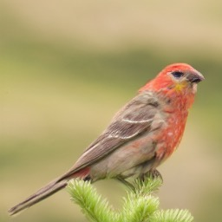
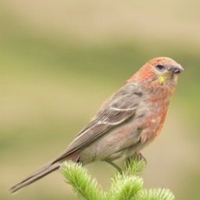
Input image
NFS-CBM decision
Concept selection
Concept perturbation
Contribution to class ŷ
z
k*
NFS-CBM
Perturb zₖ*
z′
k*
Predicted class ŷ
k*
x
k* = arg maxₖ R(ŷ, k)
Other dimensions fixed
z, z′
Concept dictionary
Concept naming
Image generation
A: Original
Naming prompt
A
ID | Name
⋮ | ⋮
82 | Red plumage
⋮ | ⋮
GPT-5.4
CDG
B: Perturbed
B
names.csv
result.json
Notes:
Single-sample inference and explanation workflow requested by the author. NFS-CBM predicts class y-hat; concept selection is by R(y-hat,k)=W(y-hat,k)*z_k (manuscript Eq. 6), not activation alone. k*=argmax_k R(y-hat,k). The contribution bars are schematic and do not report measured values. Perturb only the selected coordinate and hold all others fixed; CDG generates original and perturbed reconstructions. Perturbation does not prescribe a sign. Image A and image B are stacked vertically and enter GPT-5.4 through two separate, straight horizontal arrows in the same request. The model receives the naming prompt as an additional input. The dictionary maps concept_id to best_name. The script stores confidence, evidence and additional fields in names.csv and result.json; no confidence value is fabricated in this diagram. Sources: tcsvt_initail.pdf, Sections III-F and III-G, Fig. 4a; Supplementary Material Section II. Only one sample from Fig. 4a is shown. Im68 is the original reconstruction; Im67 is the perturbed reconstruction. Because the raw input photograph was not supplied, the input-image node reuses Im68 as a schematic stand-in, not as evidence of exact reconstruction fidelity. Red plumage is the manuscript example for dimension 82; neither prediction nor ranking nor naming was recomputed. Current name_concepts.py implements the final image-pair naming stage; model inference, ranking, intervention and CDG require the trained NFS-CBM implementation.

