Slide 1


Snail
PROJECT
social network application based on Android
DATE
5/24/2015
tEAM
dx2152, mw2987, XK2122, yt2443

Slide 2

Goal&Motivation
Build first mobile app based on Android
Get more familiar with google play and google map API
Use cloud to store huge amounts of data

Slide 3

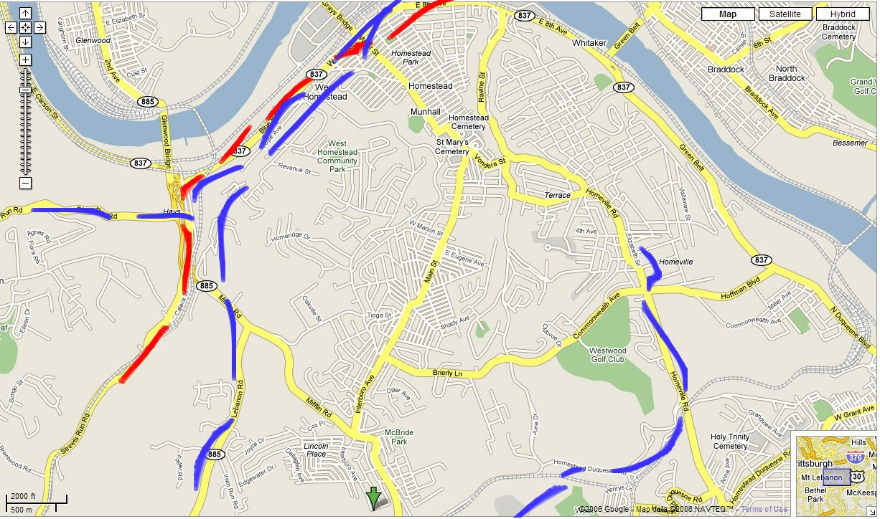

Snail Structure
Google
Server
Database

Slide 4
Front-end
XML layout language
Mobile device interaction
Login security check

Slide 5
Back-end
Google map API
Get current location
Draw trace behind a moving marker
Get recommended route from starting point to destination
Display old routes and friends' previous moments
Database
UserInfo table
Follow table
Moments table
RoutePoints table
RouteStartEnd table

Slide 6
Future Work
1. team route
2. peer-to-peer chat
3. group chat

Slide 7


Demo

