Slide 1



Getting Quantum Safe
in
5 Slides
Executive Presentation
Cloud Security Alliance Quantum-Safe Security working group

Slide 2
Problem
Quantum computers are likely to become sufficiently capable in the near future to compromise many popular cryptography solutions that protect us today

Slide 3
Goal
All quantum-susceptible computers/devices/software/hardware/networks will need to be migrated/replaced with quantum-resistant cryptography solutions
“Post-Quantum” projects will likely take years for most organizations
All organizations should begin preparing now by performing a data protection inventory (what?, where?)

Slide 4
Possible Solution Types
Isolate critical data against eavesdropping
Strengthen quantum-susceptible symmetric keys
Quantum-resistant (i.e., post-quantum) cryptography
Quantum-key distribution (QKD)
Hybrid defenses
Quantum random number generators
Quantum-enabled defenses
Adopt “crypto-agility”

Slide 5
Your Next Steps
Educate yourself and others
Get senior leadership support
Start a post-quantum project team
Pick a quantum safe education lead(s) to help team stay up on latest developments and recommendations
Get a data protection inventory
Review, determine, and implement solutions

Slide 6
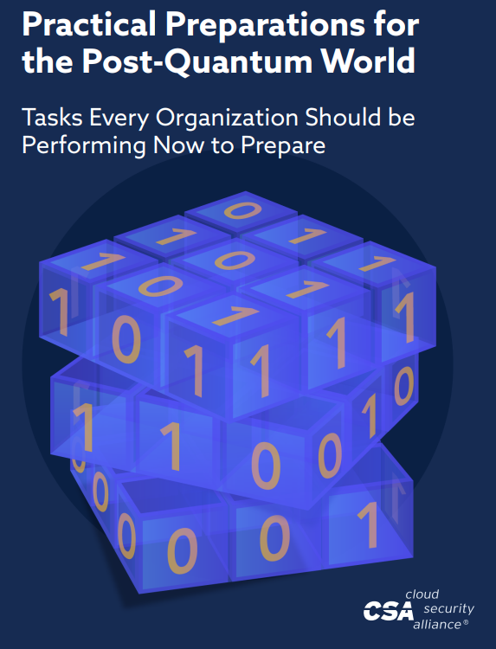
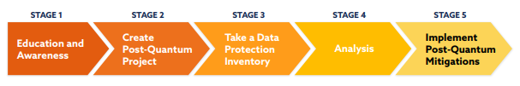
For More Information
https://cloudsecurityalliance.org/artifacts/practical-preparations-for-the-post-quantum-world/
More information and details
Step-by-step project plans
Data protection inventory instructions
Example senior management memo
FAQ

