Slide 1
CloudSpace Technologies
INSWITCH
INSWITCH: settlement reliability infrastructure for Nigerian banks
Response to the Bank's EIMRPP RFP: one gateway for IMTO onboarding, remittance processing, settlement, and reporting.
Bank CIO / ED briefing
Enterprise decision
CIO / ED enterprise investment briefing / June 2026
Prepared by CloudSpace Technologies
01

Slide 2
EXECUTIVE DECISION
The bank is not buying another dashboard. It is buying control over final-leg uncertainty.
INSWITCH addresses the point where digital payments become executive risk: customer value has left one system, final credit is not cleanly proven, and the next action can create loss if handled manually.
Customer confidence
Operational loss
Executive oversight
Branches, contact centers, and digital channels need a defensible answer when a beneficiary has not been credited.
Manual follow-up can lead to duplicate credits, delayed reversals, and unresolved suspense positions.
The CIO/ED needs one governed view of provider health, SLA pressure, evidence, and closure authority.
CX / brand risk
Loss control
Control layer
CloudSpace Technologies / INSWITCH CIO-ED briefing
02

Slide 3
BOARD-LEVEL PROBLEM
A single local settlement dependency turns provider noise into bank risk.
When the final-leg route slows down, the bank still owns the customer conversation, the reversal decision, the ledger proof, and the partner escalation.
Bank channels
Single route pressure
Uncertain finality
Executive exposure
Mobile, branch, API, partner channels submit payment instructions.
NIP or one contracted provider becomes the practical bottleneck.
Timeouts, delayed callbacks, TSQ gaps, reversal questions, settlement mismatch.
Customer complaints, operational breaks, financial exposure, audit questions.
The CIO/ED question is not “did the API respond?” It is “can the bank prove what happened and act safely before the issue becomes loss or reputational damage?”
CloudSpace Technologies / INSWITCH CIO-ED briefing
03

Slide 4
CLOUDSPACE TECHNOLOGIES PROPOSAL
INSWITCH gives the bank a governed switching and repair layer for the local settlement leg.
The bank keeps its core ledger, policies, and maker-checker controls. CloudSpace delivers the orchestration layer that selects eligible routes, monitors provider health, drives repair, and preserves the evidence trail.
One bank instruction
INSWITCH API
Local providers
Proof and closure
Idempotent transfer intake from bank or partner systems.
Eligibility, policy, routing, provider health, SLA timers.
NIP, Moniepoint, Interswitch, Paystack and approved rails.
TSQ, session ID, callback, ledger posting, settlement report, audit.
Not a core replacement
Not a pass-through adapter
Bank policy remains in control
This is the layer between transaction submission and operational finality: the place where reliability, evidence, and safe closure are enforced.
CloudSpace Technologies / INSWITCH CIO-ED briefing
04

Slide 5
RFP ALIGNMENT
INSWITCH answers the EIMRPP RFP scope end to end.
The Enterprise IMTO Management and Remittance Processing Platform RFP asks for one gateway for onboarding, integration, processing, reconciliation, settlement, and reporting. INSWITCH covers each scope area.
Partner management
Integration
Remittance processing
IMTO onboarding and approval workflows, partner profile, contract and SLA management, risk classification, and due diligence tracking.
API gateway and partner connectivity over REST, SOAP, and SFTP, message routing and transformation, partner-specific mapping, and ISO 20022 support.
Instruction receipt and validation, beneficiary and account verification, routing and payment processing, returns, reversals, and recall management.
RFP scope 3.1
RFP scope 3.2
RFP scope 3.3
CloudSpace Technologies / INSWITCH CIO-ED briefing
05

Slide 6
OPERATING MODEL
INSWITCH turns unresolved payments into governed work, not inbox traffic.
Every case has an owner, a permitted action, an evidence requirement, and an audit event. That is the difference between a software demo and a bank operating platform.
Detect
Failed, reversed, delayed, indeterminate, or SLA-breached local transfers are surfaced immediately.
Signal
Route
New eligible traffic can move toward the best-performing local provider while existing cases remain protected.
Decision
Repair
TSQ, callback replay, ledger search, settlement matching, and reversal approval are step-based.
Control
Prove
Session IDs, Receiving Entity responses, core postings, settlement reports, reasons, and maker-checker history stay linked.
Evidence
CloudSpace Technologies / INSWITCH CIO-ED briefing
06

Slide 7
EXECUTIVE DASHBOARD
Command Center: quick operating answers at the top of the screen.
Failed transfers, local provider condition, partner SLA breaches, and INSWITCH telemetry are visible before any drilldown.
Yes / 2
3 / 4
1
Live
failed or reversed local transfers in the active window
local providers currently working
international partner SLA currently failing
INSWITCH switching telemetry current
LOCAL PROVIDER WINDOW
RANKED BY CURRENT ROUTE PRESSURE
MONIEPOINT
BEST
INTERSWITCH
WORKING
PAYSTACK
WATCH
NIP
CONTAIN
41s
P95 credit
52s
P95 credit
1m 26s
P95 credit
4m 18s
P95 credit
0.3% timeout / 0 open
0.9% timeout / 1 open
2.1% timeout / 2 open
8.7% timeout / 4 open
Live product signal from deployed INSWITCH demo environment
07

Slide 8
PROVIDER PERFORMANCE
Provider routing becomes a management decision backed by current evidence.
In the active window, INSWITCH makes the provider stance plain: prefer Moniepoint for eligible new local payouts, contain NIP pressure, and keep Paystack behind stronger rails until callback lag clears.
P95 credit time
Operating stance
Moniepoint
41s
Moniepoint / increase eligible traffic
Interswitch
52s
Interswitch / monitor closely
Paystack
1m 26s
Paystack / callback watch
The value is not “routing for routing’s sake.” It is measurable operational control before the next batch of customer-impacting transfers is sent.
CloudSpace Technologies / INSWITCH CIO-ED briefing
08

Slide 9
PARTNER ONBOARDING
New IMTOs onboard through configuration, not development.
A guided wizard captures profile, contract, integration, and compliance data, then routes the record through maker-checker approval before integration testing starts.
Partner profile
Contract and SLA
Integration setup
Compliance
Checker approval
Name, country, corridor, and risk classification recorded by the maker.
Credit SLA, settlement currency, prefunding model, and contract dates.
REST, SOAP, or SFTP mode with credential and certificate references; ISO 20022 flag.
Licence verification, AML review, and sanctions calibration tracked as due-diligence items.
Multi-level approval gates the partner before any live traffic.
Each new IMTO is configuration plus approval workflow. No code change is required per partner.
CloudSpace Technologies / INSWITCH CIO-ED briefing
09

Slide 10
REPAIR WORKFLOW
The platform blocks unsafe closure until evidence and reason are present.
For high-value bank operations, buttons are not enough. INSWITCH structures each remediation case as a controlled sequence that can survive audit, customer escalation, and reconciliation review.
Choose action
Enter evidence
Enter reason
Review checklist
Submit audit
Attach evidence, manual requery, completed outside platform, or reversal.
Specific reference: TSQ, NIP Session ID, callback, ledger posting, settlement batch.
Operator states the checked source and why the action is safe.
Duplicate-credit risk, maker-checker, settlement link, customer value proof.
New state, evidence record, and immutable action trail.
This is how CloudSpace positions INSWITCH to the bank: not as a monitoring screen, but as an operating control that reduces discretion where discretion creates loss.
CloudSpace Technologies / INSWITCH CIO-ED briefing
10

Slide 11
EVIDENCE MODEL
A Nigerian payments case is only closed when the bank can defend the evidence.
INSWITCH keeps NIP webhook, TSQ/status API, ledger, escalation, and reversal evidence in one defensible case record.
NIP Session ID
TSQ / status API
Receiving Entity response
Rail/session proof
Latest rail status
Destination-bank evidence
Core ledger posting
Provider escalation email
Evidence note
Bank-of-record proof
Timed provider response
Double-payment guard
NIP / Instant EFT
Reversal control
No double pay
Evidence aligned to NIP operations: status, ledger, escalation, reversal, and reconciliation.
11

Slide 12
ARCHITECTURE FOR GOVERNANCE
INSWITCH is designed to fit bank architecture, not fight it.
CloudSpace Technologies delivers a switching and operations layer that integrates with the core banking system, AML and fraud systems, data warehouse, identity management, approved local providers, reconciliation files, and MariaDB-backed audit records.
Bank / partner channels
INSWITCH control plane
Local payment providers
API intake, idempotency, contract scope, user permissions.
Route policy, health windows, SLA clocks, requery/backoff, case state.
NIP, Moniepoint, Interswitch, Paystack, approved bank endpoints.
Evidence and audit
provider_calls, outcome_evidence, remediation_cases, reconciliation_matches, audit_events.
Database target: MariaDB. The platform model avoids introducing a competing ledger of record.
CloudSpace Technologies / INSWITCH CIO-ED briefing
12

Slide 13
VALUE BY EXECUTIVE OWNER
The enterprise case is cross-functional because every disputed transfer needs one owner and one evidence path.
INSWITCH gives Technology, Operations, Risk, Settlement, and CX the same transfer status, evidence, and escalation record.
CIO / Technology
One governed integration layer instead of route-specific exception tooling.
ED Operations
Reduced manual chase, cleaner handoffs, and visible ownership of high-value repair cases.
Risk / Compliance
Evidence-led closure with callback, status API, provider email, and double-payment guard.
Treasury / Settlement
NIP/session status, suspense checks, and reconciliation breaks surfaced before payout decisions.
Customer Experience
Named staff owners can update customers from the same status and evidence trail.
CloudSpace Technologies / INSWITCH CIO-ED briefing
13

Slide 14
REPORTING
Operational, regulatory, and executive reporting with self-service downloads.
The Reports screen generates downloadable CSV or JSON extracts for a selected time range, aligned to RFP section 8, from the same records that drive the dashboard.
Operational
Regulatory
Executive
Delivery
Transaction, failed transaction, settlement, and reconciliation reports.
Compliance and audit reports for regulators and business stakeholders.
Revenue analysis, partner performance, and business trend reports.
On-demand generation, time-range filters, and CSV or JSON download.
Self-service
Time-ranged
Audit-linked
Reports come straight from operational records. No separate data preparation or manual extracts.
CloudSpace Technologies / INSWITCH CIO-ED briefing
14

Slide 15
IMPLEMENTATION CONFIDENCE
CloudSpace can take the bank from executive approval to controlled pilot in 90 days.
The deployment path protects production settlement operations while proving value on real exception queues, webhooks, status APIs, and provider escalations.
Weeks 1-2
Weeks 3-6
Weeks 7-10
Weeks 11-12
Architecture and controls
Integration build
Pilot operations
Go-live decision
Confirm routes, contracts, data fields, staff assignment rules, and closure controls.
Connect intake API, webhooks, status APIs, ledger/suspense evidence, and provider escalation email.
Run selected local rails with Payment Ops, Settlement, Risk, and CX on real exception queues.
Review pilot evidence, tune escalation windows, train operators, approve production rollout.
Pilot measures: unresolved cases, webhook/status API turnaround, provider escalation aging, reversal safety, and evidence completeness.
CloudSpace Technologies / INSWITCH CIO-ED briefing
15

Slide 16
COMMERCIAL LOGIC
An enterprise platform decision must be justified by avoided loss, reduced operating drag, and protected digital confidence.
CloudSpace Technologies should position INSWITCH as infrastructure for settlement reliability, not as a collection of screens. The pilot should establish measurable value before full rollout.
Avoided exposure
Operational efficiency
Provider leverage
Customer protection
Duplicate-credit risk, unsafe reversals, unresolved suspense and settlement breaks.
Less case chasing across portals, mail, chat, spreadsheets, and core lookups.
Objective evidence for routing decisions and partner escalation.
Faster answers and fewer unresolved debit-without-credit journeys.
Pilot baseline
Measured reduction
Board-ready evidence
Do not sell the UI. Sell measurable control over where money, proof, and accountability sit when the local settlement leg misbehaves.
CloudSpace Technologies / INSWITCH CIO-ED briefing
16

Slide 17
ENTERPRISE CONTROLS
The platform is designed for bank governance from day one.
For a CIO/ED buyer, implementation confidence matters as much as product capability. INSWITCH should be presented as controlled, auditable, and compatible with bank operating standards.
Identity and roles
Maker-checker actions
Audit event trail
Operator, checker, admin, auditor and viewer permissions with bank-context access.
Closure, reversal, and manual-completion workflows require evidence and reason.
System and operator actions are retained against the instruction and repair case.
MariaDB data model
Feature controls
Operational telemetry
Operational records align to incoming instructions, route decisions, attempts, calls, evidence, reconciliation, and audit.
Advanced modules remain disabled until the bank chooses to expand scope.
Provider endpoints, callbacks, polling freshness, and API health are monitored separately from business cases.
CloudSpace Technologies / INSWITCH CIO-ED briefing
17

Slide 18
SECURITY AND RESILIENCE
The platform meets the RFP security and non-functional targets.
Authentication, authorization, data protection, audit, and resilience map directly to RFP sections 6 and 7.
Authentication
Authorization
Data protection
Active Directory and LDAP integration with multi-factor authentication.
Role-based access control, segregation of duties, and maker-checker workflows.
TLS 1.2+ in transit; credentials held as vault references, never stored raw.
Availability
Performance
Audit
99.95% uptime target with Active-Active or Active-Passive disaster recovery.
Sub-3-second transaction response at 5,000+ TPS with real-time processing.
Standard audit logs covering user and transaction activity end to end.
CloudSpace Technologies / INSWITCH CIO-ED briefing
18

Slide 19
CloudSpace Technologies
INSWITCH
Product proof
The following screens are not the pitch. They are evidence that the operating model is already visible in the deployed INSWITCH experience.
imsi.cloudspacetechs.com
Live product screens appended after the executive case
19

Slide 20
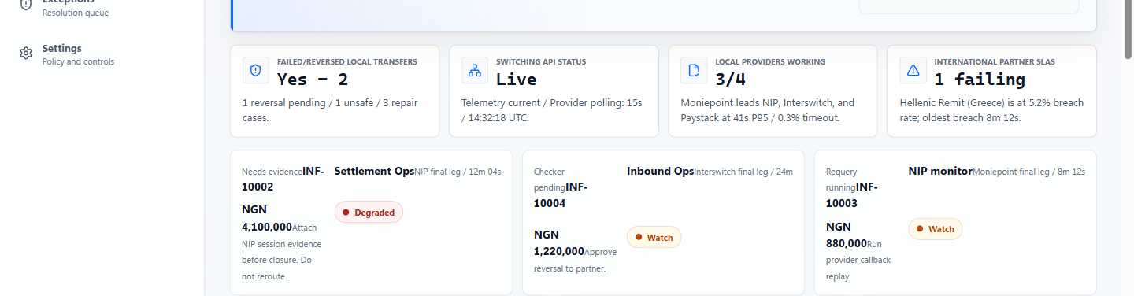
LIVE PRODUCT PROOF
Command Center: the CIO/ED can see exposure and provider stance immediately.
The dashboard now says plainly that Moniepoint is outperforming NIP, Interswitch, and Paystack in the current local-provider window.
Command Center / deployed INSWITCH demo
CloudSpace Technologies / INSWITCH CIO-ED briefing
20

Slide 21
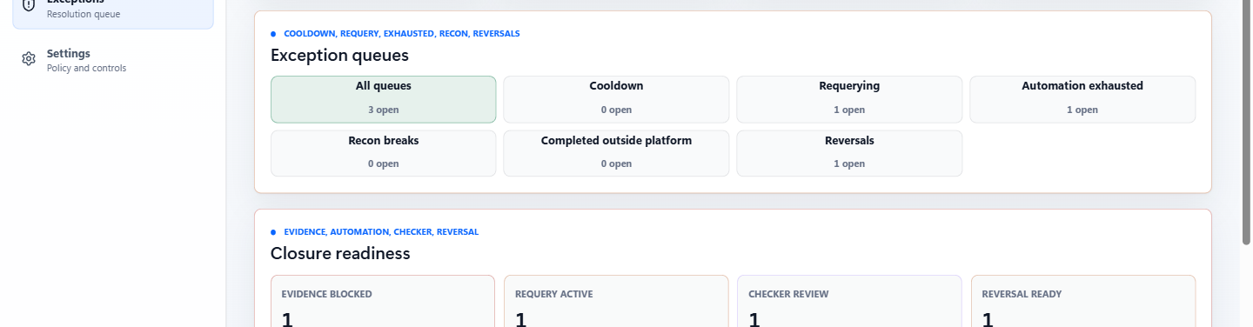
LIVE PRODUCT PROOF
Exception detail: operators repair with evidence, not instinct.
The case workspace shows owner, route, value at risk, evidence gaps, backoff/requery state, and closure guardrails.
Exception workspace / evidence-led repair
CloudSpace Technologies / INSWITCH CIO-ED briefing
21

Slide 22
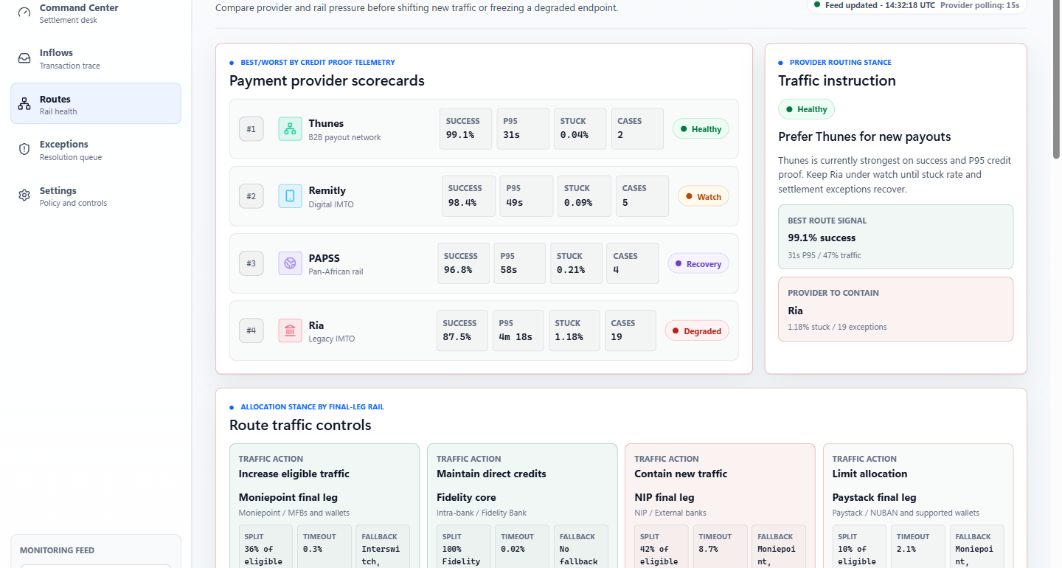
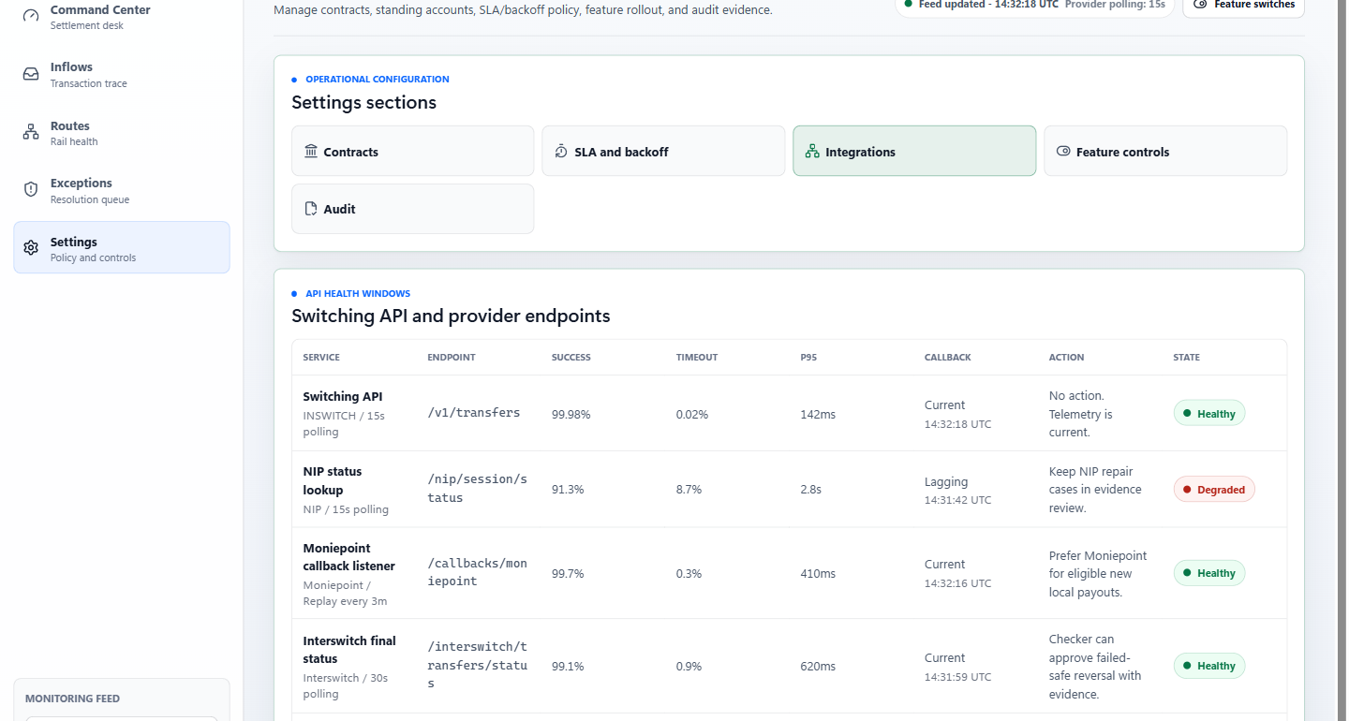
LIVE PRODUCT PROOF
Routes and integrations: provider decisions and API readiness are managed separately.
The bank sees which local provider should receive new eligible traffic while technical teams watch endpoint freshness, callbacks, polling, and last successful checks.
Route performance and traffic stance
Switching API and provider endpoint health
CloudSpace Technologies / INSWITCH CIO-ED briefing
22

Slide 23
CloudSpace Technologies
INSWITCH
Decision requested
Approve a controlled INSWITCH technical-commercial workshop with CloudSpace Technologies, focused on one high-volume local settlement use case and one international partner corridor.
1. Next step
2. Next step
3. Next step
Architecture workshop
Pilot scope and metrics
Commercial approval
Confirm channels, provider routes, identity, evidence fields, and risk controls.
Select live-use corridors, baseline unresolved cases, and define approval gates.
Finalize enterprise license, implementation support, SLA, and rollout governance.
INSWITCH should be evaluated as settlement reliability infrastructure: switching, repair, evidence, and control for the bank’s local final leg.
cloudspacetechs.com / imsi.cloudspacetechs.com
Prepared by CloudSpace Technologies
23

