Slide 1
INSWITCH
NIP exception control for Nigerian payment teams.
Built for Payment Operations, Settlement, Reconciliation, Digital Banking, and Customer Experience teams.
Resolve failed Instant EFT, reversals, TSQ follow-up, settlement breaks, and customer-impacting exceptions from one operating desk.
NIP Direct Credit
TSQ
reversal
settlement report

Slide 2
NIGERIAN PAYMENT LANGUAGE
Run the desk in the language Nigerian payment teams already use.
Every queue, timer, and evidence field maps to NIP, Instant EFT, Sending Entity, Receiving Entity, TSQ, reversal, chargeback, DNS, and settlement report.
Sending Entity
Receiving Entity
Name Enquiry
Direct Credit
Transaction Status Query
INSWITCH
02

Slide 3
THE DAILY OPERATING QUESTION
Was the beneficiary credited, reversed, or still indeterminate?
Every failed or delayed payout lands in one action state: prove credit, requery status, reverse safely, or reconcile the break.
Credited
Reverse
Requery
Reconcile
confirmed credit
failed Instant EFT
TSQ pending
settlement mismatch
INSWITCH
03

Slide 4
NIP FINAL-LEG FLOW
INSWITCH monitors and controls the local credit leg after the bank instruction is received.
The bank gets one operating trail across Name Enquiry, Direct Credit, TSQ, reversal watch, and settlement report matching.
IMTO / bank channel
>
Name Enquiry
>
NIP Direct Credit
>
TSQ / reversal watch
>
Settlement report
INSWITCH
04

Slide 5
EXCEPTION STATES
Queues should match the words operators use during payment exceptions.
Debit posted; no beneficiary credit
Delayed inward NIP beyond 4 minutes
TSQ response pending
Reversal due
Settlement report mismatch
Duplicate credit risk
Chargeback open
Each status points to the next permissible bank action.
INSWITCH
05

Slide 6
EVIDENCE PACK
Closure requires evidence a Nigerian dispute desk can defend.
No payout is closed or reversed without the references Operations, Reconciliation, and Customer Experience will ask for.
NIP Session ID
TSQ response
Receiving Entity response
Core ledger posting
T+1 settlement report
NIBSS reversal report
Operator reason
INSWITCH
06

Slide 7
CBN-ALIGNED CLOCKS
Payment Operations needs the timers that decide escalation, reversal, and customer communication.
The operating clock tracks failed NIP reversal, delayed inward NIP, T+1 settlement reports, and daily NIBSS reversal reports.
24h
>4m
T+1
10pm
failed NIP reversal
delayed inward NIP
settlement report
reversal report
INSWITCH
07

Slide 8
SETTLEMENT SESSIONS
NIP settlement belongs to named sessions.
Each exception should be tied to its Deferred Net Settlement session before closure or escalation.
2am
2pm
session
first DNS cut-off
second DNS cut-off
case matching
INSWITCH
08

Slide 9
INBOUND REMITTANCE PAYOUT
INSWITCH gives the bank control of the Nigerian final leg after the remittance instruction.
The customer promise is complete only when the Nigerian beneficiary is credited or the reversal path is clean.
IMTO instruction
>
Bank validation
>
NIP / local provider
>
Beneficiary credit
INSWITCH
09

Slide 10
LOCAL PROVIDER RANKING
Moniepoint is the preferred local provider in this window.
It is outperforming NIP, Interswitch, and Paystack on P95 credit time, timeout rate, and open repair cases.
Moniepoint P95
41s
best now
healthy
Paystack P95
86s
watch
INSWITCH
10
Interswitch P95
52s

Slide 11
DAY IN PAYMENT OPERATIONS
A productive shift starts with failed NIP, TSQ, settlement, and reversal queues.
08:00
Review failed NIP and reversal-due queues
10:00
Run TSQ and attach Session ID evidence
13:00
Match cases to settlement session
16:00
Checker approves reversal or closure
INSWITCH
11

Slide 12
MARIADB RECORD SPINE
Every screen writes to the payment record.
The bank sees familiar payment language; the platform keeps the audit, reconciliation, and dispute trail complete.
incoming_instructions
>
route_decisions
>
final_leg_attempts
>
provider_calls
outcome_evidence
>
remediation_cases
>
reconciliation_matches
audit_events
INSWITCH
12

Slide 13
What operators see
The appendix shows the operating flow: command center, exception queue, transaction evidence, route pressure, and integration health.
imsi.cloudspacetechs.com

Slide 14
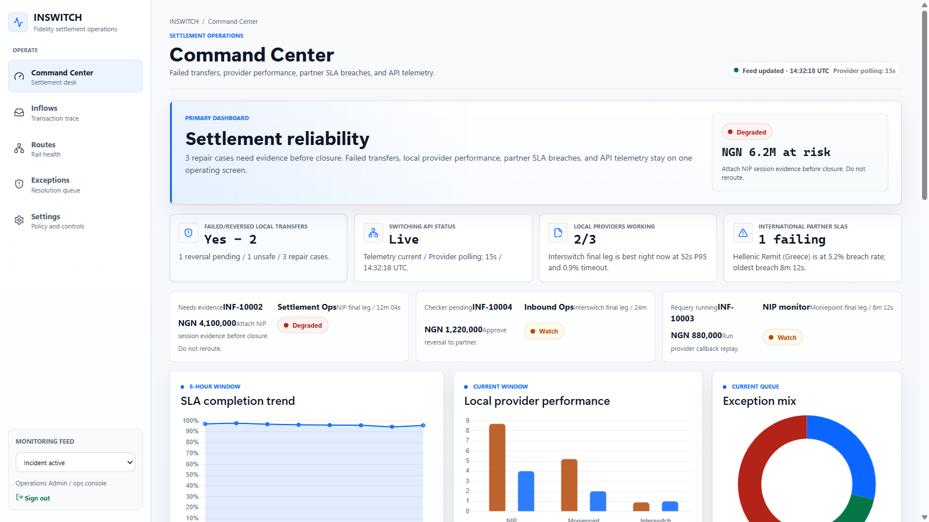
Command Center

Slide 15
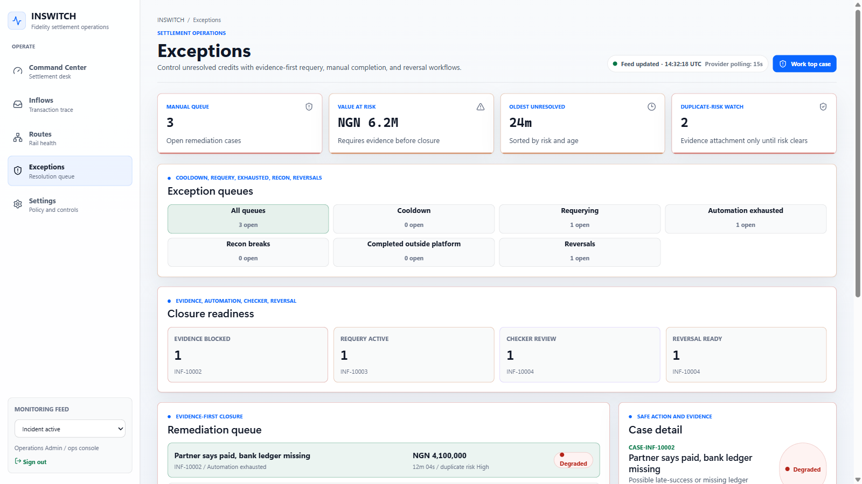
Exception queue

Slide 16
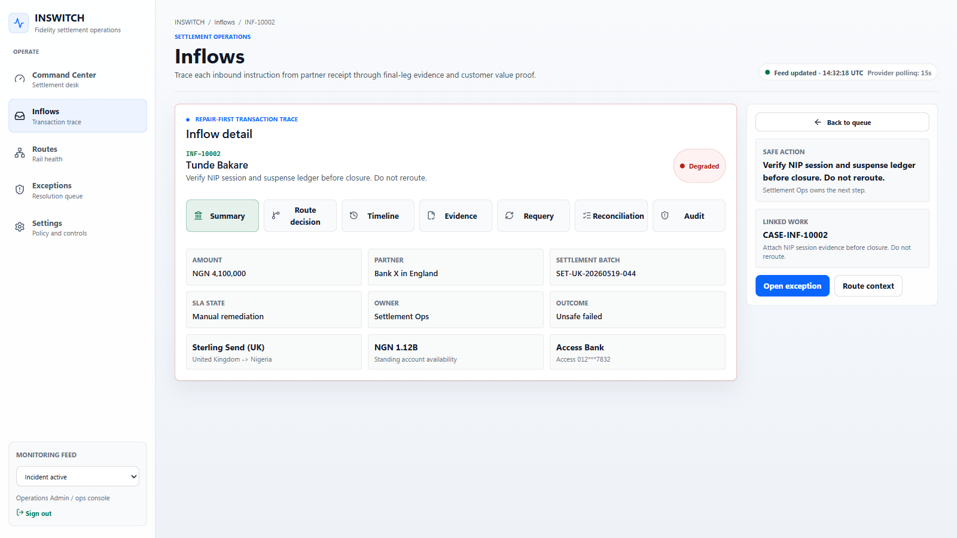
Transaction workspace

Slide 17
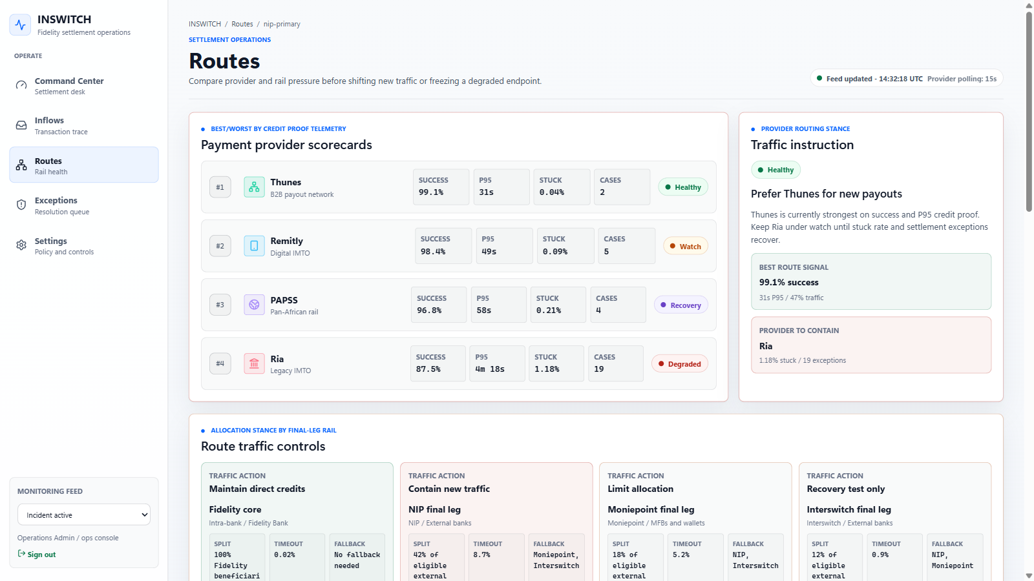
Route pressure

Slide 18
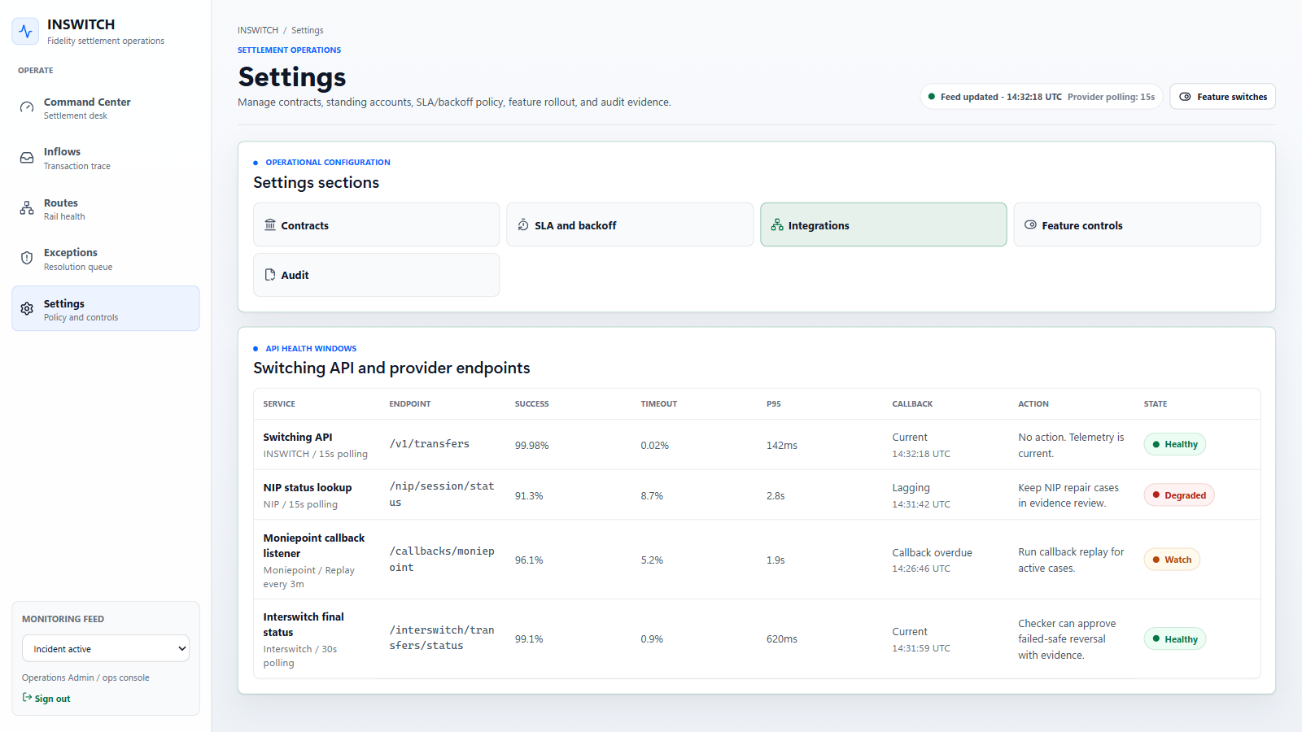
Integration health

Slide 19
Thank you.
NNSWNTCH
NNP exception operations for Nigerian banks.
imsi.cloudspacetechs.com

