Slide 1
Tor Internals and Hidden Services
o

Slide 2
Plan
Four part series
Basic skeleton – TOR – Theory Only
Why only stop yourself to browsers? - Hidden Services
How it is actually used while hacking – Mostly Demo
Bypassing Countermeasures

Slide 3
Introduction to TOR
What is tor?
What are you going to gain from talk-1?
History – Wikipedia (A long time ago in a galaxy far, far away. .....) [1995] [DARPA]
It was originally open-sourced in October of 2003
Onion Routing?
⎳Layers + Layers ….
So - Tor works by bouncing connections from your computer to destinations (such as google.com) through a series of intermediate computers, or relays.
Notes:
Tor is an anonymity tool used by those who want to stay private and uncensored when browsing the Internet.
In this series of talk, we’ll take a deep dive into the structure and protocols used by the Tor network in order to see first-hand how Tor operates.
This idea of Onion Routing was (and is!) simply that we can wrap traffic in encrypted layers (like onions) in order to protect the contents of the data as well as the anonymity of the sender and receiver.
Tor works by bouncing connections from your computer to destinations (such as google.com) through a series of intermediate computers, or relays.

Slide 4
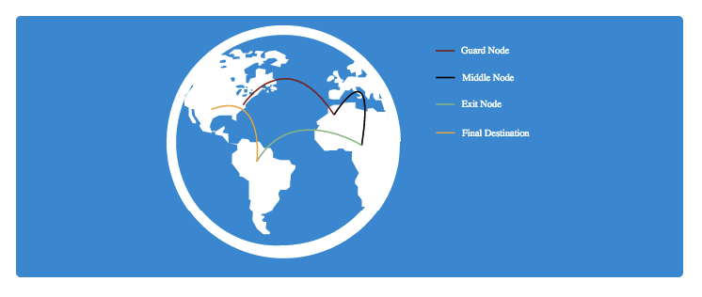
From Nigeria to DC

Slide 5
Relays
6000 relays – [Link]
These relays are located all across the world and run completely by volunteers willing to give up some bandwidth for the cause.
Tor software configured to act as a relay. (No special HW or SW)
Speed ~ No. of relays
If there are more relays to choose from, it will be more difficult to track any one user.
Notes:
https://metrics.torproject.org/networksize.html

Slide 6
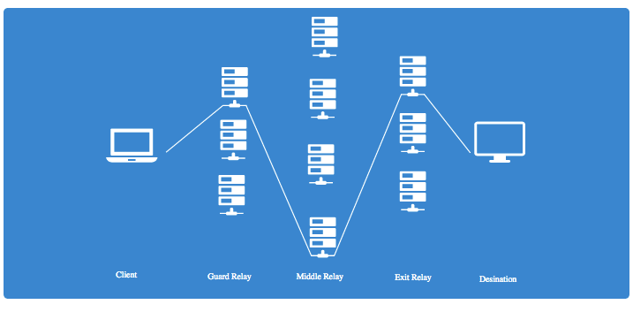
Types of relays
Tor bounces connections through 3 relays.
Each of these have a specific role to play

Slide 7
Types of Relays
Entry/Guard Relay - This is the entry point to the Tor network. Relays are selected to serve as guard relays after being around for a while, as well as having shown to be stable and having high bandwidth.
Middle Relay - Middle relays are exactly that - middle nodes used to transport traffic from the guard relay to the exit relay. This prevents the guard and exit relay from knowing each other.
Exit Relay - These relays are the exit point at the edge of the Tor network. These relays send traffic to the final destination intended by the client.
Notes:
Generally, it is safe to run a guard or middle relay on any VPS or shared server, since all the server operators will see is harmless encrypted traffic.
However, there are special responsibilities to consider when running an exit node. Since exit relays send traffic directly to the end destination, any illicit activity done through Tor appears to come from the exit relay. This leads to the rare possibility of raids, abuse notices, or more.
Thanks Exit node operated.

Slide 8
Why Onions?
How do we know we can actually trust relays?
How can we be sure relays won’t track who we’re connecting to and sniff the data we send across the wire?
we don’t have to!.
Tor is designed to put as little trust in relays as possible. It does this through the use of encryption.
Notes:
Now that we know how connections are routed through relays, how do we know we can actually trust relays?

Slide 9
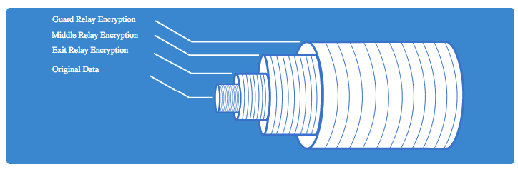
How it works? – Onion protocol
The client encrypts the original data in such a way that only the exit relay can decrypt it.
This encrypted data is then encrypted again in such a way that only the middle relay can decrypt it.
Finally, this encrypted data is encrypted once more in such a way that only the guard relay can decrypt it.
Notes:
This means that we have wrapped our original data in layers of encryption, much like an onion is wrapped in layers of
exit relays can see the original data sent by the client, since they have to pass that data to the destination. This means that, if credentials are passed over HTTP, FTP, or other cleartext protocols, the exit relays can sniff the traffic!

Slide 10
Relays – SHHH ….
Hah! I blocked TOR : PS OG
How do they blocked it?
When a Tor client starts up, it needs a way to fetch a list of all the entry, middle, and exit relays available.
This list of all relays isn’t a secret.
Making this list public is necessary, it also presents a problem.
Two Ways:
Block users coming out of Tor
Block users going into Tor
Notes:
Oppressive Government
- The first situation is possible, and is up to the discretion of the device (router, etc.) or website owner. All a site owner needs to do is to download the list of Tor exit nodes and block all traffic from those nodes.
the second situation is much worse. While blocking incoming Tor users can keep them from a particular site, blocking users from going into Tor will keep them from every site, making Tor effectively useless to those under censorship - some of the users who need Tor most. Just using relays, this is possible since real OG’s can just download a list of all guard relays and block any traffic to them.

Slide 11
Hello to Bridges !!
Simply : bridges are just unpublished entry relays.
Users that are behind censored networks can use bridges as a way to access the Tor network.
How to to connect without knowing bridges?
The Tor project has created a way for users to receive a small list of bridges so that they can connect to the rest of the Tor network.
Notes:
https://bridges.torproject.org/bridges

Slide 12
Can Anyone Find Every Bridge?
The list of all bridges is a closely guarded secret.
But there are ways to discover bridges [Link]
Scanning entire IPV4 NW
Zmap or masscan
79 to 80% positive results
Notes:
Ways :
https://blog.torproject.org/blog/research-problems-ten-ways-discover-tor-bridges
Zmap - 79–86%”

Slide 13
How TOR is organized & maintained?
Master list of Relays & Bridges
Who Maintains it?
10 Tor nodes run by trusted volunteers are hardcoded into each Tor client.
These nodes have a very special role :
To maintain the status of the entire Tor network.
These nodes are known as directory authorities (DA’s).
Why 10?
9 of the DA’s maintain the master list of relays, while one DA (Tonga) maintains the list of bridges.
Notes:
https://gitweb.torproject.org/tor.git/tree/src/or/config.c#n824

Slide 14
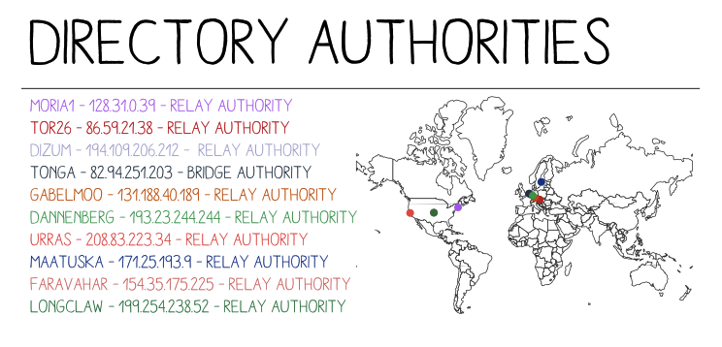
Directory Authorities Map

Slide 15
How DA helps in maintaining TOR?
The status of all the Tor relays is maintained in a living document called the consensus.
DA’s maintain this document and update it every hour by a vote.
Process :
Each DA compiles a list of all known relays
Each DA then computes the other needed data, such as relay flags, bandwidth weights, and more
The DA then submits this data as a “status-vote” to all the other authorities
Each DA next will go get any other votes it is missing from the other authorities
All the parameters, relay information, etc. from each vote are combined or computed and then signed by each DA
This signature is then posted to the other DA’s
There should be a majority of the DA’s that agree on the data, validating the new consensus
The consensus is then published by each DA
Notes:
You’ll notice that I mention each DA publishes this consensus.
This is done over HTTP such that anyone can download the latest copy
http://directory_authority/tor/status-vote/current/consensus/
http://86.59.21.38/tor/status-vote/current/consensus/
Exit nodes

Slide 16
Thanks

