Slide 1
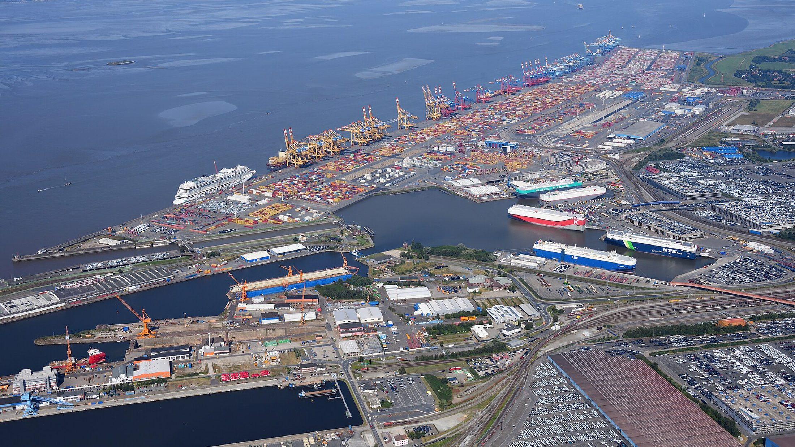
TRAINING WORKSHOP
Mini Importation
From a good idea to your first profitable shipment
A practical, story-led guide for beginners | CloudTech Academy
Notes:
[Stand where everyone can see you. Smile. Wait until the room is quiet.]
Good morning, everyone, and welcome. Thank you for coming.
Before we start, I want to say one thing. Today is not a lecture. Nobody is going to read slides at you for hours. Instead, I am going to tell you a story, the story of an ordinary shop owner who wants to bring goods in from another country and make a profit.
As the story moves, you will learn every step of what we call mini importation. That means importing in small quantities, the way most beginners start. Every step has a real number, a common mistake, and something you can do this week.
[Pause.]
By the end of today, each of you will have your own product, your own cost sheet, and your own thirty-day plan. That is a promise.
I also want to be honest with you. I am not going to promise easy money. Importing can be very profitable, and it can also be very expensive when it is done wrong. My job today is to help you do it right, and to protect you from the mistakes that cost people their savings.
So, are we ready? Let us begin with a story.
[Click to the next slide.]

Slide 2
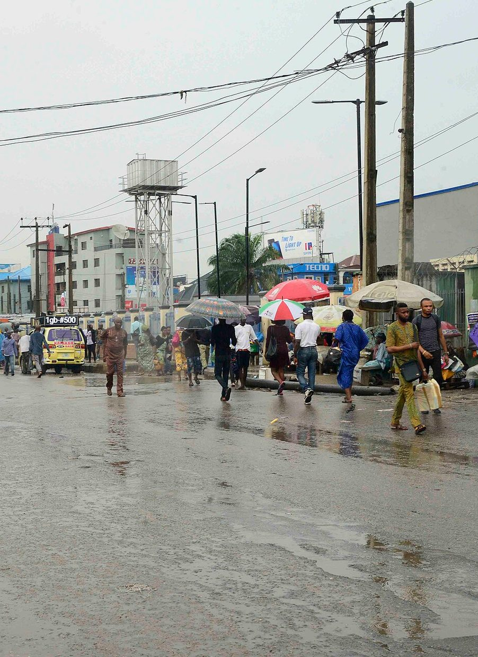
It starts with one sentence
“My cousin buys power banks directly from China. He sells them cheaper than you and still makes a profit.”
Tunde sells phone accessories at Computer Village. He pays ₦9,500 for a power bank. A supplier website shows the same item at $3.00.
“I should order 300 tomorrow.”
What could go wrong? Hold that thought.
Computer Village, Ikeja. Photo: Lightfast Media, CC BY-SA 4.0
Notes:
[Slow down. This is the story. Speak like you are telling it to friends.]
Meet Tunde. Tunde has a small stall in Computer Village, in Ikeja, Lagos. He sells phone accessories: chargers, earphones, power banks. Every week he buys from wholesalers in Lagos, and every month, it seems, he pays a little more than the month before.
One evening, a customer says something that changes his mind. Read it with me: "My cousin buys power banks directly from China. He sells them cheaper than you and still makes a profit."
[Pause.]
Tunde goes home and thinks about it. That night he opens a supplier website. He sees a power bank, the same kind he sells, at three dollars. And right now he is paying nine thousand, five hundred naira for the same thing at the wholesaler.
Three dollars. Nine thousand five hundred naira. He does the quick maths in his head and says, "I should order three hundred tomorrow."
[Pause. Look at the room.]
Now I want to ask you something. If you were Tunde's friend, sitting beside him that night, what would you tell him? What could go wrong with this plan?
[Ask the room. Take three or four answers. Thank each person. Write the answers on a board if you have one: fraud, delay, customs, damage, wrong product.]
Good. Hold on to all of those answers. By the end of today, we will have an answer to every one of them. Let us move on.

Slide 3




What you will leave with today
Choose well
Buy safely
Pick a product people already buy, and check demand and margin before you spend a naira.
Find suppliers, spot scams and pay in a way that protects your money.
Ship and clear
Know your cost
Choose air or sea, understand the documents and clear goods at the port.
Work out the real cost of every unit and a price that leaves a profit.
Built for beginners. No experience needed.
Notes:
[Keep this one short and warm. You are setting expectations.]
Let me tell you what you will leave with today. There are four things.
The first is to choose well. You will learn to pick a product that people already buy, and to check demand and profit before you spend even one naira.
The second is to buy safely. You will learn how to find suppliers, how to spot the scams, and how to pay in a way that protects your money.
The third is to ship and clear. You will understand air and sea freight, the documents, and what happens at the port.
And the fourth, which is the most important, is to know your cost. You will learn to work out what each unit really costs you, and the price that leaves you a profit.
[Pause.]
I want you to know this is built for beginners. You do not need any experience. If you have never imported anything in your life, you are in exactly the right room.
If something I say is not clear, please stop me and ask. Somebody else is wondering the same thing, I promise you.
Alright, let us start with the very basics.

Slide 4


Importing and exporting in plain words
Import
ONE SALE, TWO NAMES
Buy goods from another country and bring them in.
Guangzhou factory
EXPORT for China
Export
Lagos trader
IMPORT for Nigeria
Sell goods you make or buy locally to a buyer abroad.
The gap in price is your opportunity.
Your job: turn the price gap into profit after every cost in between.
Notes:
[Speak simply. Do not rush the definitions.]
Let us start with two words that people use all the time: importing and exporting.
Importing simply means you buy goods from another country and bring them in. Exporting means you sell goods, goods you make or buy here, to a buyer in another country.
Here is the part that surprises people. They are two sides of the same sale. Look at the right side of the slide. A factory in Guangzhou, in China, sells phone cases to a trader in Lagos. For China, that is an export. For Nigeria, it is an import. Same sale, two names.
[Point to the arrow on the slide.]
Now, why do people do this at all? Because a product can cost far less, or be far better, in the place where it is made. There is a gap in price. And your job, as an importer, is to turn that gap into profit.
But listen carefully to the last words of that sentence. Into profit, after you have paid for everything that sits between the factory and your customer. Freight, taxes, clearing, transport, bank charges. All of it.
[Pause.]
If you remember one sentence from today, make it this one: the price on the supplier's page is never your real cost. We are going to come back to that sentence again and again.

Slide 5

Mini importation versus full trade
Mini importation
Full trade
Dozens to a few hundred units
Often air cargo or courier
One person or a small team
Goods bought for resale
Rules still apply in full
Container loads (FCL)
Mostly sea freight
Forwarder and clearing agent team
Larger capital and contracts
Letters of credit for big orders
Mini does not mean exempt: small commercial imports still need correct declarations.
Notes:
[This slide separates the small beginner version from the big version.]
People often ask me, "Do I need a huge amount of money to import?" The answer is no, and that is why we talk about mini importation.
On the left, mini importation. You are buying small quantities, from a few dozen to a few hundred units. Very often you ship by air cargo or by courier, because the quantities are small. It is usually one person or a small team. And you are buying the goods to resell them.
On the right, full trade. Here we are talking about whole container loads. That is mostly sea freight. You will have a team around you, a freight forwarder and a clearing agent. You need bigger capital and contracts. For very large orders, people even use something called a letter of credit, which is a bank promise to pay.
[Pause.]
Now look at the orange bar at the bottom. It is important. Mini does not mean exempt. Some beginners think, "My goods are small, so the rules do not apply to me." That is not true. Even small commercial imports for resale still need correct declarations.
The good news is that a small first order is the best classroom you can have. In this business, we say your first order is tuition. You are going to learn, and you want to pay for that learning in small amounts, not big ones.

Slide 6
The price on the page is not your cost
$3.00
₦7,420
+65%
price on the supplier page,
about ₦4,500 a unit
the real cost per unit
once everything is added
the gap between
the two numbers
Example: 300 power banks, $3.00 each, air freight, Lagos.
We build this number up step by step later today.
Notes:
[This is the most important slide of the day. Slow down. Let the numbers sink in.]
I want you to look at three numbers.
The first is three dollars. That is the price Tunde saw on the supplier's page. At the exchange rate we are using in this example, that is about four thousand, five hundred naira a unit.
The second number is seven thousand, four hundred and twenty naira. That is what each power bank really costs him, once everything is added up. Freight, insurance, import duty, VAT, the clearing agent, port charges, transport from the port, and bank charges.
And the third number is sixty-five percent. That is the gap between the two. His real cost is about sixty-five percent higher than the number he first saw.
[Pause.]
Now here is what I want you to understand. Nobody cheated Tunde. Nothing dishonest happened. He simply had not counted. If Tunde had priced his power banks at six thousand naira, because he believed his cost was four thousand, five hundred, he would have lost money on every single sale and he would not even know why.
[Ask the room.] Be honest with me. How many of you have ever set a price by looking only at the buying price? Raise your hand.
[Wait. Smile. Many hands will go up.]
That is completely normal, and that is exactly why we are here. Later today, we will build this seven thousand, four hundred and twenty naira number line by line, so you can do it yourself.

Slide 7
The whole journey in ten steps
1
Lesson 2
2
Lesson 2
3
Lesson 3
4
Lesson 4
5
Lesson 5
Choose a product
Check the market
Find suppliers
Verify the supplier
Negotiate and sample
Pick what people already buy
Demand, competition, margin
Platforms, markets, agents
Scam checks, safe payment
Price, MOQ, sample first
6
Lesson 6
7
Lessons 7-8
8
Lesson 9
9
Lesson 9
10
Lesson 10
Ship it
Documents and customs
Count the real cost
Price it
Sell and reorder
Air or sea, forwarder, insurance
Invoice, B/L or AWB, HS code
Landed cost per unit
Price for your target margin
Channels, stock, cash flow
Dark boxes protect your money: do the numbers before you spend, test small before you go big.
Notes:
[Leave this slide up for a minute. It is the map for the whole day.]
This is the whole journey of a mini importation, on one page. There are ten steps. Everything we do today is one of these ten boxes, so if you ever feel lost, come back to this slide.
Let me walk through it quickly. One, choose a product. Two, check the market. Three, find suppliers. Four, verify the supplier, which means check that they are real. Five, negotiate and ask for a sample. Six, ship it. Seven, documents and customs. Eight, count the real cost. Nine, price it. Ten, sell and reorder.
[Point to the two dark boxes.]
Look at the two dark boxes, step two and step eight. These are the steps that protect your money. In step two you check the market before you spend. In step eight you count the real cost before you commit.
Here is something I have noticed over the years. Beginners rush to step six, shipping, because shipping feels like progress. Something is moving. But the people who succeed spend most of their time in steps one, two and eight. They do their homework first.
[Pause.]
So today, we are going to go through these steps in order, one at a time, and at each one I will tell you what to do and what usually goes wrong.

Slide 8


Steps 1 and 2: choose and test the market
Demand
Gap
Margin
Are people already buying it again and again?
Is it overpriced, hard to find or badly presented locally?
After every cost, is the profit worth the risk?
FOUR QUICK TESTS BEFORE YOU SPEND
Search it on Jumia, Jiji, Instagram and Google
Read competitor reviews: repeated complaints are your gap
Ask ten possible customers what they would pay
Pre-sell with supplier sample photos and collect deposits
Notes:
[Steps one and two. Keep your energy up.]
Step one is choosing a product, and here is my first piece of advice. Do not choose what you love. Choose what people already buy.
There are three questions to ask. First, demand. Are people already buying this, again and again? Second, gap. Is it overpriced, hard to find, or badly presented here in Nigeria? And third, margin. After every cost, is the profit worth the effort and the risk?
Now, where do you find the answers? You do not need expensive research. Go to the markets. Look at Jumia, Jiji and Instagram sellers. Notice what is always out of stock. Notice what gets lots of comments asking, "How much?" And listen to complaints. When someone says, "I can never find a good version of this," that is a product idea.
[Point to the dark box at the bottom.]
Then use these four quick tests before you spend a single naira. Search the product on Jumia, Jiji, Instagram and Google, and see how many sellers there are. Read the reviews of your competitors, because repeated complaints are your opportunity. Ask ten possible customers what they would pay. And finally, the best test of all: pre-sell. Post the product using the supplier's sample photos, be honest that they are sample photos, and collect names and deposits from real buyers.
[Pause.]
If nobody wants to pay a deposit, you have just saved yourself a lot of money.

Slide 9


Pick small, light and legal
A good first product
Check before you buy
Small and light, cheap to ship
Durable, survives the journey
Already selling near you
Not heavily regulated
Margin you can prove on paper
Banned or restricted goods
Food, drugs, cosmetics: NAFDAC
Electrical goods: SON standards
Fake brands (replicas): seizure
Batteries, liquids: shipping limits
Tunde's power banks: lithium batteries have airline limits. Ask the forwarder first.
Notes:
[Tell the room what a good first product looks like, and what to avoid.]
So what makes a good first product? Look at the left side. It should be small and light, so shipping is cheap. It should be durable, so it survives the journey. It should already be selling near you. It should not be heavily regulated. And you should be able to prove the margin on paper, before you buy.
Now the right side, which is just as important. These are the things to check before you buy.
First, some goods are banned or restricted. If you import them, they can be seized. Second, food, drinks, drugs and cosmetics generally need approval from NAFDAC before they can be sold. Third, many electrical and manufactured goods are expected to meet the standards of SON, the Standards Organisation of Nigeria. Fourth, fake branded goods, the ones people call replicas, can be seized and can bring you legal trouble. Sell your own brand, or genuinely authorised products. And fifth, batteries, liquids and aerosols have shipping limits, especially by air.
[Point to the dark bar at the bottom.]
And look at this note. Tunde's power banks contain lithium batteries. Airlines have strict rules about those. So before Tunde ships anything by air, he must ask his freight forwarder what is allowed. This is the kind of detail that nobody mentions on the supplier's website, and it can stop a shipment completely.

Slide 10
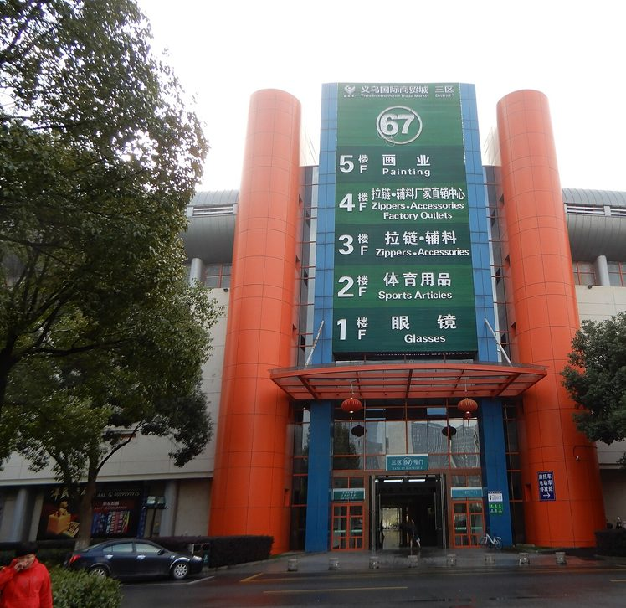
Step 3: where to find suppliers
Alibaba.com
Wholesale and customising
1688.com
Lowest prices, needs an agent
AliExpress
Very small test orders
Other B2B sites
Made-in-China, Global Sources
Markets and trade fairs
See and touch the goods
Sourcing agents
Help for beginners, for a fee
Yiwu market. Whisper of the heart, CC BY-SA 4.0
Shortlist 3 to 5 suppliers. Send each the same enquiry.
Notes:
[Step three. Make it practical.]
Now that you have a product idea, where do you find a supplier?
Let me go through the list. Alibaba is the big one. It is a huge online marketplace, mostly with Chinese suppliers, and it is good for wholesale orders and for customising products. 1688 is a Chinese wholesale site with the lowest factory prices, but it is in Chinese and you will usually need an agent. AliExpress is from the same group, and it is good for very small test orders, although the price per unit is higher. There are other business-to-business sites too, such as Made-in-China and Global Sources, which often list verified exporters, especially for electronics.
You can also go in person. On the right you see the Yiwu International Trade Market in China, where you can see and touch the goods. Trade fairs, like the Canton Fair in Guangzhou, put thousands of factories in one place. And if you are a beginner with a language gap, a sourcing agent can find and check suppliers for you, for a fee.
[Pause.]
Here is my advice. For your first mini import, start with Alibaba and a small sample order. But treat Alibaba as a directory, not a guarantee. The platform lists suppliers. It does not make every one of them honest or good.
And look at the line at the bottom. Shortlist three to five suppliers, and send every one of them the same enquiry. That way you can compare them fairly. Never message one supplier and accept the first price.

Slide 11
Reading a supplier listing
1
Title and photos
Do they match? Ask for real photos.
Wireless earbuds, Bluetooth 5.3
1
Photos
Price tiers
Price falls as you buy more. Plan your tier.
1-99 pcs
$6.80
2
2
100-499 pcs
$5.90
500+ pcs
$5.20
3
Minimum order
Does your first order fit your budget?
Minimum order: 100 pieces
3
Shenzhen Example Electronics Co.
Manufacturer | 8 years | Verified
4
Who is selling
Factory or trader? Badges help, not proof.
4
Samples available | Logo printing
5
5
Samples
Order one before the bulk order.
Order protection: payment held
6
Contact supplier
6
Payment protection
Pay via the platform: held until delivery.
Notes:
[Walk through the picture slowly. Point to each number as you speak.]
This is an example of a supplier listing. It is an illustration, not a real supplier. I want to show you what to look at, because beginners usually look at one thing only, the price.
Number one, the title and photos. Do they match what you actually want? Ask the supplier for real photos, not just the glossy ones.
Number two, the price tiers. Look at the box with three prices. The more you buy, the lower the price per unit. So plan for the tier you can really afford.
Number three, the minimum order. This one says one hundred pieces. That is the smallest order the supplier will accept. For your first order, you may have to buy exactly that, so check that it fits your budget.
Number four, who is selling. Is this a manufacturer or a trading company? Here it says manufacturer, eight years, verified. Those are good signs, but they are not proof. A real factory usually focuses on one line of products. If a profile sells electronics, shoes and furniture, it is probably a trader.
Number five, samples. Samples are available. Always order one before the bulk order.
And number six, payment protection. If the platform holds your money until delivery, use it.
[Pause.]
Remember, always open the company profile, not just the product page.

Slide 12


Step 4: verify before you pay
RED FLAGS
SAFE HABITS
Price far below every other quote
Bait price
Pay through the platform
Trade Assurance or escrow holds your money
New bank account after weeks of emails
Hijacked email
Ask for a live video call
Factory floor, stock, production line
Personal account for a company
No protection
Match every name
Licence, invoice and bank account holder
No live video of the factory
Probably not a factory
Pay a deposit, not everything
Often 30%, balance after inspection
Notes:
[Step four. Be serious here. This is where beginners lose money.]
I am going to be very direct with you now. This is the step where most beginners lose their money, so please listen carefully.
On the left are the red flags. A price far below every other quote. That is bait. A supplier who, after weeks of normal emails, suddenly sends new bank details. That usually means their email was hijacked, and the money would go to a criminal. A company asking you to pay into a personal account, which gives you no protection at all. And a supplier who will not do a live video call of the factory. A real supplier will accept that.
[Pause.]
Now the safe habits on the right. Pay through the platform, using Trade Assurance or an escrow service, so your money is held until you are satisfied. Ask for a live video call and see the factory floor, the stock and the production line, live, not a recorded clip. Match every name: the business licence, the invoice and the bank account holder must all be the same company. And pay a deposit, not everything. Often that is thirty percent, with the balance paid after inspection.
One more thing. Never, ever pay with gift cards, cryptocurrency, or cash handed to an agent. There is no protection in any of those.
[Pause. Look around the room.]
I would rather you lose a week asking questions than lose your savings in one transfer. A good supplier will never be offended by careful questions.

Slide 13



Step 5: negotiate, then test a sample
Ask for tier prices
Show you will reorder
What is the price at 300, 500 and 1,000 units?
A repeat buyer is worth a lower price.
Be exact about the spec
Order a sample first
Model, material, colour, packaging.
Test it like a customer. Keep it as evidence.
Typical payment: 30% deposit, 70% before shipment or against the bill of lading.
Notes:
[Step five. This is a friendlier slide. Smile and use the real examples.]
Now you have a verified supplier. It is time to negotiate. And yes, you should negotiate.
Before you start, know three things: your target price, which you work out backwards from the selling price you found earlier, your walk-away price, which is the highest price at which the deal still makes sense, and two or three other quotes so you know what is normal.
Then use these four ideas. First, ask for tier prices. Say, "What is your price at three hundred, five hundred and one thousand units?" The difference between tiers shows you how much room there is. Second, show them you will reorder. A repeat buyer is worth a lower price. Third, be exact about the specification: the model, the material, the colour, the packaging. Vague requests lead to vague prices and later disputes. And fourth, order a sample first.
About samples. Ask what the sample costs and whether it is refunded when you place the bulk order. Then test it like a real customer would. Use it, drop it, charge it. Take photos and weigh it. And keep it. If the bulk goods arrive worse than the sample, the sample is your evidence.
[Point to the dark bar.]
And look at typical payment terms: thirty percent deposit, and seventy percent before shipment, or against a copy of the bill of lading. That way, you can inspect or see proof of shipment before you pay the balance.
One last tip: be polite and patient. Pressure often makes suppliers cut quality instead of price.

Slide 14
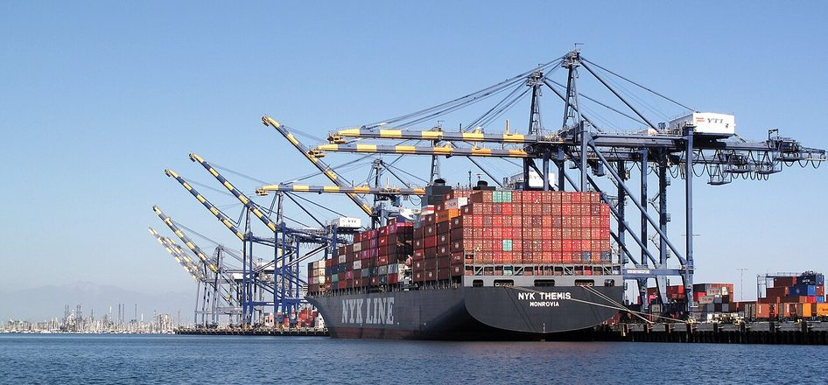
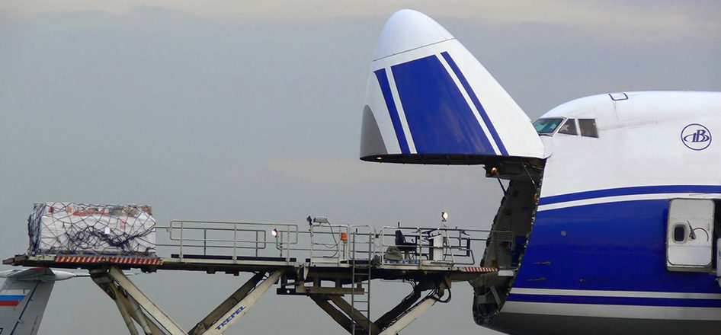
Step 6: air or sea?
Sea freight. Photo: Downtowngal, CC BY-SA 4.0
Air cargo. Photo: Aleksandr Markin, CC BY-SA 2.0
Air freight
Sea freight
Speed
About 1 to 2 weeks
Several weeks
Cost
Higher per kg
Much lower per unit
Best for
Small, light, urgent
Heavy, bulky, large
Notes:
[Step six. Use the photos to make it feel real.]
Your goods are bought. Now, how do they get here? There are two main ways, air and sea. Look at the two photos. On the left, a container ship being loaded. On the right, a cargo aircraft being loaded.
How do you choose? You look at weight, size, value, urgency and budget.
Air freight is faster. It is roughly one to two weeks, door to door. But it costs more for every kilogram. It is best for small, light, high-value or urgent goods, and for samples.
Sea freight is slower. It often takes several weeks, commonly over a month from China. But it costs much less per unit of cargo. It is best for heavy, bulky or large orders. The risk is that there is more handling and there can be port delays.
[Pause.]
For your first mini import of light goods, air cargo is often the practical choice. As your volumes grow, sea freight will bring your cost per unit down.
Two cautions. First, prices and times change often, so always get a current quote. Second, make sure that when you compare quotes from different freight forwarders, they are built the same way. One may include delivery to your door and another may stop at the airport. If you compare those two, you are not comparing like with like.

Slide 15
Worked example: chargeable weight
ONE CARTON
60 × 40 × 50 = 120,000
60 × 40 × 50 cm
multiply the sides
Actual weight: 15 kg
120,000 ÷ 6,000 = 20 kg
Volumetric weight = L × W × H ÷ 6,000
volumetric weight
20 kg is more than 15 kg
Always confirm the divisor your carrier uses.
so you are charged for 20 kg
Notes:
[This is a maths slide. Let the room follow along. If anyone has a phone calculator, encourage them to use it.]
Here is something that surprises almost every beginner. Airlines do not only charge you for how heavy your box is. They charge you for the space it takes up.
So they compare two numbers: the actual weight, and the volumetric weight, and they charge you for whichever is greater.
The volumetric weight formula is on the left. Length times width times height, in centimetres, divided by six thousand.
Let us try it together. We have one carton. It is sixty centimetres by forty by fifty, and it weighs fifteen kilograms.
[Point to the white boxes on the right, one by one.]
First, we multiply the sides. Sixty times forty times fifty is one hundred and twenty thousand.
Second, we divide by six thousand. One hundred and twenty thousand divided by six thousand is twenty. So the volumetric weight is twenty kilograms.
Third, we compare. The box actually weighs fifteen kilograms, but the volumetric weight is twenty. Twenty is greater, so you will be charged for twenty kilograms, not fifteen.
[Ask the room.] Why does this matter? Because if the forwarder quotes a price per kilogram, you must multiply by twenty, not by fifteen. If you use the wrong number, your cost is wrong.
[Pause.]
One more point. Some carriers use slightly different divisors, so always ask how your quote is calculated. If time allows, ask people to try it now with a box they know.

Slide 16
Step 7: the documents that travel with goods
1
2
3
4
5
Supplier
Freight forwarder
Ship or airline
Customs and agent
You, the importer
Packs and sells
Books the transport
Carries the goods
Checks, values, taxes
Receives and sells
DOCUMENTS
DOCUMENTS
DOCUMENTS
DOCUMENTS
DOCUMENTS
Commercial invoice, packing list
Booking, bill of lading or air waybill
Bill of lading or air waybill
Form M, PAAR, duty receipt
Release order, delivery note
All documents must match. Never understate the value or change a description to cut duty: it is an offence.
Notes:
[Step seven. Documents can feel boring, so use the story: documents are the passport of the goods.]
Think of documents as the passport of your goods. Customs does not clear goods on trust. It clears them on documents that agree with each other and with the goods.
Look at the five boxes at the top. This is the path of a shipment: the supplier, the freight forwarder, the ship or airline, customs and the clearing agent, and finally you, the importer. And under each one are the documents they handle.
The supplier gives you the commercial invoice, which is the bill, and the packing list, which says what is in each carton. The forwarder books the transport and gives you a bill of lading for sea freight, or an air waybill for air freight. Both are the receipt and the contract for carrying your goods.
In Nigeria, before the goods ship, you raise something called a Form M through your bank. After the documents are submitted, Customs issues a PAAR, a Pre-Arrival Assessment Report. And your clearing agent uses these to clear the goods.
[Point to the red bar.]
Now the golden rule, and it is at the bottom. All the documents must match. The names, the addresses, the quantities, the weights, the descriptions and the values. The most common reason for delay and fines is a mismatch.
And please hear this clearly. Never agree to understate the value of your goods, or to change the description on an invoice, to pay less duty. That is an offence. It can lead to seizure of your goods and penalties, and it makes every future shipment harder.

Slide 17
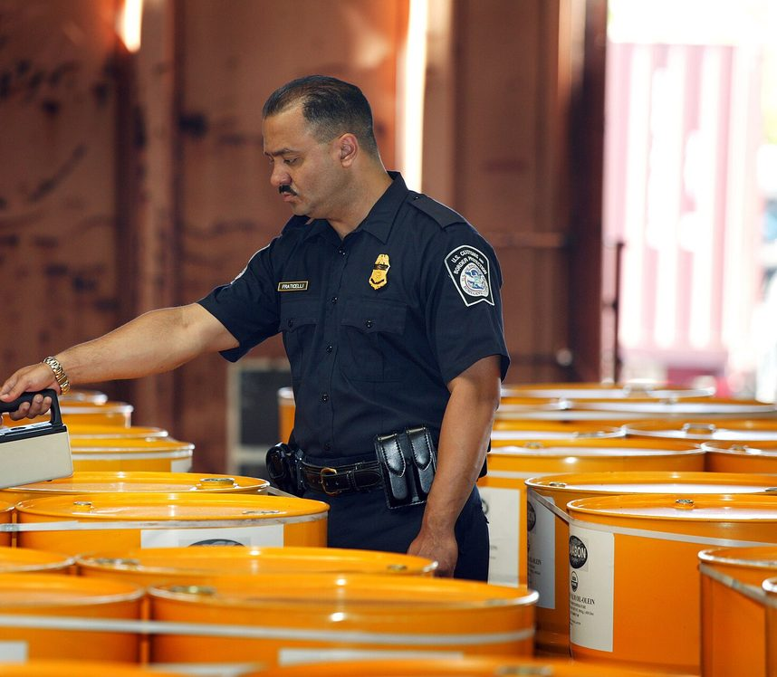
HS codes, duty and customs value
1
HS code
decides your duty rate and permits
2
CIF value
product + freight + insurance
3
Duty
% of the naira CIF value
4
VAT
% of naira CIF + duty
Rates change. Confirm the current rate for your code.
Customs check. Photo: CBP, public domain
Notes:
[Keep this simple. HS codes scare people, but the idea is easy.]
Let us talk about duty, which is the tax you pay to bring goods into the country.
Every product in the world has a code. It is called the HS code, from the Harmonized System. Think of it as the product's ID number. The first six digits are the same everywhere, and each country adds more digits for its own tariff.
Why does it matter? Because the code decides your duty rate, which rules and permits apply, and whether the product is restricted. If you use the wrong code, you pay the wrong duty, and you can face delays and penalties. So ask your forwarder or your clearing agent to confirm the code before you ship.
Now follow the four steps on the left. After the HS code, we work out the CIF value. CIF means cost, insurance and freight, so it is your product cost plus freight plus insurance. Third, duty. That is a percentage of the CIF value, converted to naira. And fourth, VAT. That is a percentage of the naira CIF value plus the duty. So VAT is charged on top of duty.
[Point to the red text at the bottom.]
One warning. Rates change. In today's examples I am using teaching rates. For your real goods, always confirm the current rate for your HS code, and do not trust a number from a video or a friend.
And the photo on the right is a customs officer inspecting goods. Some shipments are examined when they arrive, so be ready and answer your agent quickly.

Slide 18
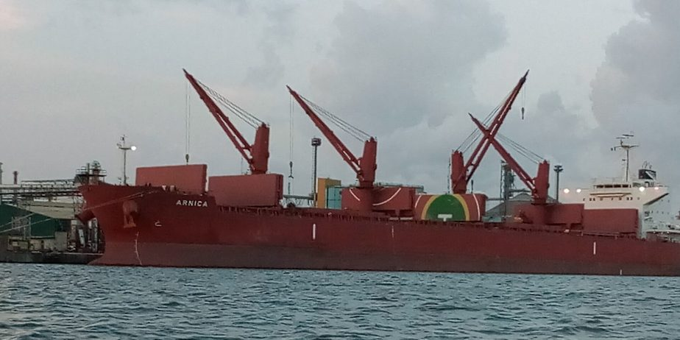
Importing into Nigeria: who does what
Customs
Duty, tax, examination, release
SON and NAFDAC
Standards, food, drugs
Your bank
Form M and foreign exchange
Clearing agent
Handles Customs for you
Apapa port, Lagos. Photo: Quadrex24, CC BY-SA 4.0
THE ORDER OF EVENTS
Register business
Form M via bank
Ship goods
PAAR from Customs
Clear at the port
Notes:
[Step seven, continued, and now it is about Nigeria specifically. Remind them that rules change.]
Importing into Nigeria involves several organisations, and each one cares about its own area.
Nigeria Customs Service assesses and collects duty, enforces the bans, and examines and releases your goods. SON, the Standards Organisation of Nigeria, deals with product standards. NAFDAC deals with food, drinks, drugs and cosmetics. Your bank handles foreign exchange and the Form M. And a licensed clearing agent deals with Customs on your behalf.
A single shipment, like cosmetics, can involve Customs, NAFDAC and SON all at once.
Now look at the order of events at the bottom. First, register your business with the Corporate Affairs Commission, and get a tax identification number. Second, raise your Form M through your bank before shipping. Third, the goods ship. Fourth, Customs issues the PAAR. And fifth, you clear the goods at the port.
[Point to the photo of Apapa.]
Here is Apapa port in Lagos. At ports, watch out for storage and demurrage. You only get a limited number of free days. After that, you pay storage and demurrage charges every day, and a few days of delay can add up to a lot of money. So be ready to collect your goods quickly.
Choose a licensed clearing agent carefully. A good one saves you money and time, and a bad one costs you both.
[Pause.]
And please remember, requirements change. Always confirm the current rules with Customs and the agency that covers your product before you ship.

Slide 19
Step 8: build the landed cost
Product 300 × $3.00
$900
TOTAL LANDED COST
Air freight
$150
₦2,226,100
Insurance
$10
CIF value
$1,060
CIF in naira (₦1,500 = $1)
₦1,590,000
PER UNIT (÷ 300)
Duty at 20%
₦318,000
₦7,420
VAT 7.5% on ₦1,908,000
₦143,100
Clearing and port
₦120,000
Local transport
₦30,000
vs about ₦4,500 on the supplier page
Bank and payment charges
₦25,000
Teaching rates. Use current rates for your own goods.
Notes:
[Step eight. This is the heart of the day. Work through it slowly with the room, line by line. Let people use calculators.]
Now we are going to build Tunde's real cost, line by line. Remember, he is buying three hundred power banks at three dollars each.
[Point to the table.]
First, the product. Three hundred times three dollars is nine hundred dollars. Air freight is one hundred and fifty dollars. Insurance is ten dollars. Add them up and the CIF value is one thousand and sixty dollars.
Now we change it to naira. At one thousand, five hundred naira to the dollar, that is one million, five hundred and ninety thousand naira.
Next, duty. At twenty percent, that is three hundred and eighteen thousand naira.
Then VAT. Remember, VAT is charged on the CIF value plus the duty. So one million, five hundred and ninety thousand plus three hundred and eighteen thousand is one million, nine hundred and eight thousand. Seven point five percent of that is one hundred and forty-three thousand, one hundred naira.
Then the local costs. The clearing agent and port charges: one hundred and twenty thousand naira. Local transport: thirty thousand. And bank and payment charges: twenty-five thousand.
[Point to the dark box on the right.]
Add everything, and the total landed cost is two million, two hundred and twenty-six thousand, one hundred naira. Divide by three hundred, and each power bank costs seven thousand, four hundred and twenty naira.
[Pause.]
Remember the number we saw on the supplier's page? About four thousand, five hundred. The real cost is about sixty-five percent higher. That is why we count.
And a reminder: these rates are for teaching. For your own goods, use the current rates.

Slide 20
Where the money goes
HOW TO REDUCE IT
Compare freight quotes
Confirm the HS code
Spread fixed charges over more units
Collect goods before storage fees start
Amber: goods and freight Brick: duty and tax Blue: local costs
Notes:
[Use the chart to make the point visual.]
Here is the same information as a picture. Each bar is a cost.
The product is the biggest bar, one million, three hundred and fifty thousand naira. But look at all the others. Freight and insurance, two hundred and forty thousand. Duty, three hundred and eighteen thousand. VAT, about one hundred and forty-three thousand. And then clearing and port charges, local transport, and bank charges.
The brick-red bars are the government's share, the duty and the tax. The blue bars are local costs. The amber bars are the goods and their freight.
If Tunde had priced only from the product, he would have missed around eight hundred and seventy-six thousand naira of costs across the batch. That is nearly a whole second order, gone, just because he did not count.
[Ask the room.] Look at this chart and tell me: which of these costs could you reduce?
[Take a few answers. Then confirm them using the panel on the right.]
You are right. First, compare freight quotes from several forwarders. Second, confirm the HS code, so you do not pay the wrong duty. Third, order enough units to spread the fixed charges, like clearing fees, over more items. And fourth, collect your goods before storage fees start.
Notice that you cannot change the product cost much, and you cannot change the tax rate. But you can control the freight, the delays and the planning. That is where smart importers save money.

Slide 21
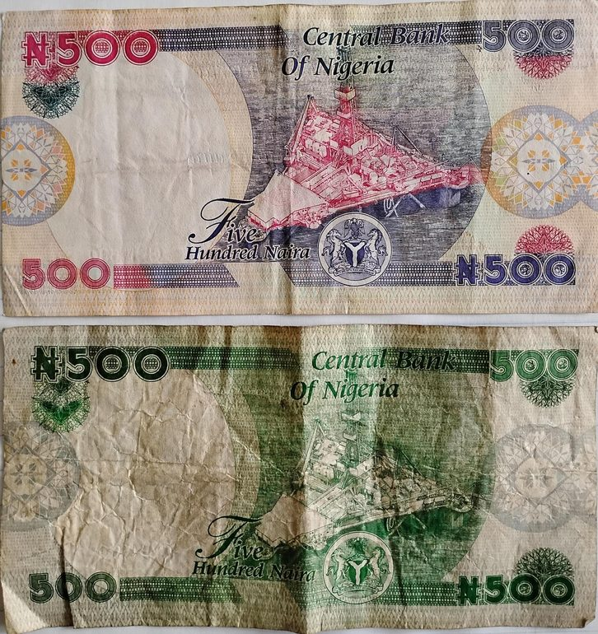
Step 9: price for the profit you want
SELLING PRICE FORMULA
Price = landed cost ÷ (1 − target margin)
₦7,420 ÷ 0.65 = ₦11,415 for a 35% margin
MARKUP
MARGIN
Profit ÷ cost
Profit ÷ selling price
₦4,000 ÷ ₦6,000 = 66.7%
₦4,000 ÷ ₦10,000 = 40%
A 35% margin is not 35% profit: marketing, packing, delivery and your time still come out.
Photo: FAdelabu, CC BY-SA 4.0
Notes:
[Step nine. Pricing. Many people confuse two words here, so be careful and clear.]
You now know your real cost. The next question is: what price should you sell at?
First, two words that people mix up. Markup and margin.
Markup is profit as a percentage of your cost. Margin is profit as a percentage of your selling price. They are different numbers.
Look at the example. A product costs six thousand naira, and you sell it at ten thousand. Your profit is four thousand. The markup is four thousand divided by six thousand, which is sixty-six point seven percent. The margin is four thousand divided by ten thousand, which is forty percent. Same product, same profit, two different numbers. When someone tells you "I make forty percent," always ask: forty percent of what?
Now the formula at the top. To reach a target margin, divide your cost by one minus the margin. For Tunde, the cost is seven thousand, four hundred and twenty naira, and he wants a thirty-five percent margin. So seven thousand, four hundred and twenty divided by point six five. That gives about eleven thousand, four hundred and fifteen naira.
Then check the market. If competitors sell for less, you must lower your cost, change the product, or accept a smaller margin. If they sell for more, you may be able to price higher.
[Point to the pink bar.]
And one important warning. A thirty-five percent margin is not thirty-five percent profit in your pocket. You still have to pay for marketing, packaging, delivery and your own time. So keep some room.

Slide 22
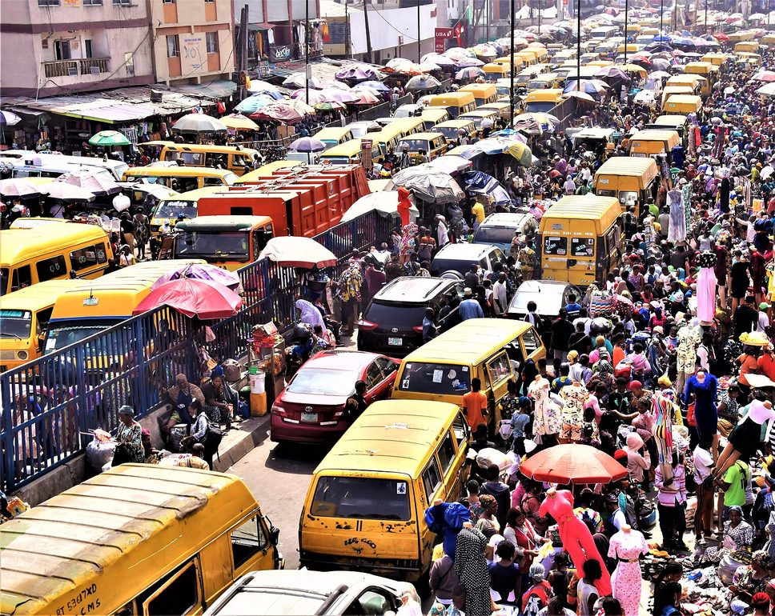
Step 10: sell, collect and reorder
RETAIL
₦12,000 − ₦7,420
= ₦4,580 profit per unit, slower to sell
WHOLESALE (10 or more)
₦9,500 − ₦7,420
= ₦2,080 a unit. Ten units: ₦20,800 in a day
A busy Lagos market. Photo: Sir Demo, CC BY-SA 4.0
Notes:
[Step ten. Reassure them: selling is half the business, so plan it early.]
An import is not profit until the goods are sold and the money is in your account. This is where many beginners go wrong. They spend all their energy on sourcing and shipping, and then they sit on stock for months.
So plan how you will sell before the goods arrive. Start with the channels you can reach this week. For most people that is WhatsApp status, Instagram, Facebook, TikTok and the people they already know. These are cheap and they give you direct contact with customers. Later, you can add marketplaces, a shop, or your own website.
Now look at the two cards. Tunde's cost per unit is seven thousand, four hundred and twenty naira.
If he sells at retail, at twelve thousand naira, he makes four thousand, five hundred and eighty naira on each unit. That is a good profit per item, but it takes time and effort to sell one at a time.
If he sells wholesale, to a trader who buys ten or more, at nine thousand, five hundred naira, he makes two thousand and eighty naira per unit. That is less per item. But look: sell ten units to one trader in one day, and he makes twenty thousand, eight hundred naira. To make the same money at retail, he would need to sell about five units.
[Pause.]
So wholesale moves stock fast and frees up your money, so you can reorder. Retail earns more per unit but is slower. A smart importer uses both.
And one last thing. Do not put all your profit back into one slow product. Keep some cash ready for the next order.

Slide 23

Exporting: the other direction
Agriculture
Foods and spices
Sesame, cocoa, cashew, ginger, hibiscus
Packaged snacks and sauces for the diaspora
Beauty and care
Fashion and crafts
Shea butter, black soap, natural oils
Ankara, beads, leather goods
Start with one buyer and one product. Confirm the current rules with NEPC and Customs.
Notes:
[A short slide. Give them a glimpse of the other direction. Do not go deep.]
So far we have talked about bringing goods into Nigeria. But there is a whole other direction: exporting, which means selling goods outside the country.
Why would you do it? It can earn foreign currency, it reaches much bigger markets, and it can give you better prices than you can get at home. It also asks more of you. The product must meet the buyer's standard, the paperwork must be right, and the payment terms need care.
And exporting is not only for big companies. A small producer can start with one buyer and one product.
What does Nigeria export? Look at the four cards. Agricultural products, like sesame, cocoa, cashew, ginger and hibiscus, which many of you call zobo. Processed foods and spices, especially for Nigerians living abroad. Beauty and personal care products, like shea butter, black soap and natural oils. And fashion and crafts, like Ankara fabrics, beads and leather goods.
[Pause.]
If you are making any of these, you are already halfway there.
One note. Export rules, agencies and incentives change. So before you ship anything out, confirm the current requirements with the Nigerian Export Promotion Council and with Customs. We have a full lesson on this in the course.

Slide 24


Six risks and how to manage them
Supplier fraud
Poor quality
Delays
Verify, pay through protection
Sample first, inspect before the balance
Buffer time and spare stock
Damage or loss
Surprise charges
Exchange rate
Strong packing and insurance
Landed cost before you order
Add a margin, order often in smaller lots
Start small. Test. Then grow. The first order is tuition.
Notes:
[Go back to the question from the beginning of the day. This slide ties everything together.]
Remember at the start, I asked you what could go wrong for Tunde? And you gave me answers. Now you can answer that question properly.
Look at the six boxes.
Supplier fraud: you verify the supplier and pay through a protected method. Poor quality: you order a sample first, and you inspect before paying the balance. Delays: you allow buffer time and keep some spare stock. Damage or loss: you use strong packing and insurance. Surprise charges: you work out the landed cost before you order. And exchange-rate changes: you add a margin, you pay promptly, and you order smaller amounts more often.
[Pause.]
Every risk has a way to manage it. None of these risks is a reason to avoid importing. They are reasons to prepare.
And remember the line at the bottom: start small, test, then grow. The first order is tuition. You are paying to learn. If your first order is small, then even your mistakes are cheap, and you will make fewer of them on the second order.
[Look around the room.]
The people who fail at importing are usually not the ones who made small mistakes. They are the ones who went big before they understood the process.

Slide 25
Your turn: a 30-minute working session
1
Pick a product
Small, light, legal and already selling. Name three people who would buy it this week.
2
Check the market
Find three competitor prices: lowest, typical, highest.
3
Build the landed cost
Use a real supplier price and the cost sheet steps.
4
Set your price
Landed cost ÷ 0.65 for a 35% margin. Does the market accept it?
Notes:
[This is the practical session. Tell them clearly what to do, then walk around the room. Allow about thirty minutes.]
Now it is your turn. Everyone, take out a pen and paper, or open a spreadsheet on your phone or laptop. For the next thirty minutes, you are going to work on your own product.
There are four steps on the slide.
Step one. Pick a product. It should be small, light, legal and already selling. And write down three people who would buy it from you this week.
Step two. Check the market. Look up three competitor prices, and write the lowest, the typical and the highest.
Step three. Build the landed cost. Use a real supplier price from a website, and follow the steps we did for Tunde: product, freight, insurance, CIF, naira, duty, VAT, clearing, transport, bank charges. You can use today's teaching rates, but note them down.
Step four. Set your price. Divide your landed cost by zero point six five for a thirty-five percent margin. Then ask yourself: does the market accept this price?
[Pause.]
I will walk around, and if you get stuck, put your hand up and I will come to you.
[When people finish, ask them to swap papers with a neighbour.]
When you finish, swap with the person next to you. Your job is to find the weakest assumption in their plan. Is the competitor price realistic? Did they forget a cost? This is how professionals check each other.
[After thirty minutes, ask two or three people to share.] Who would like to tell us: did your margin survive? Was there a surprise?

Slide 26
Your first 30 days
WEEK 1
WEEK 2
WEEK 3
WEEK 4
Choose
Source
Test
Decide
Pick a product and ask ten buyers what they would pay.
Shortlist 3 to 5 suppliers and verify the best two.
Order a sample. Build landed cost and set a price.
Pre-sell. Place a small first order, or drop it.
A bad product dropped after a week of research is a win.
Notes:
[Bring the day to a practical close. Give them a calm, doable plan.]
Let me finish with a simple plan for the next thirty days. And I want to say this clearly: nobody has to import anything this month. The goal of the first thirty days is to test an idea cheaply and to learn.
Week one, choose. Pick a product, and ask ten buyers what they would pay for it.
Week two, source. Shortlist three to five suppliers, send each the same enquiry, and verify the best two.
Week three, test. Order a sample. Build your landed cost and set your target price.
Week four, decide. Pre-sell to real customers. Then decide: place a small first order, or drop the idea and test another.
[Pause.]
Now read the line at the bottom. A bad product dropped after a week of research is a win. I say that because it is true. If you spend a week and discover the margin does not work, you have lost nothing. That is the research doing its job. Someone who skips research would discover the same problem after paying for the shipment.
So be brave enough to test, and wise enough to stop when the numbers say stop.
I believe many of you in this room can do this. You do not need to be rich or to know everyone. You need to be careful, to count everything, and to start small.

Slide 27
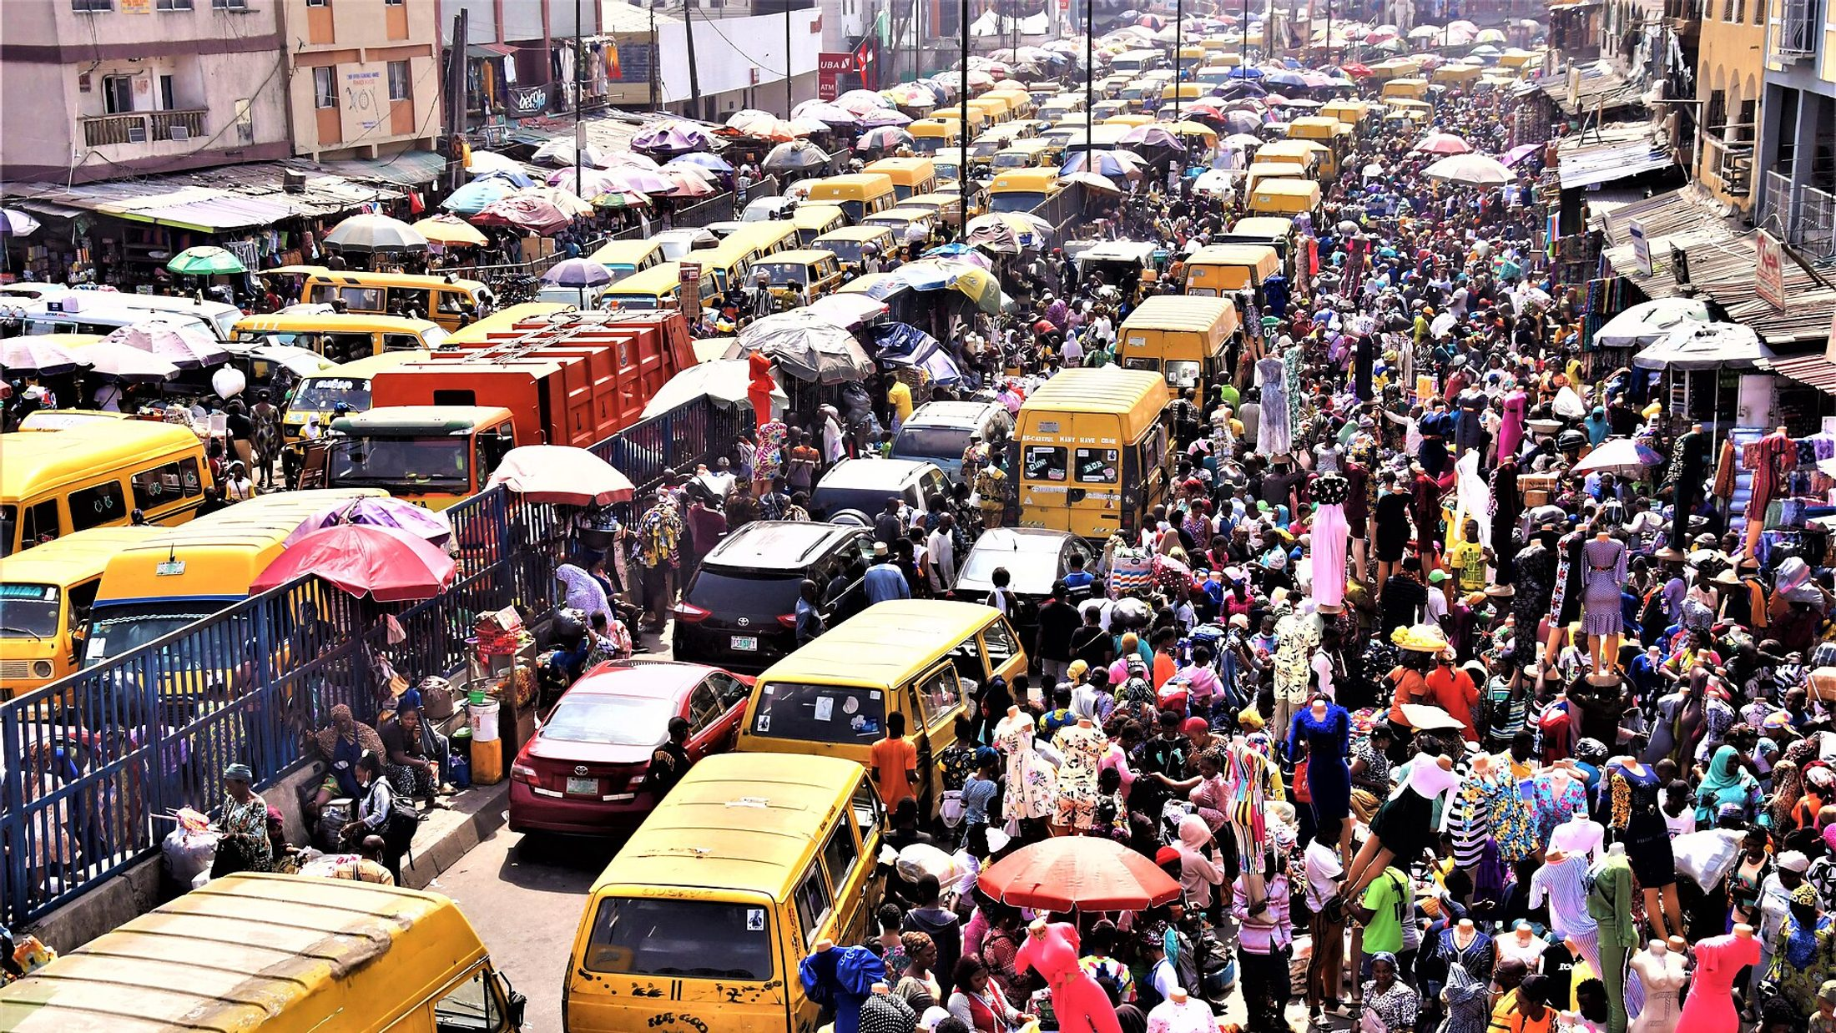
REMEMBER
The price on the page is never your real cost.
Test small. Count everything. Then grow.
Questions? Take the full course at academy.cloudtechanalytics.com
Notes:
[Stand up straight and speak slowly. This is the ending. Let the last sentence land.]
Let me end with the story we started with.
Tunde did not order three hundred power banks the next day. He tested the market. He checked his suppliers. He ordered a sample. He built his real cost, and he priced for a margin. His first order was small, and it sold. Then his second order was bigger.
That is how it is done. Not with luck, but with steps.
[Pause.]
And here is the sentence I asked you to remember at the beginning. The price on the page is never your real cost. If you remember only that, you are already safer than most beginners.
Test small. Count everything. Then grow.
[Smile.]
Thank you so much for your time and your attention today. I would love to hear your questions. Please go ahead.
[Take questions. When finished:]
And if you want the lesson-by-lesson version, with practice tasks, calculators and a final business plan, the full course is at academy dot cloudtech analytics dot com. Everything we did today is in it, with more detail.
Thank you, everyone. Well done today.

Slide 28
Photo credits
Container ship at a port: Downtowngal, CC BY-SA 4.0, Wikimedia Commons
Cargo aircraft loading: Aleksandr Markin, CC BY-SA 2.0, Wikimedia Commons
Computer Village, Ikeja: Lightfast Media, CC BY-SA 4.0
Yiwu International Trade Market: Whisper of the heart, CC BY-SA 4.0
Apapa port, Lagos: Quadrex24, CC BY-SA 4.0
Lagos market: Sir Demo, CC BY-SA 4.0
Naira notes: FAdelabu, CC BY-SA 4.0
Customs inspection: CBP Photography, public domain
Container terminal (aerial): Carsten Steger, CC BY-SA 4.0
All photos from Wikimedia Commons and used under the licences shown. CC BY-SA: credit the author and share adaptations alike. Diagrams: CloudTech Academy.
Notes:
[This slide is not read aloud. It keeps the licence information for the photographs: all are from Wikimedia Commons, used under the licences shown, and the diagrams are original to CloudTech Academy. Leave it on screen at the end if anyone asks where the photos came from.]

