Slide 1
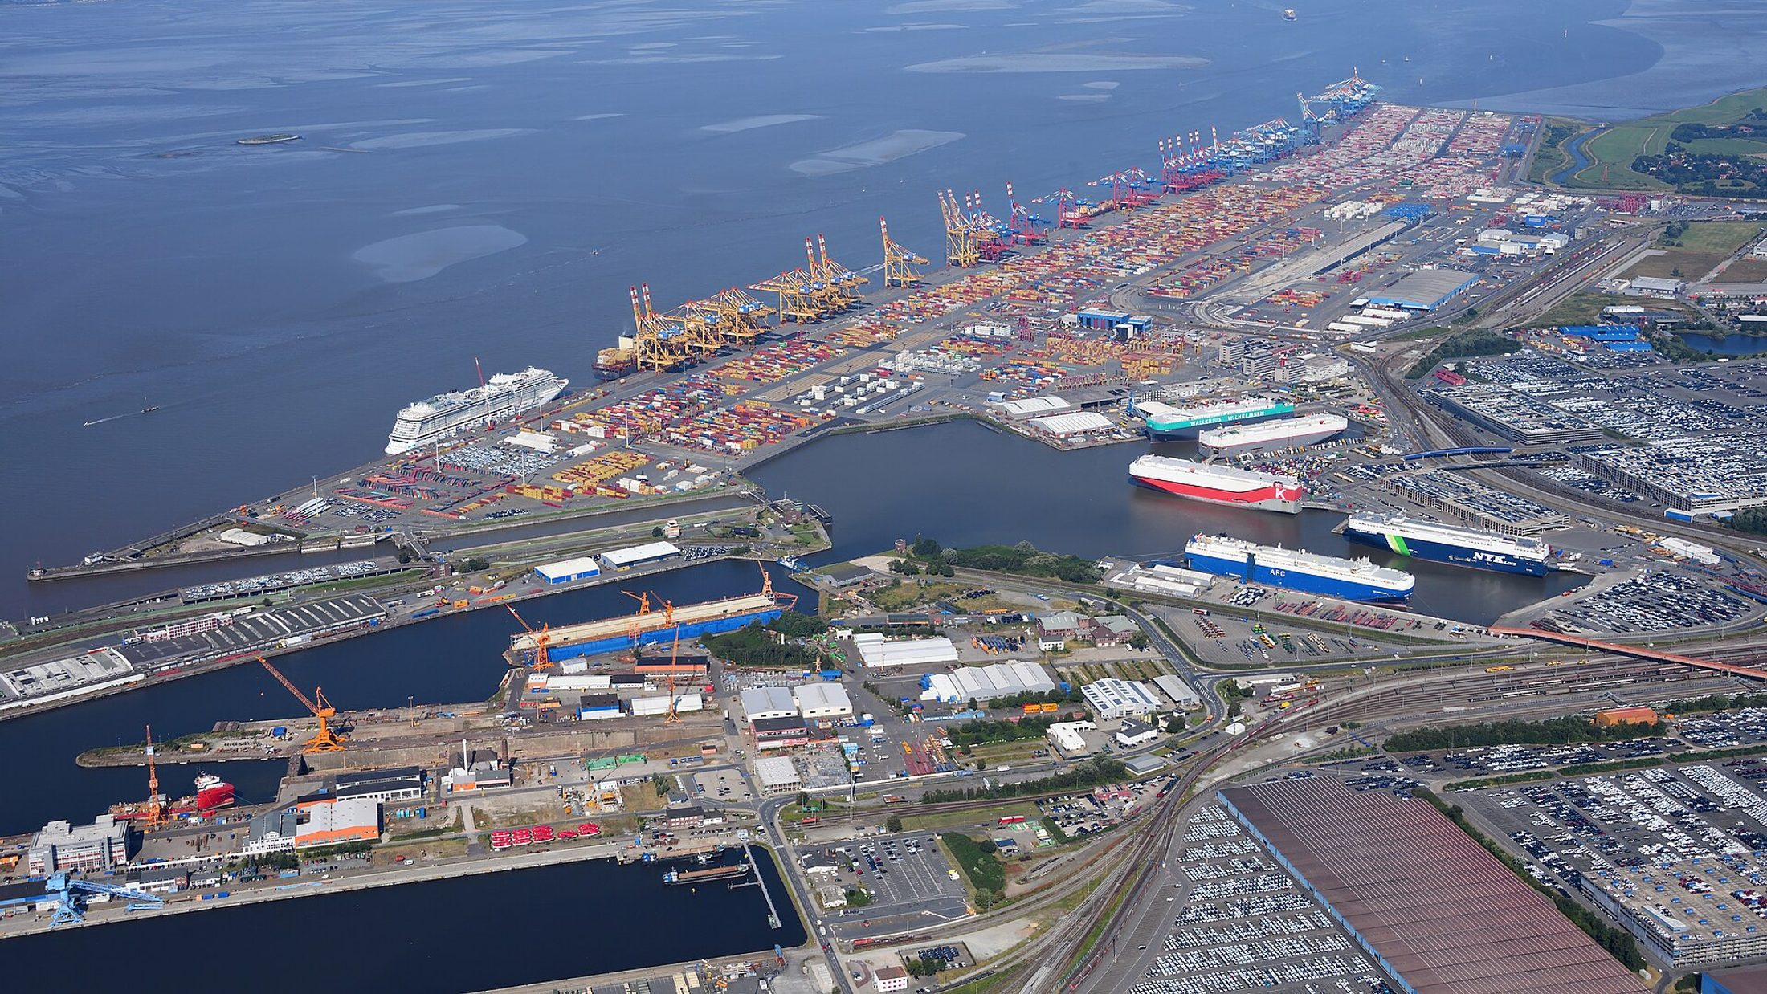
TRAINING WORKSHOP
Mini Importation
From a good idea to your first profitable shipment
A practical, story-led guide for beginners | CloudTech Academy
Notes:
Welcome everyone. Today is not a lecture about trade. It is the story of how an ordinary shop owner turns one good idea into a shipment that arrives, clears customs and sells at a profit. I will tell you that story step by step. Every step has a real number, a common mistake, and something you can do this week. By the end of the day each of you will have your own product, your own cost sheet and a 30-day plan.

Slide 2

It starts with one sentence
“My cousin buys power banks directly from China. He sells them cheaper than you and still makes a profit.”
Tunde sells phone accessories at Computer Village. He pays ₦9,500 for a power bank. A supplier website shows the same item at $3.00.
“I should order 300 tomorrow.”
What could go wrong? Hold that thought.
Computer Village, Ikeja. Photo: Lightfast Media, CC BY-SA 4.0
Notes:
Tell this slowly. Tunde has a stall in Computer Village, Ikeja. He buys phone accessories from Lagos wholesalers and every month he pays a little more. One evening a customer says: my cousin buys power banks directly from China, sells cheaper than you and still makes profit. Tunde goes home, opens a supplier website, sees a power bank at $3, and thinks: I pay ₦9,500 for this. Order 300 tomorrow. Pause here and ask the room: what could go wrong? Collect three answers before moving on. Today we answer that question properly.

Slide 3




What you will leave with today
Choose well
Buy safely
Pick a product people already buy, and check demand and margin before you spend a naira.
Find suppliers, spot scams and pay in a way that protects your money.
Ship and clear
Know your cost
Choose air or sea, understand the documents and clear goods at the port.
Work out the real cost of every unit and a price that leaves a profit.
Built for beginners. No experience needed.
Notes:
Set expectations. This is a beginner session. Nobody needs prior experience. Four skills: choosing a product that already sells, finding and checking suppliers, getting goods shipped and cleared, and, most important, knowing your true cost so you know your true profit. Say clearly: we are not going to promise easy money. We are going to protect you from expensive mistakes.

Slide 4


Importing and exporting in plain words
Import
ONE SALE, TWO NAMES
Buy goods from another country and bring them in.
Guangzhou factory
EXPORT for China
Export
Lagos trader
IMPORT for Nigeria
Sell goods you make or buy locally to a buyer abroad.
The gap in price is your opportunity.
Your job: turn the price gap into profit after every cost in between.
Notes:
Importing: you buy goods from another country and bring them in. Exporting: you sell goods to a buyer in another country. They are two sides of the same sale. A factory in Guangzhou that sells phone cases to a trader in Lagos is exporting; the trader is importing. Why do people do it? Because a product can cost far less, or be far better, where it is made. Your job is to turn that gap into profit after paying for everything that sits between the factory and your customer. Write on the board: the price on the supplier page is never your real cost. We will come back to that sentence all day.

Slide 5

Mini importation versus full trade
Mini importation
Full trade
Dozens to a few hundred units
Often air cargo or courier
One person or a small team
Goods bought for resale
Rules still apply in full
Container loads (FCL)
Mostly sea freight
Forwarder and clearing agent team
Larger capital and contracts
Letters of credit for big orders
Mini does not mean exempt: small commercial imports still need correct declarations.
Notes:
Mini importation means small quantities, usually bought for resale, often shipped by air cargo or courier, often run by one person or a small team. Full trade is container loads, bigger capital and a bigger team of forwarders and clearing agents. The key message: mini does not mean exempt. Small commercial quantities for resale still need correct declarations, and the same risks exist, only smaller in size. A mini import is the best classroom: the first order is tuition.

Slide 6
The price on the page is not your cost
$3.00
₦7,420
+65%
price on the supplier page,
about ₦4,500 a unit
the real cost per unit
once everything is added
the gap between
the two numbers
Example: 300 power banks, $3.00 each, air freight, Lagos.
We build this number up step by step later today.
Notes:
This is the most important slide of the day. Tunde saw $3.00 and mentally converted it to about ₦4,500. After freight, insurance, duty, VAT, clearing, transport and bank charges, his real cost per power bank was ₦7,420. That is about 65 percent more than the number he saw. Nothing dishonest happened. He simply had not counted. If he had priced at ₦6,000 because he thought his cost was ₦4,500, he would have lost money on every sale and not known why. Ask: how many of you have ever priced something from the buying price alone?

Slide 7
The whole journey in ten steps
1
Lesson 2
2
Lesson 2
3
Lesson 3
4
Lesson 4
5
Lesson 5
Choose a product
Check the market
Find suppliers
Verify the supplier
Negotiate and sample
Pick what people already buy
Demand, competition, margin
Platforms, markets, agents
Scam checks, safe payment
Price, MOQ, sample first
6
Lesson 6
7
Lessons 7-8
8
Lesson 9
9
Lesson 9
10
Lesson 10
Ship it
Documents and customs
Count the real cost
Price it
Sell and reorder
Air or sea, forwarder, insurance
Invoice, B/L or AWB, HS code
Landed cost per unit
Price for your target margin
Channels, stock, cash flow
Dark boxes protect your money: do the numbers before you spend, test small before you go big.
Notes:
Put this map in front of the room and leave it up. Everything we do today is one of these ten boxes. Walk through it with your finger: choose a product, check the market, find suppliers, verify them, negotiate and sample, ship, documents and customs, count the real cost, price it, sell and reorder. Point out the two steps that protect your money before you spend any: check the market, and count the real cost. Beginners rush to step 6 because shipping feels like progress. The professionals spend their time in steps 1, 2 and 8.

Slide 8


Steps 1 and 2: choose and test the market
Demand
Gap
Margin
Are people already buying it again and again?
Is it overpriced, hard to find or badly presented locally?
After every cost, is the profit worth the risk?
FOUR QUICK TESTS BEFORE YOU SPEND
Search it on Jumia, Jiji, Instagram and Google
Read competitor reviews: repeated complaints are your gap
Ask ten possible customers what they would pay
Pre-sell with supplier sample photos and collect deposits
Notes:
Do not choose what you love. Choose what people already buy. Three questions: is there demand, is there a gap, is there margin after every cost. Where do you look? Markets, Jumia, Jiji and Instagram sellers; note what is always out of stock and what gets many comments asking for the price. Listen to complaints: I can never find a good X is a product idea. Then check the competition: how many sellers, their price range, their reviews. Ask ten possible customers what they would pay and what worries them. Finally, the best test is a pre-sale: post the product with sample photos, say they are sample photos, and take names and deposits.

Slide 9


Pick small, light and legal
A good first product
Check before you buy
Small and light, cheap to ship
Durable, survives the journey
Already selling near you
Not heavily regulated
Margin you can prove on paper
Banned or restricted goods
Food, drugs, cosmetics: NAFDAC
Electrical goods: SON standards
Fake brands (replicas): seizure
Batteries, liquids: shipping limits
Tunde's power banks: lithium batteries have airline limits. Ask the forwarder first.
Notes:
A good first product is small, light, durable and not heavily regulated. Phone accessories, small kitchen tools, hair accessories and similar items are common starting points. A product that breaks easily, weighs a lot for its value or needs special approval makes a poor first order. Then cover the four danger areas. Banned or restricted goods can be seized. Regulated products such as food, drinks, medicines, cosmetics and supplements generally need NAFDAC approval to be sold. Electrical items and many manufactured goods are expected to meet SON standards. Fake branded goods called replicas can be seized and bring legal trouble. Batteries, liquids and aerosols have shipping restrictions especially by air. A tip: power banks contain lithium batteries, so confirm the airline and forwarder rules before you ship by air.

Slide 10
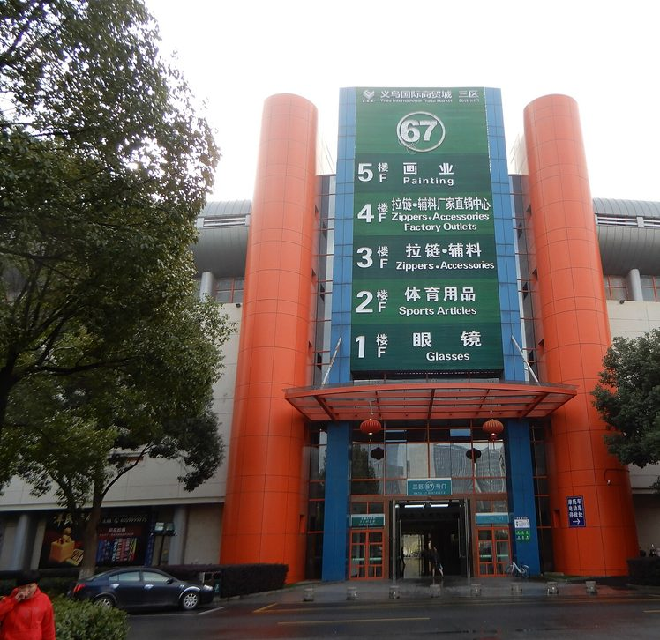
Step 3: where to find suppliers
Alibaba.com
Wholesale and customising
1688.com
Lowest prices, needs an agent
AliExpress
Very small test orders
Other B2B sites
Made-in-China, Global Sources
Markets and trade fairs
See and touch the goods
Sourcing agents
Help for beginners, for a fee
Yiwu market. Whisper of the heart, CC BY-SA 4.0
Shortlist 3 to 5 suppliers. Send each the same enquiry.
Notes:
Treat Alibaba as a directory, not a guarantee. The platform lists suppliers; it does not make each one honest or good. For a first mini import, Alibaba plus a small sample order is the usual start. 1688 has the lowest factory prices but is in Chinese and normally needs an agent. AliExpress suits very small test orders but at higher unit prices. Made-in-China and Global Sources list verified exporters, strong in electronics. Physical markets like Yiwu in China show you the goods, and trade fairs such as the Canton Fair put many factories in one place. A sourcing agent can find and check suppliers for a fee, helpful for beginners with a language gap. Shortlist three to five suppliers and send each the same clear enquiry.

Slide 11
Reading a supplier listing
1
Title and photos
Do they match? Ask for real photos.
Wireless earbuds, Bluetooth 5.3
1
Photos
Price tiers
Price falls as you buy more. Plan your tier.
1-99 pcs
$6.80
2
2
100-499 pcs
$5.90
500+ pcs
$5.20
3
Minimum order
Does your first order fit your budget?
Minimum order: 100 pieces
3
Shenzhen Example Electronics Co.
Manufacturer | 8 years | Verified
4
Who is selling
Factory or trader? Badges help, not proof.
4
Samples available | Logo printing
5
5
Samples
Order one before the bulk order.
Order protection: payment held
6
Contact supplier
6
Payment protection
Pay via the platform: held until delivery.
Notes:
Open the supplier's company profile, not just the product page. Walk through the six numbered parts. One: do the photos and title match what you want, and ask for real photos. Two: price tiers, the price falls as you buy more; plan for the tier you can afford. Three: the minimum order quantity; your first order may have to be the minimum, so check it fits your budget. Four: who is selling, a manufacturer or a trader; years active and verification help but are not proof. A factory focuses on one line of goods; a profile selling electronics, shoes and furniture is probably a trader. Five: samples; order one before the bulk order. Six: payment protection; pay through the platform so the money is held until delivery. The listing is an illustration, not a real supplier.

Slide 12


Step 4: verify before you pay
RED FLAGS
SAFE HABITS
Price far below every other quote
Bait price
Pay through the platform
Trade Assurance or escrow holds your money
New bank account after weeks of emails
Hijacked email
Ask for a live video call
Factory floor, stock, production line
Personal account for a company
No protection
Match every name
Licence, invoice and bank account holder
No live video of the factory
Probably not a factory
Pay a deposit, not everything
Often 30%, balance after inspection
Notes:
Here is where beginners lose money. Tell the room the patterns. The fake supplier: a page copied from a real factory with a different bank account. The changed bank details: after weeks of normal emails the accountant sends a new account number because the email was hijacked. The bait price: far below every other supplier, limited time, full payment first. The sample trap: a good sample, then poor bulk goods. The forged documents: fake licences and certificates. Defences: check the business licence, ask for a live video call of the factory floor and stock, make sure the bank account name matches the company on the licence and invoice, reverse image search the photos, and use Trade Assurance or escrow. Never pay a company into a personal account. Never use gift cards, crypto or cash to an agent.

Slide 13



Step 5: negotiate, then test a sample
Ask for tier prices
Show you will reorder
What is the price at 300, 500 and 1,000 units?
A repeat buyer is worth a lower price.
Be exact about the spec
Order a sample first
Model, material, colour, packaging.
Test it like a customer. Keep it as evidence.
Typical payment: 30% deposit, 70% before shipment or against the bill of lading.
Notes:
Before you negotiate know three things: your target price worked backwards from the selling price you found earlier, your walk-away price, and two or three other quotes. Then use the tactics: ask for tier pricing at 300, 500 and 1,000 units, show your plan to reorder, be specific about the model, material and packaging, bundle models or colours to reach a higher tier, and trade rather than push: a faster deposit for a better price or free packaging. Never accept the first price; a modest counter-offer is normal. Then the sample. Ask what it costs and whether it is refunded against the bulk order. Test it as a customer would, check it against your list, photograph and weigh it, and keep it. If the bulk goods are worse the sample is your evidence. Sample payments are usually 100 percent in advance so use protected payment.

Slide 14
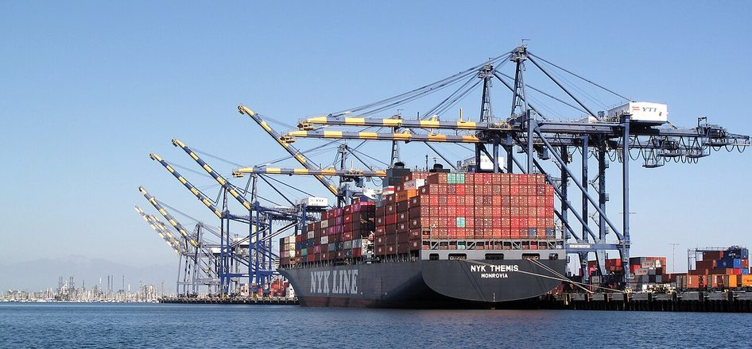
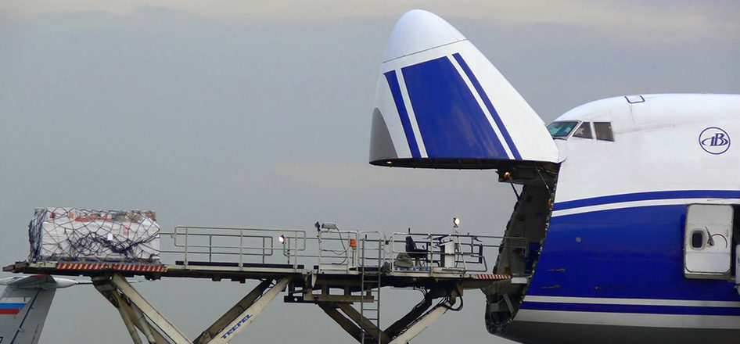
Step 6: air or sea?
Sea freight. Photo: Downtowngal, CC BY-SA 4.0
Air cargo. Photo: Aleksandr Markin, CC BY-SA 2.0
Air freight
Sea freight
Speed
About 1 to 2 weeks
Several weeks
Cost
Higher per kg
Much lower per unit
Best for
Small, light, urgent
Heavy, bulky, large
Notes:
Choose by weight, size, value, urgency and budget. Air is roughly a week or two door to door, costs more per kilogram, and is best for small, light, high-value or urgent goods and samples. Sea often takes several weeks, commonly over a month from China, costs much less per unit of cargo, and suits heavy, bulky or large orders, but has more handling and port delay risk. For a first mini import of light goods, air cargo is often practical. As volume grows, sea brings the cost per unit down. Times and prices change often, so always get a current quote, and make sure quotes from different forwarders are built the same way.

Slide 15
Worked example: chargeable weight
ONE CARTON
60 × 40 × 50 = 120,000
60 × 40 × 50 cm
multiply the sides
Actual weight: 15 kg
120,000 ÷ 6,000 = 20 kg
Volumetric weight = L × W × H ÷ 6,000
volumetric weight
20 kg is more than 15 kg
Always confirm the divisor your carrier uses.
so you are charged for 20 kg
Notes:
Airlines charge for the greater of actual weight and volumetric weight, because large light boxes take up space and space is paid for. Volumetric weight in kilograms equals length times width times height in centimetres, divided by 6,000. Take one carton 60 by 40 by 50 centimetres weighing 15 kilograms. 60 times 40 times 50 is 120,000. Divide by 6,000 and you get 20 kilograms. Actual weight is 15 so the chargeable weight is 20 kilograms. If the forwarder quotes, say, a certain price per kilogram you multiply by 20 not 15. Ask the room to try it with their own product box. Some carriers use slightly different divisors, so always confirm how a quote is calculated.

Slide 16
Step 7: the documents that travel with goods
1
2
3
4
5
Supplier
Freight forwarder
Ship or airline
Customs and agent
You, the importer
Packs and sells
Books the transport
Carries the goods
Checks, values, taxes
Receives and sells
DOCUMENTS
DOCUMENTS
DOCUMENTS
DOCUMENTS
DOCUMENTS
Commercial invoice, packing list
Booking, bill of lading or air waybill
Bill of lading or air waybill
Form M, PAAR, duty receipt
Release order, delivery note
All documents must match. Never understate the value or change a description to cut duty: it is an offence.
Notes:
Customs does not clear goods on trust. It clears them on documents that agree with each other and with the goods. The commercial invoice is the bill from the supplier. The packing list says what is in each carton, with counts, weights and dimensions. For sea freight the bill of lading is the receipt, the contract of carriage and the document of title. For air the air waybill is the contract and receipt, but not a document of title. You may also need a certificate of origin, an insurance certificate, product certificates such as SON or NAFDAC, and in Nigeria the Form M raised through your bank before shipment. The golden rule: all documents must match. Name, address, quantities, weights, descriptions and values. A mismatch is the most common cause of delay and fines. And never agree to understate the value or change the description to reduce duty. It is an offence.

Slide 17
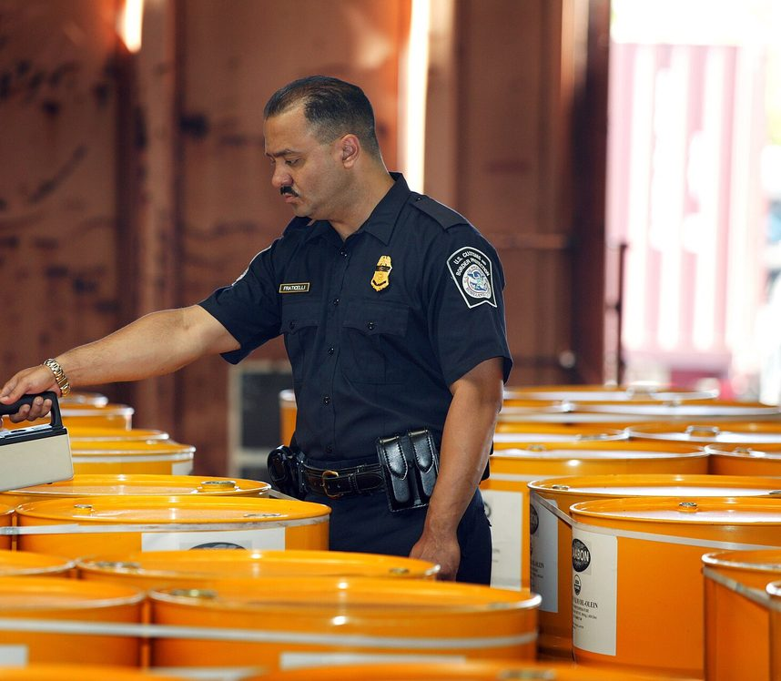
HS codes, duty and customs value
1
HS code
decides your duty rate and permits
2
CIF value
product + freight + insurance
3
Duty
% of the naira CIF value
4
VAT
% of naira CIF + duty
Rates change. Confirm the current rate for your code.
Customs check. Photo: CBP, public domain
Notes:
Every product has an HS code under the Harmonized System. The first six digits are the same worldwide and countries add digits for their own tariff. The code decides your duty rate, which rules and permits apply, and whether the product is restricted. Using the wrong code leads to wrong duty, delays and penalties. Ask your forwarder or clearing agent to confirm the code before you ship. Customs value for duty is normally the CIF value: cost, insurance and freight. Duty is a percentage of that, converted to naira at the customs exchange rate. VAT is then charged on the naira CIF plus duty. Rates change, so check the current rate for your code instead of trusting a number from a video.

Slide 18
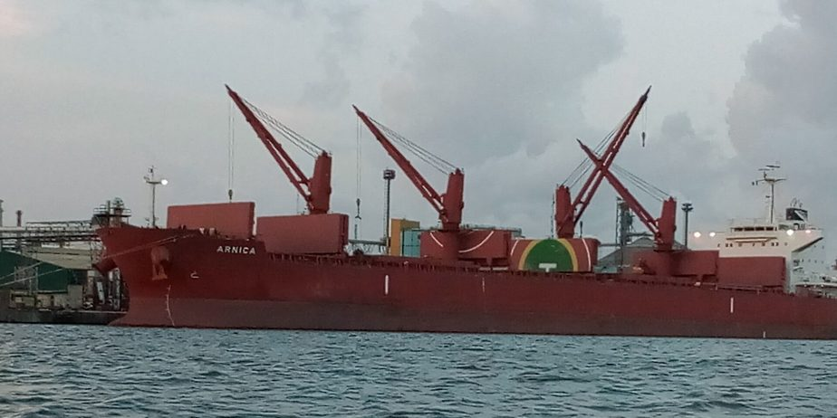
Importing into Nigeria: who does what
Customs
Duty, tax, examination, release
SON and NAFDAC
Standards, food, drugs
Your bank
Form M and foreign exchange
Clearing agent
Handles Customs for you
Apapa port, Lagos. Photo: Quadrex24, CC BY-SA 4.0
THE ORDER OF EVENTS
Register business
Form M via bank
Ship goods
PAAR from Customs
Clear at the port
Notes:
Several bodies have a say. Nigeria Customs Service assesses and collects duty and taxes, enforces prohibitions, and examines and releases goods. SON covers product standards. NAFDAC covers food, drinks, drugs, cosmetics and chemicals. NAQS inspects plant and animal products. NCC type-approves telecom and some electronic equipment. The CBN and your bank handle foreign exchange and the Form M. CAC registers your business. Before importing commercially you usually need a registered business with a TIN, a business bank account that handles foreign transactions, a Form M raised before the goods ship, and a PAAR from Customs after documents are submitted. Remember that mini importation does not exempt you. Use a licensed clearing agent. At the port watch for storage and demurrage: free days are limited and a few days of delay can add up to a lot. Confirm all current requirements with Customs and the agency for your product.

Slide 19
Step 8: build the landed cost
Product 300 × $3.00
$900
TOTAL LANDED COST
Air freight
$150
₦2,226,100
Insurance
$10
CIF value
$1,060
CIF in naira (₦1,500 = $1)
₦1,590,000
PER UNIT (÷ 300)
Duty at 20%
₦318,000
₦7,420
VAT 7.5% on ₦1,908,000
₦143,100
Clearing and port
₦120,000
Local transport
₦30,000
vs about ₦4,500 on the supplier page
Bank and payment charges
₦25,000
Teaching rates. Use current rates for your own goods.
Notes:
This is the heart of the session. Walk through Tunde's 300 power banks line by line and have people calculate along. Product cost: 300 times $3.00 is $900. Air freight $150, insurance $10. CIF value is $1,060. At ₦1,500 to the dollar that is ₦1,590,000. Duty at 20 percent is ₦318,000. VAT at 7.5 percent is charged on ₦1,590,000 plus ₦318,000, which is ₦1,908,000, giving ₦143,100. Add clearing agent and port charges ₦120,000, local transport ₦30,000 and bank and payment charges ₦25,000. Total landed cost ₦2,226,100. Divide by 300 and each power bank costs ₦7,420. Remind them: the supplier price looked like ₦4,500. The real cost is about 65 percent higher. Rates in this example are for teaching; use current rates for your own product.

Slide 20
Where the money goes
HOW TO REDUCE IT
Compare freight quotes
Confirm the HS code
Spread fixed charges over more units
Collect goods before storage fees start
Amber: goods and freight Brick: duty and tax Blue: local costs
Notes:
Look at the chart. The product is the biggest bar but far from the whole story. Duty and VAT together are about ₦461,000. Clearing, transport and bank charges add another ₦175,000. Freight and insurance ₦240,000. The brick bars are government duty and tax. The blue bars are local costs. If you priced from the product alone you would have under-counted by roughly ₦876,000 across the batch. Ask: which of these costs could you reduce? Answers: negotiate freight with several forwarders, make sure the HS code is correct, order enough to spread fixed clearing charges across more units, and move goods out of the port before storage fees start.

Slide 21
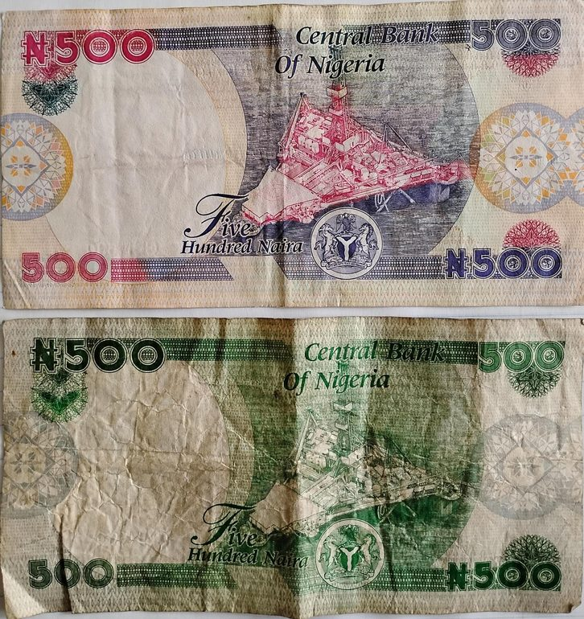
Step 9: price for the profit you want
SELLING PRICE FORMULA
Price = landed cost ÷ (1 − target margin)
₦7,420 ÷ 0.65 = ₦11,415 for a 35% margin
MARKUP
MARGIN
Profit ÷ cost
Profit ÷ selling price
₦4,000 ÷ ₦6,000 = 66.7%
₦4,000 ÷ ₦10,000 = 40%
A 35% margin is not 35% profit: marketing, packing, delivery and your time still come out.
Photo: FAdelabu, CC BY-SA 4.0
Notes:
Markup is profit as a percentage of cost. Margin is profit as a percentage of the selling price. They are different, and mixing them up is a classic mistake. Example: cost ₦6,000, sold at ₦10,000, profit ₦4,000. Markup is 66.7 percent and margin is 40 percent. To reach a target margin divide the cost by one minus the margin. For Tunde's cost of ₦7,420 and a 35 percent target margin, 7,420 divided by 0.65 equals ₦11,415. Then compare with competitors. If the market pays less you must lower your cost, change the product or accept a smaller margin. Also remind them that a 35 percent gross margin is not a 35 percent profit once marketing, packaging, delivery, staff and your own time are paid.

Slide 22

Step 10: sell, collect and reorder
RETAIL
₦12,000 − ₦7,420
= ₦4,580 profit per unit, slower to sell
WHOLESALE (10 or more)
₦9,500 − ₦7,420
= ₦2,080 a unit. Ten units: ₦20,800 in a day
A busy Lagos market. Photo: Sir Demo, CC BY-SA 4.0
Notes:
An import is only profit when the goods are sold and the money is in your account. Many importers put all their effort into sourcing and shipping, then sit on stock. Plan how you will sell before the goods arrive. Start with channels you can reach this week: social media and the people you know. WhatsApp status, Instagram, Facebook and TikTok are cheap to start and give you direct customer contact. Marketplaces bring traffic and trust but charge commission. A shop or stall lets customers touch the product. Wholesale to traders gives big, repeat orders at a lower price per unit. Work the example: landed cost ₦7,420. Retail at ₦12,000 gives ₦4,580 per unit. Wholesale at ₦9,500 for ten or more gives ₦2,080 per unit. Sell ten to one wholesaler and you make ₦20,800 in a day, and free your money to reorder. Then protect your cash: do not put all the profit back into one slow product.

Slide 23

Exporting: the other direction
Agriculture
Foods and spices
Sesame, cocoa, cashew, ginger, hibiscus
Packaged snacks and sauces for the diaspora
Beauty and care
Fashion and crafts
Shea butter, black soap, natural oils
Ankara, beads, leather goods
Start with one buyer and one product. Confirm the current rules with NEPC and Customs.
Notes:
Exporting means selling goods outside your country. It can earn foreign currency, reach far bigger markets and allow better prices than at home. It also asks more of you: the product must meet the buyer's standard, the paperwork must be right and payment terms need care. Exporting is not only for big companies; a small producer can start with a single buyer and a single product. Commonly traded Nigerian categories include agricultural products such as sesame, cocoa, cashew, ginger and hibiscus, processed and packaged foods and spices especially for the diaspora, beauty products such as shea butter, black soap and natural oils, and fashion and crafts such as Ankara, beads and leather goods. Confirm current requirements with the Nigerian Export Promotion Council, Customs and the agency for your product before you ship.

Slide 24


Six risks and how to manage them
Supplier fraud
Poor quality
Delays
Verify, pay through protection
Sample first, inspect before the balance
Buffer time and spare stock
Damage or loss
Surprise charges
Exchange rate
Strong packing and insurance
Landed cost before you order
Add a margin, order often in smaller lots
Start small. Test. Then grow. The first order is tuition.
Notes:
Go back to the question we started with: what could go wrong for Tunde? Now you can answer. Supplier fraud: verify and use protected payment. Poor quality: order a sample and inspect before paying the balance. Delay: allow buffer time and keep stock for the next few weeks. Damage or loss: good packaging and insurance. Duties and charges you did not expect: calculate landed cost before ordering. Exchange rate moves: add a margin, pay promptly and order in smaller amounts more often. Also: restricted or banned items, so check the rules before you order. A safe habit: start small, test, then grow. The first order is tuition.

Slide 25
Your turn: a 30-minute working session
1
Pick a product
Small, light, legal and already selling. Name three people who would buy it this week.
2
Check the market
Find three competitor prices: lowest, typical, highest.
3
Build the landed cost
Use a real supplier price and the cost sheet steps.
4
Set your price
Landed cost ÷ 0.65 for a 35% margin. Does the market accept it?
Notes:
Now they work. Hand out the worksheet or ask them to open a spreadsheet. Each person picks one product they could imagine importing. Step one: write the product and the three customers they could sell to this week. Step two: look up three competitor prices and write the lowest, typical and highest. Step three: take a supplier price from a listing and build a landed cost using the teaching rates. Step four: set a selling price for a 35 percent margin and compare with the competitor range. Walk around the room. When someone finishes, ask them to swap with a neighbour who looks for the weakest assumption. Debrief with two or three people sharing: did the margin survive?

Slide 26
Your first 30 days
WEEK 1
WEEK 2
WEEK 3
WEEK 4
Choose
Source
Test
Decide
Pick a product and ask ten buyers what they would pay.
Shortlist 3 to 5 suppliers and verify the best two.
Order a sample. Build landed cost and set a price.
Pre-sell. Place a small first order, or drop it.
A bad product dropped after a week of research is a win.
Notes:
Close the loop. Nobody has to import anything this month. The goal of the first thirty days is to test an idea cheaply and learn. Week one: choose a product and check demand with real people. Week two: shortlist three to five suppliers, send the same enquiry and verify the best two. Week three: order a sample, build your landed cost and set a target price. Week four: pre-sell, then decide whether to place a small first order, or drop the idea and test another. Dropping a bad product after a week of research is a win, because it cost you almost nothing.

Slide 27

REMEMBER
The price on the page is never your real cost.
Test small. Count everything. Then grow.
Questions? Take the full course at academy.cloudtechanalytics.com
Notes:
Finish with the story. Tunde did not order 300 power banks the next day. He tested the market, verified suppliers, ordered a sample, built the real cost and priced for a margin. His first order was small. It sold. His second order was bigger. Tell them the most important sentence again: the price on the page is never your real cost. Invite questions. Then point them to the full course for the lesson-by-lesson version with practice tasks, calculators and a final business plan.

Slide 28
Photo credits
Container ship at a port: Downtowngal, CC BY-SA 4.0, Wikimedia Commons
Cargo aircraft loading: Aleksandr Markin, CC BY-SA 2.0, Wikimedia Commons
Computer Village, Ikeja: Lightfast Media, CC BY-SA 4.0
Yiwu International Trade Market: Whisper of the heart, CC BY-SA 4.0
Apapa port, Lagos: Quadrex24, CC BY-SA 4.0
Lagos market: Sir Demo, CC BY-SA 4.0
Naira notes: FAdelabu, CC BY-SA 4.0
Customs inspection: CBP Photography, public domain
Container terminal (aerial): Carsten Steger, CC BY-SA 4.0
All photos from Wikimedia Commons and used under the licences shown. CC BY-SA: credit the author and share adaptations alike. Diagrams: CloudTech Academy.
Notes:
Read nothing aloud. This slide keeps the licence terms for the photographs. The diagrams are original to CloudTech Academy.

