Slide 1
Autopilot Provider
Participants:
KS Pavithra
Prasanna SP

Slide 2
Autopilot
What is webMethods CloudStreams Provider for Autopilot?
Autopilot is easy-to-use software for multi-channel marketing. The Autopilot REST API allows you to:
Send contacts from Autopilot to your app
Add contacts from your app into Autopilot
Trigger Autopilot journeys from your app
Keep unsubscribes in sync between Autopilot and your app
Enhance contact profiles with custom fields and data from your app

Slide 3
Autopilot
Benefits of the application
It is easy to integrate the Autopilot application with other applications.
Minimal external dependencies on other applications
Seamless authentication mechanism using API keys

Slide 4
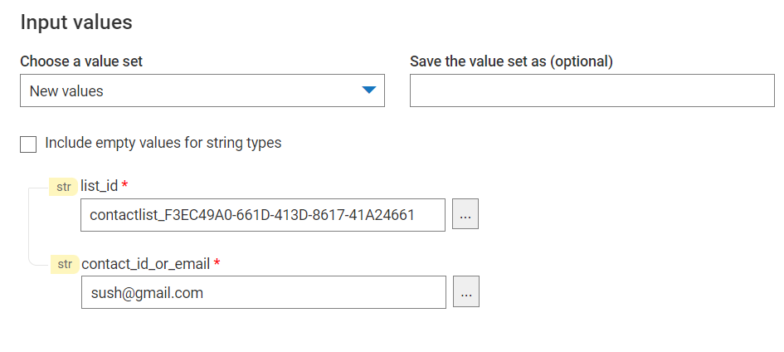
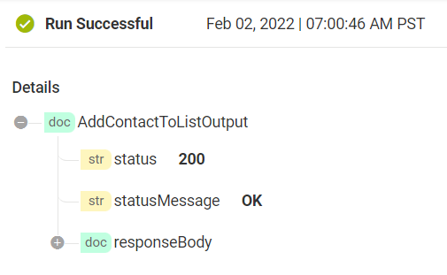
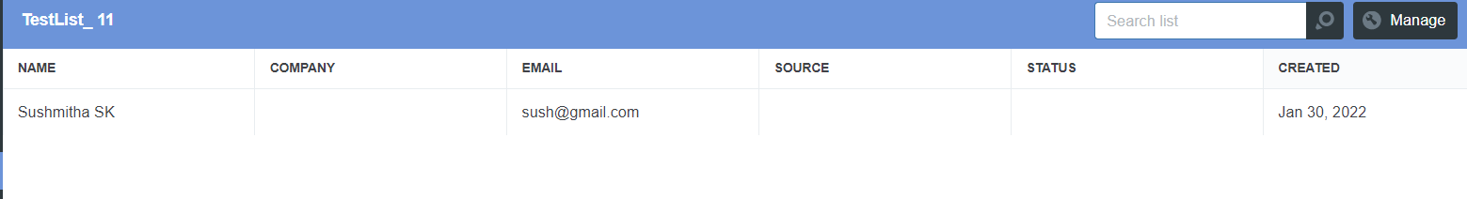
Screenshots for workflow
Add Contact to list

