Slide 1

BigCartel Provider
Participants:
Niveed Kumar Reddy Bollapally

Slide 2
Big Cartel
What is webMethods CloudStreams Provider for Big Cartel
Briefly explain about the backend.
Big Cartel is a cloud-hosted e-commerce platform, meaning you can build and operate your store from any device with internet access. You have the option to use one of its free themes to get your online store up and running, or you can create a truly unique design through its API.
Big Cartel Connector performs CURD operations. Helps in creating, updating, retrieving and deleting products, orders, categories, discounts and shipments for your e-commerce platform.
Big Cartel Connector is a lightweight connector, excellent collaboration and integrates easily.

Slide 3
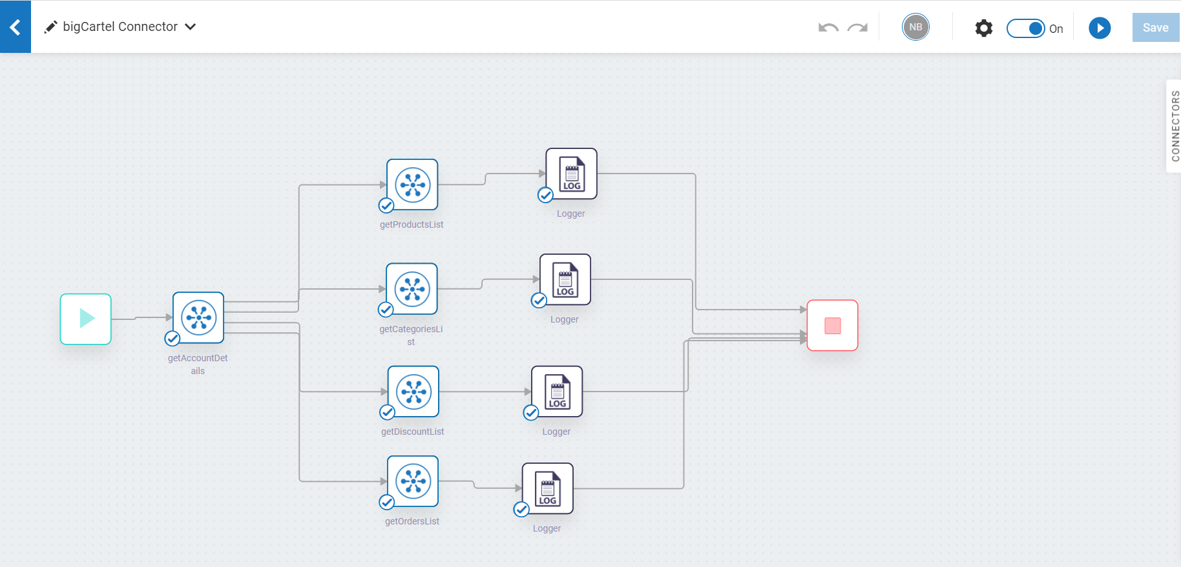
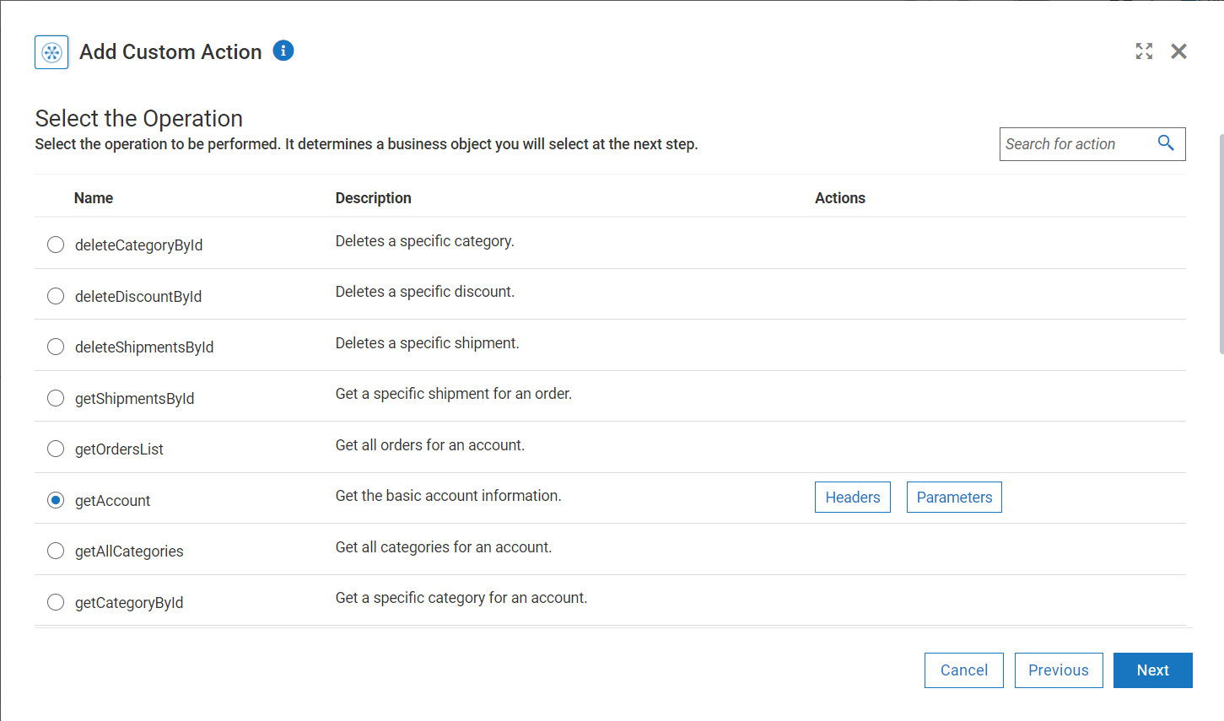
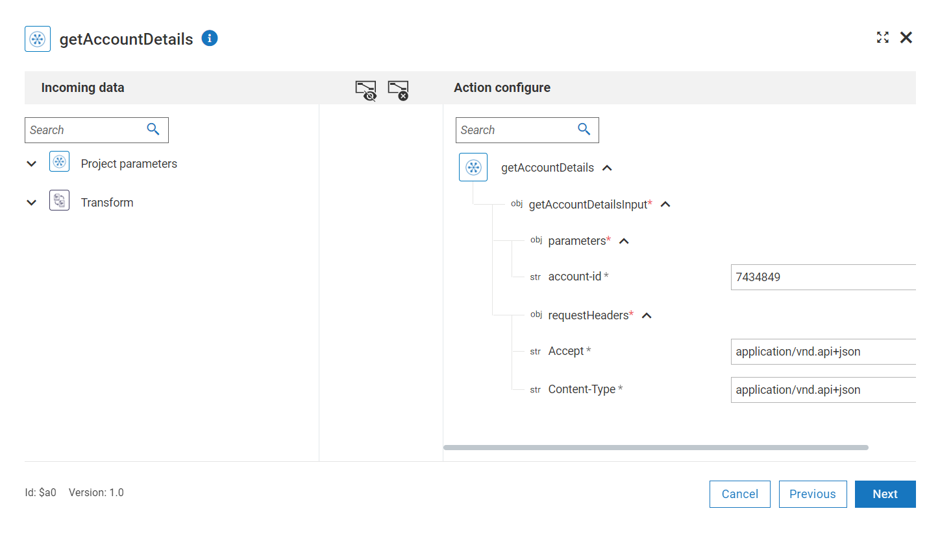
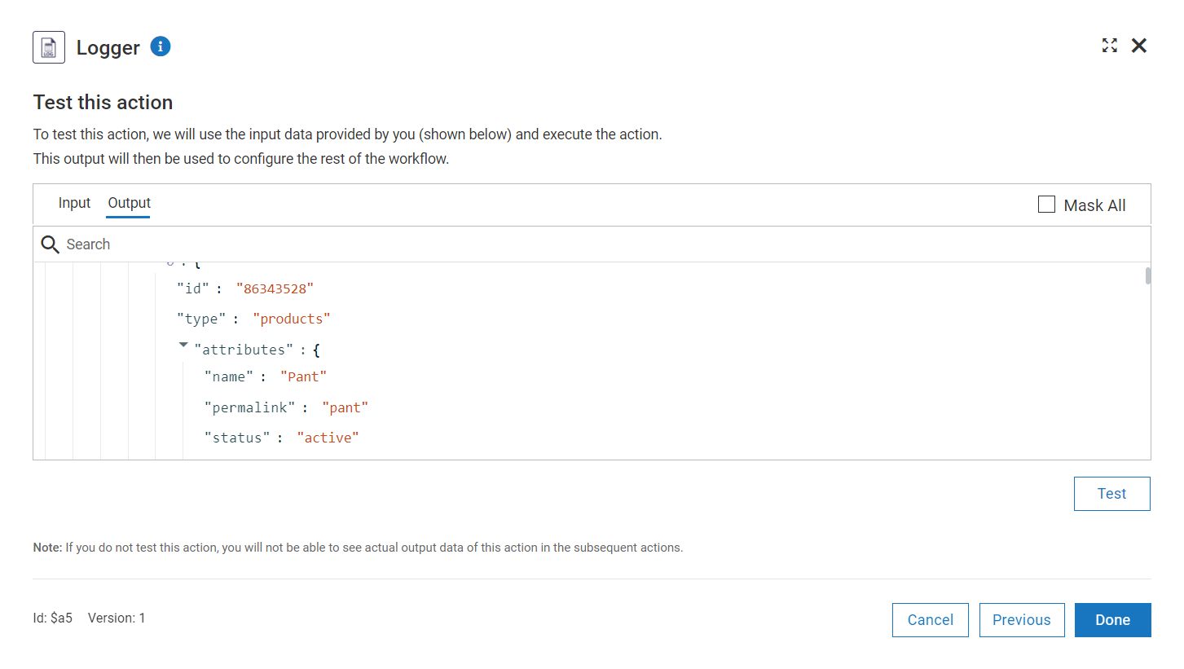
Screenshots for workflow
Workflow which helps in getting account details, product info, categories, orders, discounts and shipments details.
Select the operation to be performed by the connector.
Mapping the data for the action.
Logger information of the connecter data.

