Slide 1

DATA247 Provider
Participants: VishnuPrasath

Slide 2
<DATA247 name>
Details of Data247
What is webMethods CloudStreams Provider for <SaaS name>
Briefly explain about the backend.
Data247 is a on-demand data service platform providing carrier and Email to SMS gateway information to Email Verification and Do not call data services.
Explain about the connector and its capabilities and how it will benefit the users.
This connector helps in providing the required details to users once the known information is entered along with the type of services like carriers, email , phone etc.
This helps users by providing the information what is required for instance if the user give a phone number the details about the owner will be displayed.

Slide 3
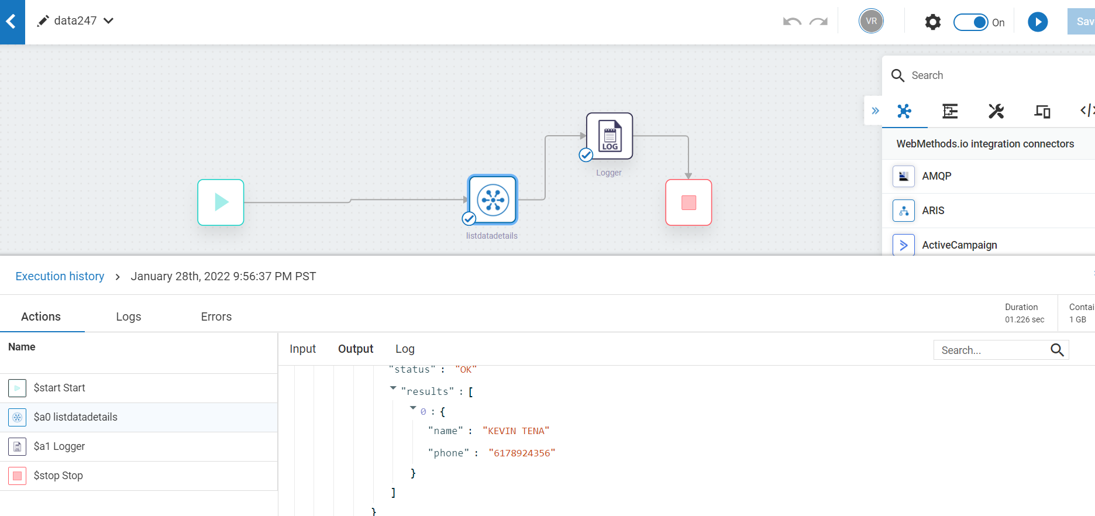
Screenshots for workflow
Screenshot of workflow (with Response json)

