Slide 1

Kochava Provider
Participants: VishnuPrasath

Slide 2
<DATA247 name>
Details of Data247
What is webMethods CloudStreams Provider for <SaaS name>
Briefly explain about the backend.
Kochava is the industry standard for secure, real-time data solutions which help people-based marketers establish identity, define and activate audiences, and measure and optimize their marketing across connected devices.
Explain about the connector and its capabilities and how it will benefit the users.
This connector helps in getting the real time data or track the information from the apps that’s been created to the users.

Slide 3
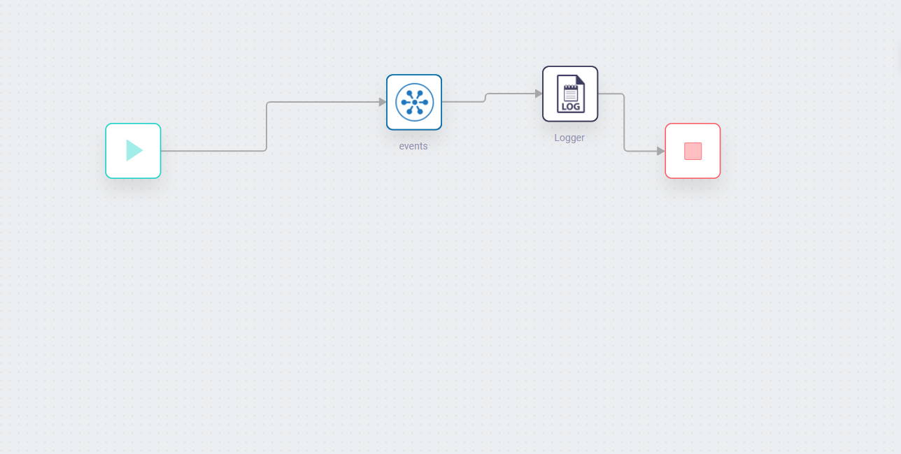
Screenshots for workflow
Screenshot of workflow (with Response json)

