Slide 1


MoneyBird Provider
Participants: VishnuPrasath

Slide 2
MoneyBird
Details of MoneyBird
What is webMethods CloudStreams Provider for MoneyBird
Briefly explain about the backend.
Moneybird offers entrepreneurs an online accounting tool for managing their finances. Features include creating invoices, storing purchase invoices, scanning receipts and sending quotes. All financial information is collected and enhanced with information from bank statements to create accounting reports..
Explain about the connector and its capabilities and how it will benefit the users.
This connector helps in providing the account information of the customer.

Slide 3
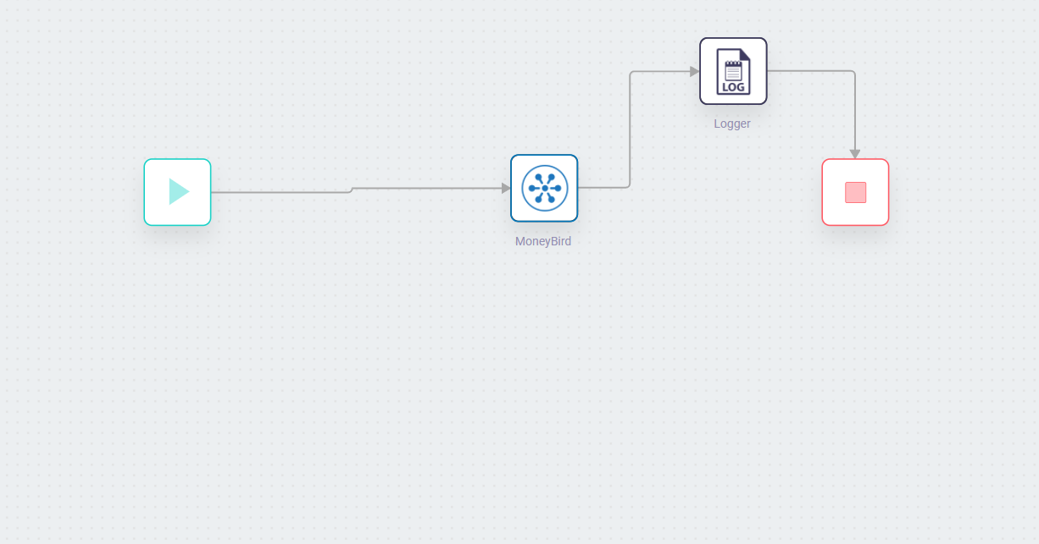
Screenshots for workflow
Screenshot of workflow (with Response json)

