Slide 1
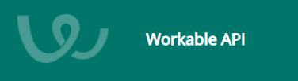
Workable Provider
Thamaraiselvi T
Participants:

Slide 2
Workable Provider
Workable Provider Details
What is webMethods CloudStreams Provider for <SaaS name>
Workable is a world’s leading recruiting software that finds and hires the right person for every job.
Since 2012, the world’s best companies have depended on Workable to find and hire the people they depend on.
Workable API displays your positions in different ways, or to extract additional information from your Workable account
Explain about the connector and its capabilities and how it will benefit the users.
Workable API allows you to extract information about your:
account
hiring members and recruiters
pipeline stages
jobs and questions

Slide 3
To Be Continued..
scheduled events
job's and/or candidate's activity
Manage your candidates by:
Fetching candidates
Extracting detail candidate info
Creating candidates
Updating candidates
Execute various actions on candidates e.g. copy, relocate or disqualify
Adding comments or ratings
Refer link https://workable.readme.io/v3/docs

Slide 4
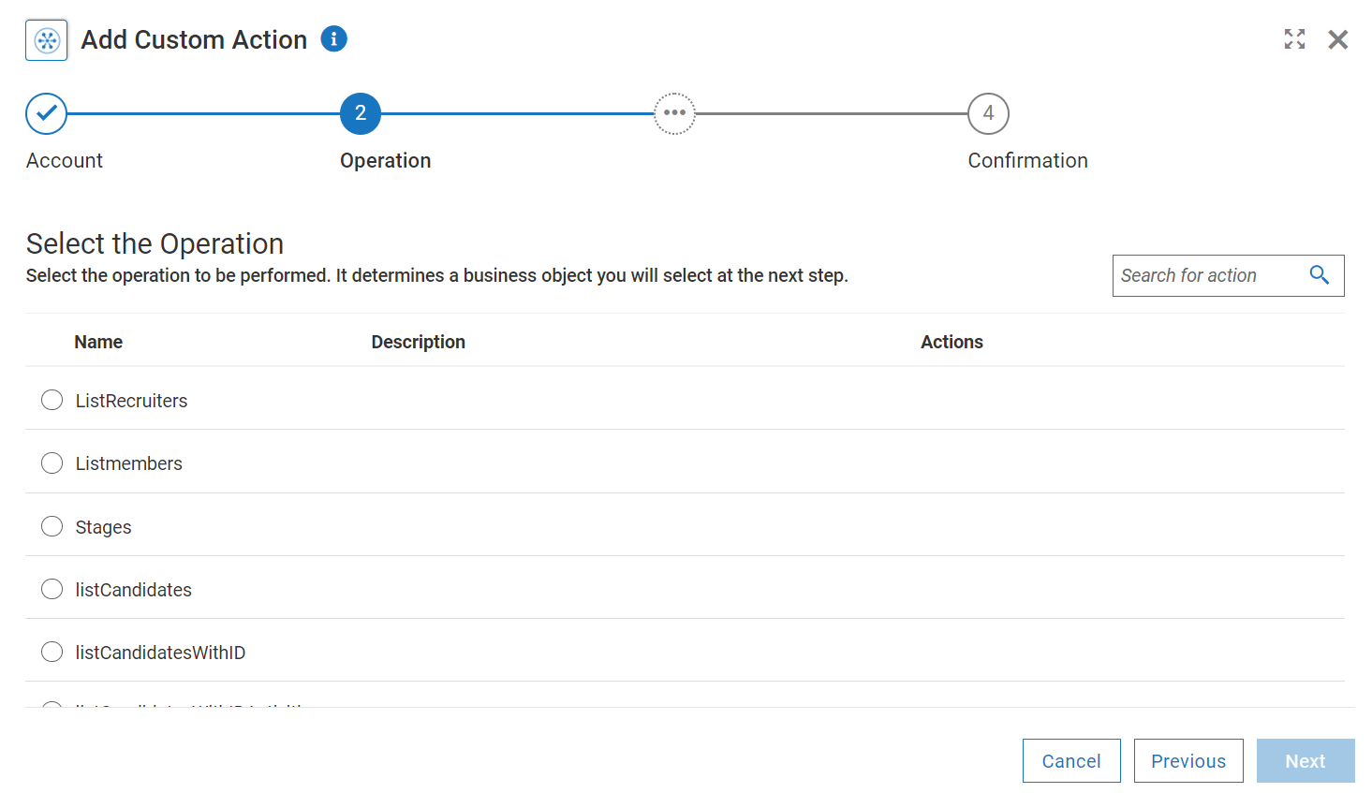
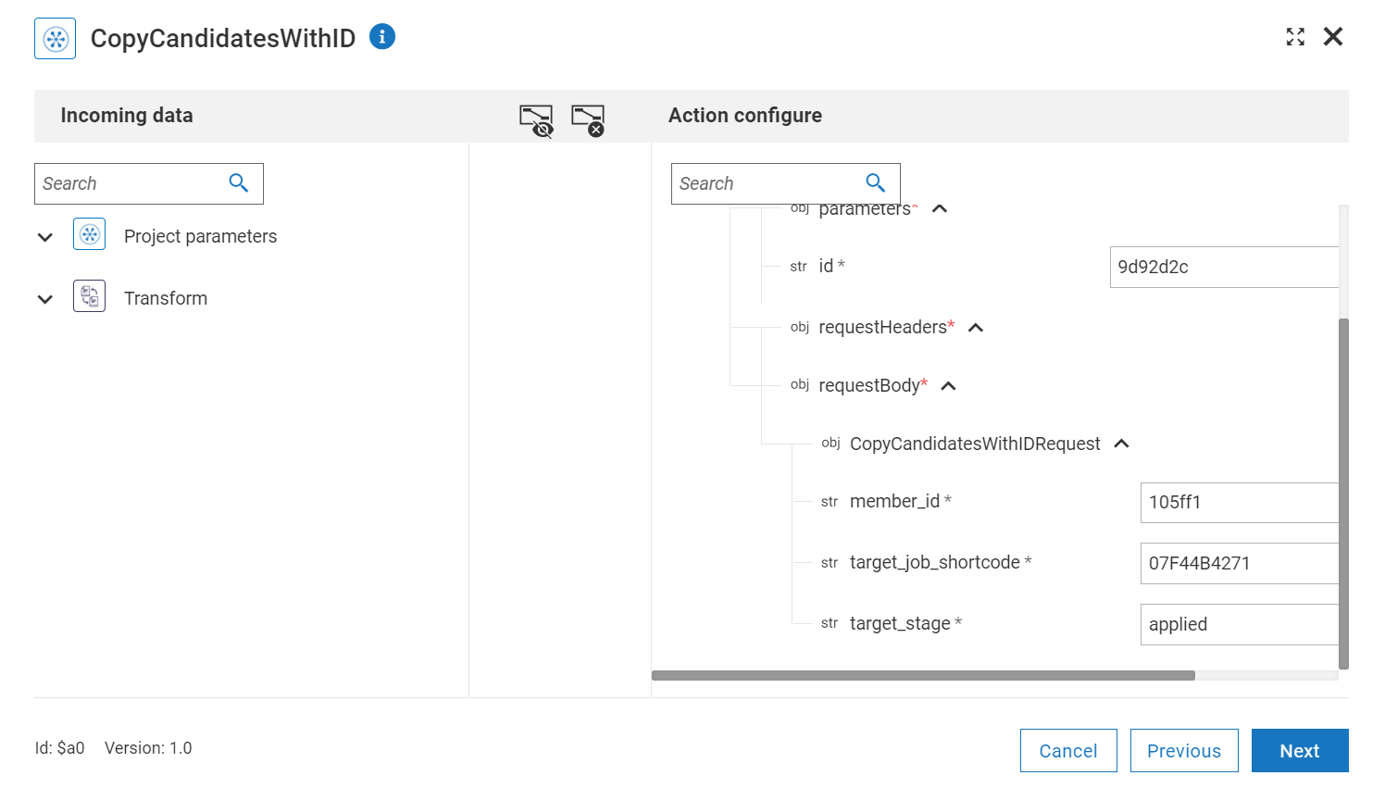
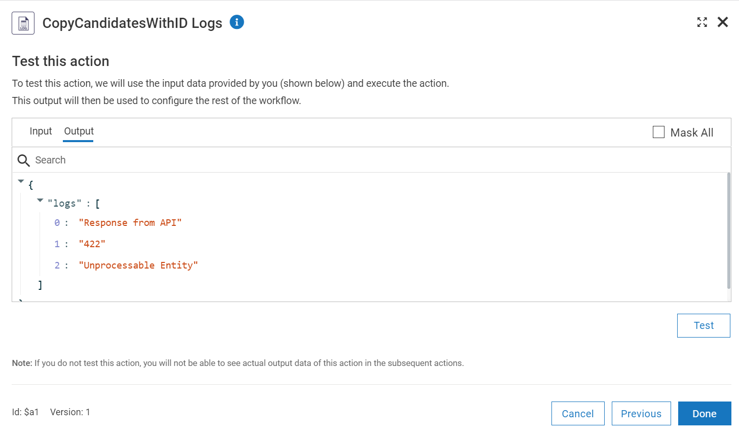
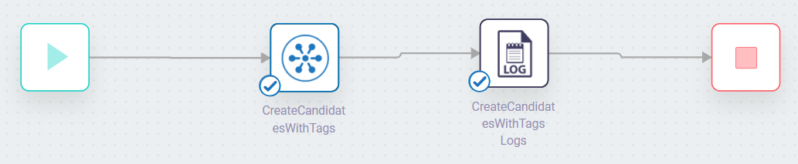
Screenshots for workflow
Workflow which helps in getting the account, recruiters, Jobs and Candidate details and Create/Update the Candidates details with various aspect's
Select the operation to be performed by the connector.
Mapping the data for the action.
Logger information of the connecter data.

