Slide 1
MeisterTask Provider
Participants:
UDHAYA KUMAR S
BHARATHI PRIYA TS

Slide 2
MeisterTask
What is webMethods CloudStreams Provider for MeisterTask
MeisterTask is an intuitive tool for project management and task management. It is ideal for your personal organization, but also for agile and efficient teams.
Whether you want to manage projects and tasks of all kinds or create clear to-do lists and checklists, with its versatile functions and flexible Kanban boards, MeisterTask offers everything you need to work together with your team to make workflows much more efficient.
MeisterTask Cloudstream connector has the capabilities to create new project/task as well as get all projects/tasks from MeisterTask application. Hence a webMethods.io application can interact with MeisterTask and can perform all functionalities through this connector for project management.

Slide 3
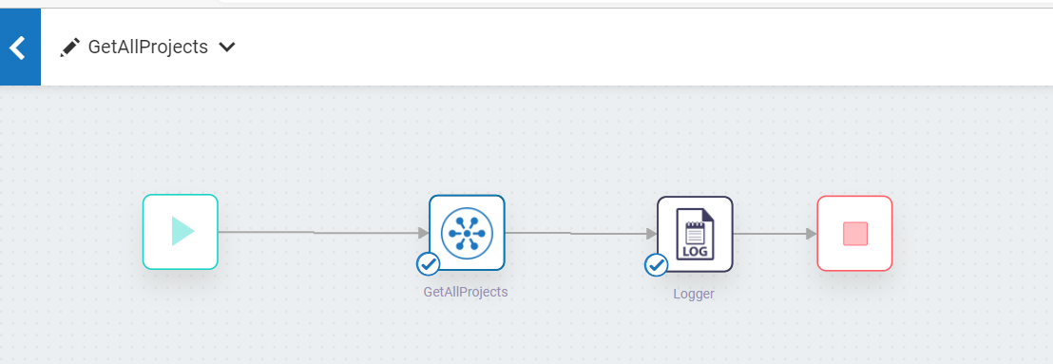
Screenshots for workflow
MeisterTask

