Slide 1
Lightspeed Retail API Provider
Participants:
Umamaheswari Hanchanahal

Slide 2
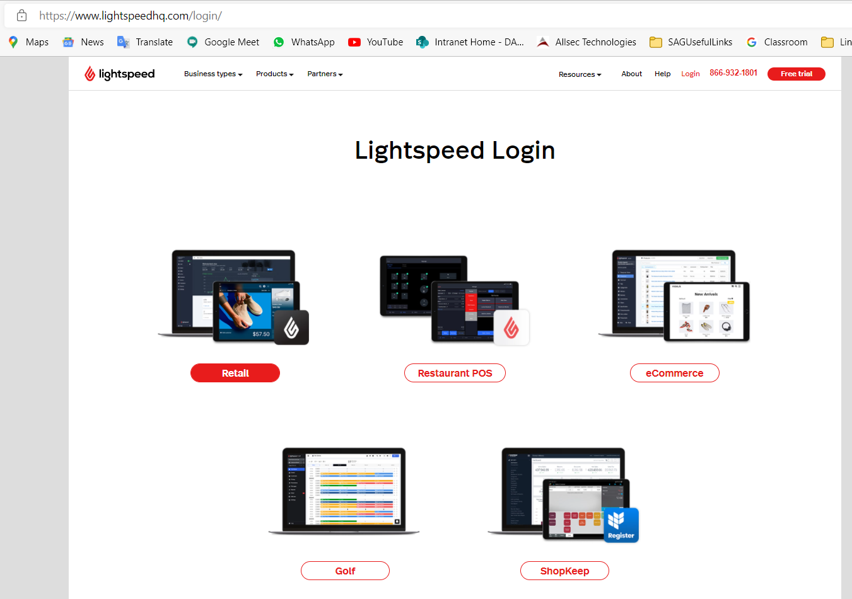
Lightspeed Retail
What is webMethods CloudStreams Provider for Lightspeed Retail
How to manage Store(Online and In-Store) remotely and still get real time information about various assets about Retail Shop
Solution: Lightspeed Retail
You own a business and want to manage with great
features - become Lightspeed Retail POS merchant.
Lightspeed Commerce provides an all-in-one,
cloud-based point of sale platform:
Retail,
Restaurant POS
eCommerce
Golf
ShopKeep
Solution for Demo – Lightspeed Retail

Slide 3
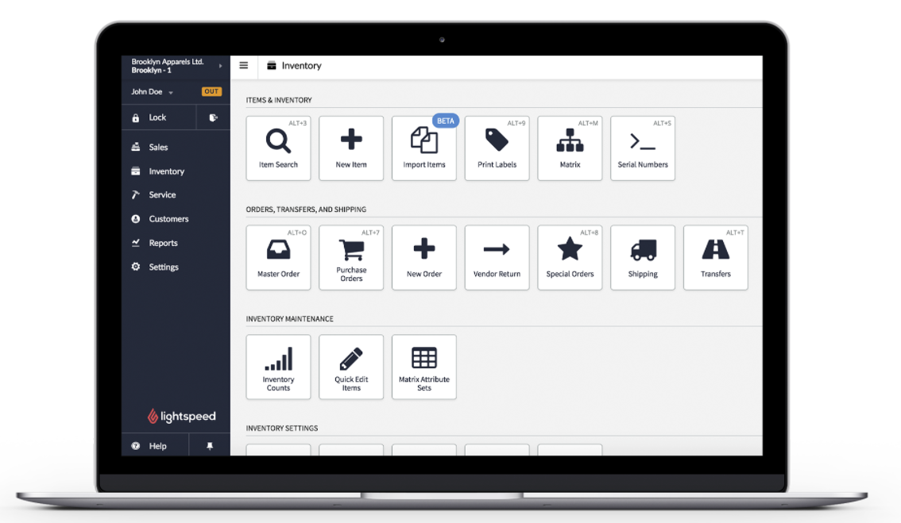
Lightspeed Retail
Benefits for users:
Roles (like store employee, store manager) based actions/APIs
Additional features for Shop owners and managers Manager tab, such as inventory management, reports and settings
Various ways of accessing account like from browser, as mobile app
Security – OAuth2
Pagination – results returned (Max 100 objects)
Load Relations
Data formats Supported –
XML or JSON

Slide 4
List of workflows covered
Inventory Item Operations:
Create Item
Update Item
Delete Item
Get All Items
Get ItembyID

Slide 5
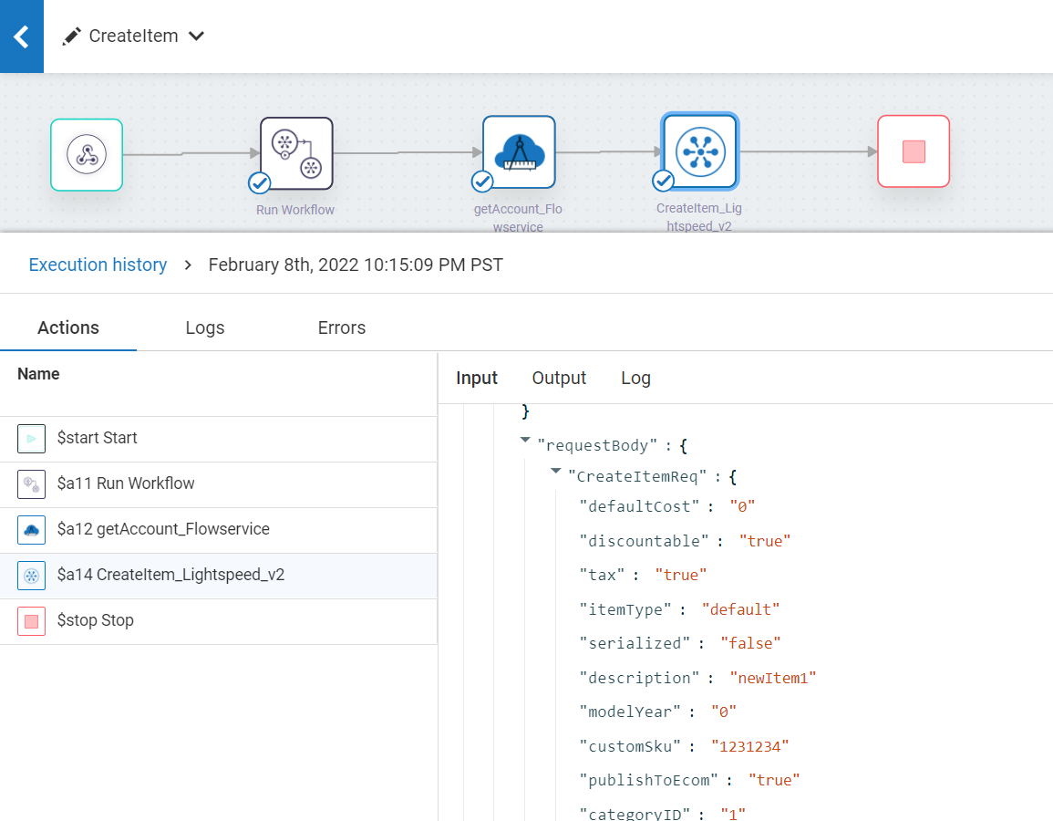
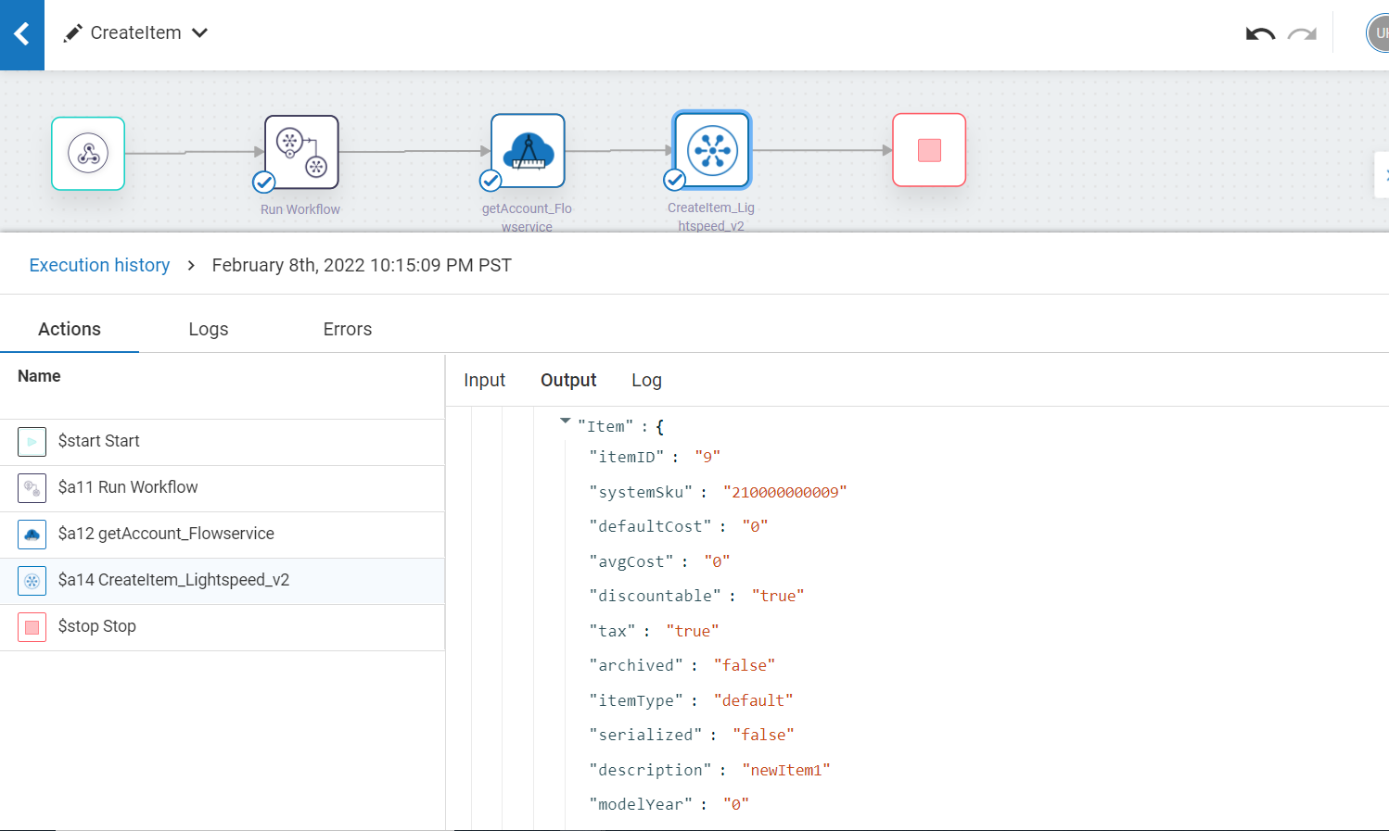
Screenshots for workflow
Create Item

Slide 6
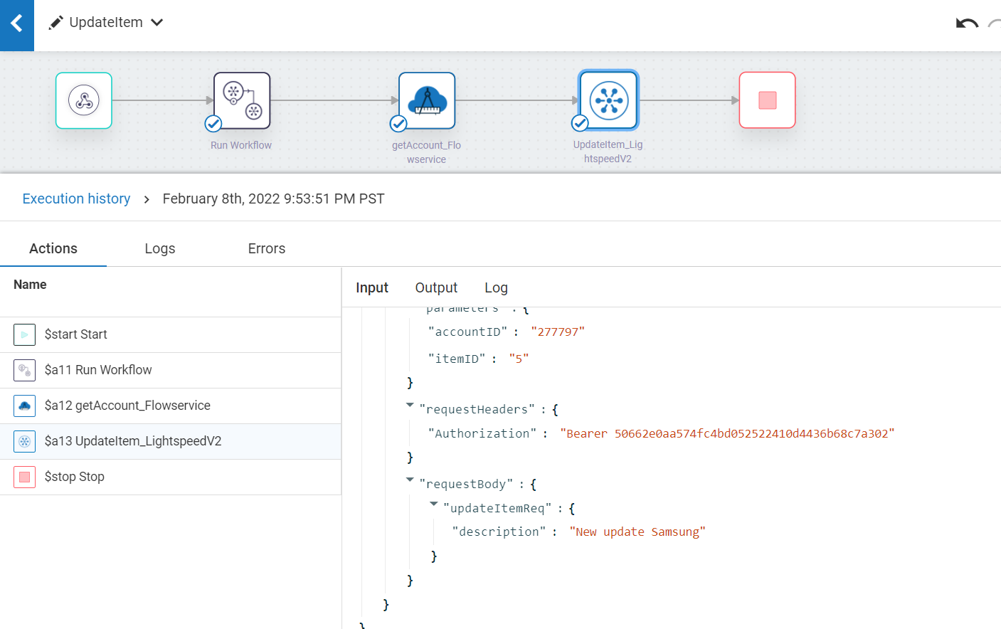
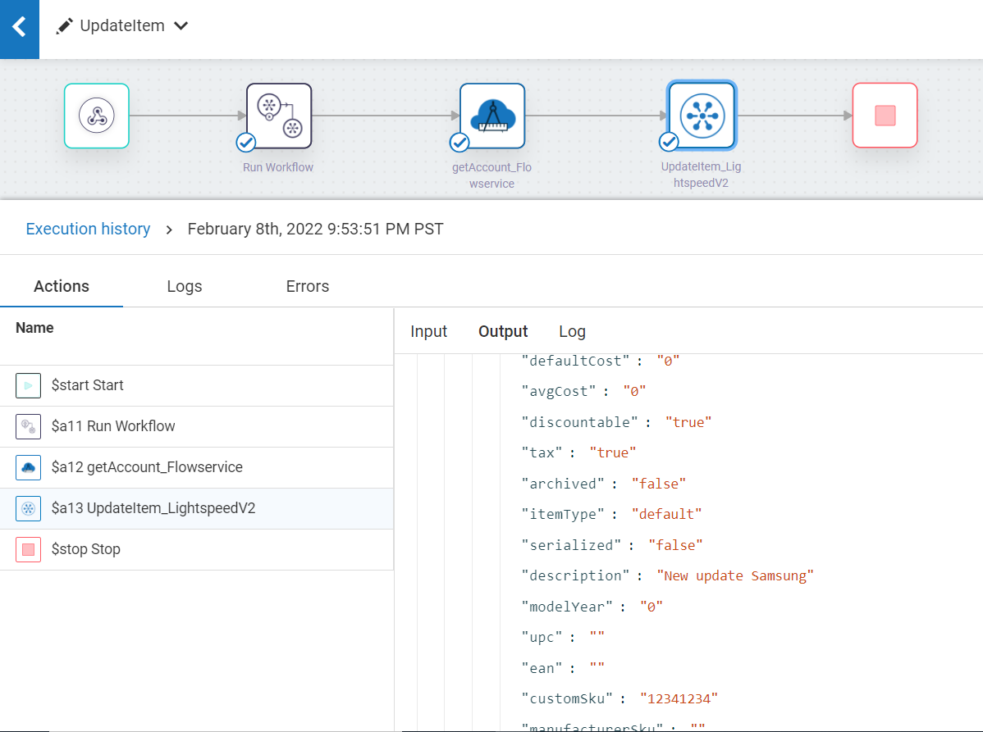
Screenshots for workflow
2. Update Item

Slide 7
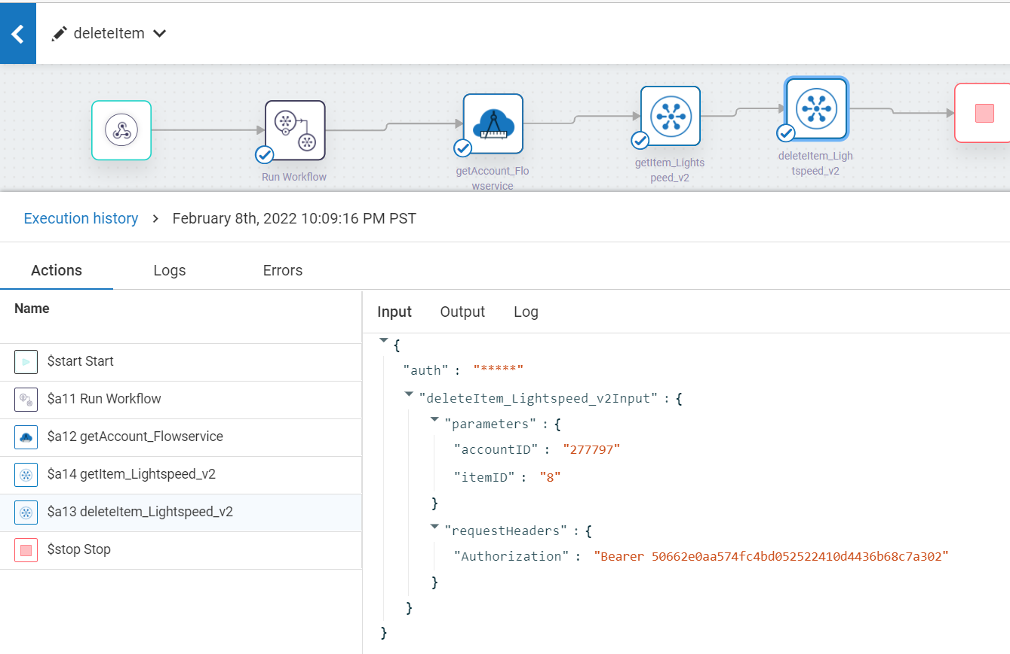
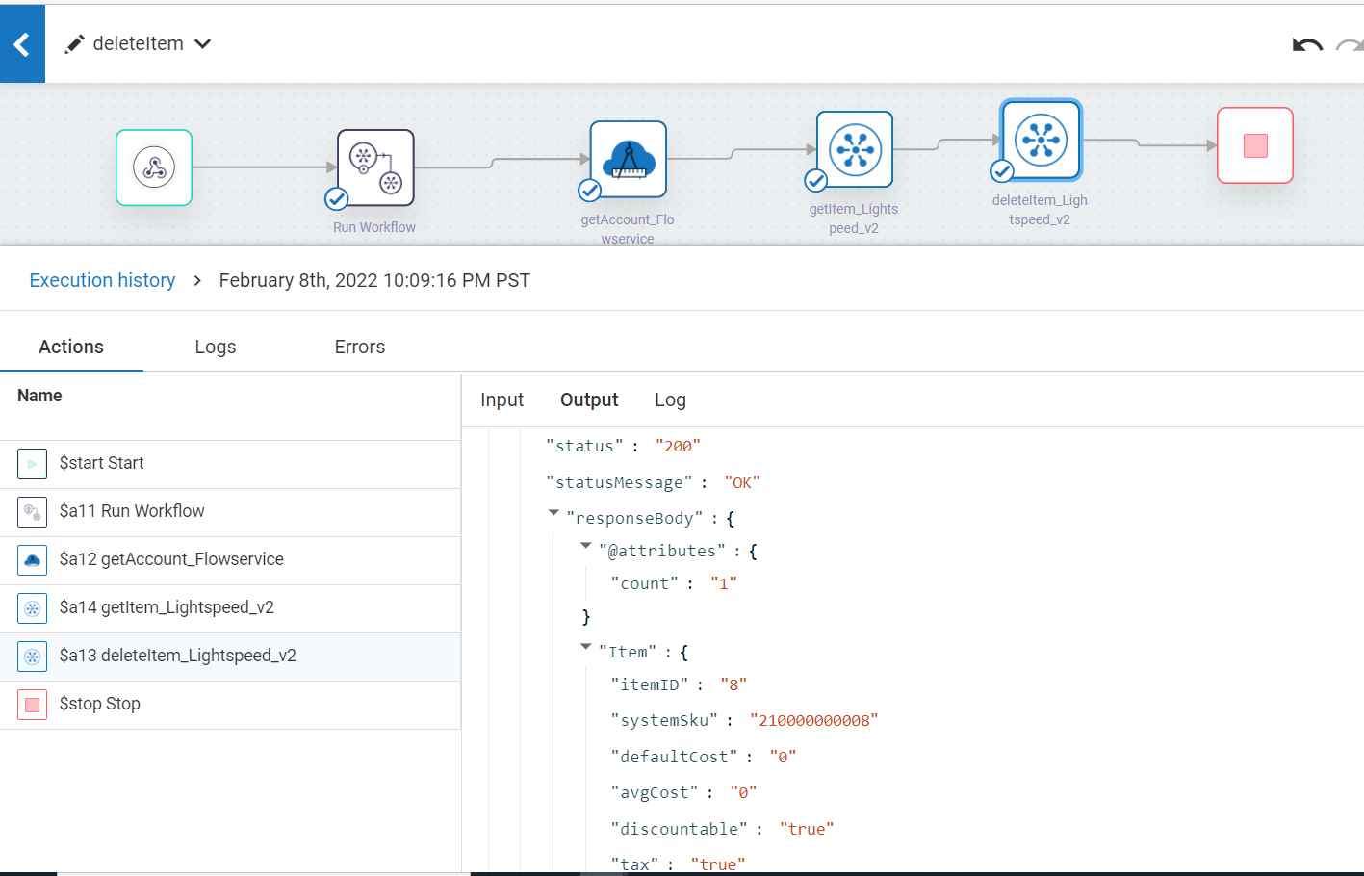
Screenshots for workflow
Delete Item

Slide 8
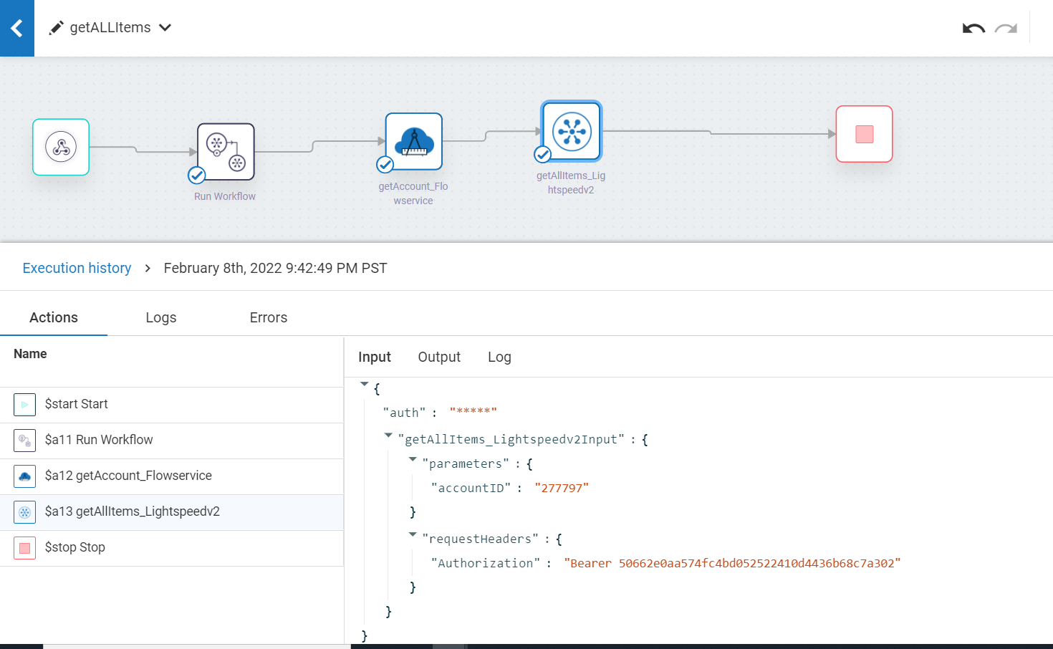
Screenshots for workflow
4. Get All Items

Slide 9
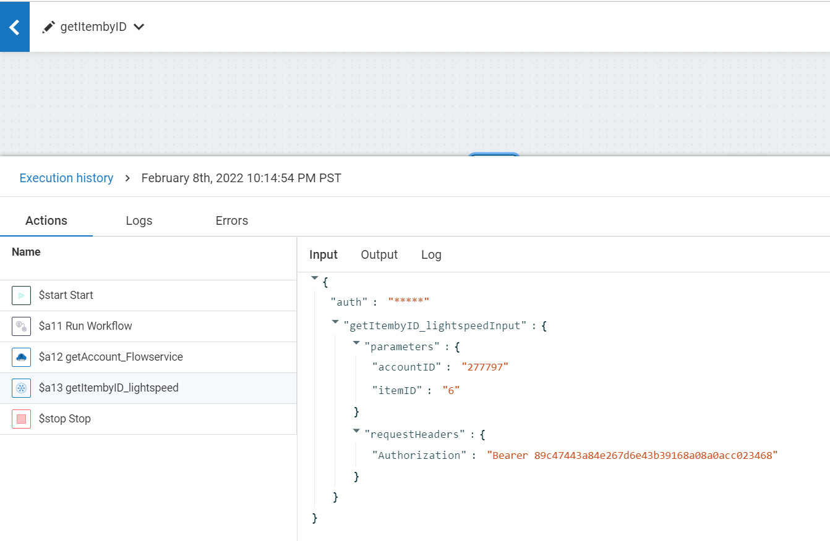
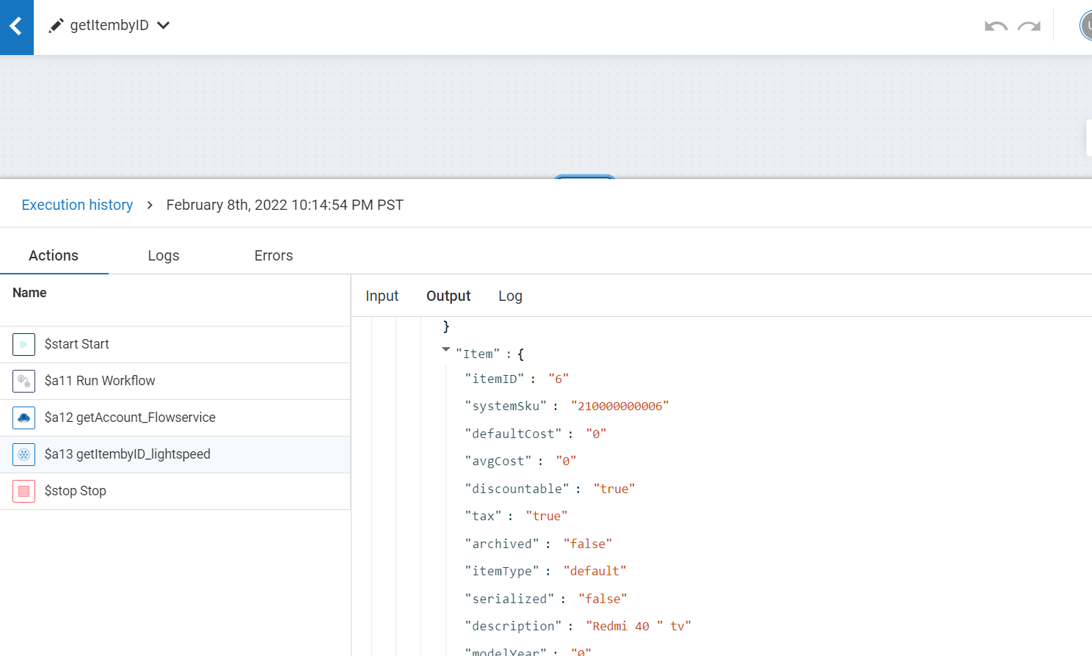
Screenshots for workflow
Workflows Covered
5. Get Item

