Slide 1

bexio Provider
Participants:
Natarajan Ramachandran

Slide 2
bexio
What is webMethods CloudStreams Provider for bexio
bexio provides a contact management platform that helps anyone to easily manage the contact information of customer, suppliers and other partners.
This connector is build using “webMethods cloudstreams provider” in Designer.
Connector capabilities :
REST Connector
0Auth 2.0 is used as the authentication
Request/Response is in JSON format
Handles various response code (200,201,400,401,404,422)
Benefits :
Easy to connect to the SAAS provider and to manage the contacts using CRUD operations
Provides pagination/limits to control the number of records being fetched

Slide 3
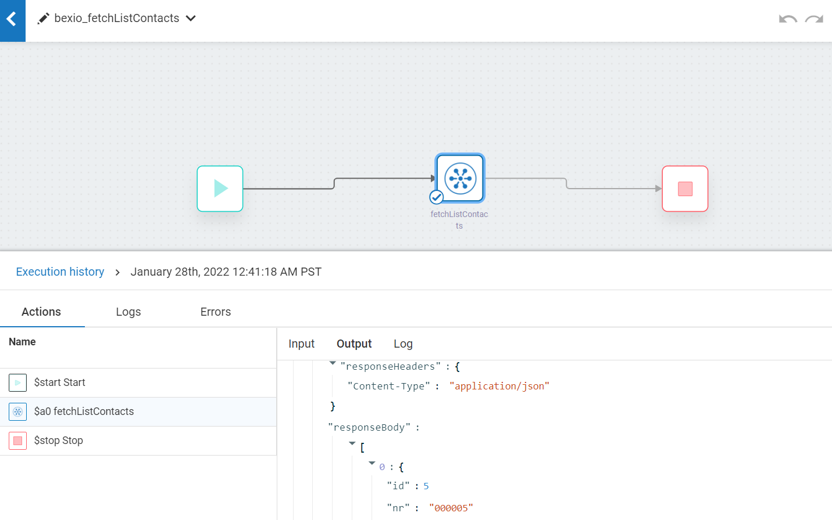
Screenshots for workflow
fetchListContacts

Slide 4
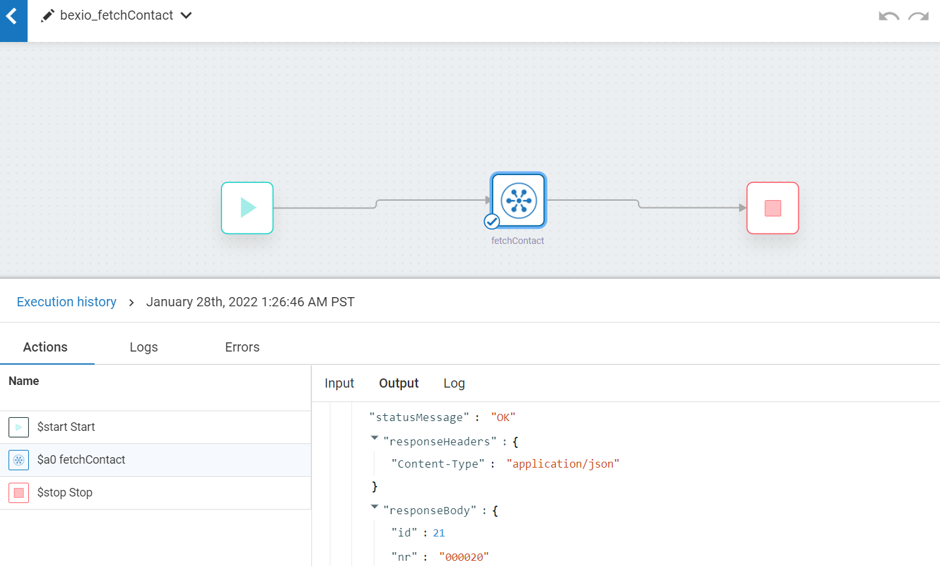
Screenshots for workflow
fetchContact

Slide 5
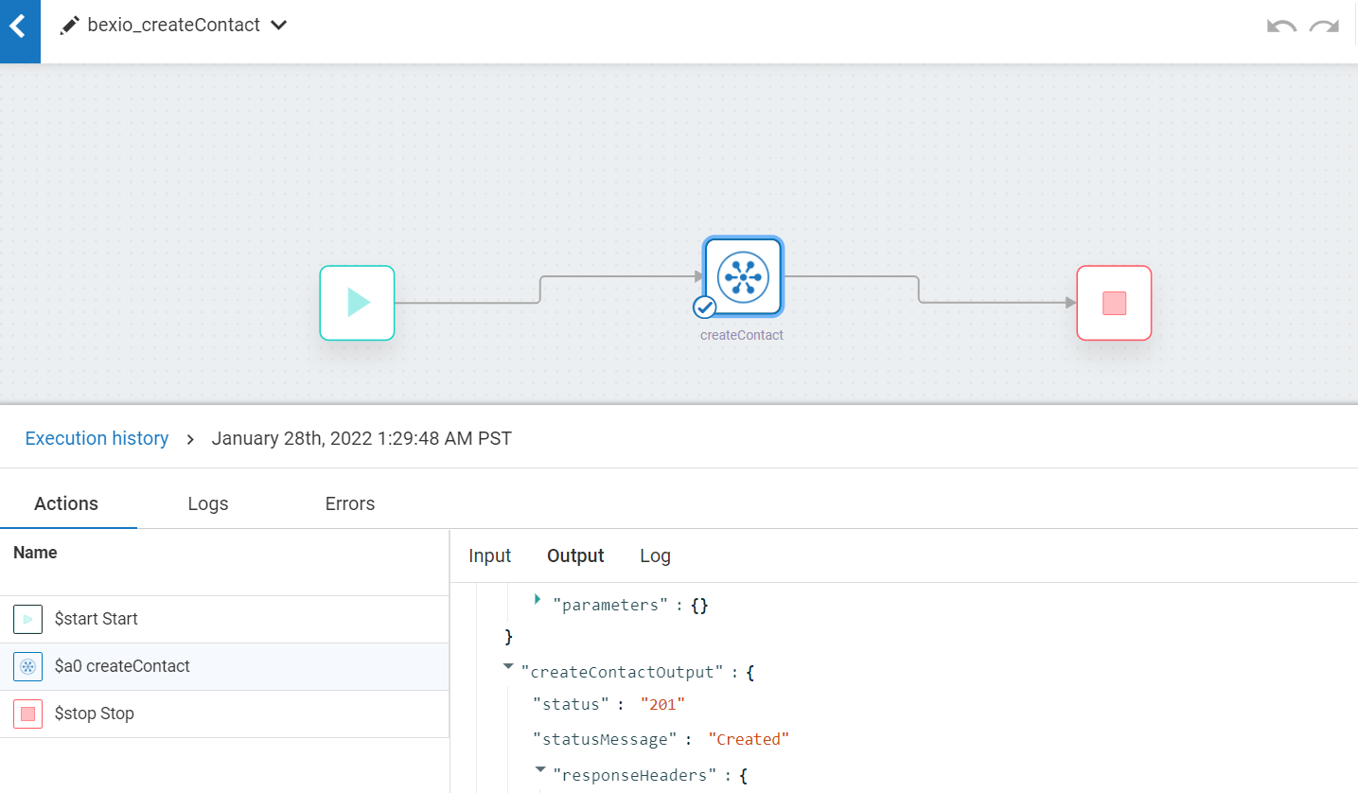
Screenshots for workflow
createContact

Slide 6
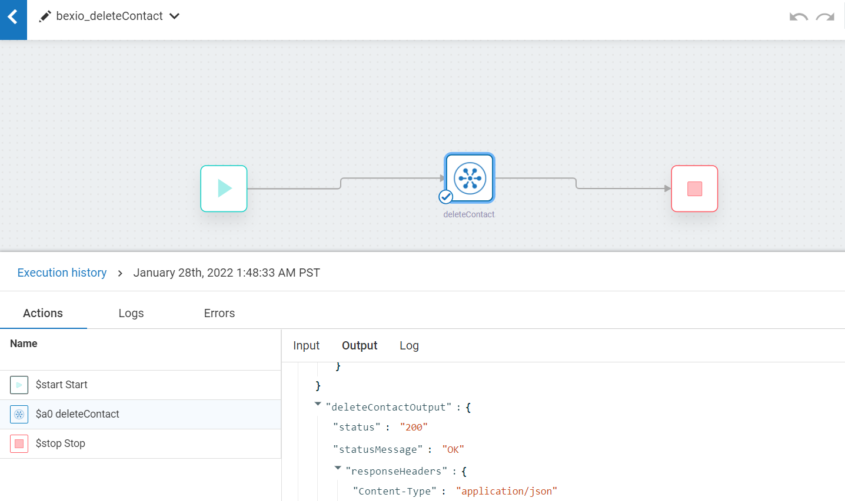
Screenshots for workflow
deleteContact

Slide 7
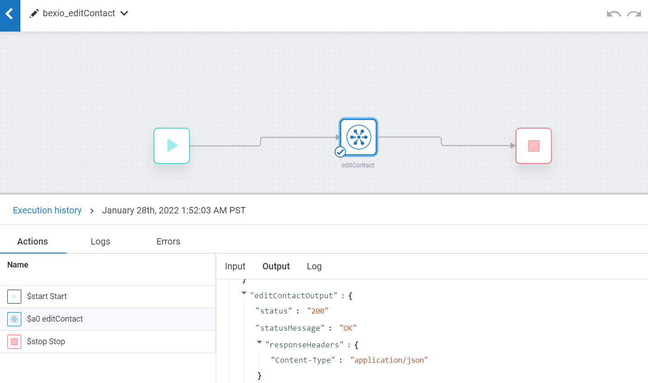
Screenshots for workflow
editContact

Slide 8

Screenshots for workflow
searchContacts

Slide 9
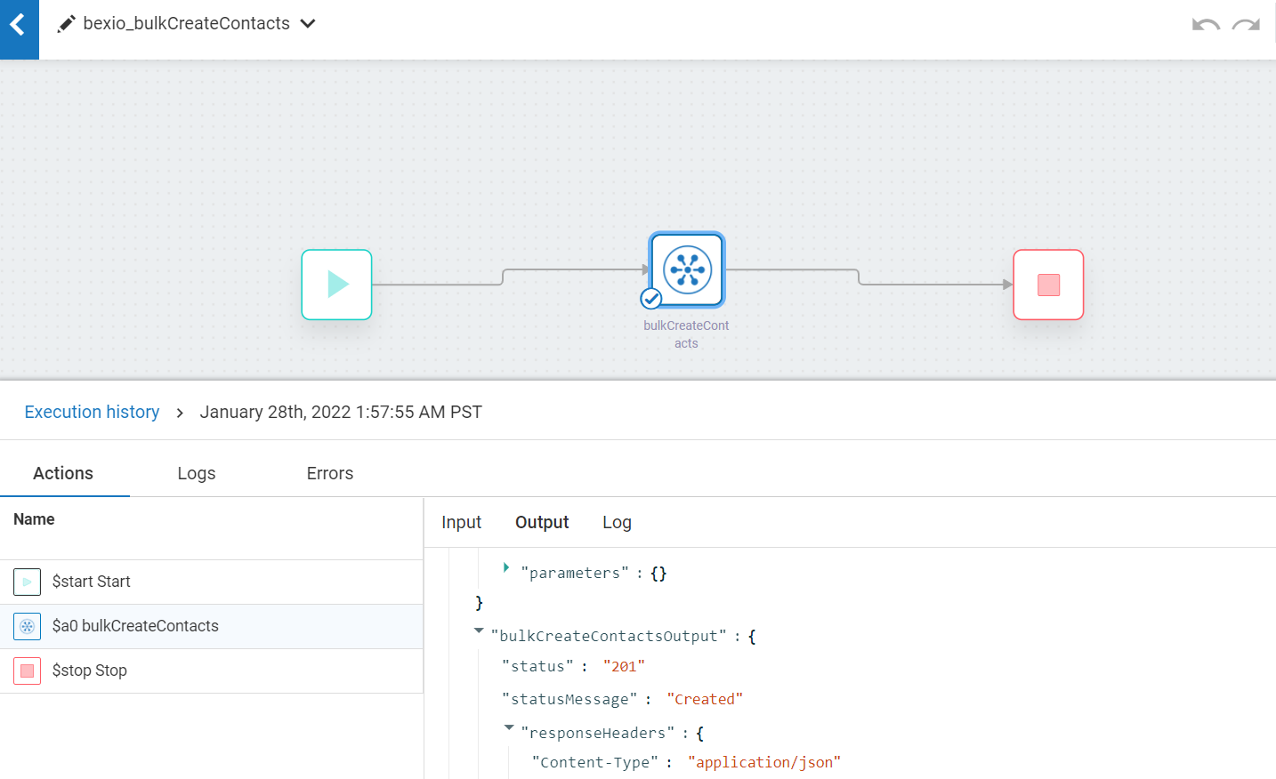
Screenshots for workflow
bulkCreateContacts

