Slide 1

Recruitee Provider
Participants:
Neha Alladi

Slide 2
Recruitee Provider
What is webMethods CloudStreams Provider for Recruitee
Recruitee is a business producing or selling computer "software as a service"(Saas.) The software functions as an applicant tracking system for handling applications for jobs.
It is the collaborative hiring software that delivers the complete solution to help internal HR teams work with the rest of their organization to hire better together.
It includes a careers site editing system for employer branding, a plugin for sourcing (personnel) (otherwise called recruitment), employment website integration, email and calendar synchronization.
With an easy-to-use interface, Recruiter and the Recruitee find it easy to navigate through intuitive UX to build custom pipelines, attract and source top talent, evaluate candidates, and hire future team members. Recruitee provider application allows create the connectors to perform various Recruitment related task like creating, updating, deleting, viewing job offers, candidates, departments along with scheduling the interviews, releasing the offers etc.

Slide 3
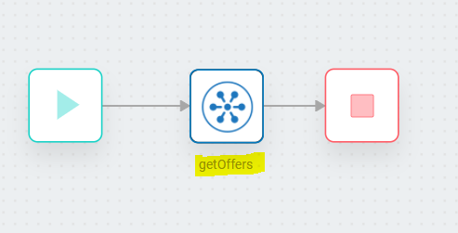
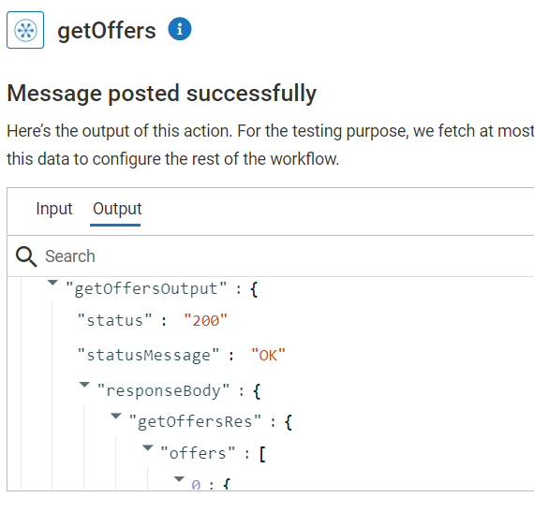
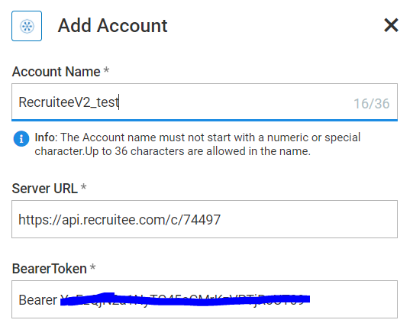
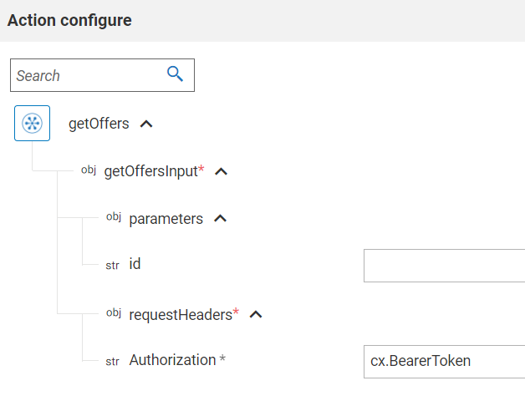
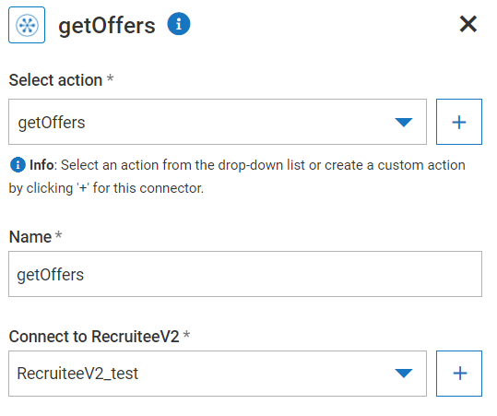
Screenshots for workflow
Workflow to invoke Recruitee ‘GetOffers’ API
GetOffers workflow is created to retrieve all the job openings available along with all the job details and description.
getOffers action is created.
RecruiteeV2_test user account is created to connect with the resource while executing the action.
Bearer Token has to be passed in ‘Authorization’.
Additionally input parameters can be passed if required.
Response 200 has been returned as result.

