Slide 1



Wm.io Splitwise Provider
Srinidhi B A

Slide 2
Splitwise
webMethods.io Connector for SAAS Splitwise
What is webMethods CloudStreams Provider for Splitwise
It enables, webMethods.io connectivity with SAAS Splitwise. Splitwise is a free tool for friends / roommates to track bills and other shared expenses, so that everyone gets paid back.
Capabilities of wm.io splitwise Connector
To establish OAUTH 2 Connectivity with Splitwise API SAAS Provider.
Make requests to Get user or expense Information
Create new expenses
Update expenses
Delete / Undelete expenses

Slide 3
Splitwise
Benefits :
Authorize webMethods.io to manage expenses without sharing your API Key / Credentials using OAuth
Retrieve, Create, Manage, Delete expenses and share them with your Friends / Stakeholders
Schedule expenses or set criteria to create / modify expenses
Integrate with hundreds of other SAAS application Providers
Take advantage of webMethods workflows / flow services and available resources / frameworks

Slide 4
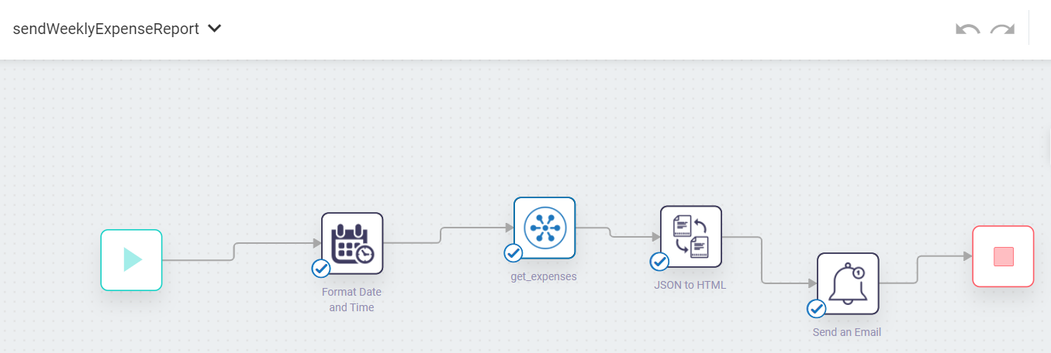
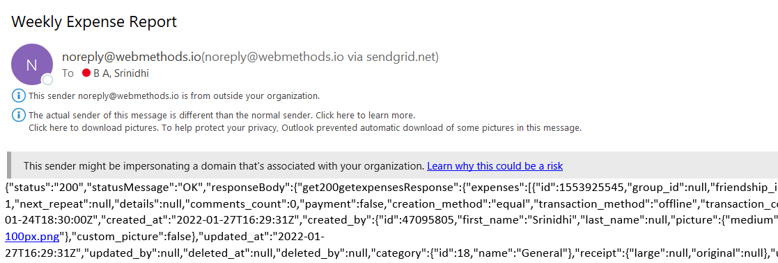
Screenshots for workflow
Workflow to Read Expenses and send a weekly Report
Get Expenses Resource
Expense Report Email

Slide 5
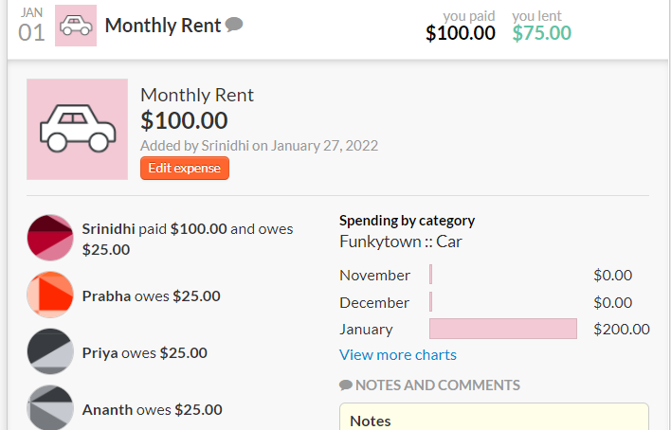
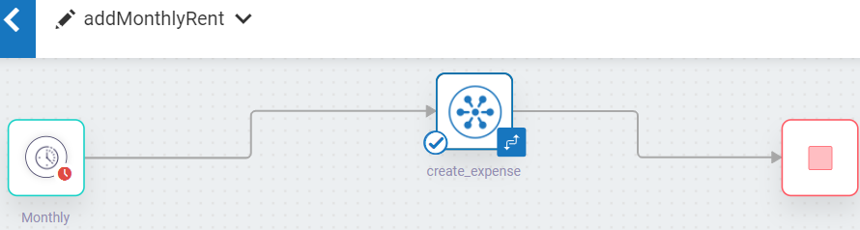
Workflow to Create Expense for Monthly Rent
Create Expense Workflow
Expense is reflected in Splitwise UI

Slide 6
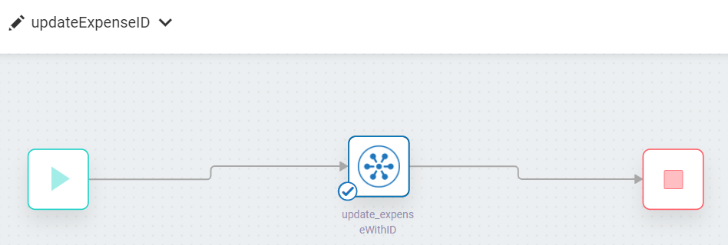
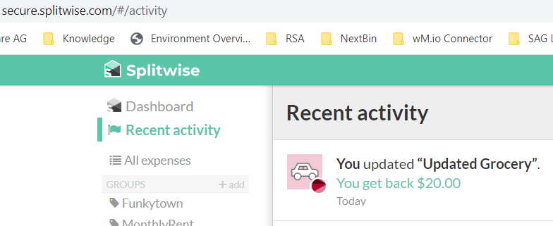
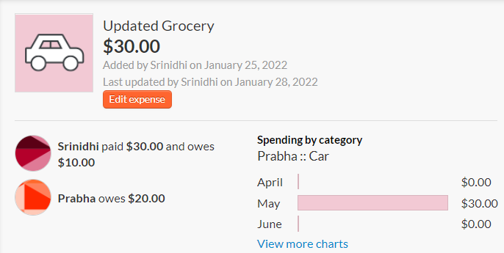
Workflow to update existing Expense
Update Reflecting in Splitwise UI (below)

Slide 7
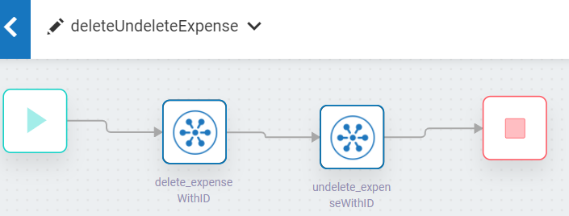
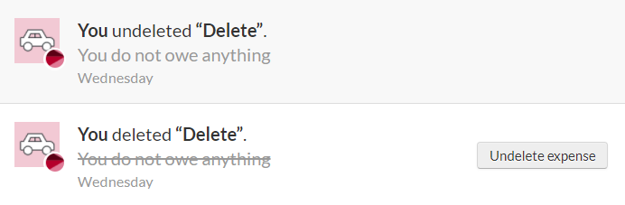
Workflow to demonstrate Delete / UnDelete existing Expense
Update Reflecting in Splitwise UI (below)

