Slide 1


Zenefits Provider
Participants:
Sirisha Kolanti
Sirisha Kolanti
Participants:

Slide 2
Zenefits Provider
What is webMethods CloudStreams Provider for Zenefits
Zenefits is a Software as a Service (SaaS) company that offers a cloud-based human resource information management (HCIM) platform to businesses for managing multiple HR services such as benefits, payroll, compliance, paid time off, health insurance, and more.
Zenefits is a well-rounded service for small to midsize businesses seeking the power and flexibility of a comprehensive platform for everything from payroll management to benefits administration.
This can be a great option for businesses seeking to manage all of their HR needs in one place, including payroll, benefits, taxes, stock options, insurance, compliance, tracking attendance and vacations.
It is useful for employees too: providing an online dashboard to access pay stubs, review and enroll in health insurance, request vacation, and review their benefits. This can allow both HR teams and employees to save significant time and money, while enjoying the experience of managing HR-related tasks.

Slide 3
To Be Continued..
Features
Zenefits offers the following features (among others):
Hiring and Onboarding
Employee Directory
HR Record Management
Company Org Chart
Customize Employee Onboarding
HR, Benefits and Payroll Reports
Data Visualization
Custom Reporting
Time Off Tracking
Compliance Assistance

Slide 4

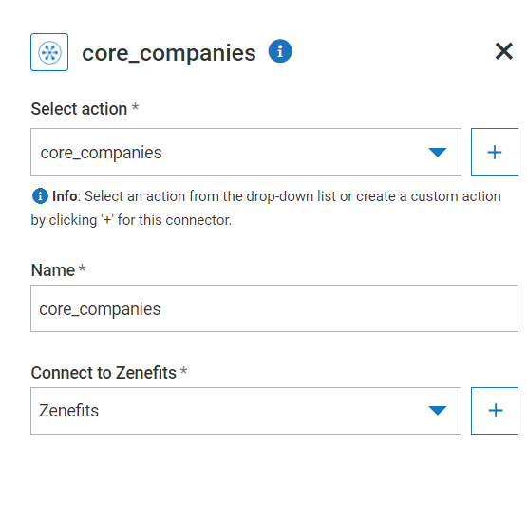
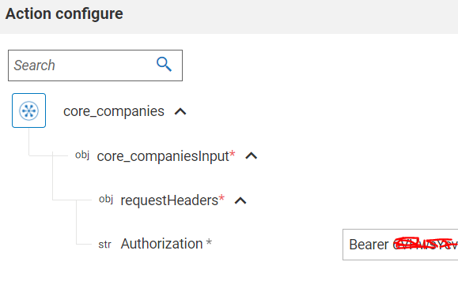
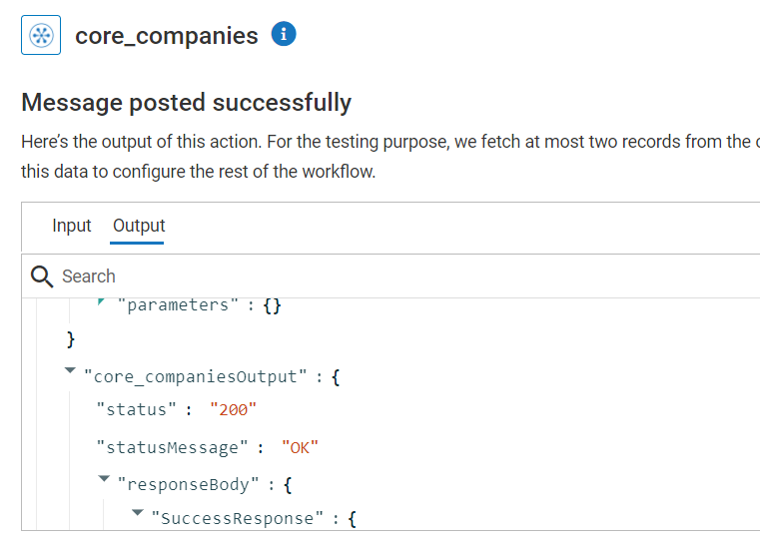
Screenshots for workflow
Workflow to invoke Zenefits ‘Core Companies’ API
Workflow has been used to get or update the company & person details, departments, employees, locations, vacations, time durations etc. from Zenefits using API.
Action Created for core_companies and connection created for Zenefits.
Bearer Token has to be passed in ‘Authorization’.
Response 200 has been returned as result.

