Slide 1

ZOHO Books Provider
Connector to Zoho Online Accounting Software
Participants:
Vageesh Shadakshari

Slide 2
Zoho Books
Online Accounting Software
What is webMethods CloudStreams Provider for Zoho Books
Zoho Books is an online accounting software that manages your finances, keeps you GST compliant, automates business workflows, and helps you work collectively across departments.
The Connector is built for handling Invoices operations on Zoho Books.
Operations teams of any organization uses multiple systems, processes and manual steps in Sales activities. All these systems can use the connector to interact with Zoho Books to create, update, delete, read the invoices.
This helps in automating manual efforts of Entering and Managing Invoices on Zoho Books Accounting app.
https://www.zoho.com/in/books/

Slide 3
API and Documentation
API
API docs: https://www.zoho.com/books/api/v3/#introduction
Zoho Books provides numerous APIs to interact with it,
It has multiple modules each containing more 10 methods, totally more than 200 methods, following are the modules
Invoices,Contacts, Expenses, Bills, Credit Notes, Debit Notes, Customer payments, Bank Accounts, Vendor Payments etc..

Slide 4
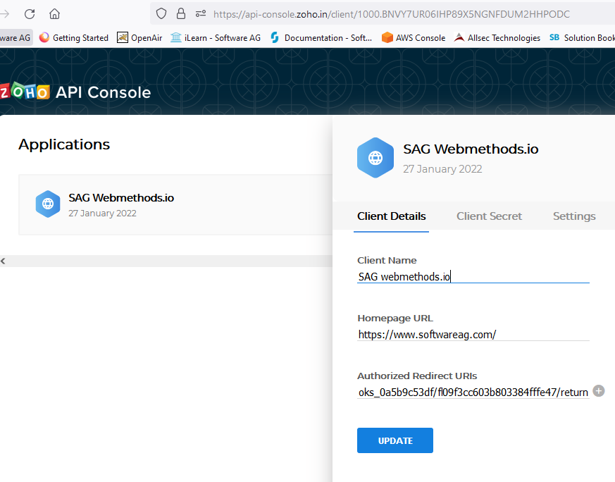
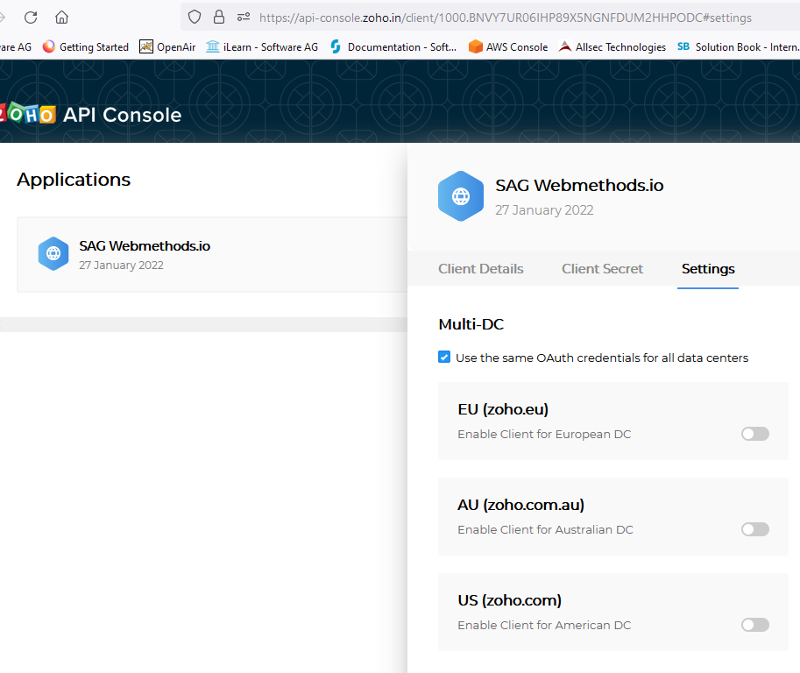
Auth
OAuth 2.0
Zoho Books supports OAuth 2.0
Prerequisites – a Zoho Account (14 day trial period available)
Zoho has 4 Datacenters across the globe, we should explicitly enable the account across all datacenters.

Slide 5
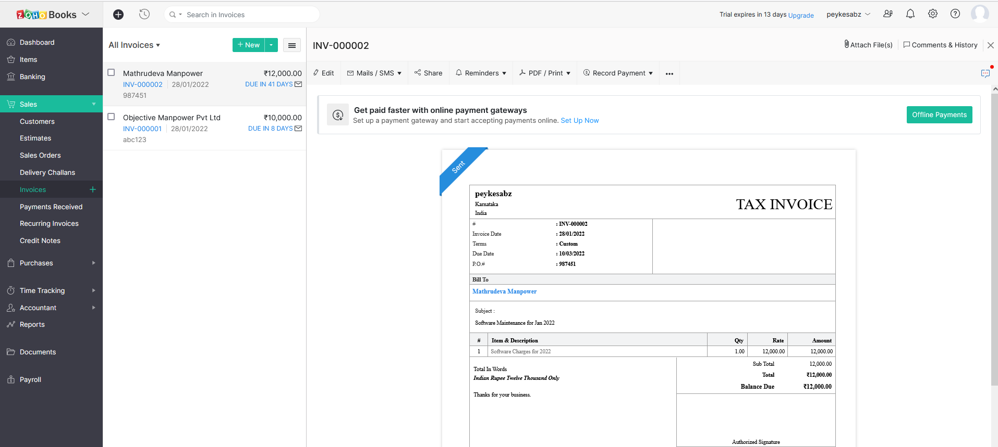
Zoho Books Invoice

Slide 6
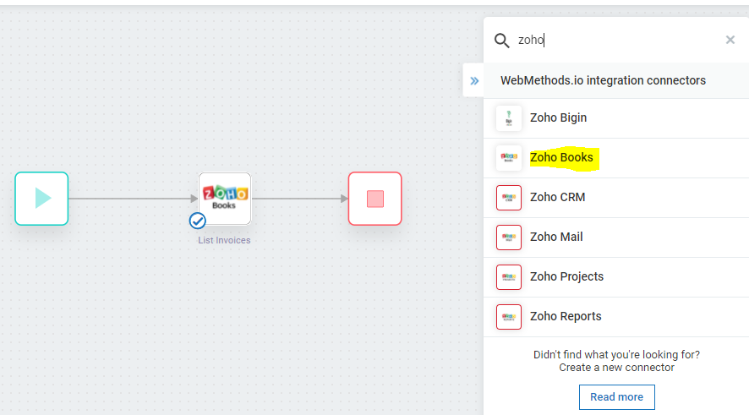
Connector Actions
CRUD on Invoices
This connector is built with Actions for CRUD operations on Invoices module
List Invoices
Get Invoice (for invoice_id)
Create Invoice
Update Invoice
Delete Invoice

Slide 7
Workflows
Workflow location: https://wmioconnectorsdev.int-az-us.webmethods.io/#/projects/fl5c79f1df6f5f5a0610e6a2/workflows

Slide 8
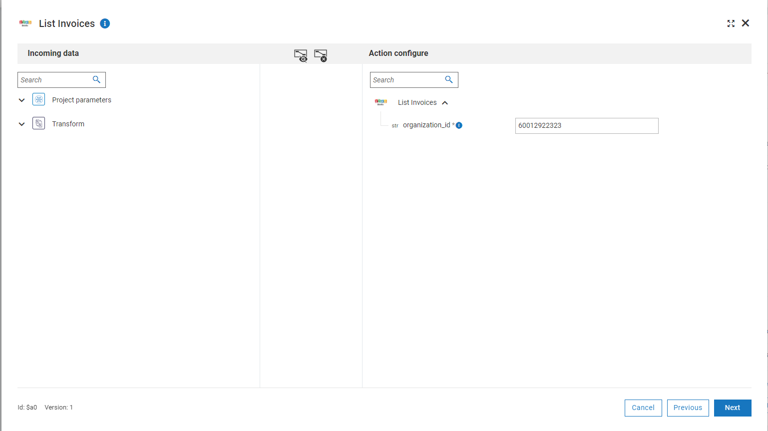
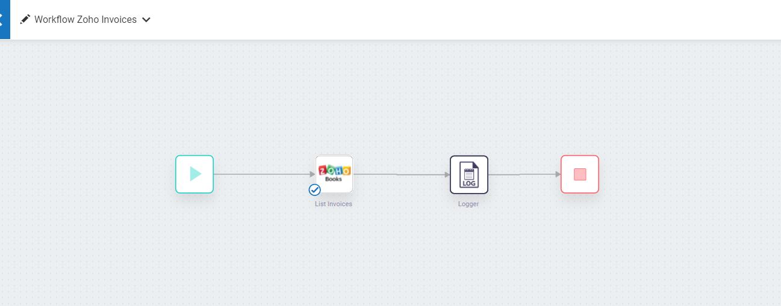
Screenshots List Invoices
Flow and Input

Slide 9
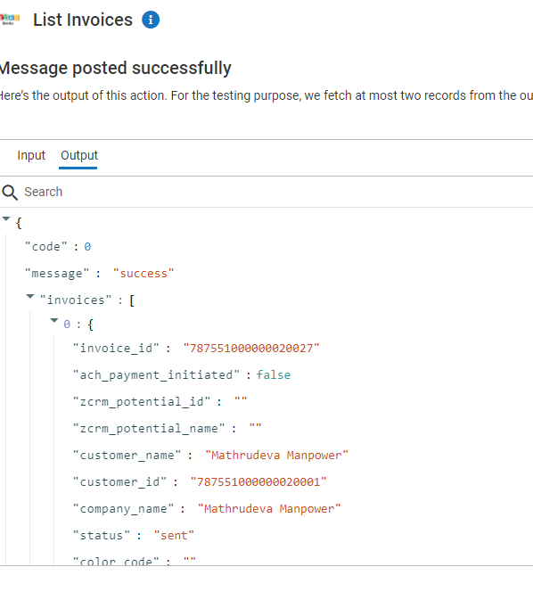
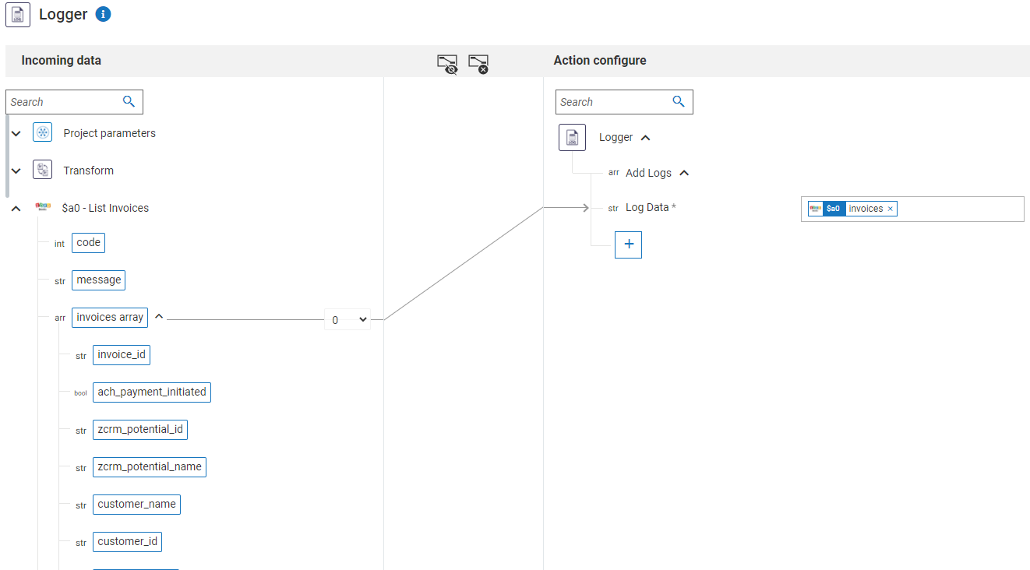
List Invoices
Output and Output Pipeline

Slide 10
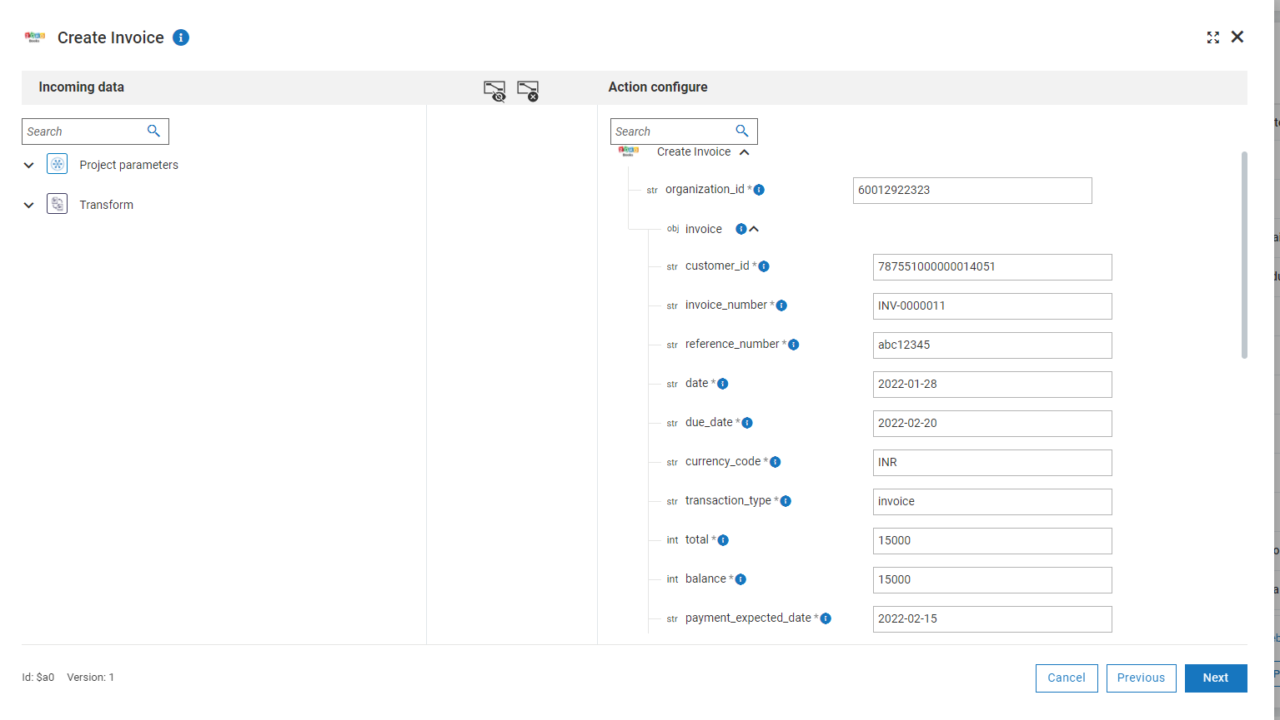
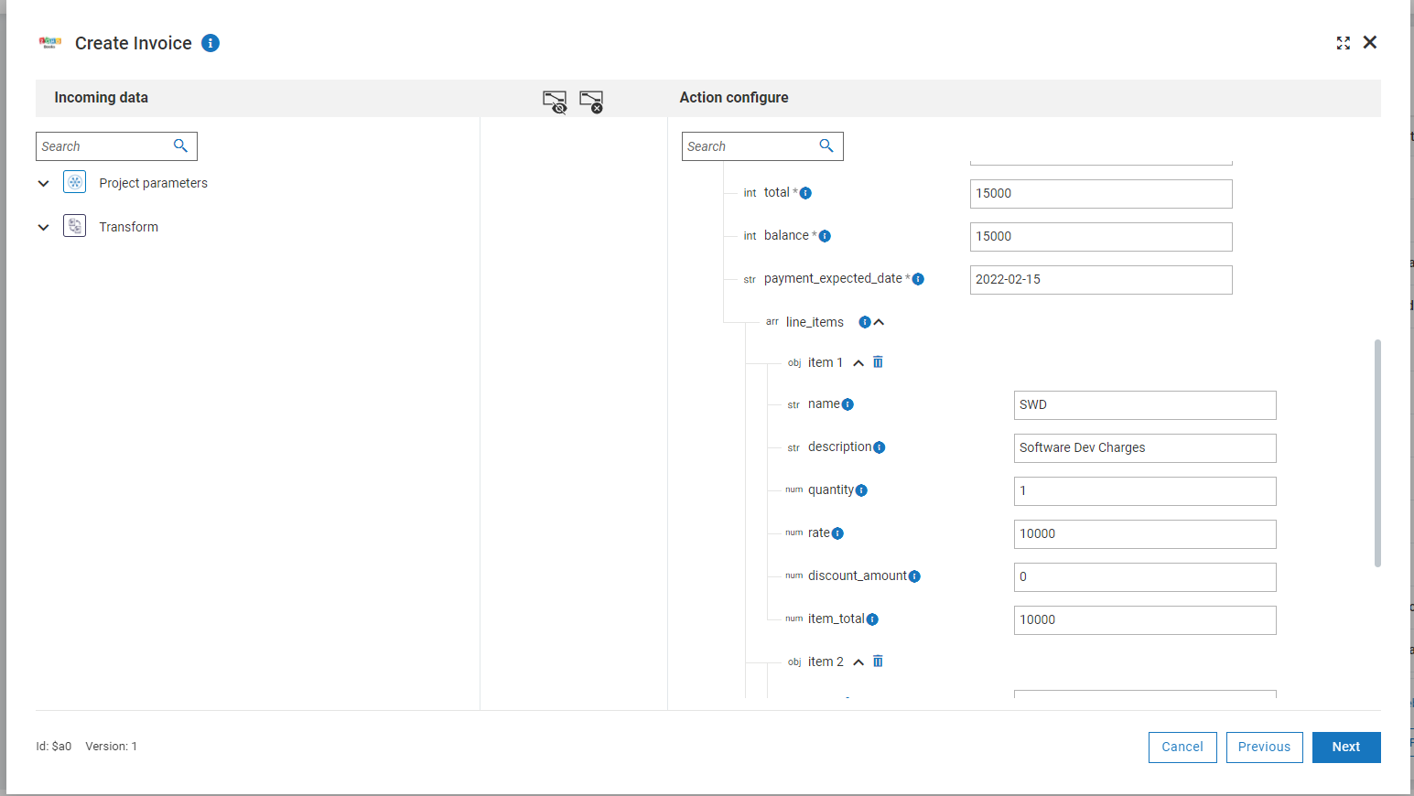
Create Invoice
Flow and Input

Slide 11
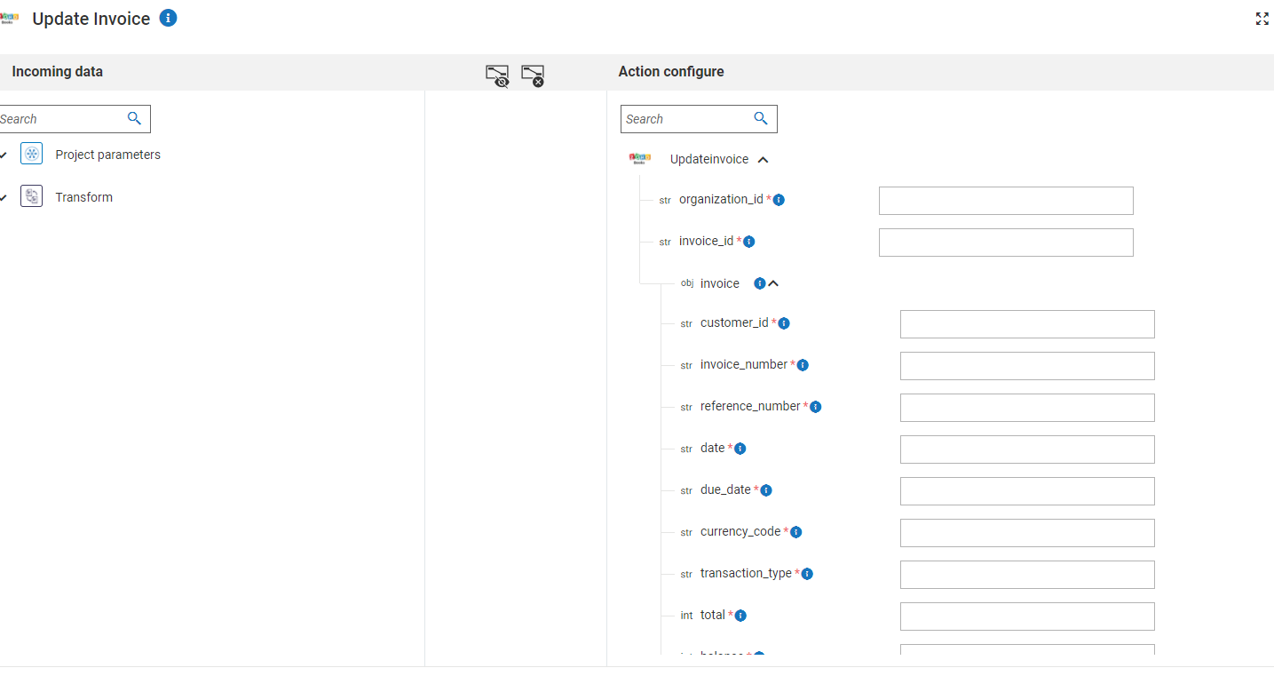
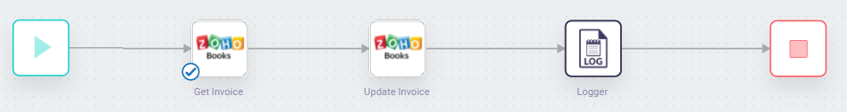
Update Invoice
Input pipeline and output

Slide 12
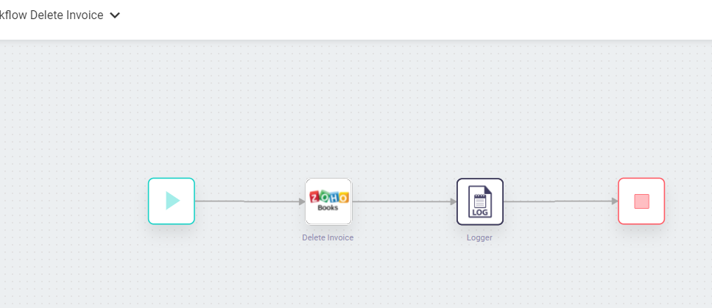
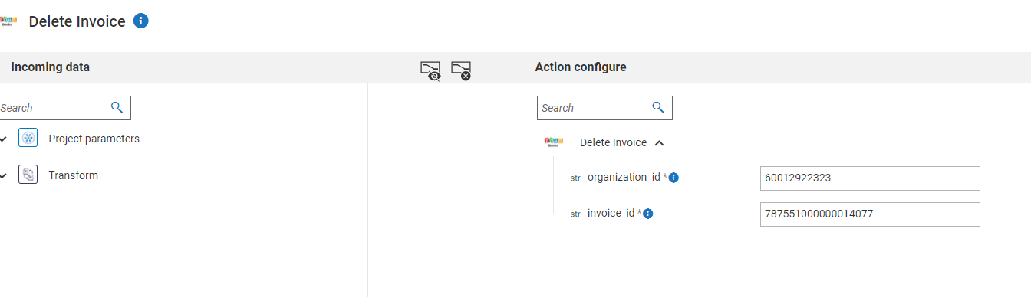
Delete Invoice
Input pipeline and output

