Slide 1

ZOHO Books Provider
Connector to Zoho Online Accounting Software
Participants:
Vageesh Shadakshari

Slide 2
Zoho Books
Online Accounting Software
What is webMethods CloudStreams Provider for Zoho Books
Zoho Books is online accounting software that manages your finances, keeps you GST compliant, automates business workflows, and helps you work collectively across departments.
The Connector is built for handling Invoices operations on Zoho Books.
Operations teams of any organization uses multiple systems, processes and manual steps in Sales activities. All these systems can use the connector to interact with Zoho Books to create, update, delete, read the invoices.
This helps in automating manual efforts of Entering and Managing Invoices on Zoho Books Accounting app.

Slide 3
Workflows
Workflow location: https://wmioconnectorsdev.int-az-us.webmethods.io/#/projects/fl5c79f1df6f5f5a0610e6a2/workflows

Slide 4
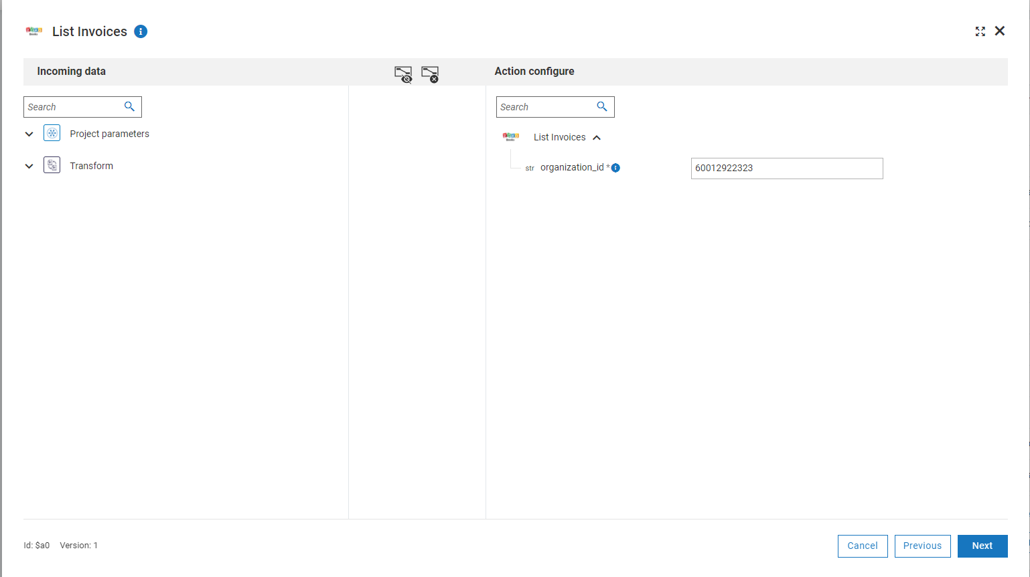
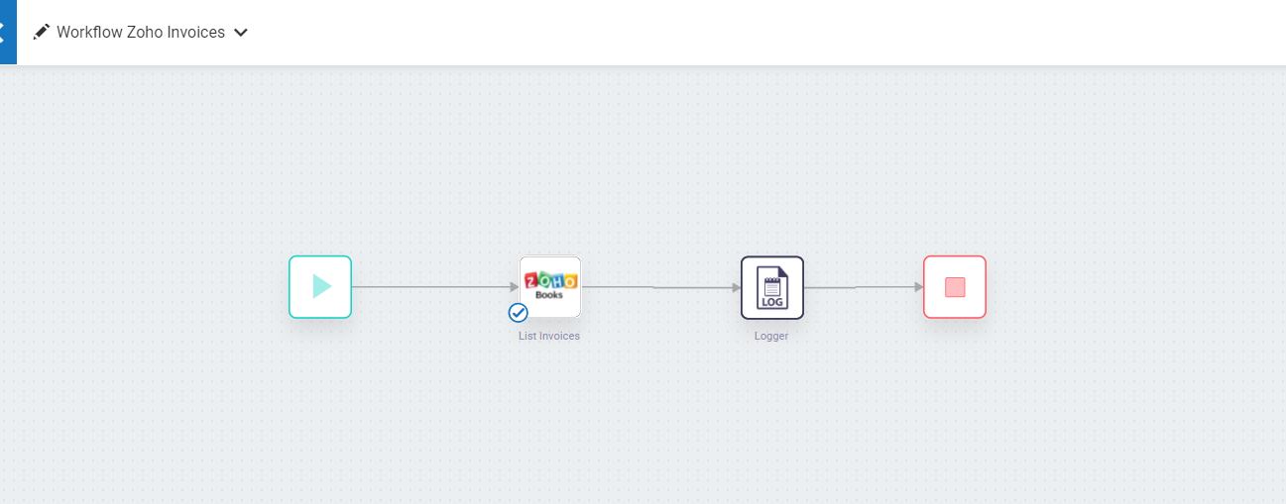
Screenshots List Invoices
Flow and Input

Slide 5
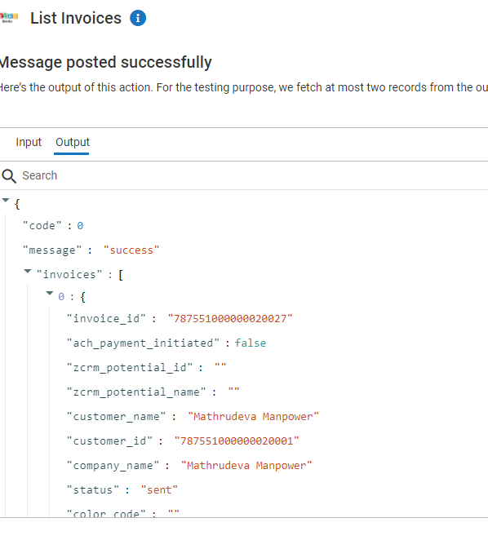
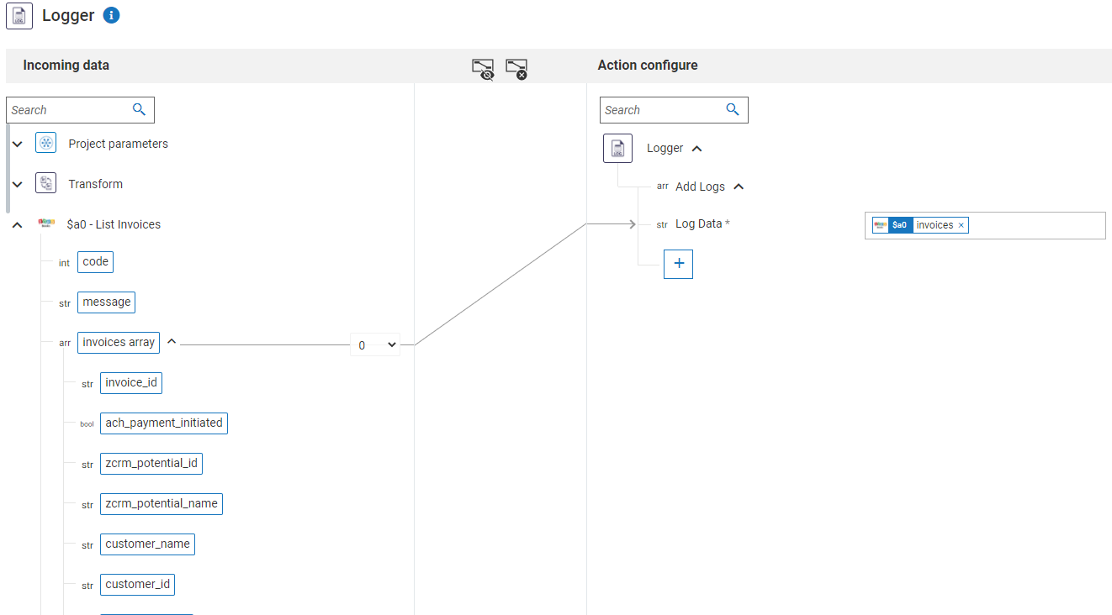
List Invoices
Output and Output Pipeline

Slide 6
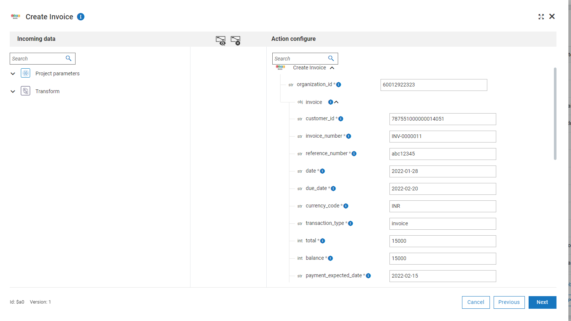
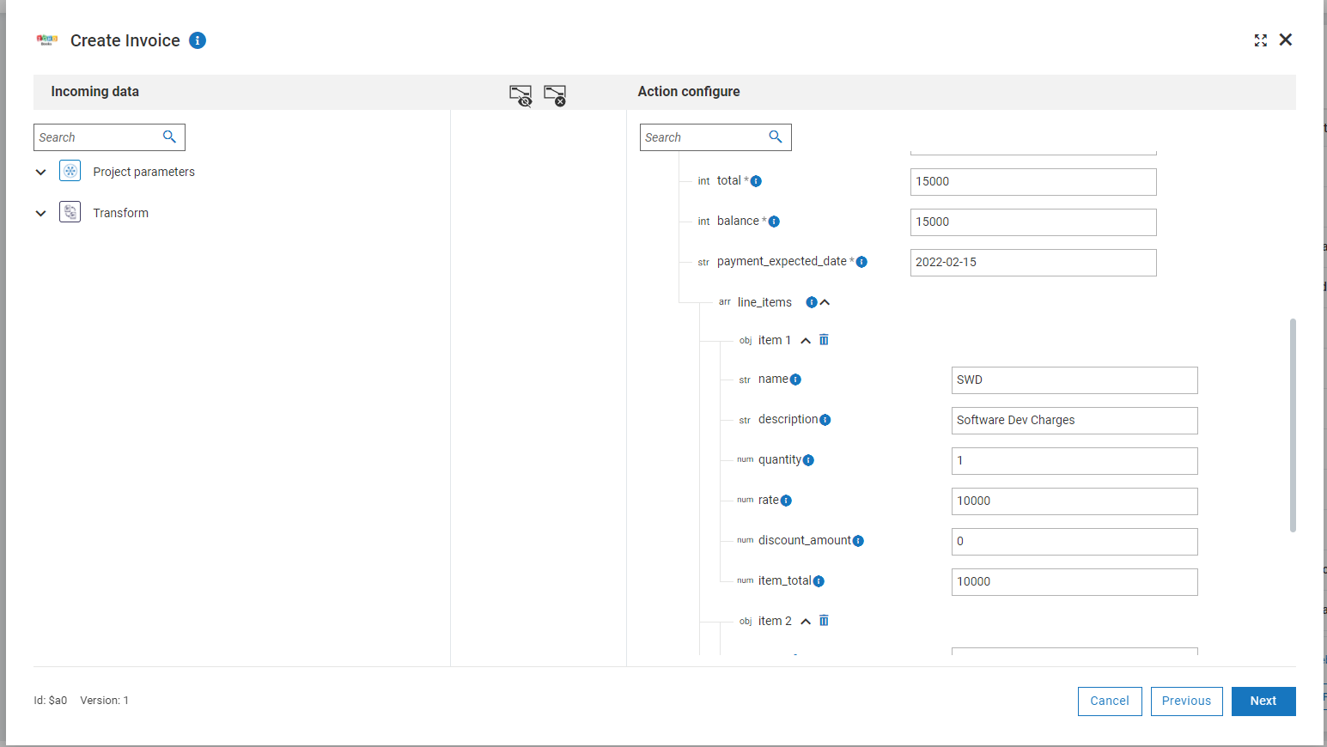
Create Invoice
Flow and Input

Slide 7
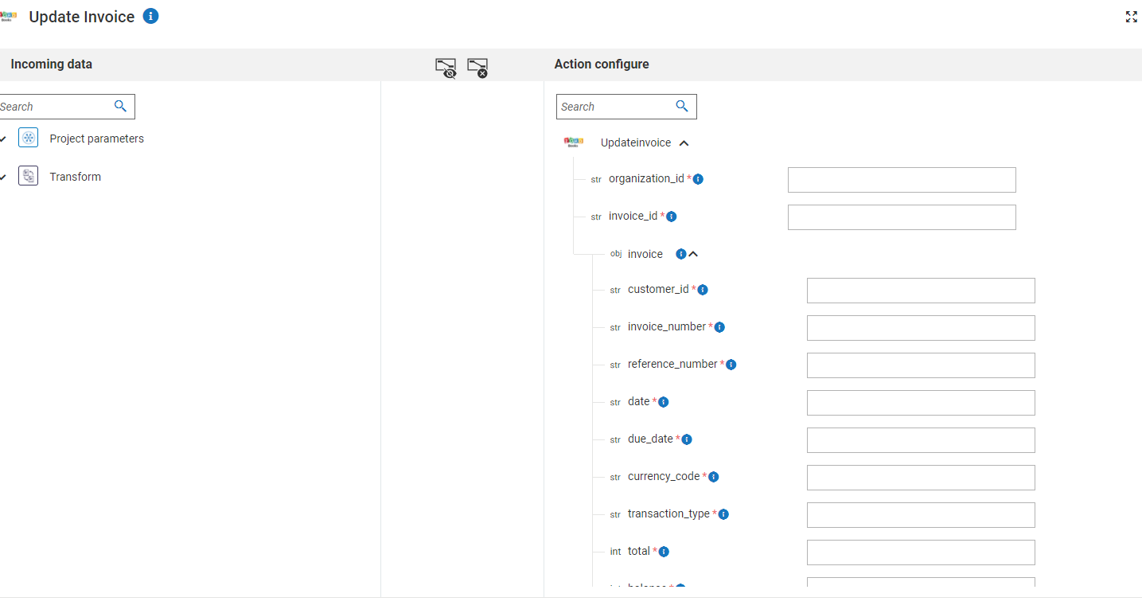
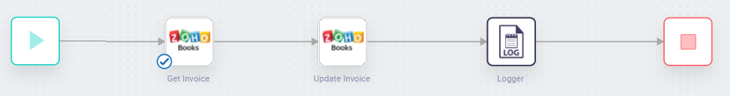
Update Invoice
Input pipeline and output

Slide 8
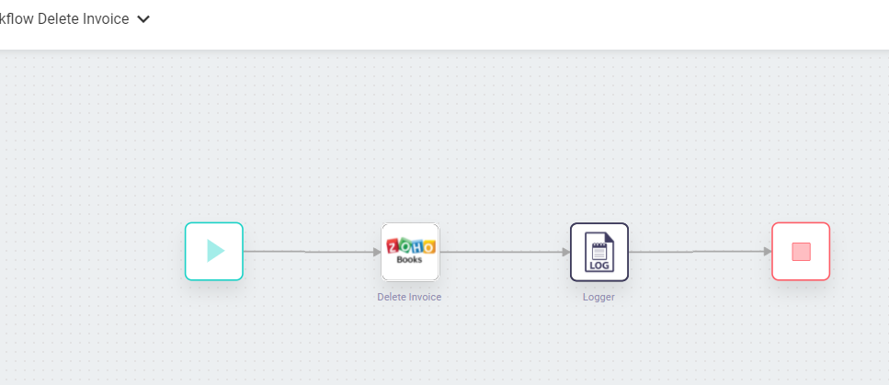
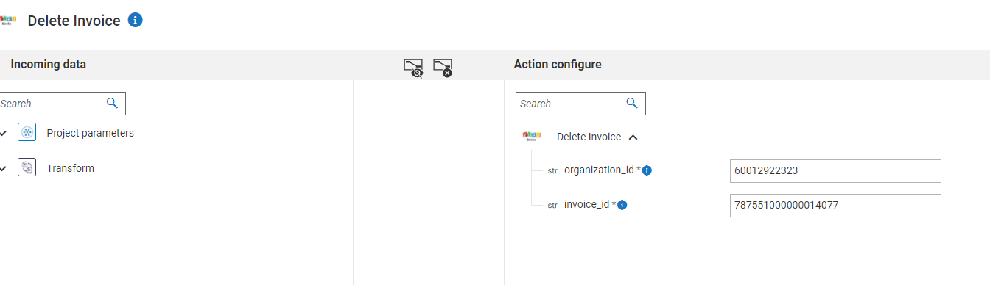
Delete Invoice
Input pipeline and output

