Slide 1
Zoho Bigin Provider
Participants:
Sukesh Maya

Slide 2
Zoho Bigin
What is Node.js CLI Provider for Zoho Bigin
Bigin is a small business CRM used to manage their customer relationships more easily. This connector will help customers to grow their business by closing the deals quickly by integrating the Bigin CRM system with their internal systems to automate the user management, managing deals, contacts, adding notes, tags, creating and updating records and notifications.

Slide 3
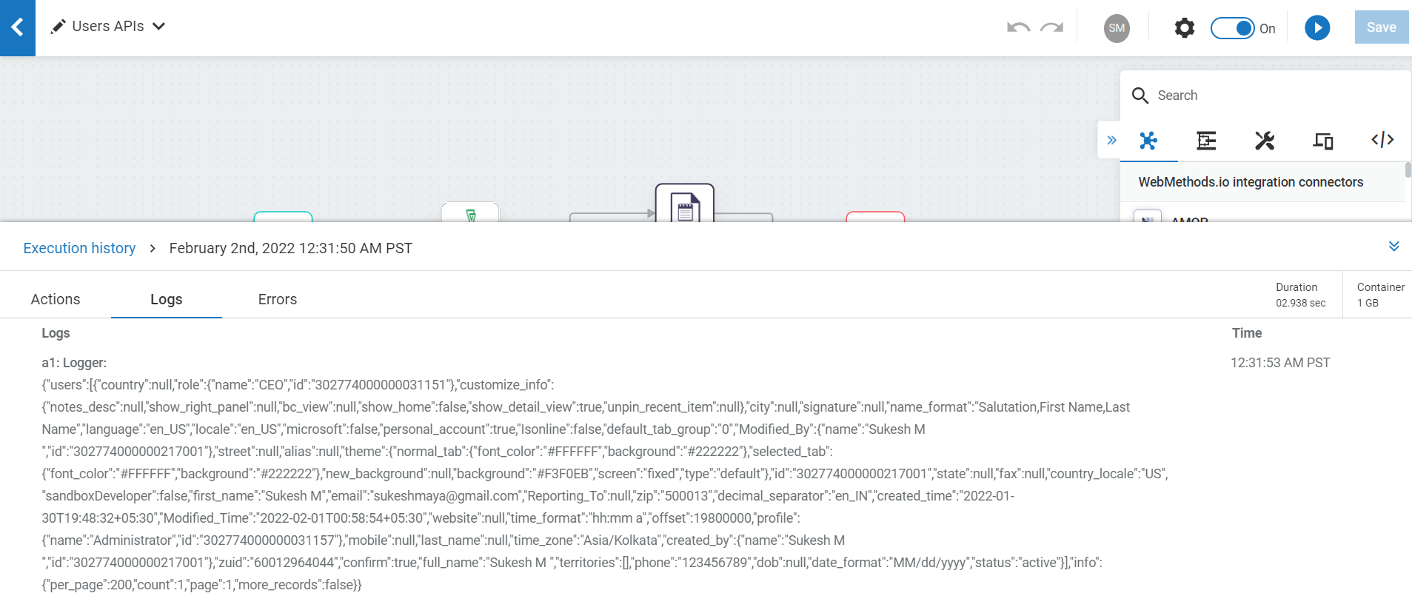
Screenshots for workflow
User APIs
User API are to add new users, update existing users, delete the users and get the users data from Bigin.

Slide 4
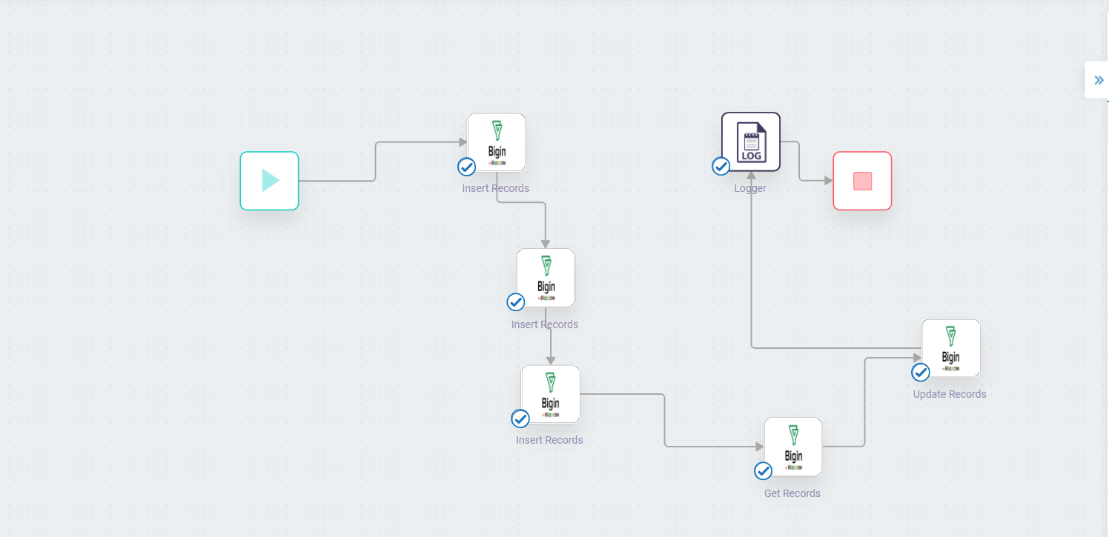
Screenshots for workflow
Record APIs
Record APIs are used to insert new records, update existing records, delete the records and get the available records from Bigin.

Slide 5
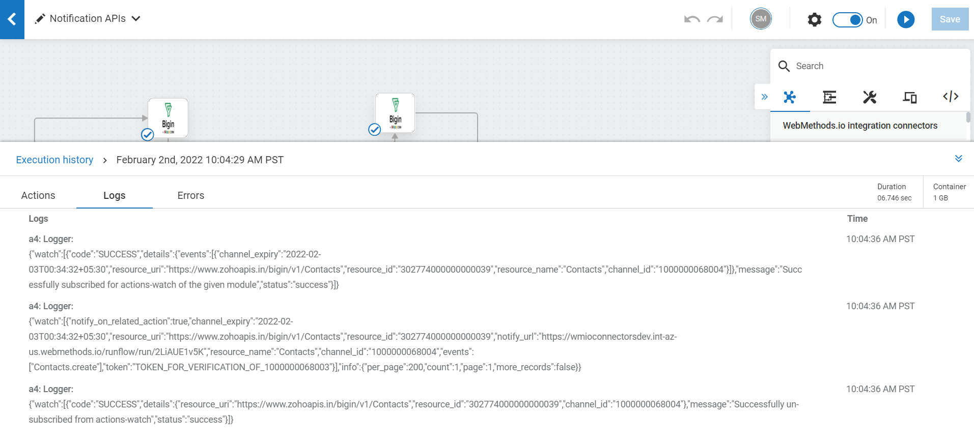
Screenshots for workflow
Notification APIs
Notification APIs are used to enable notifications for module actions, update the notifications, disable the notifications and get the notification details from Bigin.

Slide 6
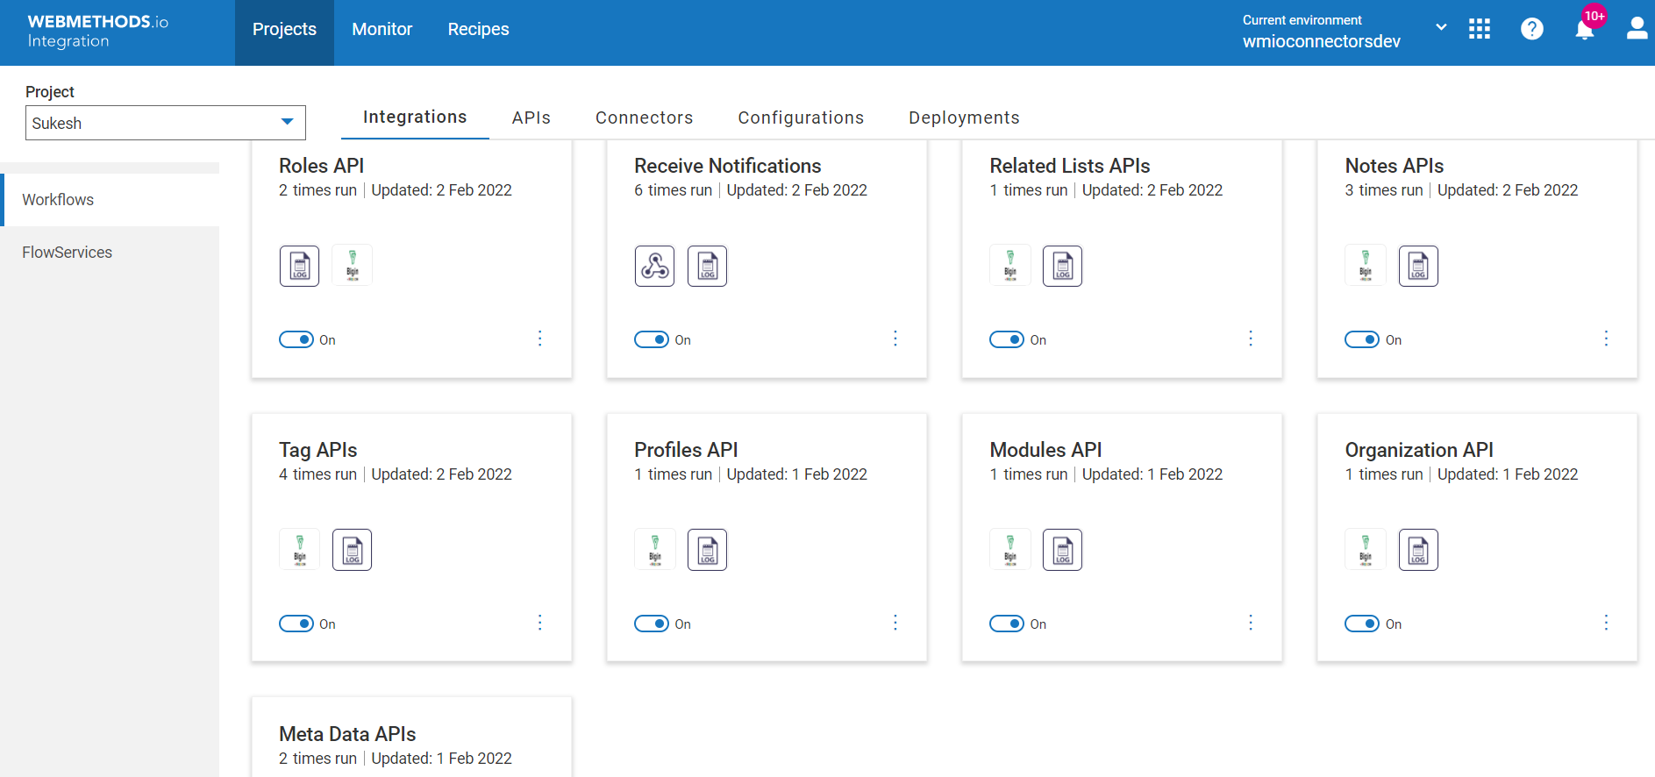
Screenshots for workflow
Other APIs
We have many other APIs to get the roles data, profiles data, organization data, modules, metadata, adding notes and updating the notes, adding relation between records, adding new tags, updating exiting tags and deleting the tags.

