Slide 1
BeaconstacProvider
Participants:
Priya Bhagat

Slide 2
Beaconstac
What is webMethods CloudStreams Provider for Beaconstac
Beaconsta is a modern QR Code platform. Connect your physical-digital worlds, collect first-party data & drive engagement - with an easy-to-use QR Code platform built for modern businesses. It provides QR code management services for an organization.

Slide 3
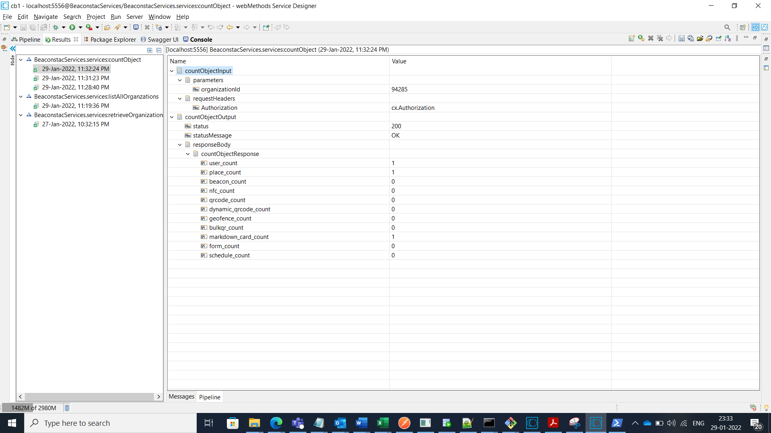
Screenshots for workflow
BeaconstacServices.services:countObject (GET)

Slide 4
