Slide 1

AirTable Provider
Participants:
Niveed Kumar Reddy Bollapally
Sumanth Lakshman

Slide 2
AirTable
AirTable Connector is a new webMethods CloudStreams Provider for AirTable SAAS application.
Airtable is a relational database tool that's also an online collaboration tool.
You can use it to manage work, track and organize inventories, plan an event, and much more.
AirTable Connector performs CURD operations. Helps in creating, updating, retrieving and deleting records from project tables.
Airtable Connector is a lightweight connector, excellent collaboration and integrates easily.

Slide 3
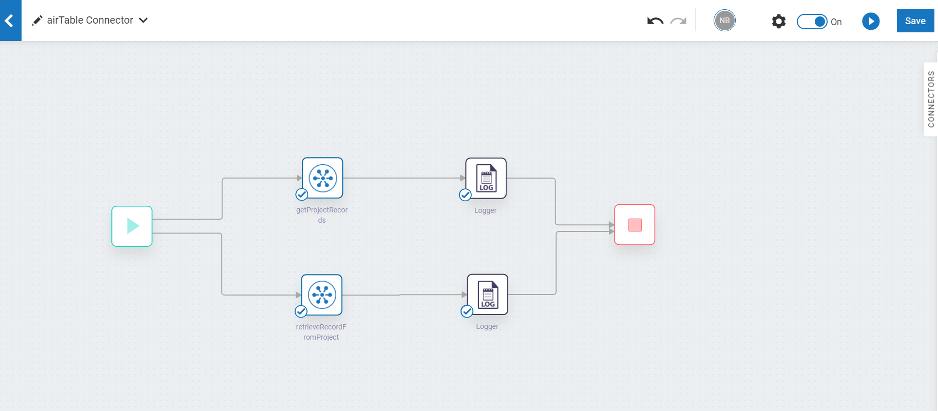
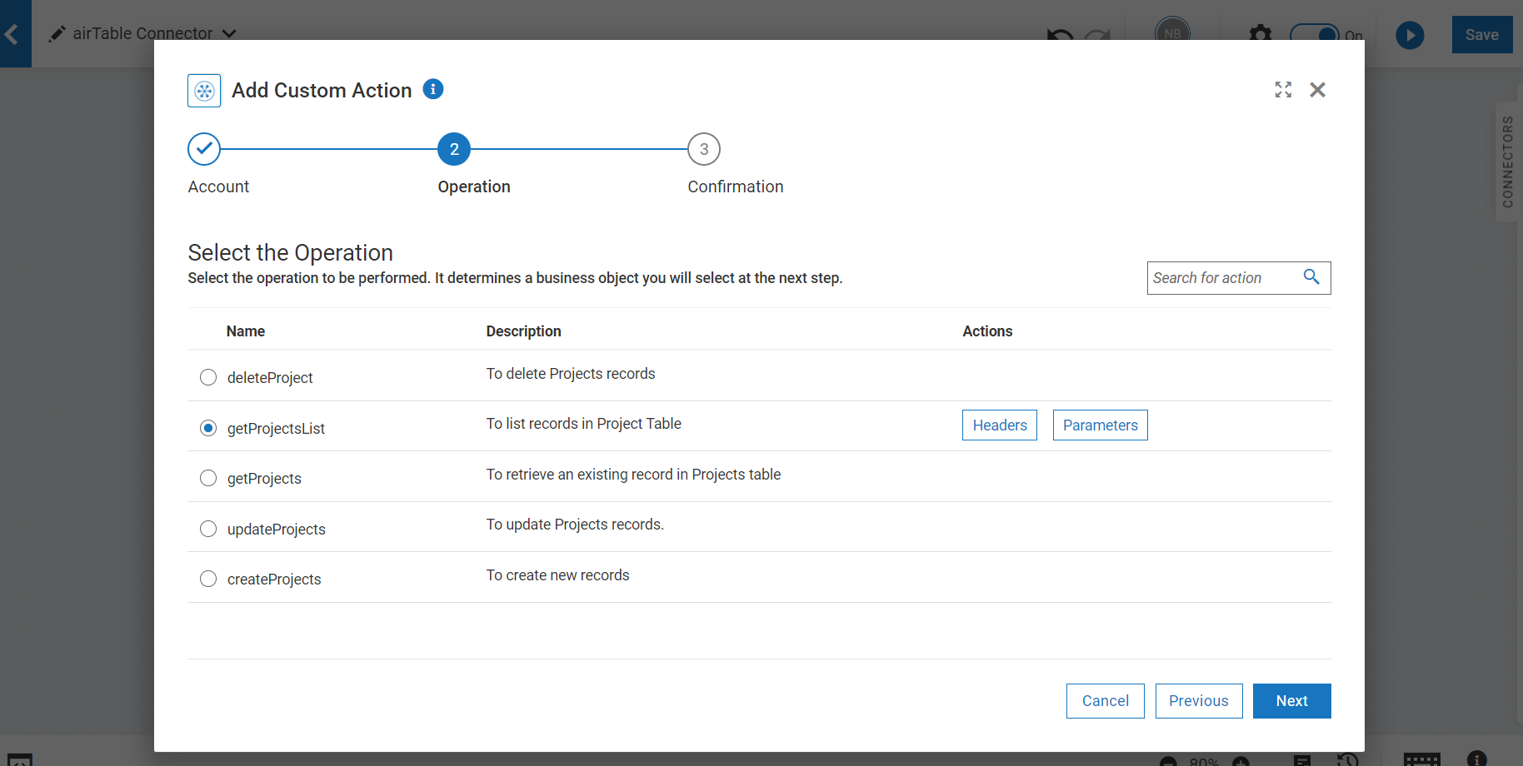
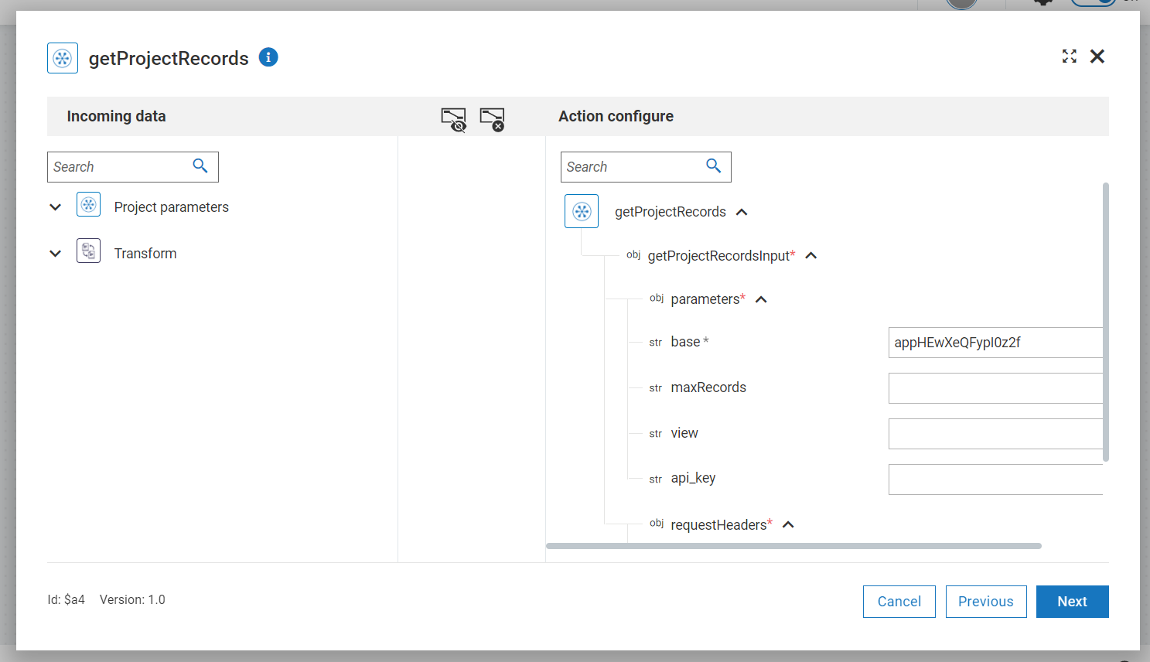
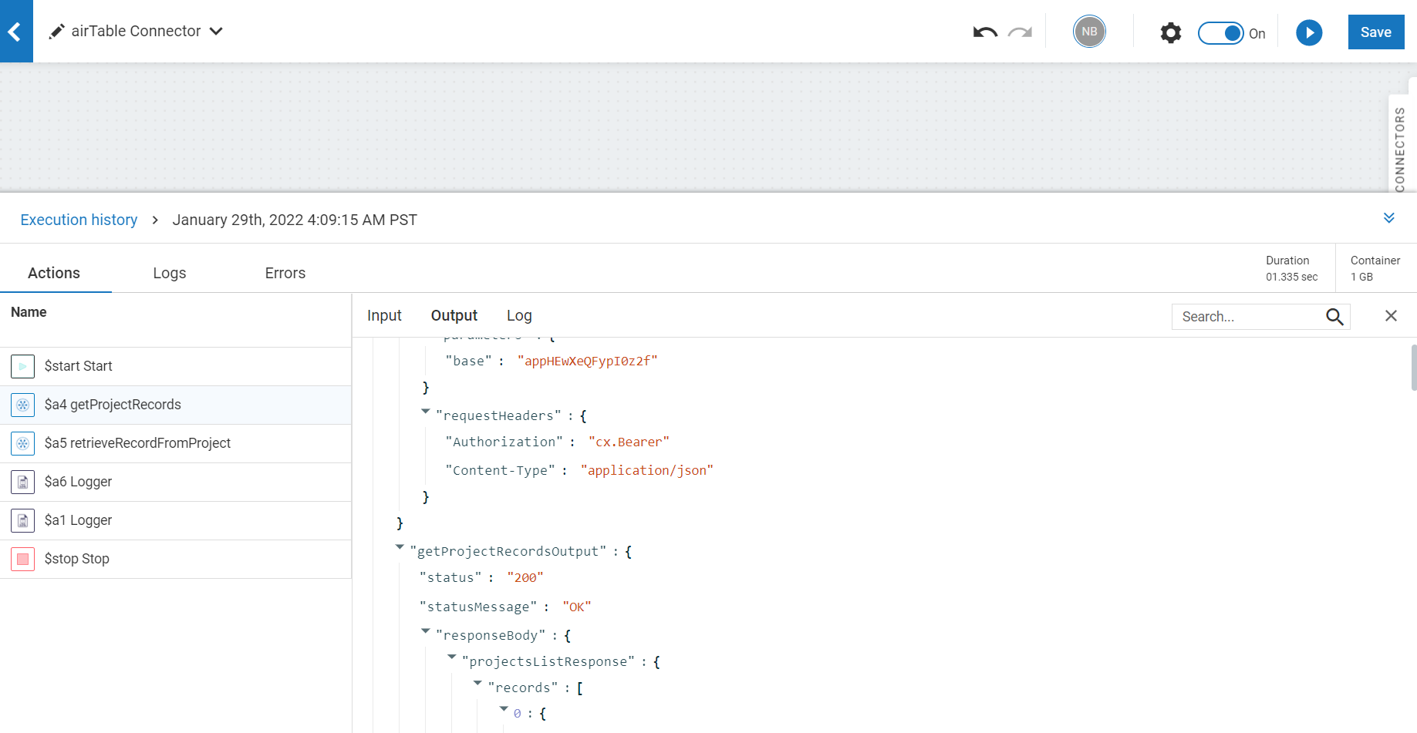
Screenshots for workflow
Workflow which helps in getting all records and getting a specific project record.
Select the operation to be performed by the connector.
Mapping the data for the action.
Logger information of the connecter data.

