Slide 1

Datadog Provider
Participants:
Karthik Babu KS

Slide 2
Datadog
What is webMethods CloudStreams Provider for Datadog
Datadog is an observability service for cloud-scale applications, providing monitoring of servers, databases, tools, and services, through a SaaS-based data analytics platform. It provides agents, prebuilt integrations, APIs to get insights into any stack at any scale.
Using this wM.io connector for Datadog, Notification from the Datadog monitors can be received in real-time and workflows can be created in wM.io to may be create a tweet or any supported actions in wM.io
It also supports certain actions like setting up of above set monitors, send logs, get host and manage downtimes through the wM.io platform.

Slide 3
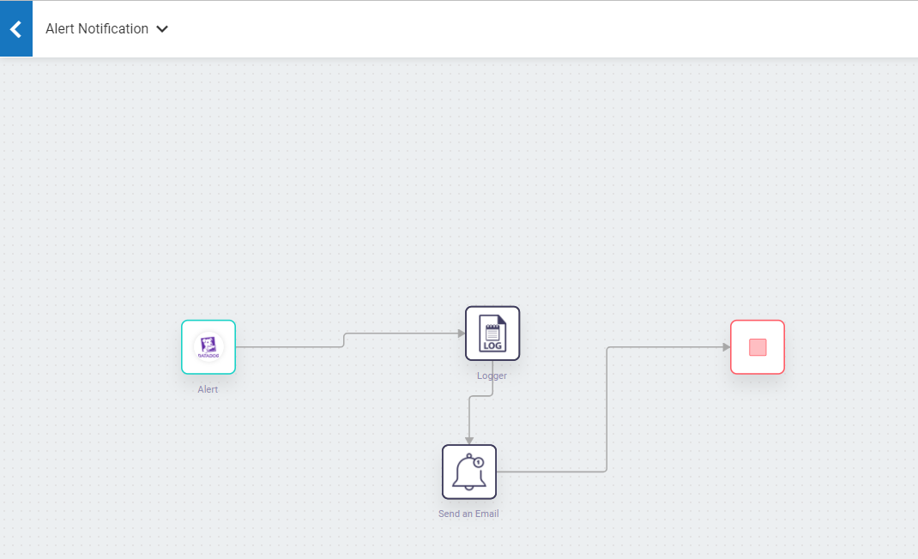
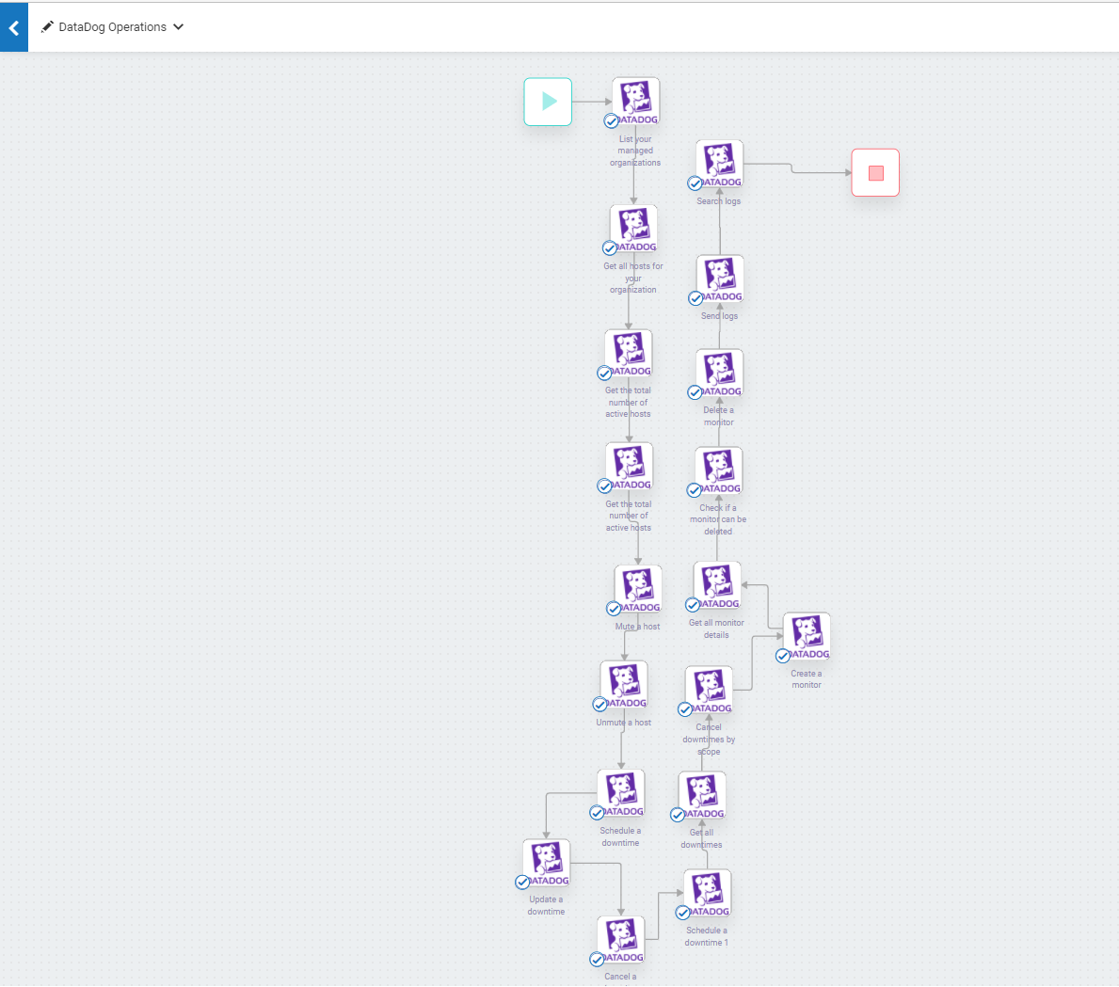
Screenshots for workflow
Alert webhook workflow
Workflow for supported actions

