Slide 1

CITS5206 Capstone Project
Fire Vulnerability App for Cultural Heritage Sites
Group: Group 21
Client: Assoc. Sven Ouzman
By Cloud Wang

Slide 2
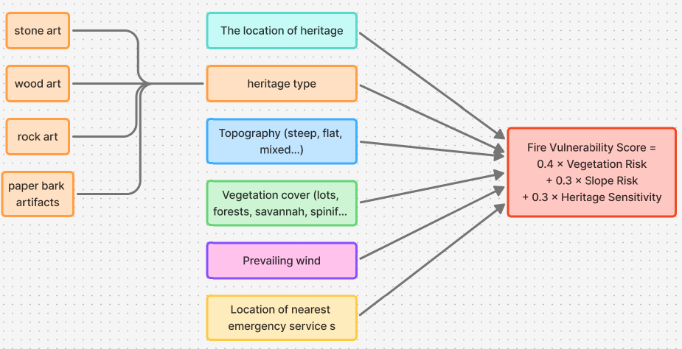
Goal
Goal: The project aims to develop a GIS tool that helps identify and visualize cultural heritage sites that may be vulnerable to bushfires.
Data Source: ACHIS, InHERIT, Data WA

Slide 3
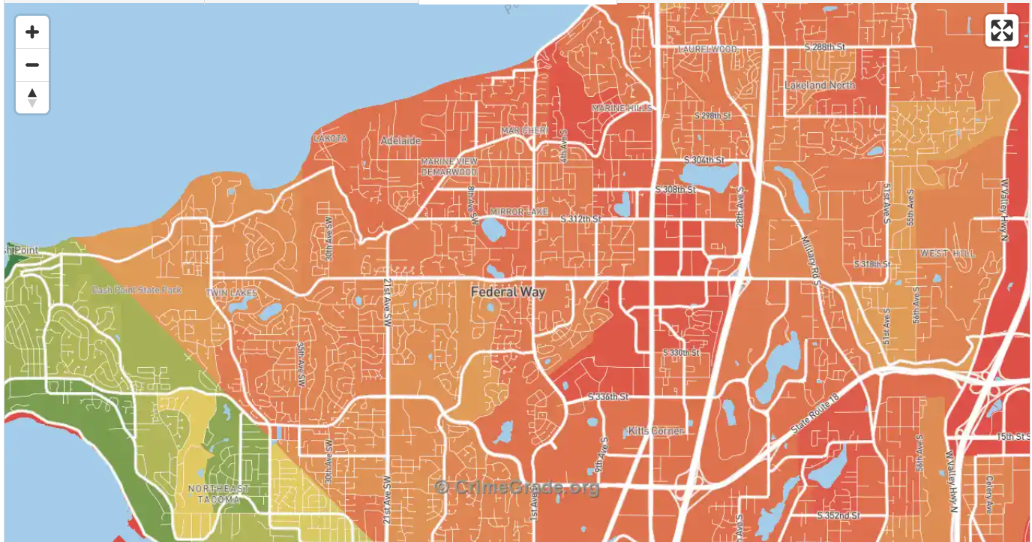
App

Slide 4
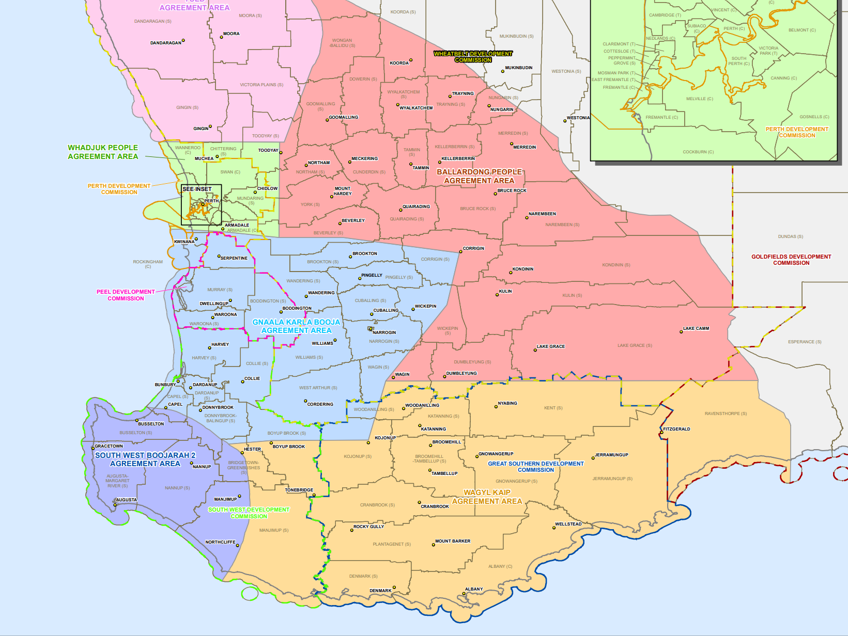
Current Progress

Slide 5
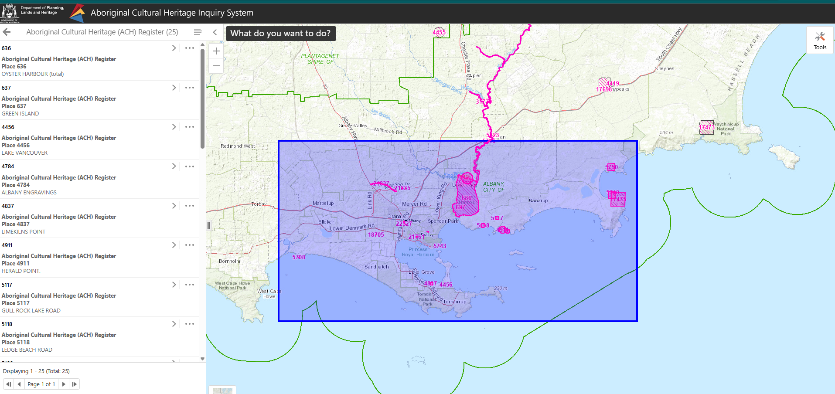
Step 1 – Region Selection

Slide 6
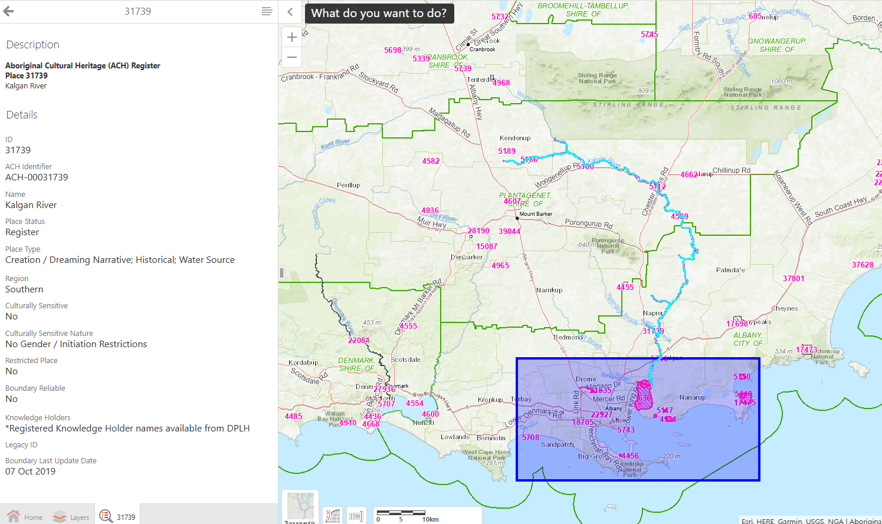
Step 1 – Region Selection

Slide 7
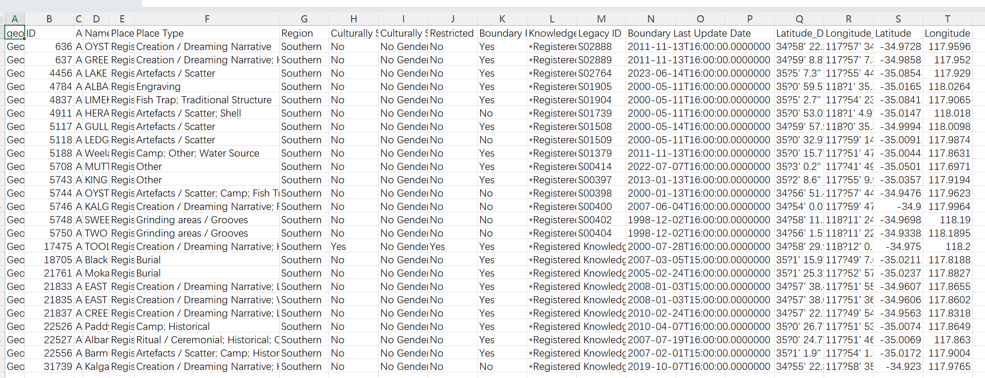
Step 2 – Export Data

Slide 8
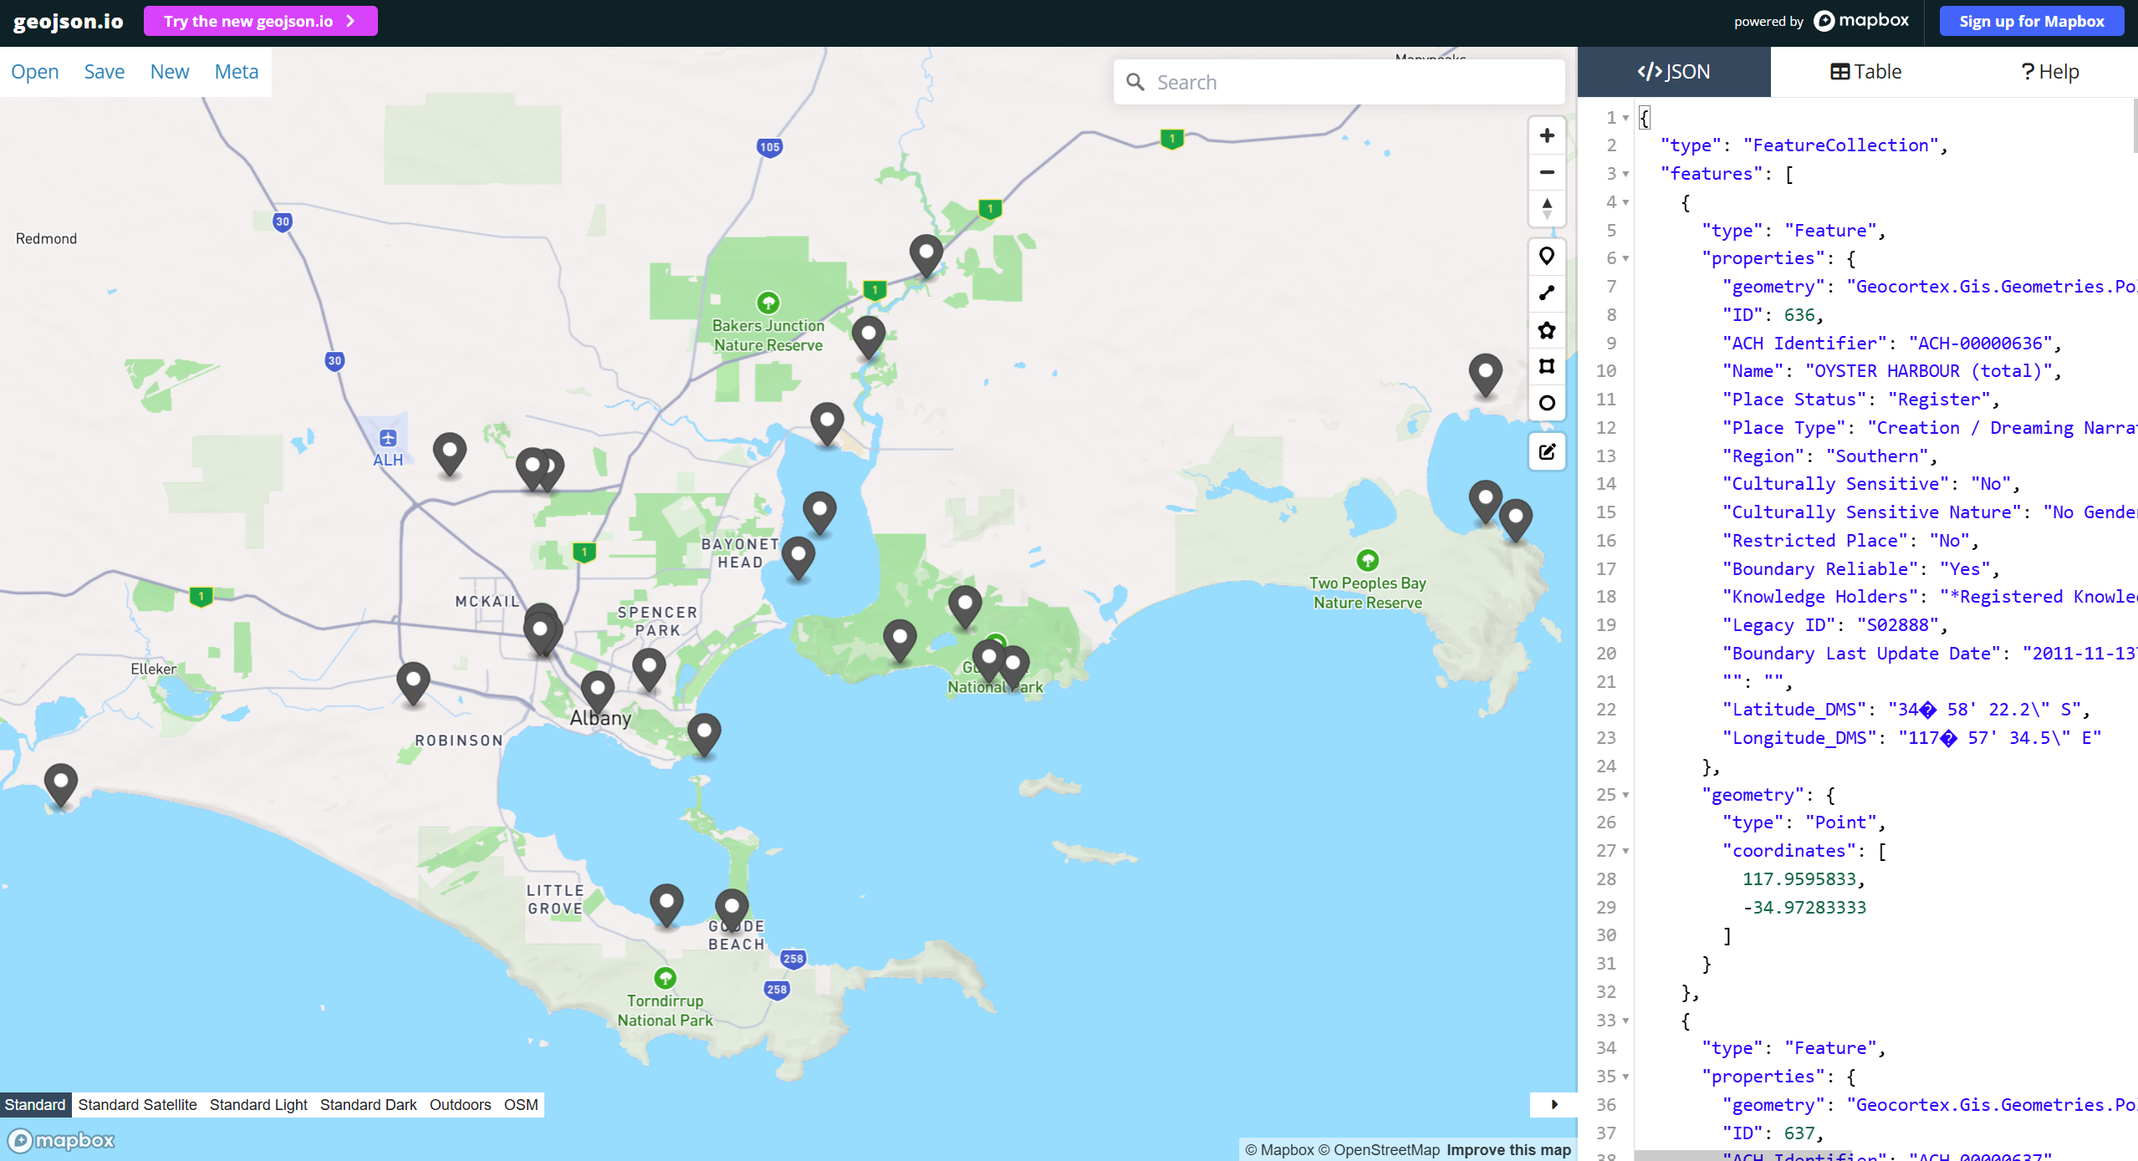
Step 3 – Convert Data to geojson
https://geojson.io/

Slide 9
Step 4 – Build a demo
Leaflet: a JavaScript library for interactive maps
OpenStreetMap: OpenStreetMap (OSM) is a free, open-source global map database
http://localhost:8000/

Slide 10
Development Method
Build a basic web GIS prototype
Enable the system to load GIS data and display heritage sites on a map.
Implement fire vulnerability analysis
Develop a simplified method to estimate fire vulnerability based on environmental factors.
Extend system functionality
Add additional features such as risk visualization and data input for heritage sites.

