Slide 1

CITS5206 Capstone Project
Fire Vulnerability App for Cultural Heritage Sites
Group: Group 21
Client: Assoc. Sven Ouzman
By Cloud Wang

Slide 2
Things to Discuss Today
Project Background
Initial Exploration
Role Allocation
D1: Project Spec and Plans Group Submission Due Mon 23 Mar, 11:59 PM
Regular Meeting Time
Available Resources

Slide 3
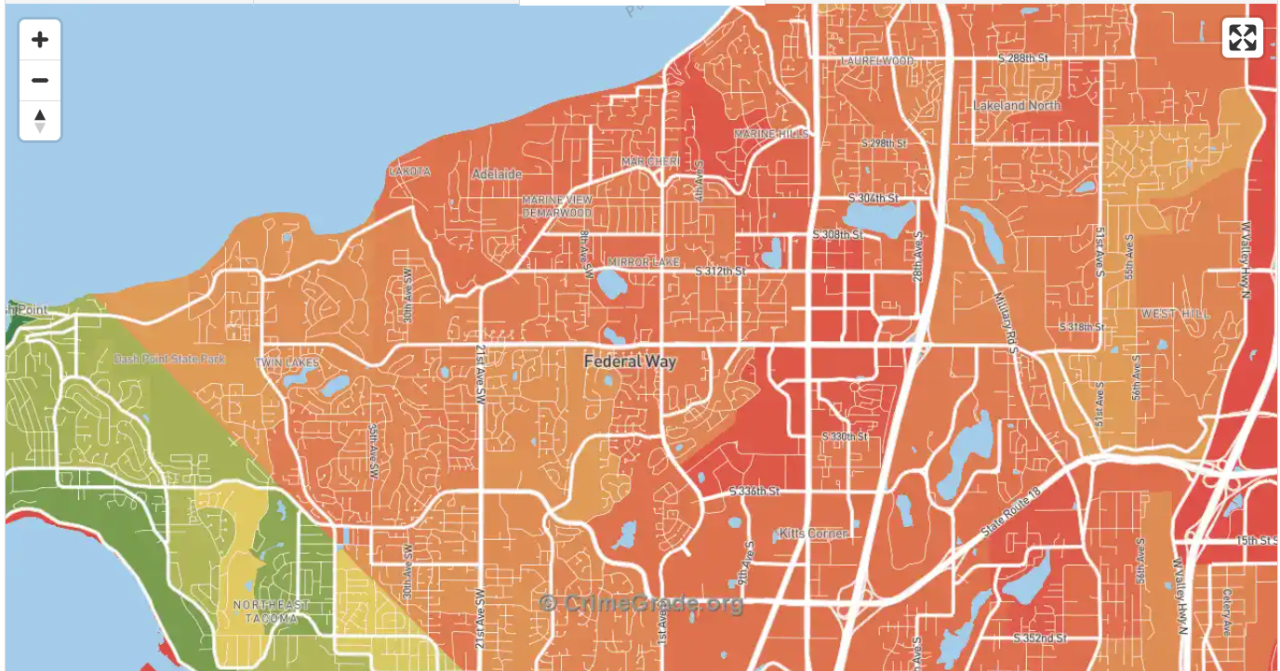
Project Background
Goal:
Develop a GIS-based application that predicts the likely locations of cultural heritage sites and their vulnerability to bushfires and visualizes this information on a map to support fire management and help prevent damage to heritage sites.
Why is it needed:
Although databases like ACHIS and InHerit record some heritage sites, many sites are still not mapped. Fire managers currently lack a tool to predict site locations and assess fire risk. Wildfires may cause serious damage to these sites.

Slide 4
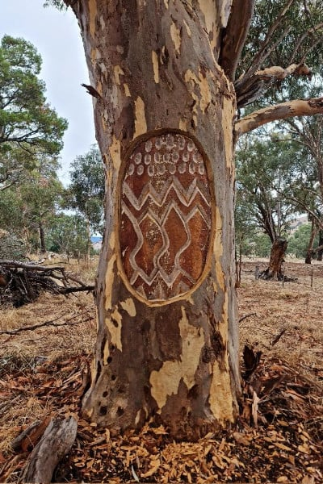
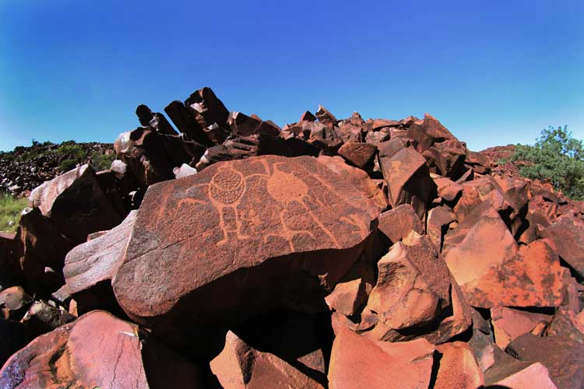
Project Background
Key Issues:
Certain sites are fragile (scar trees, material vulnerable to fire, certain types of stone which can be damaged by the heat, the radiant heat that comes off a fire, especially granite outcrops.
Scar trees
granite outcrops

Slide 5
Project Background
Influence Factors:
Topography:
Slope: Fire spreads faster uphill than downhill, and steeper slopes increase fire intensity and spread.
Elevation (high or low areas): Sites at higher elevations are more vulnerable to fire.
Vegetation position: Anything that is within 100 metres of the edge of vegetation that can burn is at risk.
Geology:
Granite outcrops: Granite areas are important indicators when predicting potential site locations.
Vegetation:
Fuel load: Areas downhill often have heavier fuel loads, which can cause fires to burn faster and more intensely.
Vegetation age: The older the vegetation is, the worse it’s likely to be.
Water: Rivers and lakes can slow down fires or change the direction they spread.
Risk Level (We need to model it, this is just an example):
Risk Level 1 - For things that are on flat ground
Risk Level 2 - Sites on slopes of around 10° with vegetation within 50 metres
Risk Level 3 – Sites on steeper slopes with heavier fuel loads

Slide 6
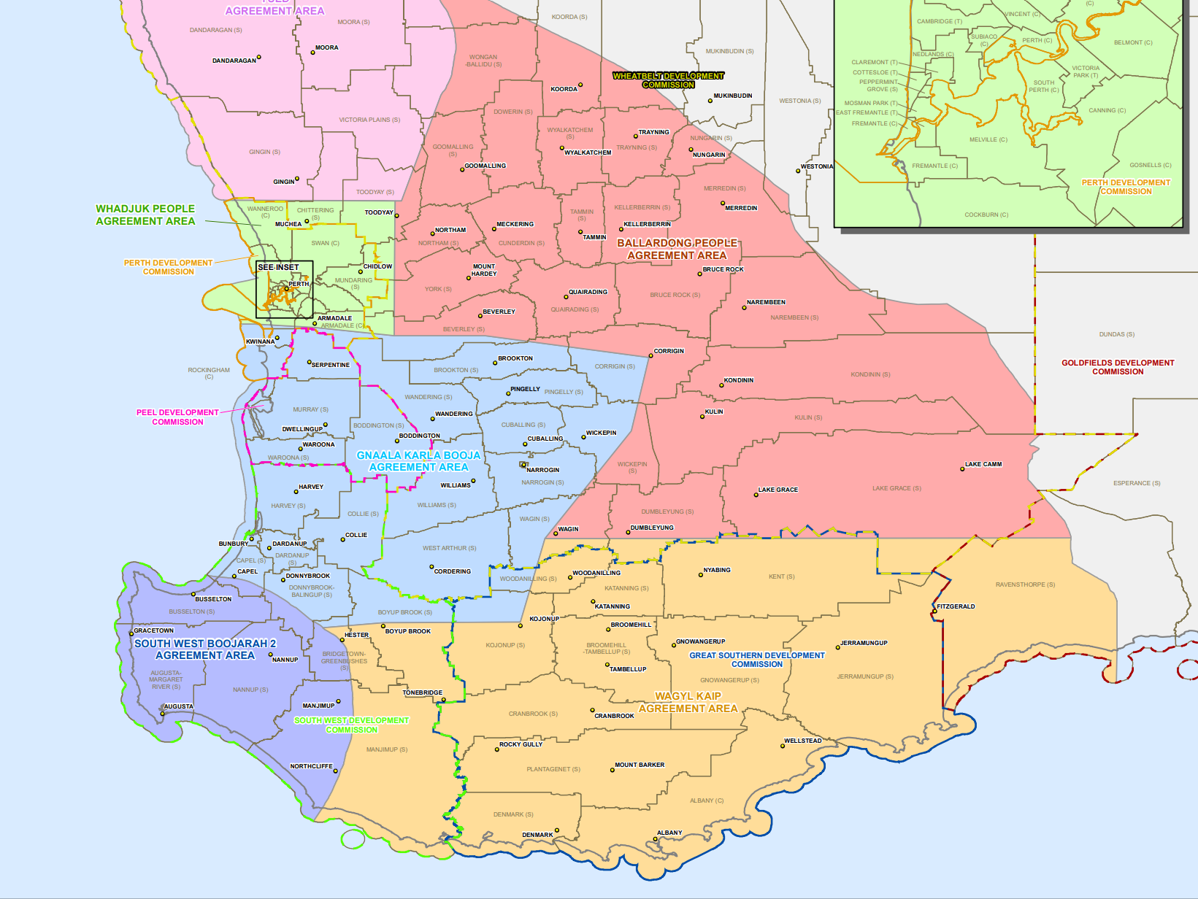
Project Background
Region Selection: Need agreement from Aboriginal people.

Slide 7
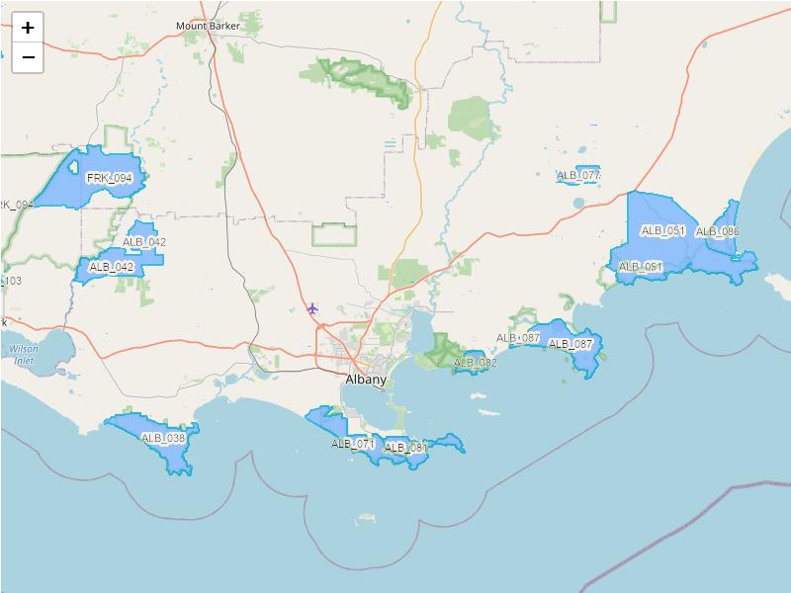
Project Background
Region Selection:
The DBCA Burn Options Program Map: Shows areas where prescribed burns are planned. This is a good starting point for the project. We could select one burn area and assess the fire risk within it. The selected area must contain granite.
FRK stands for Franklin, ALB stands for Albany
Areas selected by Sean:
FRK-114
FRK-113
FRK-115
FRK-116
FRK-108
FRK-094
ALB-042
ALB-071
ALB-081

Slide 8
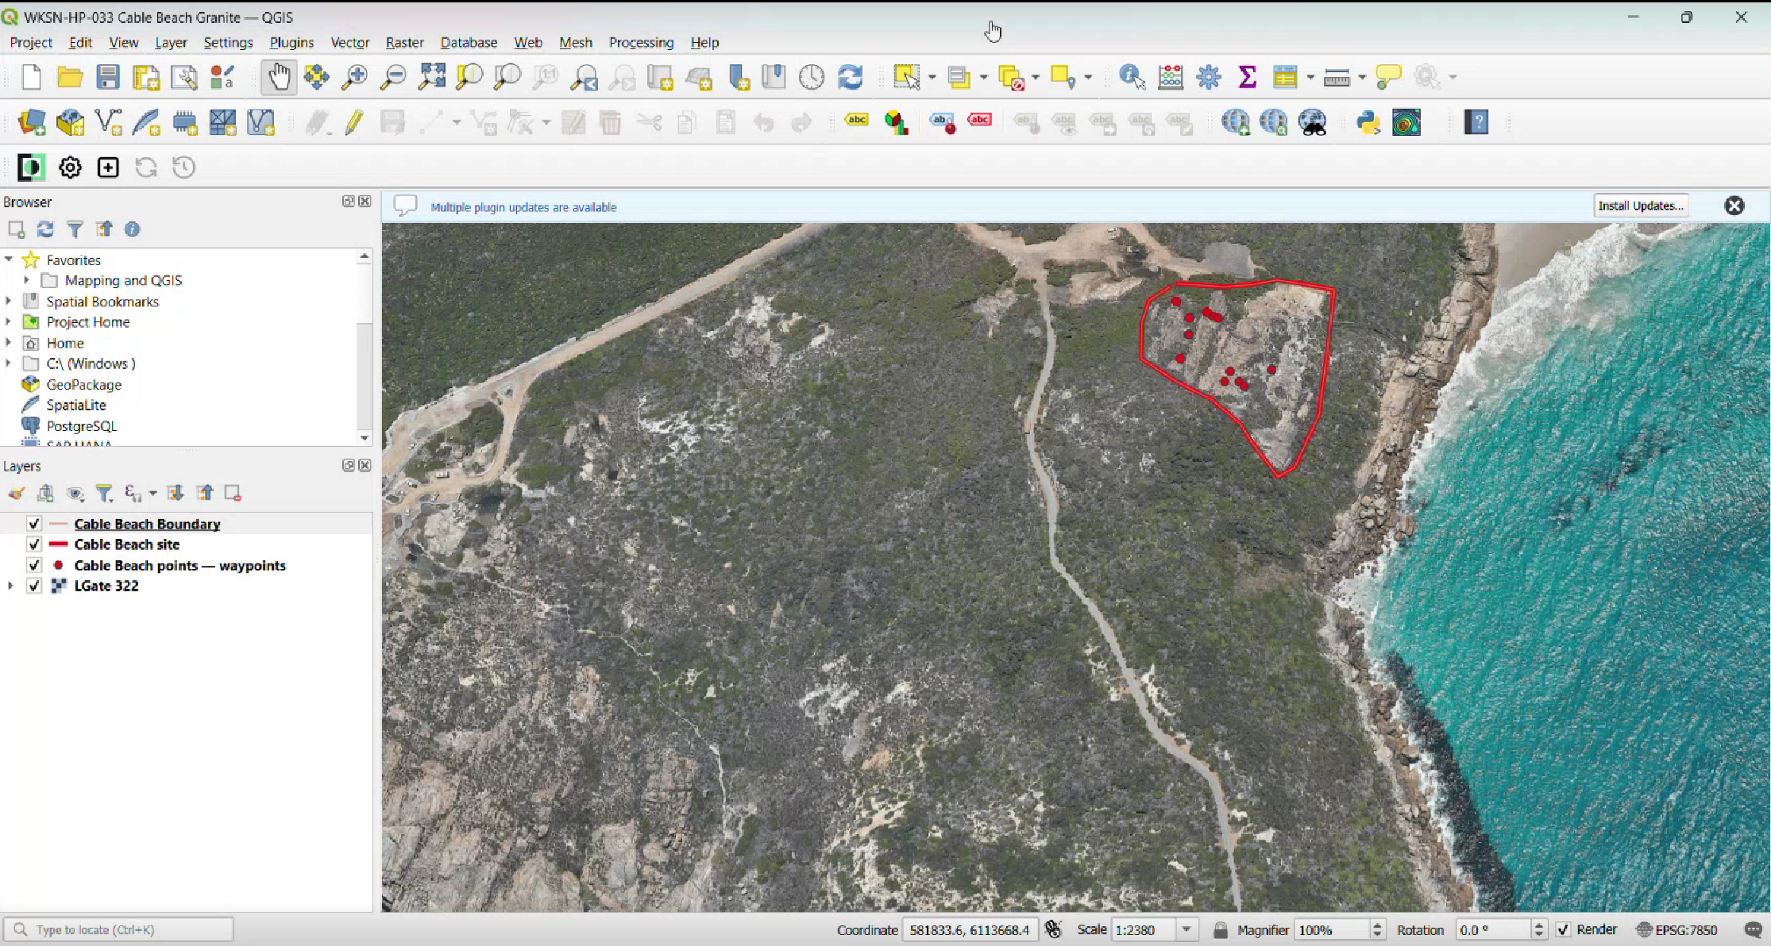
Project Background
We could identify granite sites in those areas and load them into our map application. Then we can analyse their surroundings, such as whether they are on a slope or near vegetation, to assess their potential fire risk.

Slide 9
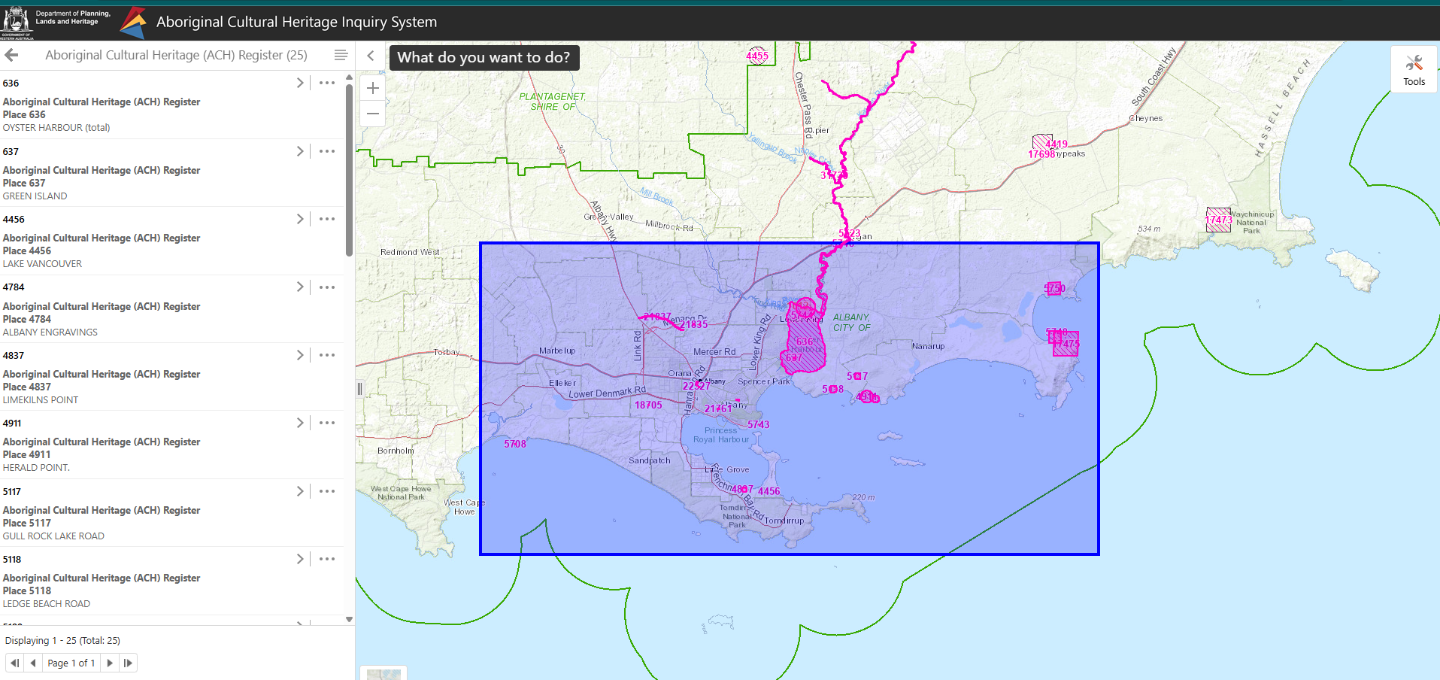
Initial Exploration
Select a region in ACHIS

Slide 10
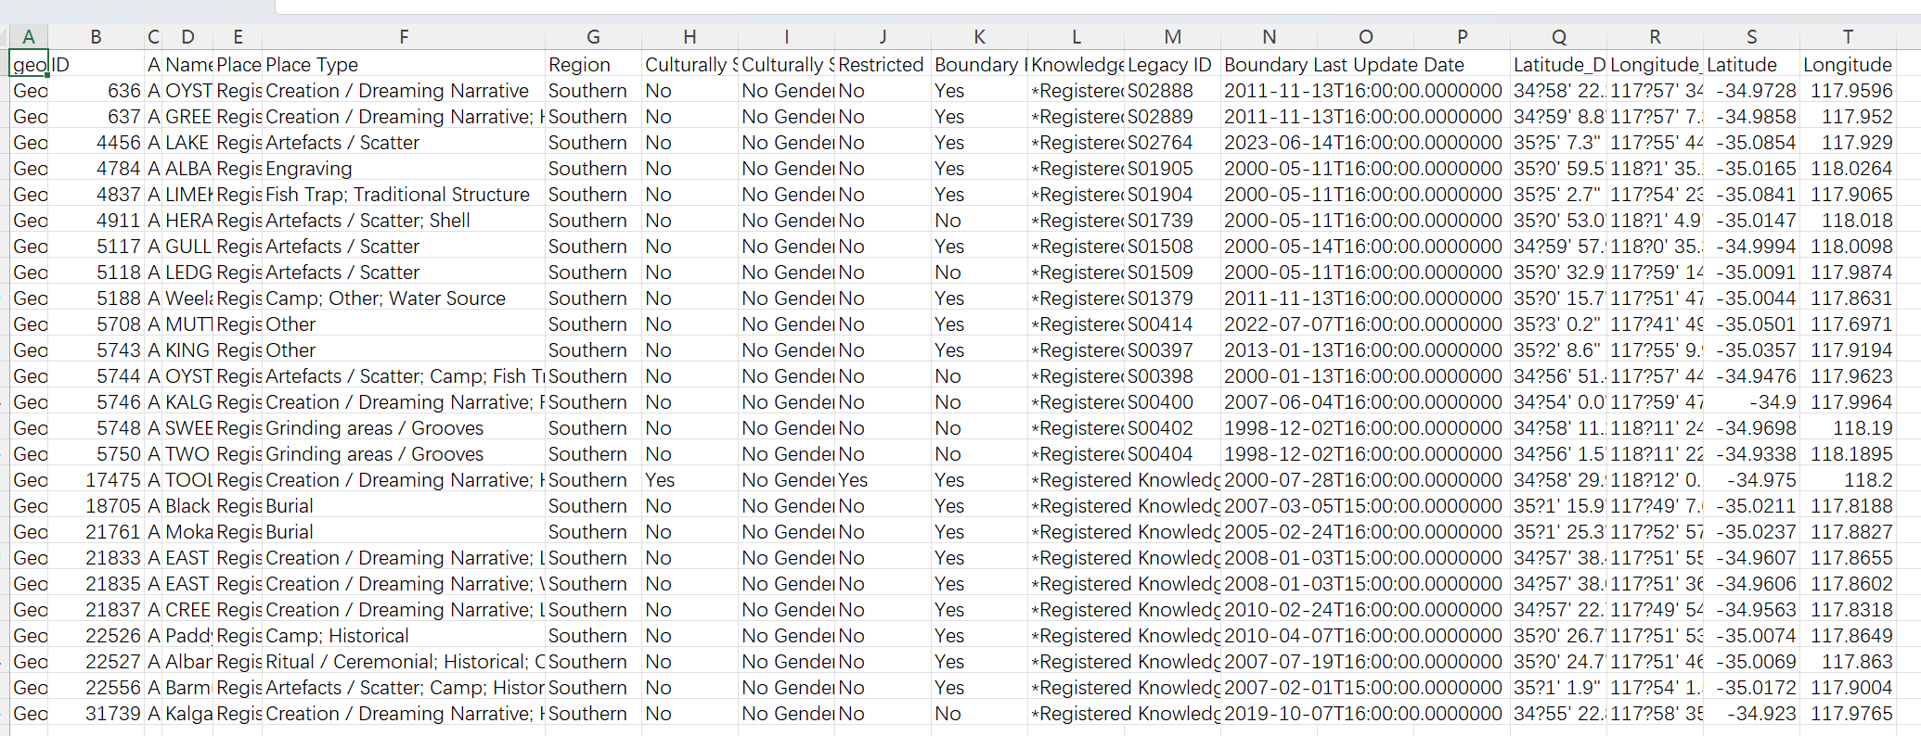
Initial Exploration
Export the data as a CSV file

Slide 11
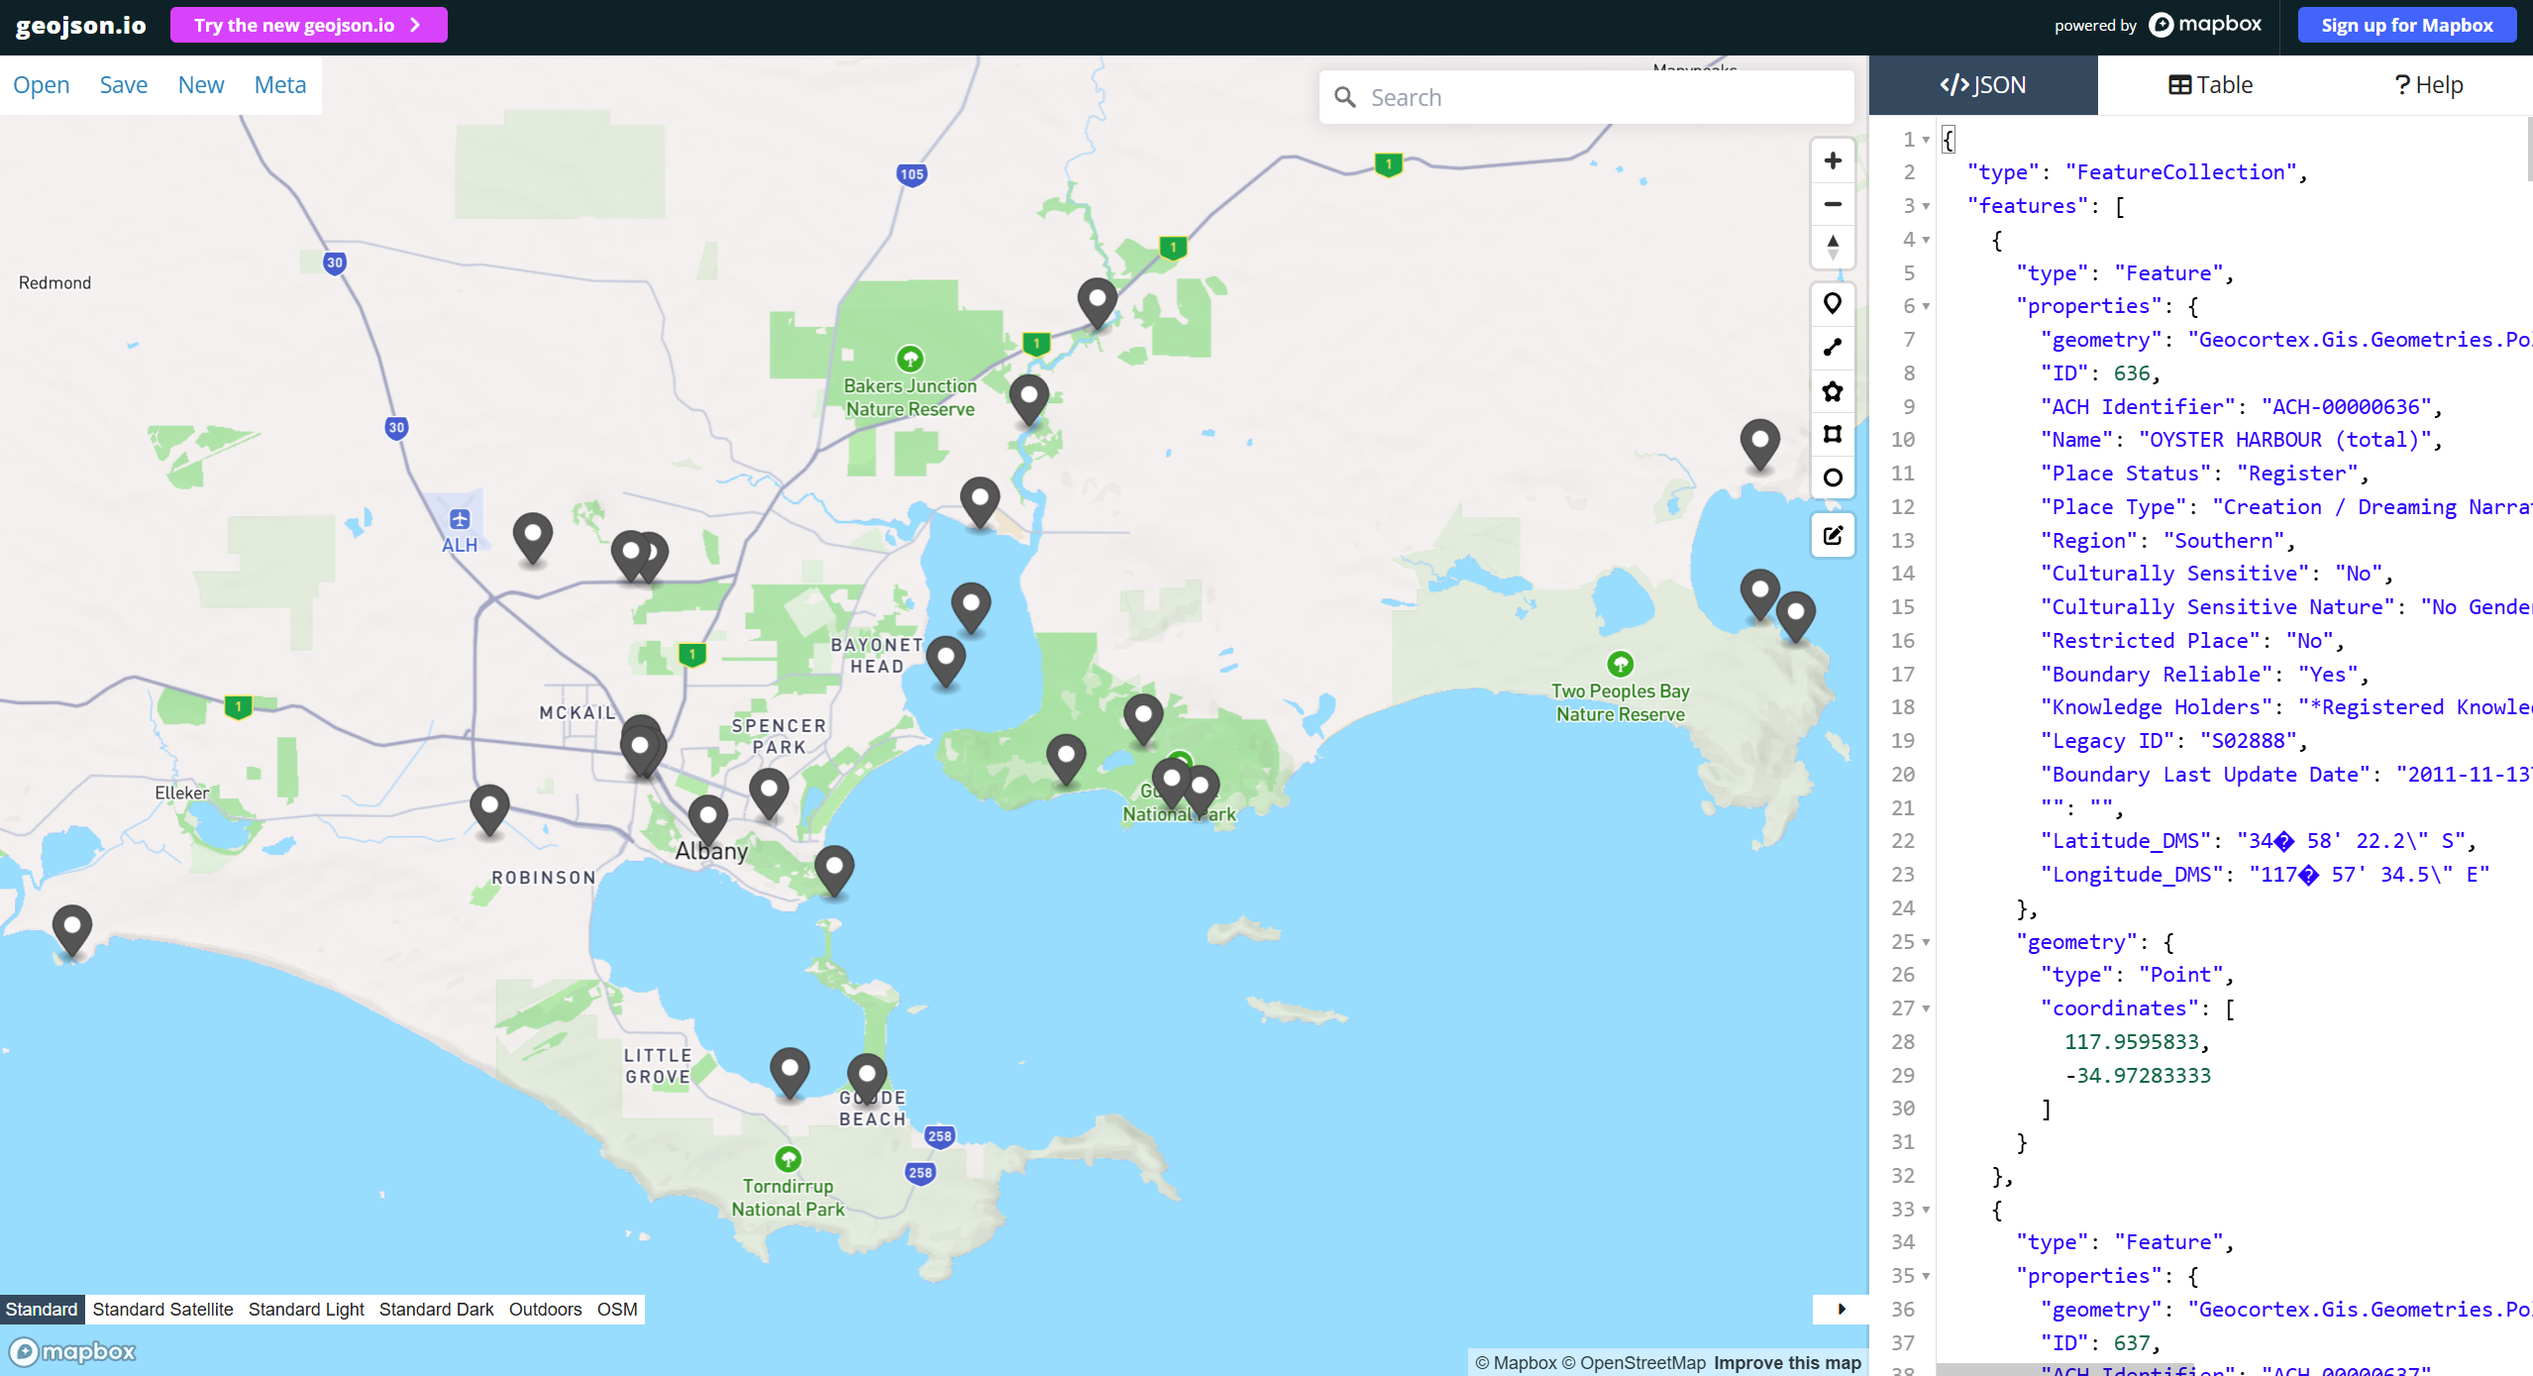
Initial Exploration
Transform the data into geojson: https://geojson.io/

Slide 12
Initial Exploration
Load the data into our app.
Useful Tools:
Leaflet: JavaScript library for interactive maps (Free & open-source)
Mapbox: Map platform + library (Freemium / paid services)
OpenStreetMap: Free open-source map data.
A demo build with Leaflet and OpenStreetMap.
http://localhost:8000/

Slide 13
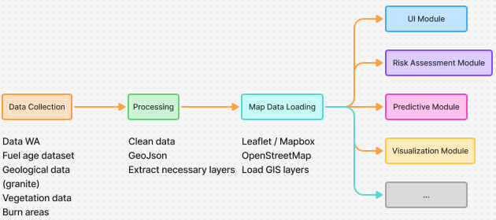
Initial Exploration
Possible workflow:
Mostly front-end with GIS data processing. (Optional) We may need a database to store user data if we implement a user upload function.
Dev tools:
TypeScript / JavaScript
React
Leaflet / Mapbox

Slide 14
Role Allocation
Rotate the Project Manager role (LMS: at least 3 people should be PM over the course of the project)
  Organize meetings
  Ensure progress
  Coordinate team
  Remind the team of deadlines
Submit weekly professionalism documents
Take meeting notes, summarize discussions, and write meeting minutes
Mention our roles in the weekly team accountability document.

Slide 15
D1 Project Spec and Plans
Problem statement: what are you going to build and why?
1.1 Current Problem
1.2 Current Solution and Limitations
2. Client communication and MVP agreement. ( presentation has been given to facilitator and client and feedback)
2.1 Client communication details
2.2 Minimum Viable Product (MVP)
3. Project planning and management
3.1 Project & Workflow Management Methodology
3.2 Timeline and Milestones
3.3 Roles and Responsibilities
3.4 Collaboration Tools and Practices
4. Risk and technology assessments
4.1 Group Skills Audit Survey
4.2 Technical Risks
4.3 Operation Risks
4.4 Technology Assessment
It’s better to complete this two days before the deadline so we have time to adjust.

Slide 16
Regular Meeting Time
Ensure everyone attends and arrives on time
Ensure everyone one the same page after the meeting

Slide 17
Available Resources
Datasets:
DBCA Fuel Age: SW Forest (DBCA-005)
Related Papers and websites:
https://www.dbca.wa.gov.au/management/fire/prescribed-burning/burn-options-program
https://www.wa.gov.au/organisation/department-of-mines-petroleum-and-exploration/geological-survey-of-western-australia/state-maps-and-statewide-datasets
https://myfirewatch.landgate.wa.gov.au/
https://catalogue.data.wa.gov.au/dataset/?tags=vegetation
https://www.wa.gov.au/service/science/biological-sciences/access-interactive-maps-showing-western-australias-biodiversity
Cruz, Miguel G., James S. Gould, Martin E. Alexander, Andrew L. Sullivan, W. Lachlan McCaw, and Stuart Matthews. 2015. “Empirical-Based Models for Predicting Head-Fire Rate of Spread in Australian Fuel Types.” Australian Forestry, 1,41.
Kim, Dong-Wook, Woodam Chung, and Byungdoo Lee. 2016. “Exploring Tree Crown Spacing and Slope Interaction Effects on Fire Behavior with a Physics-Based Fire Model.” Forest Science and Technology 12 (4): 167-175 %U http://dx.doi.org/10.1080/21580103.2016.1144541.

