Slide 1
VirtualBox & Vagrant
Reproducible development environments — package a full virtual machine as code, then stand it up with a single command. What each tool does, and how they plug into each other.

Slide 2
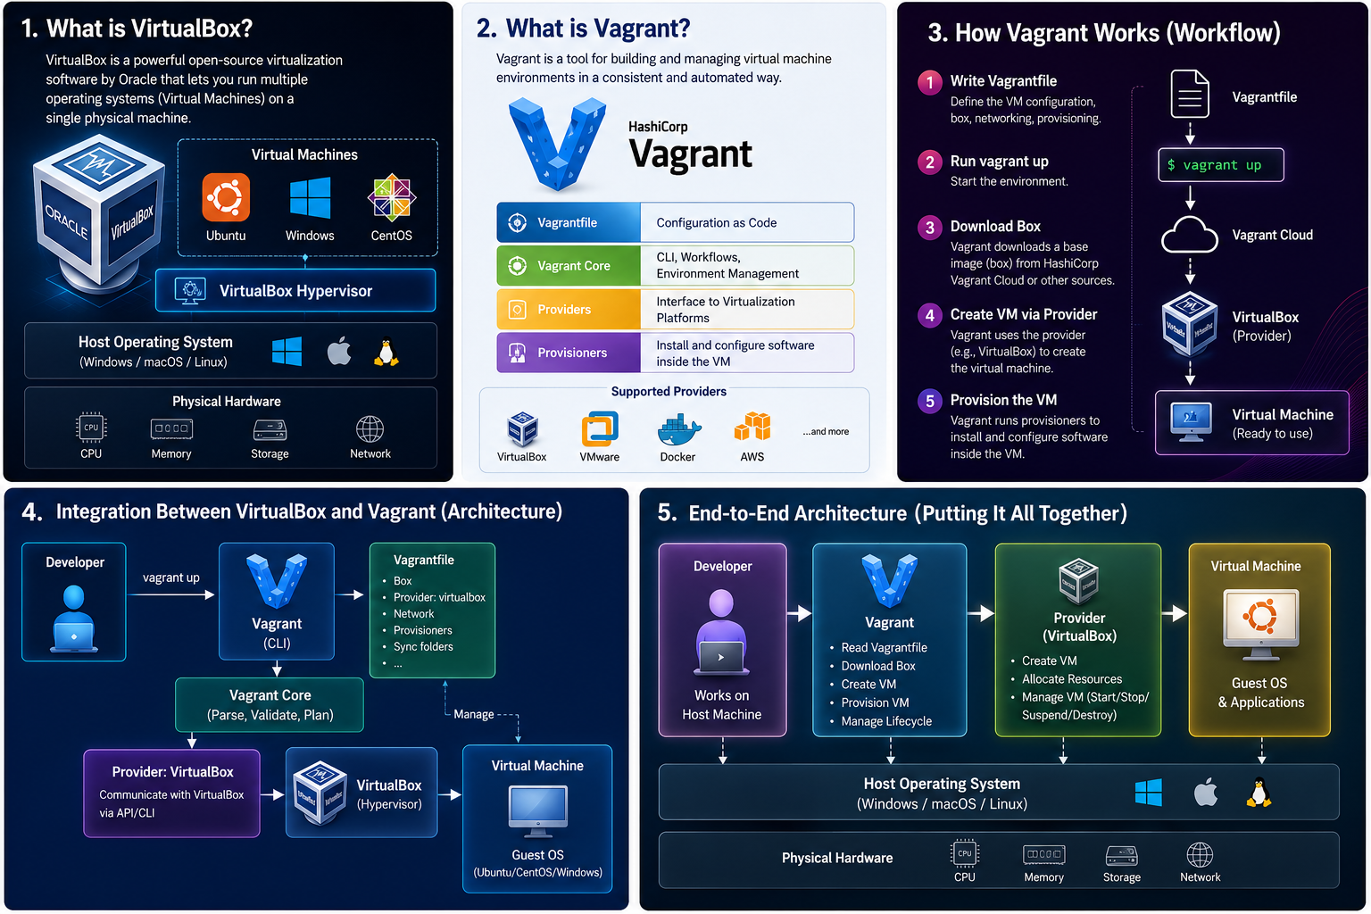

Slide 3
What This Deck Covers
From two separate tools to one smooth workflow — and the plugin that ties them together.
The two tools
VirtualBox — the hypervisor
Vagrant — automation wrapper
Boxes — base VM images
Where each tool fits
The integration
Provider plugin — the bridge
Vagrantfile — VM as code
Networking & port forwarding
Shared folders host ↔ guest
Provisioners install software
In practice
vagrant up / ssh / halt
One-command lifecycle
Multi-machine clusters
Teardown & rebuild
Sharing with your team

Slide 4
What Is VirtualBox?
Oracle’s free type-2 hypervisor — it runs complete guest operating systems as virtual machines on your desktop or laptop.
Runs whole VMs
Type-2 hypervisor on your OS
Full guest OS, own kernel
Isolated from the host
Virtual hardware
vCPU, RAM, disk you allocate
Virtual NICs NAT / bridged
Snapshots save & restore
How you drive it
GUI manager to click
VBoxManage CLI control
Manual — slow to reproduce

Slide 5
What Is Vagrant?
A command-line tool from HashiCorp that builds and manages virtual machines from a single text file — it doesn’t virtualize anything itself, it automates a provider that does.
Infrastructure as code
One Vagrantfile per project
Text file, version-controlled
Same VM for everyone
Wraps the provider
Drives VirtualBox for you
No GUI clicking needed
Boxes as base images
One-command workflow
vagrant up builds it
vagrant ssh logs in
vagrant destroy cleans up

Slide 6
How They Work Together
Vagrant gives the orders, VirtualBox does the virtualizing — and a provider plugin connects the two.

Slide 7
The Integration: Vagrant Drives VirtualBox
You describe the VM once; Vagrant translates that into VirtualBox operations through a provider plugin.
What Vagrant provides
The Vagrantfile — your VM spec
vagrant commands up / halt / destroy
Box images fetched & cached
Provisioning hooks after boot
What VirtualBox provides
The virtualization — the real engine
Compute & storage vCPU, RAM, disks
Virtual networking NAT, host-only
VBoxManage API Vagrant calls it
The bridge
The virtualbox provider is the built-in glue — it turns Vagrantfile settings into VBoxManage calls, so vagrant up creates, boots and configures the VM with no manual clicks.

Slide 8
Anatomy of a Vagrantfile
One Ruby file describes the whole VM — box, network, resources and setup. The provider block is where VirtualBox gets its instructions.
Vagrant.configure("2") do |config|
config.vm.box = "oraclelinux/8" # base box from catalog
config.vm.hostname = "ol8-lab"
config.vm.network "private_network", # host-only IP
ip: "192.168.56.10"
config.vm.network "forwarded_port",
guest: 1521, host: 1521 # Oracle listener
config.vm.provider "virtualbox" do |vb| # the provider block
vb.name = "ol8-lab"
vb.memory = 4096
vb.cpus = 2
end
config.vm.provision "shell", # runs after first boot
inline: "dnf install -y git vim"
end
▶ Commit this file to your repo, and vagrant up rebuilds the exact same machine on any host — no manual VirtualBox setup.

Slide 9
The Vagrant Workflow
The full lifecycle of a machine — five commands, all run from the folder that holds your Vagrantfile.
The core commands · run from your project folder
1. vagrant init — creates a starter Vagrantfile in the current folder.
2. vagrant up — fetches the box, then builds and boots the VM in VirtualBox.
3. vagrant ssh — drops you straight into the running guest.
4. vagrant halt — powers the VM off; vagrant reload re-reads the file.
5. vagrant destroy — deletes the VM so you can rebuild from scratch.
What this gives you
✓ The Vagrantfile is the source of truth — the same commands recreate an identical VM anywhere.
✓ vagrant up is idempotent: run it again and it only applies what is missing.

Slide 10
Why Pair Them?
VirtualBox alone means click-by-click setup; Vagrant alone virtualizes nothing. Together they turn a whole environment into code.
Reproducible
Identical VMs every time
No drift between machines
In git with your code
Fast to spin up
One command to build
Boxes cached locally
Destroy & rebuild freely
Team-friendly
Share one file not a wiki
Onboard in minutes
Any host OS — same result

Slide 11
Get started in 3 commands
vagrant init oraclelinux/8 → vagrant up → vagrant ssh
Install VirtualBox and Vagrant, drop a Vagrantfile in a folder, and you have a reproducible VM as code.

