Slide 1

Alpa Filters
Clean Air for Everyone

Slide 2

The Air Crisis Affecting 90%+ Urban Indians
90%
₹5K-20K
0
Urban Population
Purifier Cost
Clean Air Access
Unaffordable for most Indian families
For students, PG rooms, small shops, low-income homes
Exposed to unsafe PM2.5 and PM10 levels daily
The urgent need: Ultra-low-cost, effective, durable air filtration for the masses

Slide 3

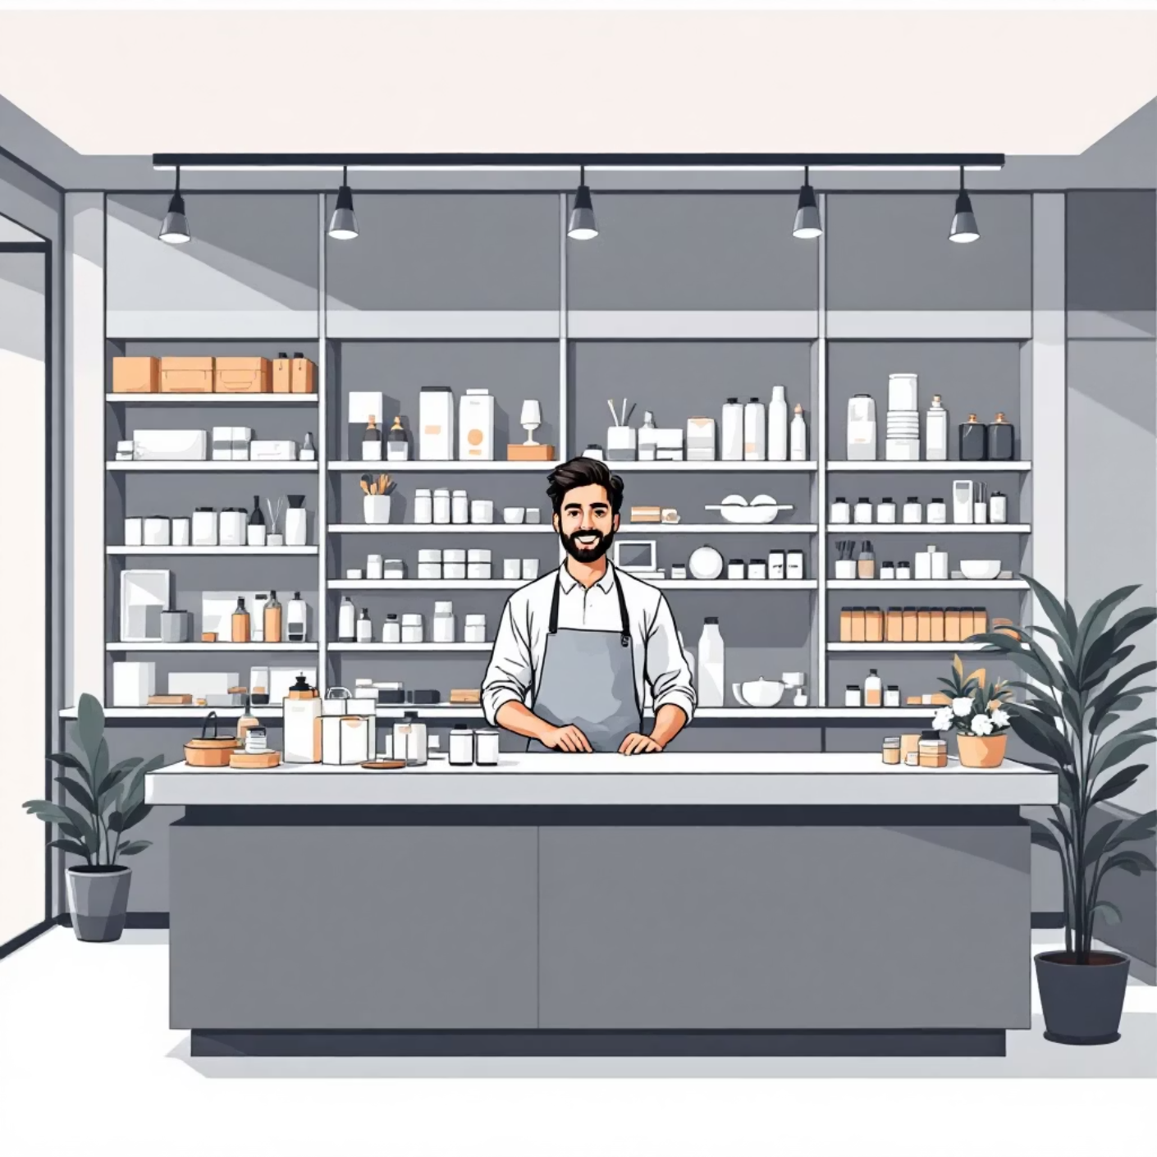
₹3000+ Crore Market Opportunity
India's Air Purifier Market
Target Users
Students and hostel residents
Middle-class households
Small retail shops
Rural and urban low-income families

Slide 4



The Gap in Current Solutions
HEPA Purifiers
Cheap Purifiers
DIY YouTube Hacks
High performance but unaffordable for most Indians
Low cost but poor filtration, unreliable quality
Not standardised, no quality guarantee or support
Critical Gap: No brand offers a tested, standardised, ultra-affordable air filter solution

Slide 5
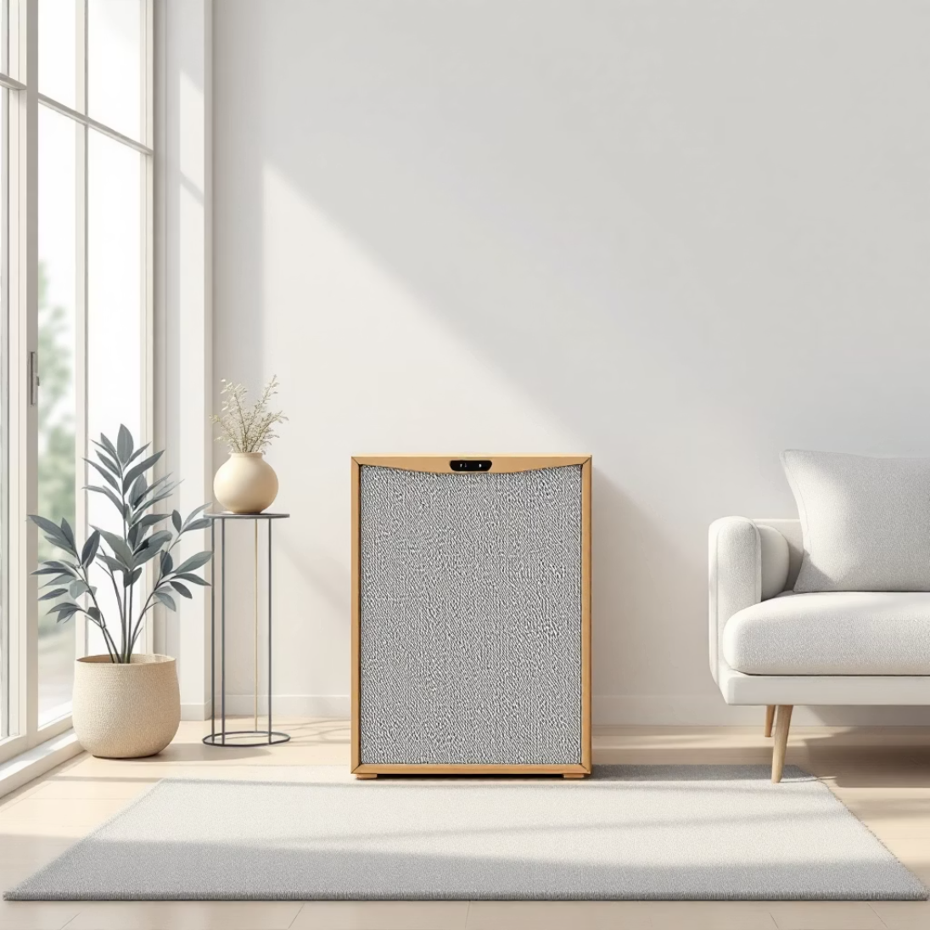





Introducing Our Solution
Affordable DIY Air Filter
₹499–₹999
Multi-layer filtration
PM2.5 and PM10 reduction
Portable design
Perfect for small 3×3×3 m rooms
Easy assembly
Simple setup, no expertise needed
Reusable filters
Low maintenance, eco-friendly
Energy efficient
Low-watt fan system

Slide 6





How It Works: Product Breakdown
Pre-filter Layer
Captures large dust particles and PM10 pollutants
Micro-fibre Fine Filter
Traps PM2.5 particles for cleaner breathing air
Activated Carbon
Removes odours and smoke (optional premium model)
Low-watt Fan Unit
Energy-efficient air circulation system
Replaceable Filter Pack
Easy maintenance with affordable refills

Slide 7




Unbeatable Value Proposition
85-90%
1/10
₹50-100
Performance Match
Cost Fraction
Filter Replacement
Comparable benefits to expensive HEPA purifiers
Just one-tenth the price of traditional purifiers
Affordable ongoing maintenance costs
Why Choose Alpa Filters?
No complex electronics required
Extremely low operating expenses
Simple, effective, reliable
Designed for Indian homes

Slide 8
Sustainable Business Model
DIY Filter Kits
Replacement Packs
Premium Models
Initial product sales at ₹499–₹999
Recurring revenue stream from filter refills
Upgraded versions with carbon filters, metal frames
Distribution Channels
Direct to Consumer
B2B Partnerships
Amazon India
Schools and educational institutions
Meesho
Small shops and retail outlets
Own website
Bulk corporate orders

Slide 9
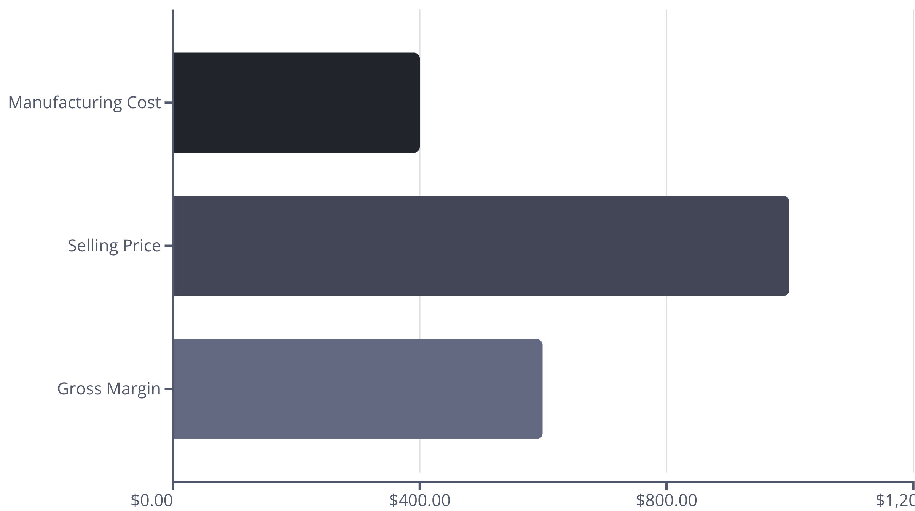
Strong Unit Economics
Product Margin: 40–60%
Filter Pack Margin: 70%
Healthy margins on initial kit sales
High-margin recurring revenue from replacements
Scalable model with strong repeat purchase potential

Slide 10

Our Vision
Clean air should be a basic right, not a luxury
Our Goal
Make India's most affordable, widely accessible air filtration system
Founded by Rehan
Thank you for your time
Let's make clean air accessible to every Indian family

