Slide 1
ScholarSphere
A graphical exploration and AI summarization for researchers
Members: Annu, Kunal, Paul, Ikshita

Slide 2






Presentation Overview
Problem Statement
Proposition
Identifying the core challenges faced by researchers.
Our solution to address these challenges.
Key Features
Architecture Overview
Highlighting the functionalities of ScholarSphere.
Understanding the system's underlying structure.
Workflow
Technology Stack
How ScholarSphere will work.
The tools and frameworks to be used.

Slide 3
Key Challenges in Research
Explore Publication Trends
Assess Paper quickly
Explore Faculty Profiles
Difficulty understanding who worked with whom and in what years.
Need to read papers fully to determine relevance without quick summarization.
Difficulty accessing comprehensive faculty profile information.

Slide 4
ScholarSphere: Our Innovative Solution
Aggregated Knowledge
Interactive Visualization
AI-Powered Summaries
Unifies faculty publication data from sources like DBLP, ORCID, OpenAlex, etc.
Builds a knowledge graph to visually map the relationships between faculty and their work.
Delivers instant, AI-generated summaries of research papers and faculty profiles.

Slide 5
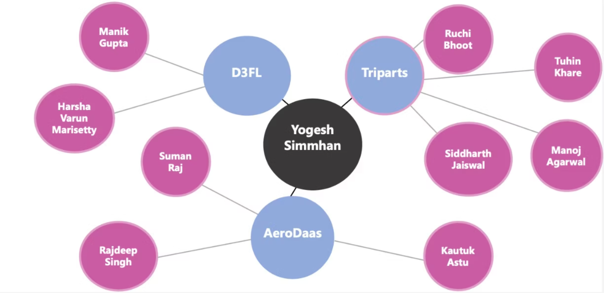
Key Features: Visualizing Connections
Model of Graph: The interactive graph allows users to explore connections by clicking on nodes.

Slide 6
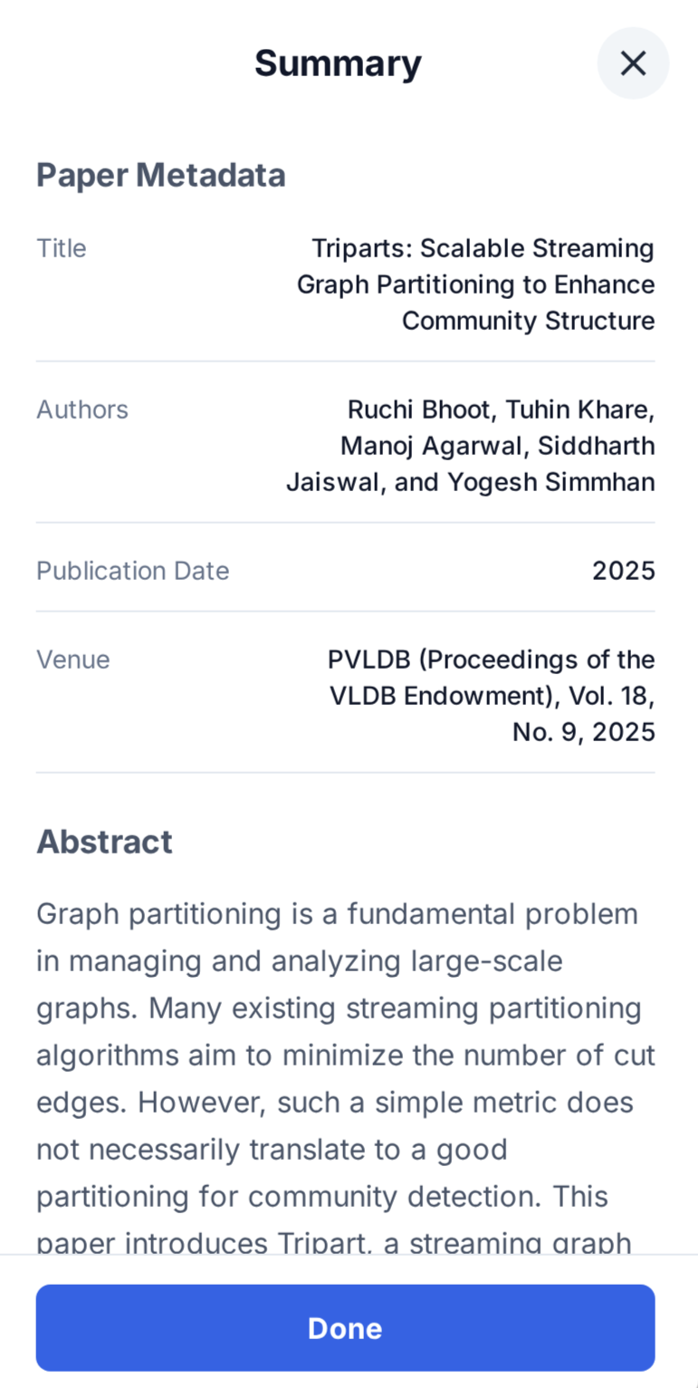
Key Features: Paper Summarization
When a user clicks on a paper node, ScholarSphere provides a concise summary and metadata :
Paper title
Authors
Publication Date
Conference

Slide 7
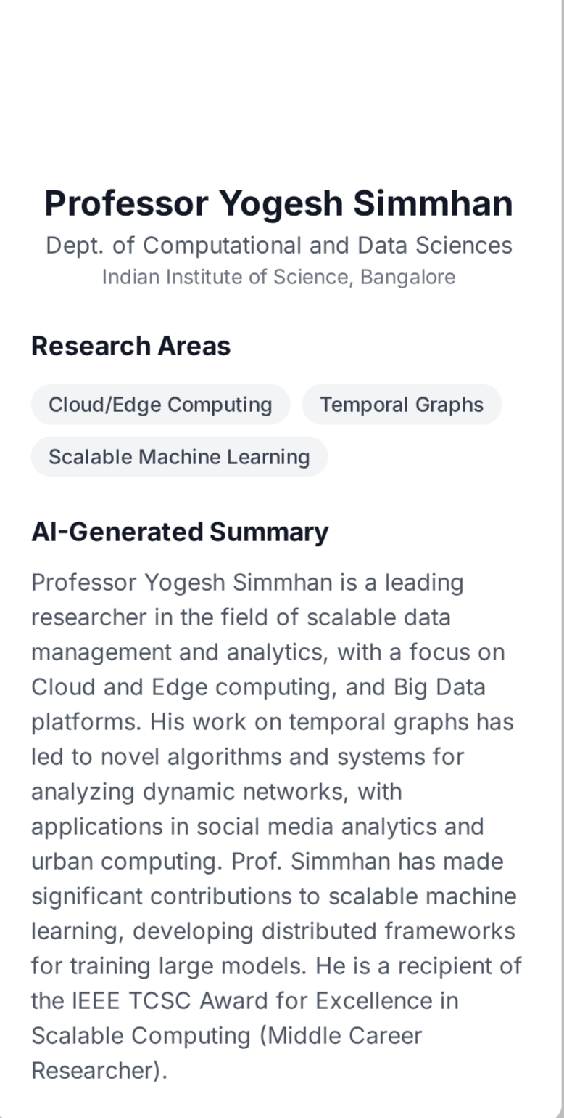
Key Features: Faculty profile Summarization
When a user clicks on a faculty node, ScholarSphere provides a concise summary and metadata:
Name of faculty
Department
Research areas

Slide 8






Architecture overview
Data Acquisition from sources
DBLP, ORCID, OpenAlex, etc.
Scraper Service
Periodic data collection and cleaning.
Database Layer
Neo4j Graph DB, PostgreSQL
Graph Service & Summarization API
REST endpoints, LLM integration
Frontend
Thymeleaf / React + Cytoscape.js
User Interaction
Visualization, search, and exploration

Slide 9
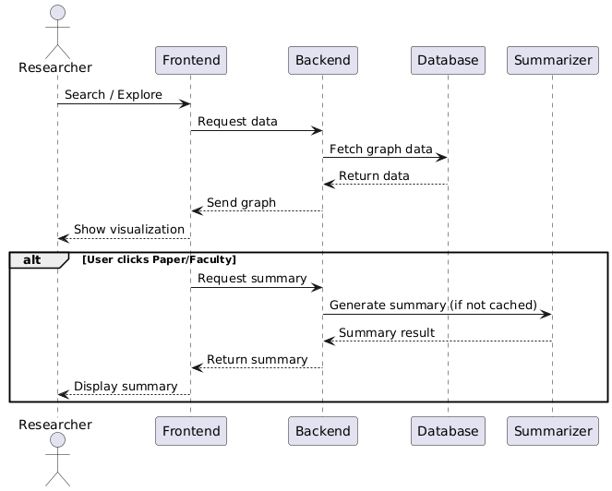

Slide 10




Technology Stack
Backend
Database
Spring Boot (REST API and services)
Neo4j (Graph database)
Open Source LLM (AI powered summarization)
PostgresSQL (Summary storage)
Frontend
Deployment
React.js/Thymeleaf (UI framework)
Docker (Containerization)
Cytoscape.js (Graph visualization)
AWS EC2(Cloud hosting)

Slide 11
Long Term Functionality
Metadata for dead nodes
Graph Expansion
Beyond IISc faculty
Retain and display metadata even for dead/inactive nodes.
Builds a knowledge graph to visually map the relationships between faculty and domain of papers .
Expand ScholarSphere to include faculty from other institutes.

Slide 12
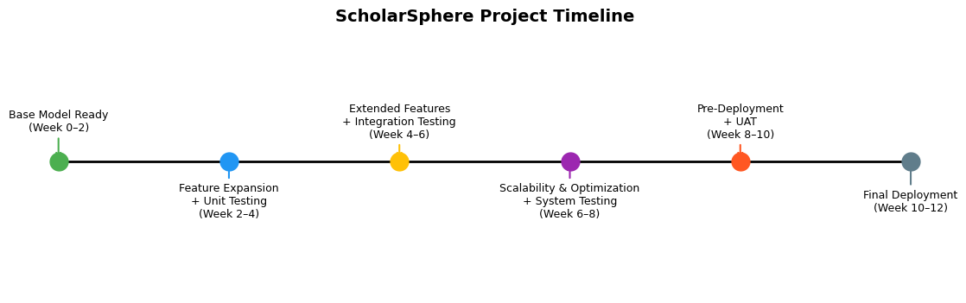

Slide 13
Thank You!

Slide 14
ScholarSphere
Aggregate faculty
publications
Build co-authorship graph
AI-based summaries.​
Members: Annu, Kunal, Paul, Ikshita

Slide 15
Project Requirement
Data Scraping: Scrape metadata from open research sources
Graph Construction: Store and manage relationships (Author–Paper–Coauthor) in Neo4j.
Frontend: Search Professor by name.
Visualization: Interactive graph explorer (Cytoscape.js) with filters .
Paper Summarization: LLM based summary of paper.
Faculty Summarization: LLM based summary of faculty profile.
Create Docker container for microservices.

Slide 16
Minor Changes
Data Ingestion
Frontend
Summary
Switched to OpenAlex API, Semantic scholar API for bibliographic data(generalization to beyond IISC)
Used Thymeleaf only for frontend for sake of simplicity. ​
Showing abstract of paper instead of summarization.

Slide 17
System Design overview
Scrappy Service: Go
Fetch from OpenAlex, Semantic scholar
Graph Service: Springboot
Traversal and API
Database Service
Neo4j Graph DB
Gateway Service: Springboot
API routing
Frontend Service
Thymeleaf + Cytoscape.js
Summary Service: Python
Llama 3.1 based summarization

Slide 18
Neo4j Schema
Nodes | Key Properties | Description
Author | displayName, orcid id, openAlex id, worksCount, citedByCount | Represents a researcher or faculty member.
Work | OpenAlex id, title, publicationYear, doi, citedByCount | Represents a published paper or research work authored by one or more authors.
Relationship: (:Author) -[:AUTHORED]-> (:Work)

Slide 19
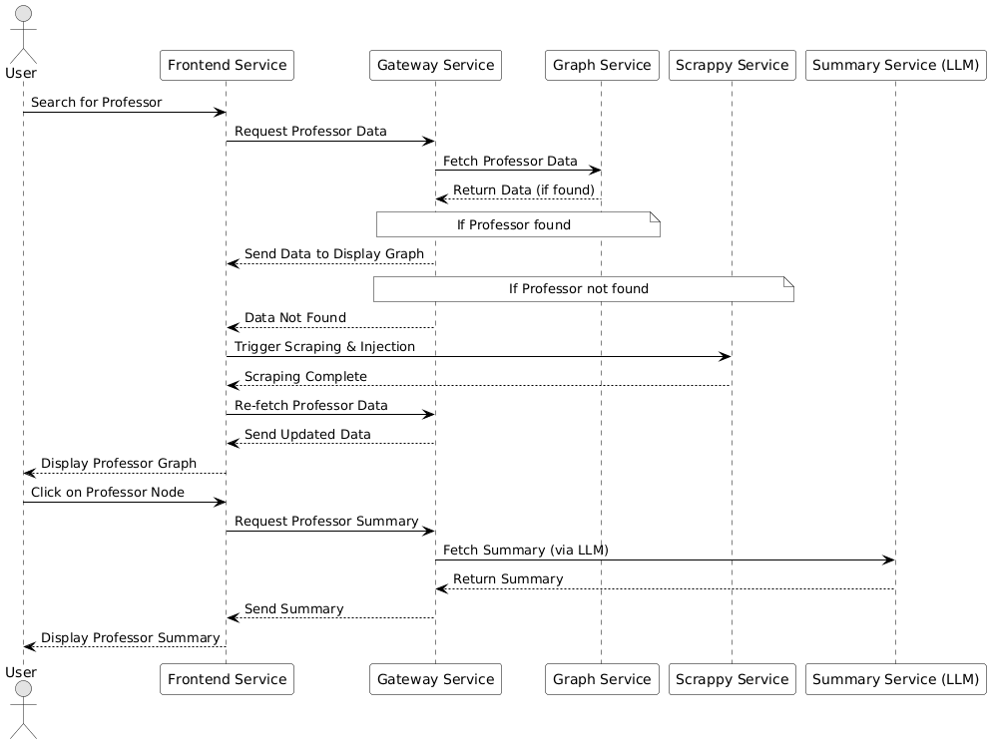
Implementation Workflow

Slide 20



Current Status
Data Scraping: Scrape metadata from open research sources
Graph Construction: Author -> Paper (no co-author relationship(2 hops))
Frontend: Search professor by name.
Visualization: Search and explore by filters .
Paper Summarization: LLM based summary of paper.
Faculty Summarization: LLM based summary of faculty profile.
Create Docker container for microservices.

Slide 21
Challenges faced
Data Scraping
Graph Display
Summary
Storage size of large data dumps from sources(
DBLP, Orcid, etc.)
Complexity in aggregation (Schema mismatch)
Redundant data
Problem with flattening graph JSON response.
Getting recursive graph instead of 2 hop.
Model sometimes hallucinate with
author summary.​
Even though Author affiliation
information is present model
sometimes miss that.

Slide 22
Future Timeline
Week 5(11 – 17 oct)
Co-Authorship graph + Paper summarization
Week 6(18 –24 oct)
Filters for search + Integrated Testing with extended dataset
Week 7(25-31 oct)
UI polish + performance testing
Week 8(1-7 nov)
End to End testing pre-deployment
Week 9(8- 14 nov)
Deployment on AWS
Week 10(15 – 21 nov)
Acceptance Testing + Final Submission

Slide 23
LLMs used
GPT 5
Gemini 2.5
Claude
Context window is limited
Good for code chunk generation and provide ideas.
Fails to capture complete context
Overly generic & redundant response
Good for code debugging ( Claude Sonnet 4.5)
Performance degrades as context length increases

Slide 24
Thank You!

