Slide 1
ScholarSphere
A graphical exploration and AI summarization for researchers
Members: Annu, Kunal, Paul, Ikshita

Slide 2






Presentation Overview
Problem Statement
Proposition
Identifying the core challenges faced by researchers.
Our solution to address these challenges.
Key Features
Architecture Overview
Highlighting the functionalities of ScholarSphere.
Understanding the system's underlying structure.
Workflow
Technology Stack
How ScholarSphere will work.
The tools and frameworks to be used.

Slide 3
Key Challenges in Research
Explore Publication Trends
Assess Paper quickly
Explore Faculty Profiles
Difficulty understanding who worked with whom and in what years.
Need to read papers fully to determine relevance without quick summarization.
Difficulty accessing comprehensive faculty profile information.

Slide 4
ScholarSphere: Our Innovative Solution
Aggregated Knowledge
Interactive Visualization
AI-Powered Summaries
Unifies faculty publication data from sources like DBLP, ORCID, Google Scholar, etc.
Builds a knowledge graph to visually map the relationships between faculty and their work.
Delivers instant, AI-generated summaries of research papers and faculty profiles.

Slide 5
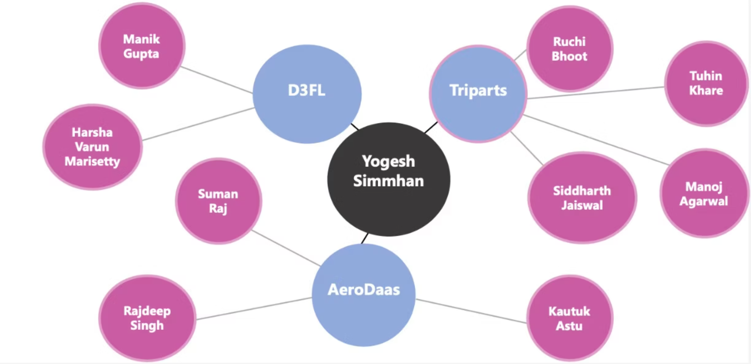
Key Features: Visualizing Connections
Model of Graph: The interactive graph allows users to explore connections by clicking on nodes.

Slide 6
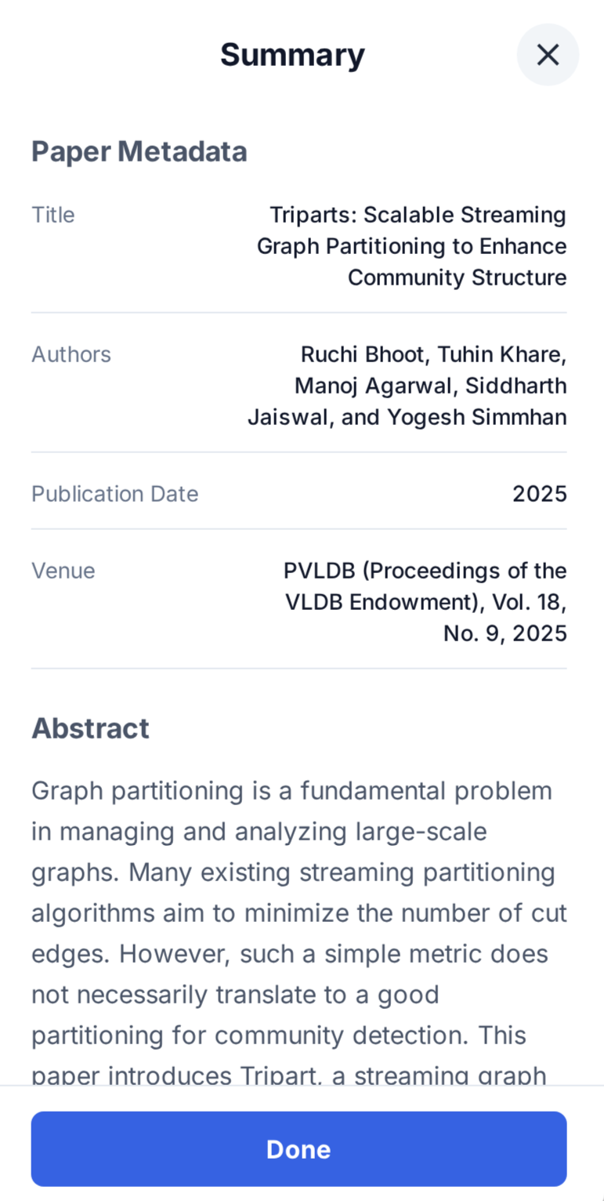
Key Features: Paper Summarization
When a user clicks on a paper node, ScholarSphere provides a concise summary and metadata :
Paper title
Authors
Publication Date
Conference

Slide 7
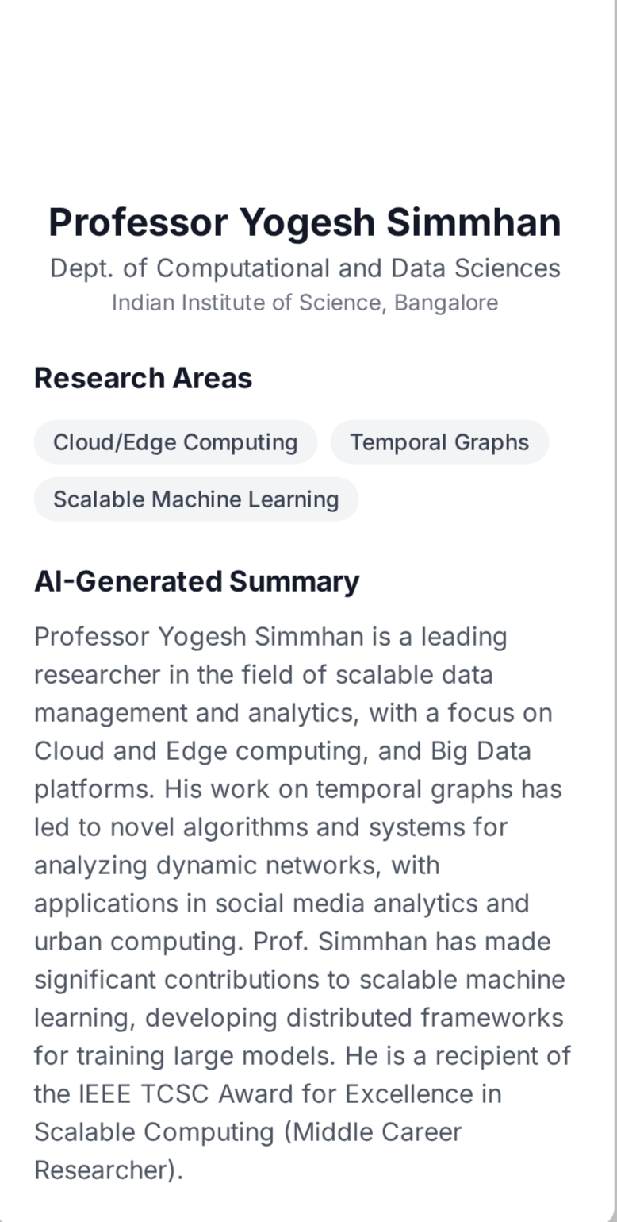
Key Features: Faculty profile Summarization
When a user clicks on a faculty node, ScholarSphere provides a concise summary and metadata:
Name of faculty
Department
Research areas

Slide 8






Architecture overview
Data Acquisition from sources
DBLP, ORCID, OpenAlex, etc.
Scraper Service
Periodic data collection and cleaning.
Database Layer
Neo4j Graph DB, PostgreSQL
Graph Service & Summarization API
REST endpoints, LLM integration
Frontend
Thymeleaf / React + Cytoscape.js
User Interaction
Visualization, search, and exploration

Slide 9
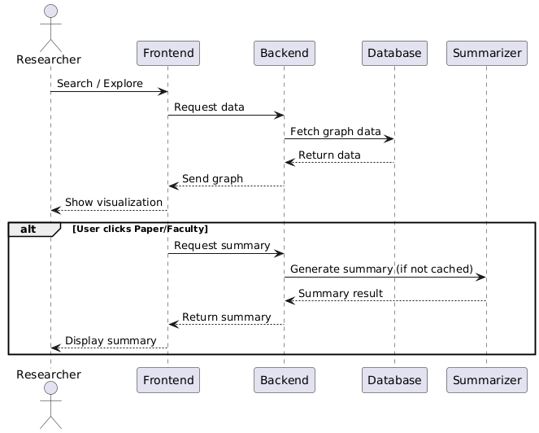

Slide 10




Technology Stack
Backend
Database
Spring Boot (REST API and services)
Neo4j (Graph database)
Open Source LLM (AI powered summarization)
PostgresSQL (Summary storage)
Frontend
Deployment
React.js/Thymeleaf (UI framework)
Docker (Containerization)
Cytoscape.js (Graph visualization)
AWS EC2(Cloud hosting)

Slide 11
Long Term Functionality
Metadata for dead nodes
Graph Expansion
Beyond IISc faculty
Retain and display metadata even for dead/inactive nodes.
Builds a knowledge graph to visually map the relationships between faculty and domain of papers .
Expand ScholarSphere to include faculty from other institutes.

Slide 12
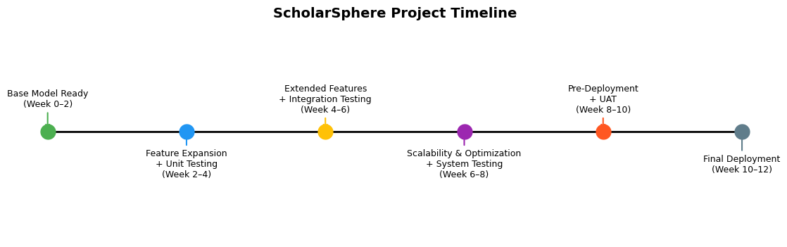

Slide 13
Thank You!

