Slide 1
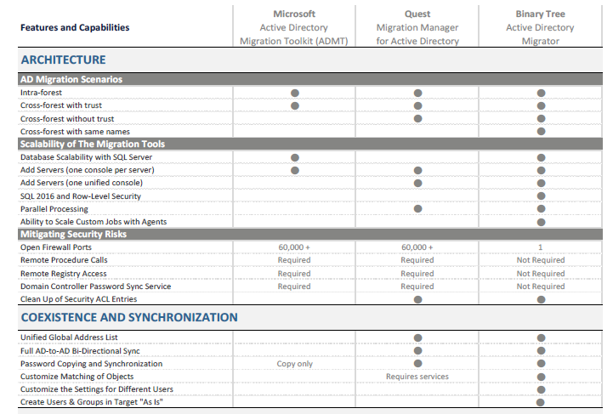
AD Migration tool – QMM (quest) VS Active Directory Migrator (binary tree) - Continued
Comparison Table between ADMT, Quest Migration Manager and Active Directory Migrator
1

Slide 2
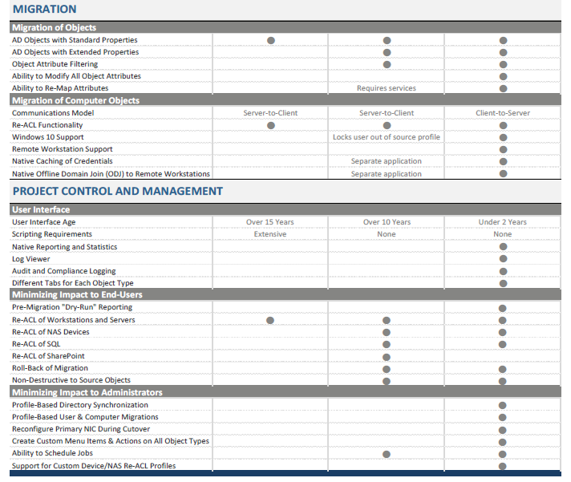
AD Migration tool – QMM (quest) VS Active Directory Migrator (binary tree)
Comparison Table between ADMT, Quest Migration Manager and Active Directory Migrator
Note: AD Migrator tool can be suggested after comparisons between ADMT, QMM and AD Migrator tools.
2

