Slide 1
Windows Azure Cloud
Roger Barga, Microsoft
Thilina Gunarathne, Indiana University

Slide 2
Agenda
Cloud Computing Fundamentals
The Windows Azure Service Model
Windows Azure Storage
High Availability and Windows Azure Services

Slide 3
Cloud Computing Fundamentals

Slide 4
What is a “Cloud”?
Cloud: on-demand, scalable, multi-tenant, self-service compute and storage resources
Server Provisioning
Cloud Provisioning
Demand
Demand
Time
Overprovisioned
Time
Underprovisioned

Slide 5
Cloud Terminology
Infrastructure as a Service (IaaS): basic compute and storage resources
On-demand servers
Amazon EC2, VMWare vCloud
Platform as a Service (PaaS): cloud application infrastructure
On-demand application-hosting environment
E.g. Google AppEngine, Salesforce.com, Windows Azure
Software as a Service (SaaS): cloud applications
On-demand applications
E.g. Office 365, GMail, Microsoft Office Web Companions

Slide 6

Cloud: Efficiency Versus Control
Windows Azure
= Managed for You | Standalone Servers | IaaS | PaaS | SaaS
Applications
Runtimes
Database
Operating System
Virtualization
Server
Storage
Networking
Efficiency
Control+Cost

Slide 7

IaaS
Developer
5) Configure load
balancer
1) Choose image, then create VM for DBMS and configure DBMS
2) Choose image, then create and configure VM(s) for application
3) Provision database, then create tables and add data
4) Install application
6) Manage VMs and DBMS (e.g., deploying new OS images in VMs)
Library
VM Images
Data
Application
Web
Server
Load Balancer
DBMS
Operating
System
Operating
System
Operating
System
VM
VM

Slide 8
PaaS
Developer
1) Provision database, then create tables and add data
2) Deploy application
Data
Application
Web
Server
Load Balancer
DBMS
Operating
System
Operating
System
Operating
System
VM
VM

Slide 9
Windows Azure
Windows Azure is an OS for the data center
Handles resource management, provisioning, and monitoring
Manages application lifecycle
Allows developers to concentrate on business logic
Provides common building blocks for distributed applications
Reliable queuing, simple structured storage, SQL storage
Application services like access control, caching, and connectivity

Slide 10
Windows Azure Platform
Windows Azure Applications
Windows
Azure
Middleware
Services
AppFabric Caching
AppFabric Access Control Server
AppFabric Service Bus
Windows
Azure
Data Services
SQL Azure
Windows Azure Storage
Windows Azure CDN
“Red Dog” Front End (RDFE)
Fabric Controller
Windows Azure Networking
Windows
Azure
Compute
Notes:
Fabric Controller: A set of modified virtual Windows Server 2008 images running across Azure that control provisioning and management
Fault Domain: A set of resources within an Azure data center that are considered non-fault tolerant and a discrete unit, like a single rack of servers. A Service by default splits virtual instances across at least two Fault Domains.
Role: Microsoft’s name for a specific configuration of Azure virtual machine. The terminology is from Hyper-V.
Service: Azure lets users run Services, which then run virtual machine instances in a few pre-configured types, like Web or Worker Roles. A Service is a batch of instances that are all governed by the Service parameters and policy.
RDFE serves as the front end for all Windows Azure services
Subscription management
Billing
User access
Service management
RDFE is responsible for picking clusters to deploy services and storage accounts
First datacenter region
Then affinity group or cluster load
Normalized VIP and core utilization

Slide 11
The Windows Azure Service Model

Slide 12
Windows Azure Application Philosophy: Design for Failure
Scale out for capacity
Scale out for redundancy
Asynchronous communication
Short time outs with retries
Idempotent operations
Stateless with durable external storage

Slide 13
Windows Azure Application Characteristics
Windows Server
Windows Azure
 | Single Instance Persistent OS | Multi-Instance Stateless OS
Automated, Consistent Application Updates
Automated, Consistent Configuration Changes
Multi-Instance Management
Scale-out
High Availability
Automated, Consistent OS Servicing
 | Single Instance Persistent OS | Multi-Instance Stateless OS
Automated, Consistent Application Updates
Automated, Consistent Configuration Changes
Multi-Instance Management
Scale-out
High Availability
Automated, Consistent OS Servicing

Slide 14
Let’s Make a Cloud Application!
Marketing wants to catch branding violations
Take as input an uploaded PowerPoint file and scan it for “branding violations” (use of “Azure” without “Windows” or “SQL” prefix)
Requirements:
High availability
IIS/MVC2 web site
Scalable violation scanning workers

Slide 15
Multi-Tier Cloud Application
A cloud application is typically made up of different components
Front end: e.g. load-balanced stateless web servers
Middle worker tier: e.g. order processing, encoding
Backend storage: e.g. SQL tables or files
Multiple instances of each for scalability and availability
Front-End
Windows
Azure
Storage, SQL Azure
Front-End
Middle-Tier
HTTP/HTTPS
Load Balancer
Cloud Application

Slide 16
The Windows Azure Service Model
A Windows Azure application is called a “service”
Definition information
Configuration information
At least one “role”
Roles are like DLLs in the service “process”
Collection of code with an entry point that runs in its own virtual machine
Windows Azure compute SLA requires two instances of each role
99.95% for connectivity to two instances
Achieved with update and fault domains

Slide 17
Role Contents
Cloud Service
Definition:
Role name
Role type
VM size (e.g. small, medium, etc.)
Network endpoints
Code:
Web/Worker Role: Hosted DLL and other executables
VM Role: VHD
Configuration:
Number of instances
Number of update and fault domains
Role: Front-End
Definition
Type: Web
VM Size: Small
Endpoints: External-1
Configuration
Instances: 2
Update Domains: 2
Fault Domains: 2
Role: Middle-Tier
Definition
Type: Worker
VM Size: Large
Endpoints: Internal-1
Configuration
Instances: 3
Update Domains: 2
Fault Domains: 2

Slide 18
Role Types
There are currently three role types:
Web Role: IIS7 and ASP.NET in Windows Azure-supplied OS
Worker Role: arbitrary code in Windows Azure-supplied OS
VM Role: uploaded VHD with customer-supplied OS
VM Role: is it a VM?
No, because it is stateless
Good for:
Long install (5+ minutes)
Manual install/config
Fragile install/config

Slide 19
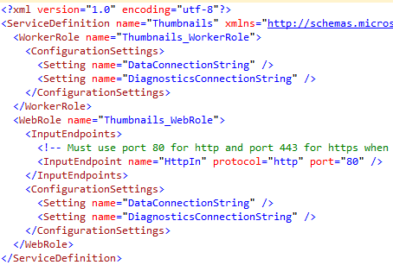
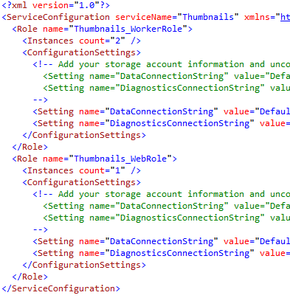

Service Model Files
Service definition is in ServiceDefinition.csdef
Service configuration is in ServiceConfiguration.cscfg
CSPack program Zips service binaries and definition into service package file (service.cscfg)

Slide 20
Windows Azure Storage

Slide 21
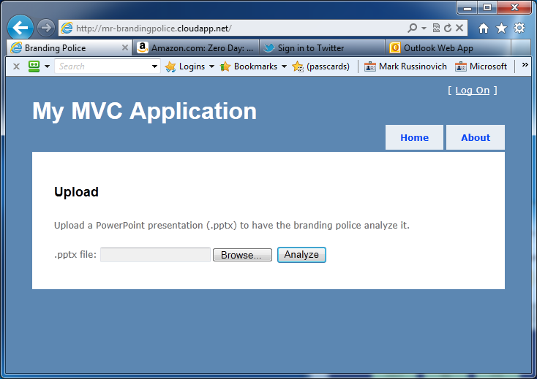
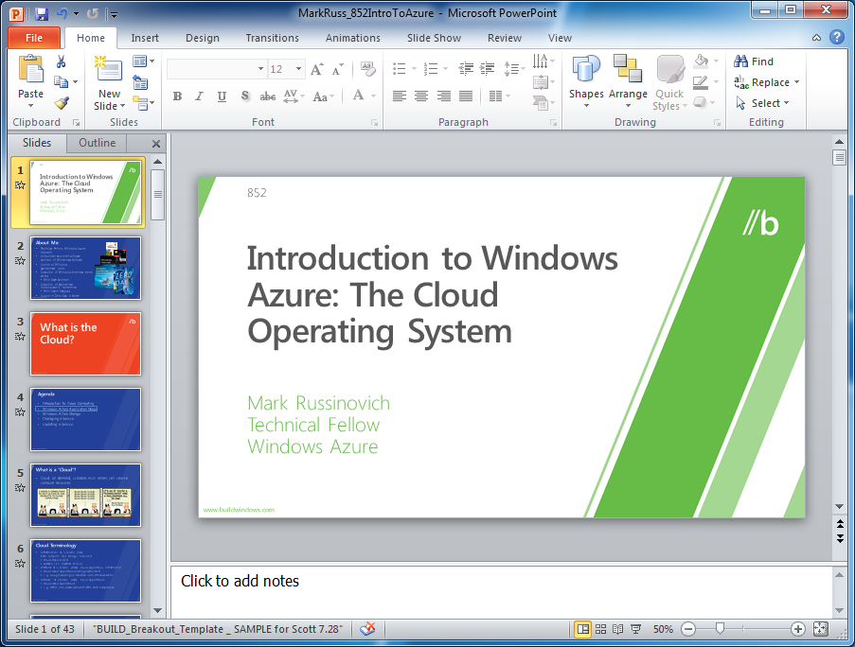
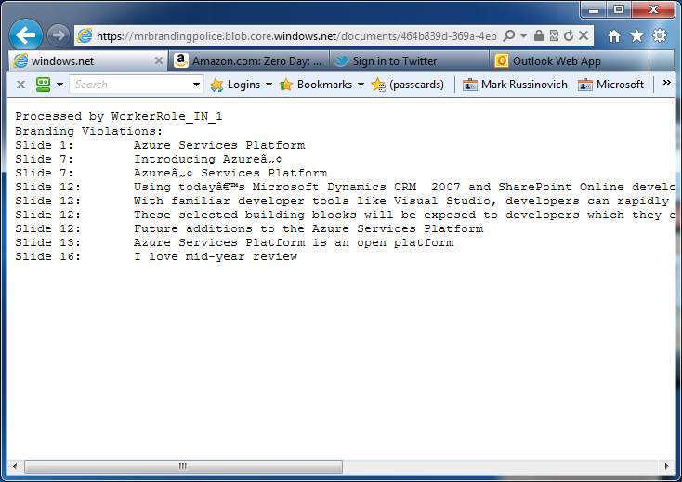
Branding Police Inter-Role Communication
We have several types of communication between roles:
PowerPoint file sent from Web Role to Worker Role
Branding violations returned from Worker Role to user
Requirements:
Communication must be asynchronous
Must support concurrent violation scans for different users
Failure of any node must cause at worst a delay
Let’s look at Windows Azure storage and communications support…
Web
Role
Worker
Role

Slide 22
Windows Azure Storage Fundamentals
Storage characteristics
Durable – replicated three times
Scalable (capacity and throughput)
Highly available
Simple and familiar programming interfaces
REST (HTTP and HTTPS)
.NET accessible

Slide 23
Storage Objects
Blobs
Provide a simple interface for storing named files along with metadata for the file
Tables
Provide lightly structured storage with a set of entities that contain a set of properties
Queues
Provide reliable storage and delivery of messages

Slide 24
Storage Account and Blob Containers
Storage account
An account can have many blob containers
Container
A container is a set of blobs
Sharing policies are set at the container level
Public READ or Private
Associate metadata with container
Metadata is <name, value> pairs
Up to 8KB per container
List the blobs in a container

Slide 25
Blob Storage Concepts
Account
Container
Blob
IMG001.JPG
pictures
IMG002.JPG
sally
movies
MOV1.AVI

Slide 26
Table Data Model
Table
A storage account can create many tables
.NET classes and LINQ
A table is a set of entities (rows)
An entity is a set of properties (columns)
Billions of entities and TBs of data
Two “key” properties that together are the unique ID of the entity in the table
PartitionKey – enables scalability
RowKey – uniquely identifies the entity within the partition
Notes:
Partitions distributedly stored.
Querying using ParititionKey and RowKey are faster. You can encode data in to the PartitionKey and RowKey..
Eventual consistency
Atomic update operations only inside a partition.

Slide 27
Table Storage Concepts
Account
Table
Entity
Name =…
Email = …
users
Name =…
Email = …
sally
Photo ID =…
Date =…
photo index
Photo ID =…
Date =…

Slide 28
Windows Azure Queues
Provide reliable message delivery
Simple, asynchronous work dispatch
Programming semantics ensure that a message can be processed at least once
Queues are highly available, durable and performance efficient
Maximum size is 64K
FIFO in general, but not guaranteed
Pulling an item from the queue doesn’t delete it
It becomes invisible for a visibility timeout
Item must be deleted before timeout or else it becomes visible
Notes:
Not exactly once..

Slide 29
Queue Storage Concepts
Account
Queue
Message
128x128, http://…
thumbnail jobs
256x256, http://…
sally
http://…
photo processing jobs
http://…

Slide 30
Windows Azure Data Storage Concepts
Container
Blobs
http://<account>.blob.core.windows.net/<container>
Account
Table
Entities
http://<account>.table.core.windows.net/<table>
Queue
Messages
http://<account>.queue.core.windows.net/<queue>

Slide 31
Branding Police
Web
Role
Worker
Role
brandingpolice.cloudapp.net
Web
Role
{…-…-...-…}
Worker
Role
Working on…
Violations:…
{…-…-...-…}-report.txt
{…-…-...-…}

Slide 32
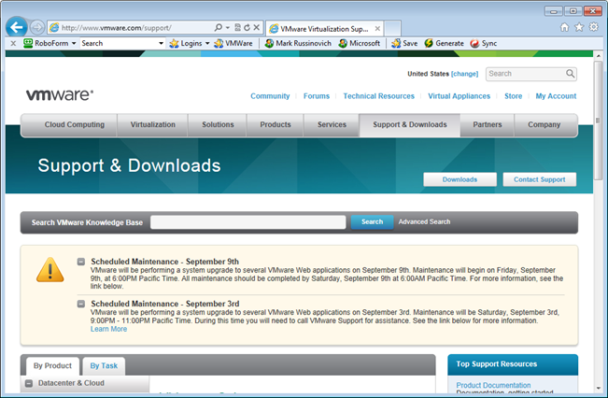

Updating Windows Azure Services

Slide 33
Update Types
There are two update types:
In-place: updating a live service
VIP swap: for testing first
In-place update:
Role instances updated one update domain at a time
Two modes: automatic and manual
VIP swap update:
Two slots: staging and production
New version of service deployed to staging slot
External VIP/DIP mapping swapped with old
Note: slots retain IP address

Slide 34
In-Place Update
Front-End-1
Middle Tier-3
Middle Tier-1
Front-End-2
Middle Tier-2
Purpose: Ensure service stays up while updating and Windows Azure OS updates
System considers update domains when upgrading a service
1/Update domains = percent of service that will be offline
Default is 5 and max is 20, override with upgradeDomainCount service definition property
The Windows Azure SLA is based on at least two update domains and two role instances in each role
Front-End-1
Front-End-2
Middle Tier-1
Middle Tier-2
Middle Tier-3
Update Domain 1
Update Domain 2
Update Domain 3

Slide 35
VIP Swap Detail
Note about VIPs: You keep your assigned VIP for the lifetime of a deployment
Even for VIP swap, “production” retains the production VIP
Production VIP – VIP1
<dnsname>.cloudapp.net
Staging VIP – VIP2
<guid>.cloudapp.net
Production VIP – VIP1
<dnsname>.cloudapp.net
Staging VIP – VIP2
<guid>.cloudapp.net
Port 80
Port 3389
Port 3390
Port 80
Port 3389
Port 3390
Port 80
Port 3389
Port 3390
Port 80
Port 3389
Port 3390
Role A
Role B
Role A’
Role B’
Role A
Role B
Role A’
Role B’
Deployment A
Deployment A’
Deployment A
Deployment A’

Slide 36
Update Type Capabilities
Supported Changes | In-place | VIP Swap | Delete and Redeploy
Operating system version | Yes | Yes | Yes
.NET trust level | Yes | Yes | Yes
Virtual machine size | Soon | Yes | Yes
Local storage settings | Yes (increase only) | Yes | Yes
Number of roles | Soon | Yes | Yes
Number of role instances | Yes | Yes | Yes
Number or type of endpoints | Soon | No | Yes
Names and values of configuration settings | Soon | Yes | Yes
Values (but not names) of configuration settings | Yes | Yes | Yes
Add new certificates | Soon | Yes | Yes
Change existing certificates | Yes | Yes | Yes
Deploy new code | Yes | Yes | Yes

Slide 37
High Availability and Windows Azure Services

Slide 38
Availability: Fault Domains
Avoid single points of physical failures
Unit of failure based on data center topology
E.g. top-of-rack switch on a rack of machines
Windows Azure considers fault domains when allocating service roles
At least 2 fault domains per service
Will try and spread roles out across more
Availability SLA – 99.95%
Front-End-1
Front-End-2
Front-End-1
Front-End-2
Middle Tier-1
Middle Tier-2
Middle Tier-1
Middle Tier-2
Middle Tier-3
Middle Tier-3
Fault Domain 1
Fault Domain 2
Fault Domain 3

Slide 39
Load Balancer Operation
FC programs load balancers (LB) to “probe” guest agent (GA) every 15 seconds
If the guest misses two probes, the LB stops forwarding traffic
The role can report “busy” status to the GA
GA stops responding to probes
LB keeps an idle connection open for 60s
Use keep-alive commands if the connection needs to be open longer

Slide 40
Guest Agent and Role Instance Heartbeats and Timeouts
Guest Agent Heartbeat
5s
Guest Agent Heartbeat Timeout
10 min
25 min
Guest Agent
Guest
Agent Connect
Timeout
Role Instance Heartbeat
15s
Role Instance “Unresponsive” Timeout
30s
Load Balancer Heartbeat
15s
Load Balancer
Timeout
30s
Indefinite
15 min
Role Instance
Role
Instance Launch
Role
Instance Start
Role
Instance Ready
(for updates only)

Slide 41
Conclusion
The Cloud enables pay-as-you-go self-service provisioning of application resources
Platform as a Service is all about reducing management and operations overhead
Windows Azure enables you to develop and deploy scalable, highly-available applications in minutes
With Windows Azure, you can deploy code using any Windows language or runtime
Windows Azure Training course
http://msdn.microsoft.com/en-us/wazplatformtrainingcourse.aspx

