Slide 1
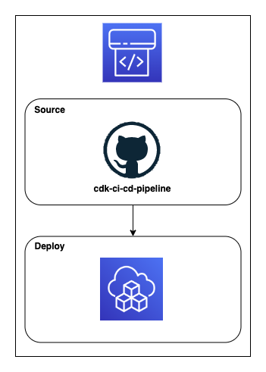
CDK CI/CD Pipeline Part 1
Source Stage (GitHub)
cdk-ci-cd-pipeline (contains two CDK projects)
Pipeline source – CLI
CodePipeline, Artifacts bucket
Infrastructure source – CI/CD
S3 bucket (API GW, Lambda, DynamoDB)
Deploy Stage
Deploy our CDK infrastructure project

Slide 2
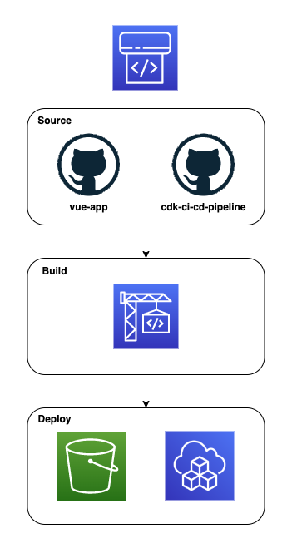
CDK CI/CD Pipeline Part 2
Source Stage (GitHub)
cdk-ci-cd-pipeline (contains two CDK projects)
Pipeline source – CLI
FE bucket, CF Dist, R53 HZ, ACM Cert
Infrastructure source – CI/CD
S3 bucket (API GW, Lambda, DynamoDB)
vue-app (frontend)
Build Stage
Build Vue app
Deploy Stage
Deploy our CDK infrastructure project
Deploy our built Vue app to S3

