Slide 1
Origin Access Identity (OAI)
Origin Access Control (OAC)
Restricts S3 bucket access to CloudFront.
Limited to S3 origins.
Basic access control through bucket policies.
Suitable for simple use cases with S3 and CloudFront.
Legacy
Provides advanced access control for CloudFront origins.
Works with multiple origin types (S3, custom origins, etc.).
Fine-grained control with support for headers, signed URLs, and cookies.
Ideal for modern, secure, and flexible cloud architectures.
Modern & best practice

Slide 2
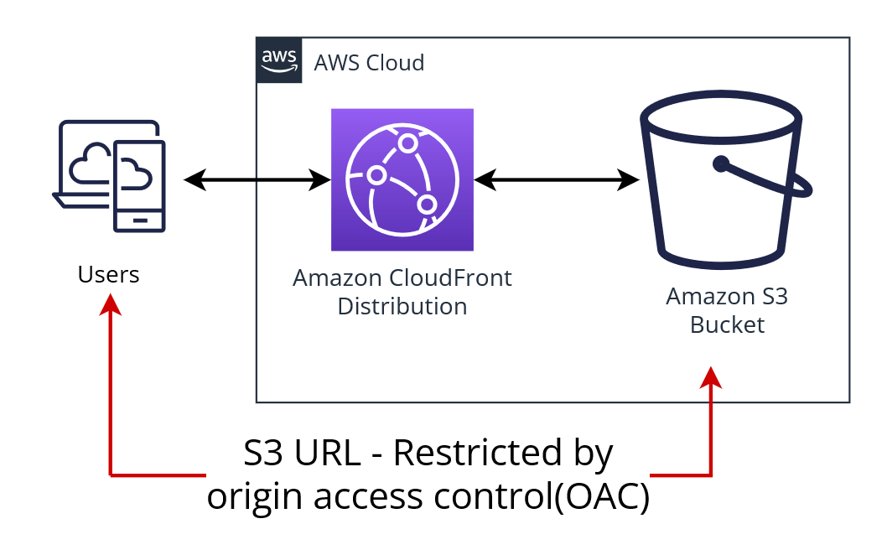
Why Use OAC Over OAI?
Enhanced Security Features
Broader Applicability
Future-Proofing
Considered Best Practice
Image credit: Storm IT

