Slide 1
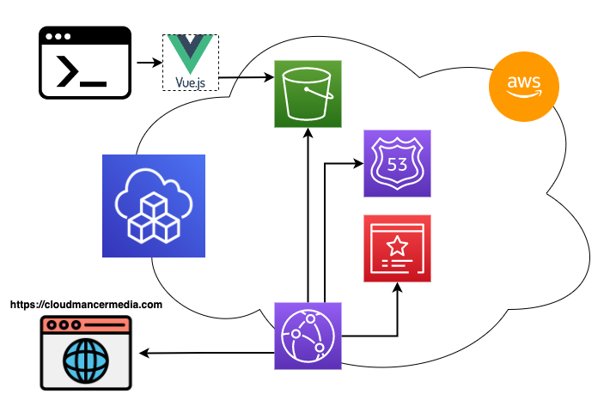
Easy SPA Website Hosting with AWS
3
Build and Deploy using the AWS CDK
Route 53 Name Servers for DNS
Build and Deploy Vue app to S3 using the AWS CLI
Visit our new website!
2
1
4

