Slide 1



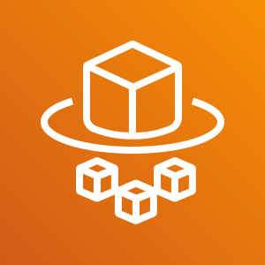


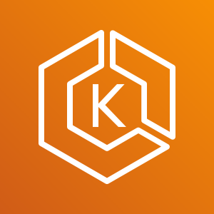
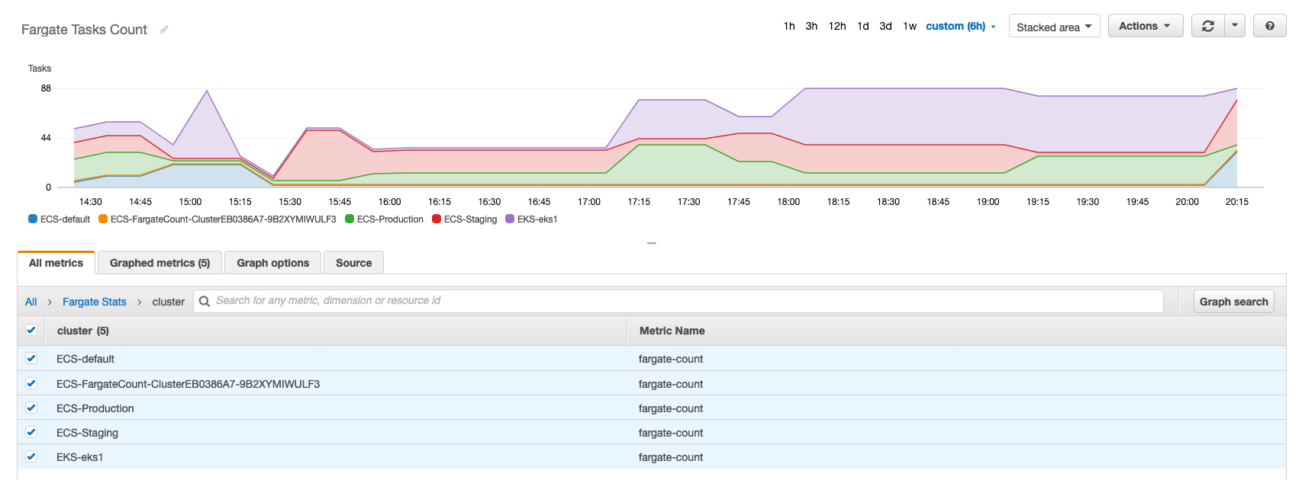

AWS Cloud
VPC
Fargate
Fargatecount
EC2
ECS
put metric
query tasks/pods
Fargate
EC2
EKS
Amazon CloudWatch

