Slide 1
Cost-Aware Probabilistic Temporal Shifting Framework
Carbon-Aware Cloud Data Centers
Comprehensive Research Presentation

Slide 2
Motivation
Rapid growth of cloud data centers increases carbon emissions
Need alignment of workloads with low-carbon energy
Temporal shifting reduces emissions but impacts cost and SLA

Slide 3
Research Gap
Deterministic job duration assumptions
Reserved instance idle cost ignored
Carbon-only optimization increases SLA violations
Lack of integrated carbon + cost + SLA model

Slide 4
Research Objectives
Analyze carbon vs cost trade-off
Design probabilistic scheduling algorithm
Integrate real carbon & pricing data
Validate with real workload traces

Slide 5
Data Sources – Workloads
Alibaba Cluster Trace (Batch Jobs)
Azure Public Workload Traces
Real CPU, memory, execution duration data

Slide 6
Data Sources – Carbon
Electricity Maps (Hourly Grid CI)
WattTime (Marginal Emissions)
Region-specific historical carbon data

Slide 7
Data Sources – Pricing
AWS Spot Price History
Reserved instance cost modeling
Cloud Carbon Footprint energy coefficients

Slide 8
System Architecture
Workload Manager
Carbon Forecast Engine
Pricing Monitor
Probabilistic Scheduler
Execution Engine & Monitoring

Slide 9
Optimization Model
Minimize C_total = Σ(αE(t)P(t) + βCI(t)E(t) + γV(t))
Balances carbon, cost, and SLA penalties
Multi-objective dynamic optimization

Slide 10
Algorithm Workflow
Fetch 24-hour carbon forecast
Predict job duration probability
Estimate carbon savings if shifted
Calculate idle and SLA cost
Execute or shift decision

Slide 11
Baseline Comparison
Immediate Execution
Static Carbon Threshold
Greedy Carbon Minimization
Cost-Only Optimization

Slide 12
Experimental Setup
Discrete time-slot simulation
Hybrid cloud: Reserved + Spot instances
Real workload + carbon + pricing integration

Slide 13
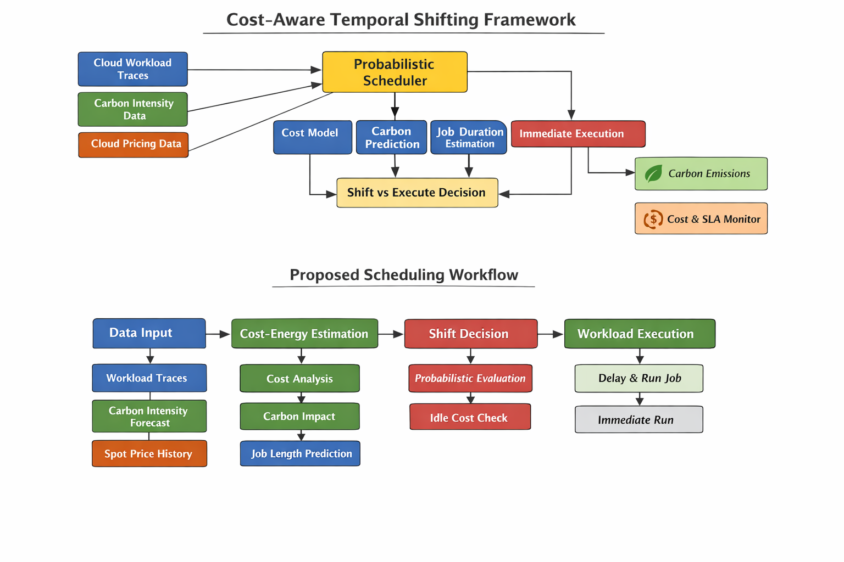
Experimental Setup

Slide 14
Evaluation Metrics
Carbon emission reduction (%)
Total operational cost
SLA violation rate
Throughput and job delay

Slide 15
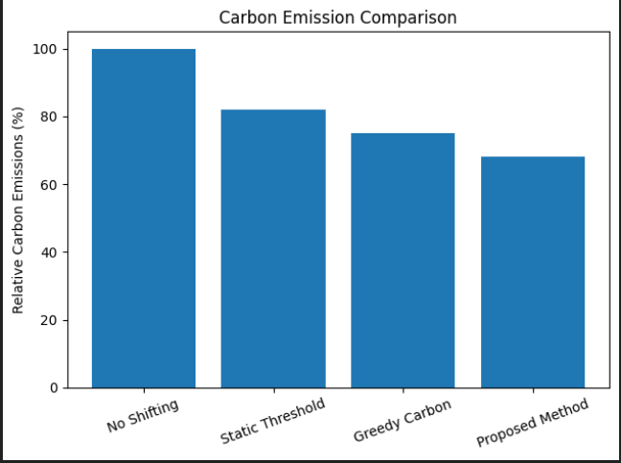
Evaluation Metrics

Slide 16
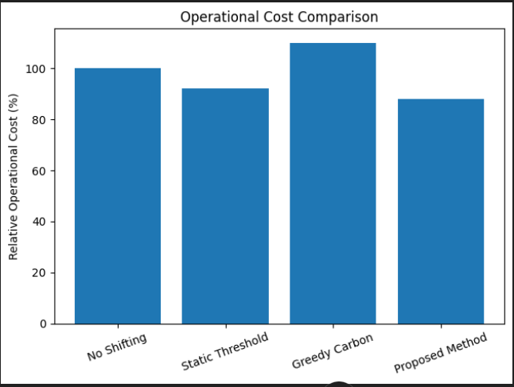
Evaluation Metrics

Slide 17
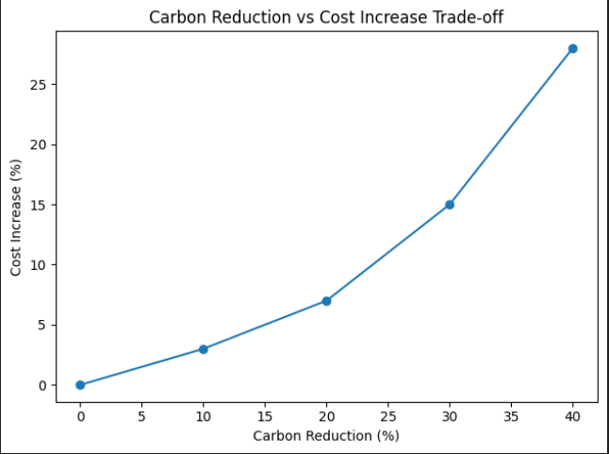
Evaluation Metrics

Slide 18
Trade-Off Analysis
Weight tuning (α, β, γ) controls balance
Carbon reduction vs cost increase curves
Optimal balance achieved by proposed model

Slide 19
Sensitivity & Scalability
Tested under workload spikes
Carbon volatility scenarios
Spot price fluctuations
Near-linear scalability observed

Slide 20
Key Contributions
Cost-aware probabilistic temporal shifting
Real-world trace integration
Multi-objective optimization formulation
Comprehensive baseline validation

Slide 21
Future Work
Reinforcement learning scheduler
Multi-region carbon-aware migration
Integration with Kubernetes
Real-time deployment testing

Slide 22
Conclusion
Balanced carbon-cost-SLA optimization achieved
Improved sustainability without economic loss
Practical framework for green cloud computing

