Slide 1
Basho Technologies
Access Patterns

Slide 3
Scheduled
Spontaneous
Notes:
One axis: Scheduled vs Spontaneous

Slide 4
Scheduled
Spontaneous
Notes:
Scheduled: we know when the traffic is going to hit
Set timers
- cronjobs
Or
Predictable clients
- traffic starts at opening bell Monday morning, 100 requests per minute for 15 minutes
Or
Can negotiate with the stakeholders
- let’s run this at 2am on a weekend

Slide 5
Scheduled
Spontaneous
Notes:
* Apache 2 Licensed
* Community contributions are not just accepted, they are highly valued
* Over 200 some contributors
* Grouped under the ‘NoSQL’ umbrella

Slide 6
Scheduled
Spontaneous
Notes:
One axis: Scheduled vs Spontaneous

Slide 8
Static
Dynamic
Notes:
Axis 2: static vs dynamic

Slide 9
Static
Dynamic
Notes:
* Apache 2 Licensed
* Community contributions are not just accepted, they are highly valued
* Over 200 some contributors
* Grouped under the ‘NoSQL’ umbrella

Slide 10
Static
Dynamic
Notes:
* Apache 2 Licensed
* Community contributions are not just accepted, they are highly valued
* Over 200 some contributors
* Grouped under the ‘NoSQL’ umbrella

Slide 11
Static
Dynamic
Notes:
* Apache 2 Licensed
* Community contributions are not just accepted, they are highly valued
* Over 200 some contributors
* Grouped under the ‘NoSQL’ umbrella

Slide 13
 | Static | Dynamic
Scheduled
Spontaneous
Notes:
Combined the axis, we have this nice table with four quadrants

Slide 14
 | Static | Dynamic
Scheduled
Spontaneous
Notes:
Scheduled + Static
Eg:
- every 10 minutes, write the log to Riak
- every night at 10pm, compile these reports
Predictable => easy
We can test and compute performance

Slide 15
 | Static | Dynamic
Scheduled | k/v map/red
Spontaneous
Notes:
We know what keys we want to read/write
OR
We know what data we want to extract (report)
OR
We know when to migrate our data

Slide 16
 | Static | Dynamic
Scheduled
Spontaneous
Notes:
Eg:
- web pages
- cache data
No time to think, just fetch or write

Slide 17
 | Static | Dynamic
Scheduled
Spontaneous | k/v
Notes:
High availability and fault tolerance: easy to scale out for traffic burst

Slide 18
 | Static | Dynamic
Scheduled
Spontaneous
Notes:
The query is different depending on runtime input
Eg:
- special reports
- some triggered analysis
- working on unknown set of records
- any text search

Slide 19
 | Static | Dynamic
Scheduled |  | map/red 2i search
Spontaneous
Notes:
These have unbounded APIs
Map/red has unlimited resource contention
In practice, 2i and search also have unpredictable resource contention

Slide 20
 | Static | Dynamic
Scheduled
Spontaneous
Notes:
We don’t know exactly what request the user or client is going to generate
Dynamic forms

Slide 21
 | Static | Dynamic
Scheduled
Spontaneous |  | relational fulltext search graph time series realtime m/r
Notes:
Realtime analysis of data
Anything that internally has a query planner
SQL
Gremlin – graph interface
SAS?
Typically assisted by giving structure to the data – indices

Slide 22
 | Static | Dynamic
Scheduled
Spontaneous |  | ☹
Notes:
What do we do when we have a 4th quadrant use case?

Slide 23

ProServ Solutioning:
Change the Formula.

Slide 24
 | Static | Dynamic
Scheduled | k/v map/red | map/red 2i search
Spontaneous | k/v
Notes:
First thing we look for is precalc
Industry isn’t use to this
Contrary to RDBMS experience

Slide 25
 | Static | Dynamic
Scheduled
Spontaneous |  | ☹
Notes:
What if that doesn’t work?

Slide 26
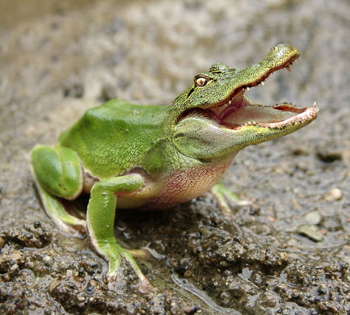
ProServ Solutioning:
Hybrid
Solutions.

Slide 27
 | Static | Dynamic
Scheduled | k/v map/red | map/red 2i search
Spontaneous | k/v | yokozuna?
Notes:
Yokozuna could potentially reframe how we see applications interacting with Riak, but we don’t have data here yet

Slide 28
 | Static | Dynamic
Scheduled
Spontaneous
Notes:
Practice

Slide 29
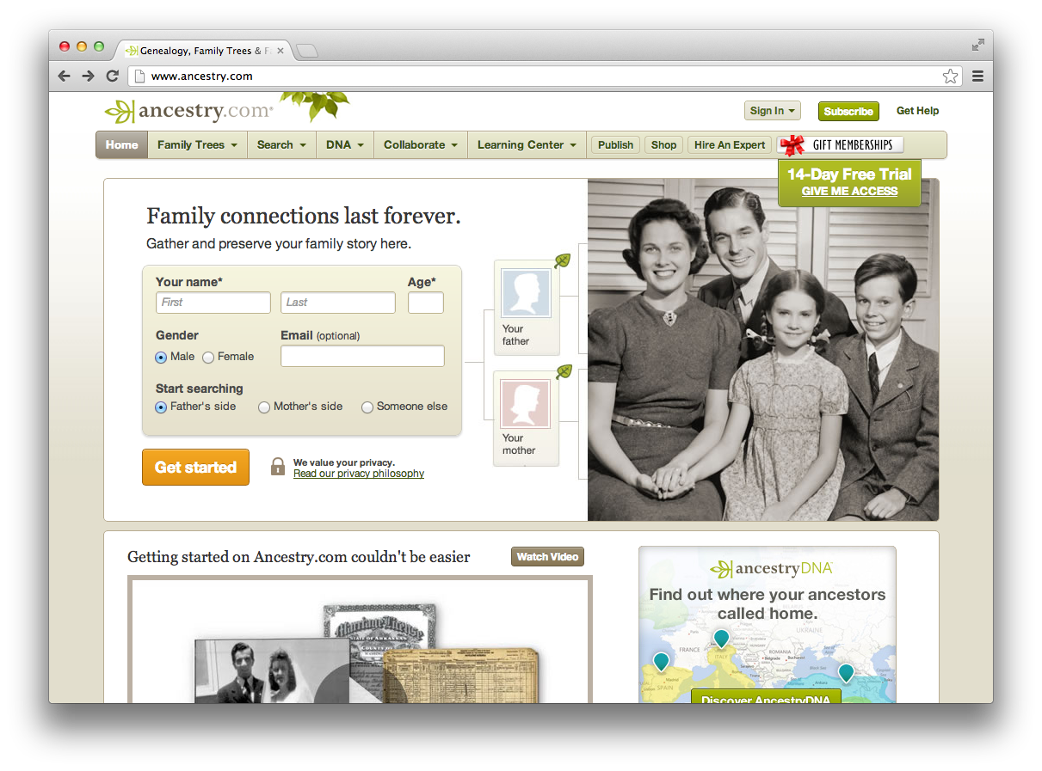
Ancestry.com:
Notes:
Records – store one, get one
Static / spontaneous

Slide 30
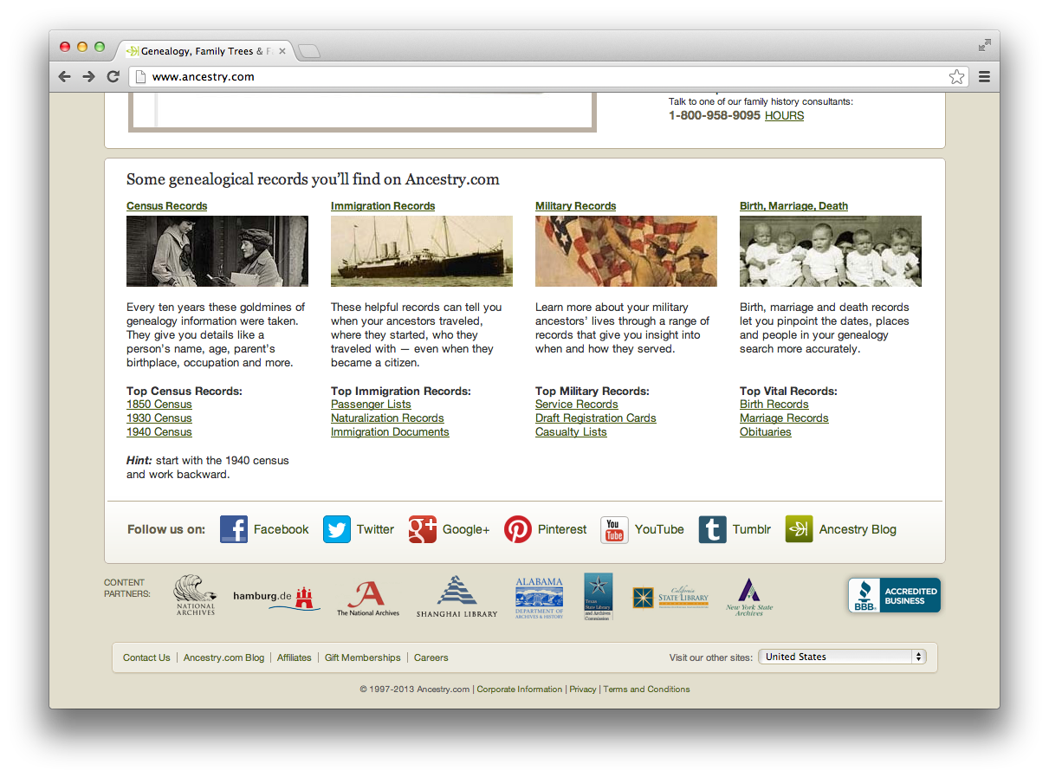
Ancestry.com:
Notes:
But look further down the site

Slide 31
Ancestry.com:
other ways to search
Notes:
But look further down the site
Data discovery – essentially self-guided analytics
+ ancestry graph

Slide 32
 | Static | Dynamic
Scheduled
Spontaneous
Notes:
Practice

Slide 33

Thinkgeek.com:
Notes:
Records – store one, get one
Static / spontaneous

Slide 34
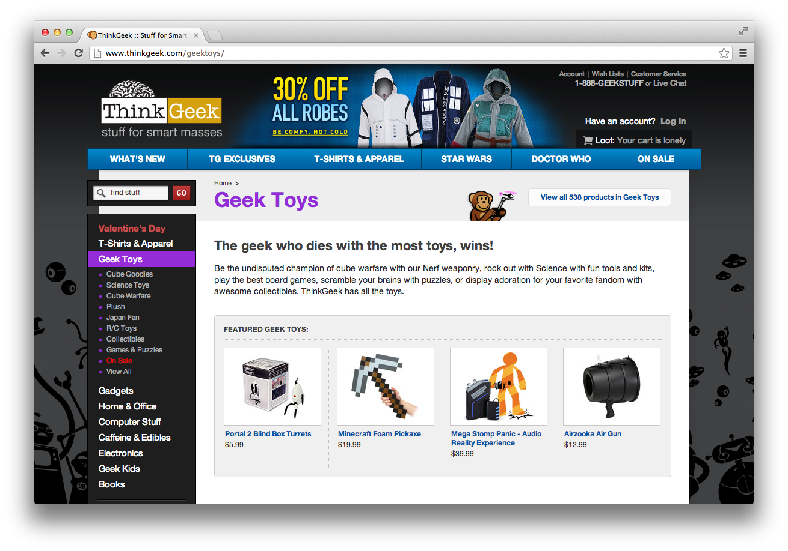
Thinkgeek.com:
Notes:
Records – store one, get one
Static / spontaneous

Slide 35
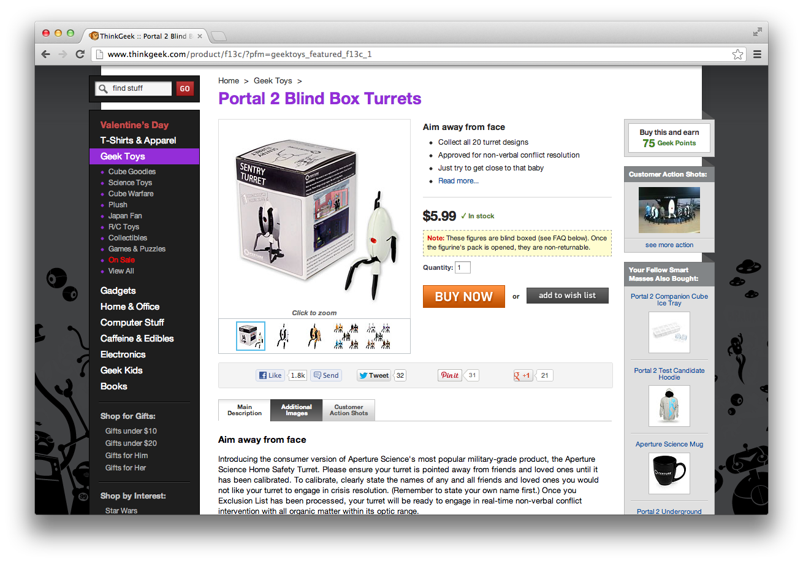
Thinkgeek.com:
Notes:
Records – store one, get one
Static / spontaneous

Slide 36
Thinkgeek.com:
Notes:
Search!

Slide 37
 | Static | Dynamic
Scheduled
Spontaneous
Notes:
Practice

Slide 38
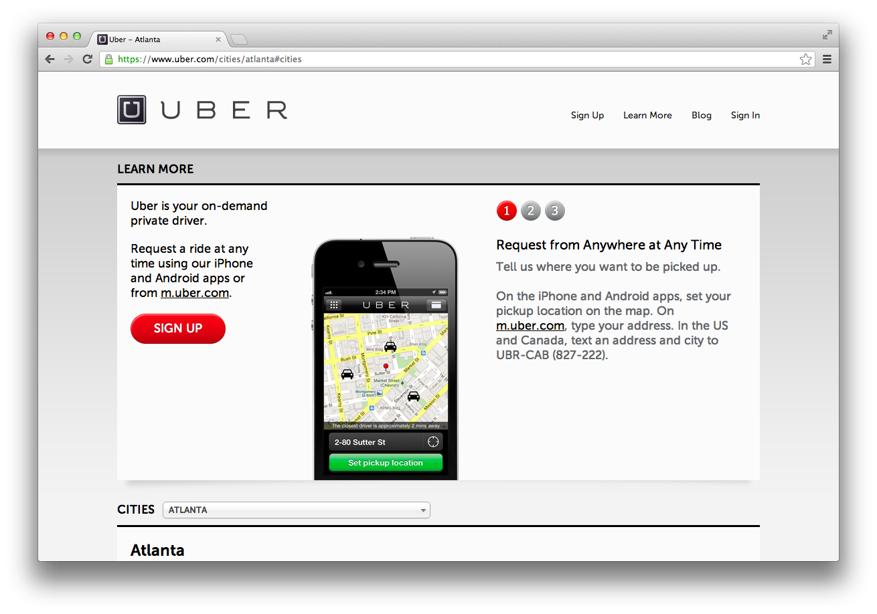
Thinkgeek.com:
Notes:
Some sort of geo search
Centroid analysis
Create contract between cars and people
Route analysis
Time series data?

Slide 39
 | Static | Dynamic
Scheduled
Spontaneous
Notes:
Practice

Slide 40
Access Patterns

