Slide 2

Basho Technologies
One is Never Enough

Slide 3


Slide 4

Notes:
Realtime… object by object.

Slide 5
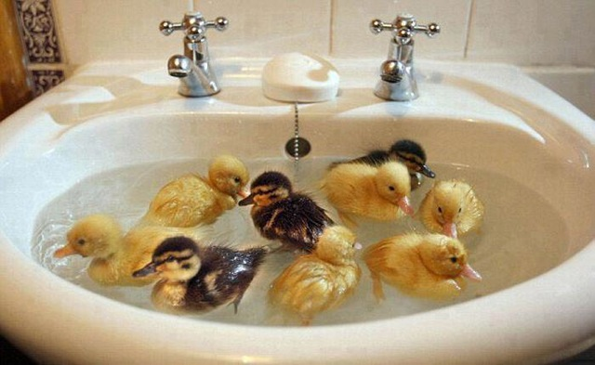
Notes:
Full-sync…. Partition by partition.

Slide 6

Notes:
These two methods are intended to clean up after each other.

Slide 8
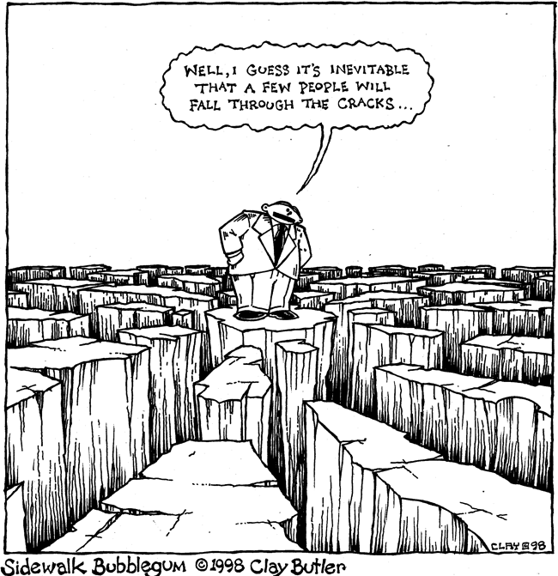
Notes:
But what happens when they both fail?

Slide 9

Notes:
Talk about what to monitor.

Slide 10

Notes:
Dropped objects!!!

Slide 11

Notes:
Monitoring leader elections.

Slide 12

Notes:
Track when full-sync starts and stops.

Slide 14
One is Never Enough

