Slide 2

Basho Technologies
Perils of Time Travel

Slide 3
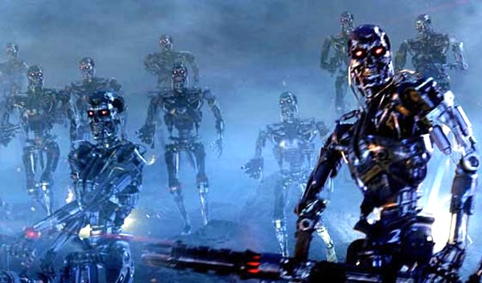
You’ve invented Skynet
Notes:
Disaster has struck, and you need to go back in time to try to right the plague you’ve unleashed on humanity.

Slide 4

tar, gzip

Slide 5
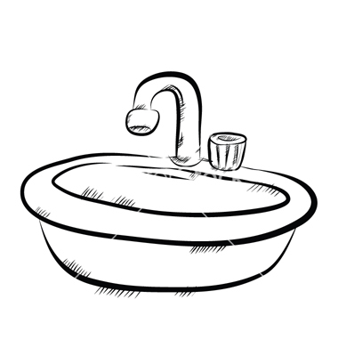
rsync
R

Slide 6

snapshots

Slide 7

Notes:
Whatever route you choose make sure you get ALL THE THINGS… ring, data dirs, AAE dirs, configs, patches, etc. SHOW THEM!!!!

Slide 9
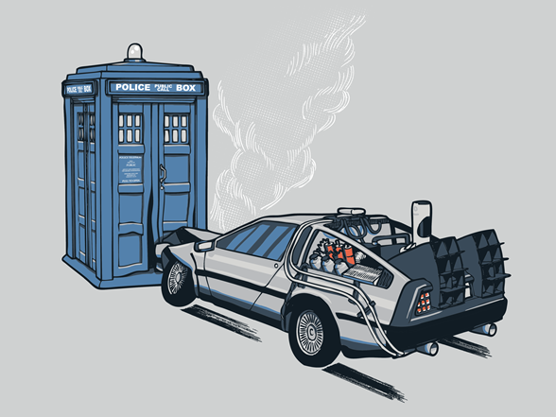
It came out of nowhere!
Notes:
-- Your cue to begin the discussion about the eventually consistent nature of node backups, and why that’s okay.

Slide 10
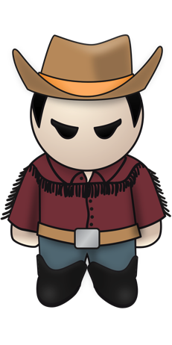




marty
marty
marty
Notes:
-- All the replicas of Marty, except taken at different points in time.

Slide 11
Blargh!
marty
Notes:
-- The sound of inevitability.

Slide 12
Perils of Time Travel

