Slide 1
Basho Technologies
PRINCIPLES of ADULT LEARNING

Slide 2
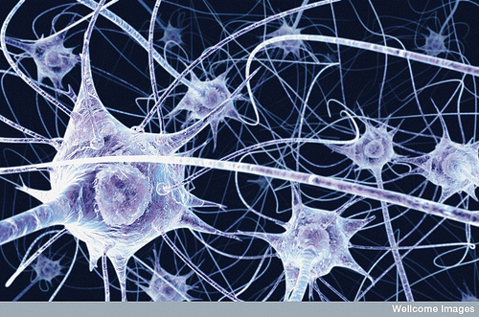
Notes:
Figuring things out and making memories is painful
Achieving understanding is pleasurable
Predictably takes 3 to 6 months to adjust to life change
Framework: RCR

Slide 3
Relevance
Notes:
Brain builds incrementally on existing knowledge
Brain cannot learn facts in isolation
Metaphors: web days of building a house, hiring an architect
Can’t build on foundation if you don’t Know the audience.
Example: Java in higher education -- is it relevant?
Hit right experience level
Failure to find relevance means audience will tune out
Basho’s History; CAP Theorem; Dynamo Paper

Slide 4
Consilience
Notes:
Cognitive dissonance is primarily a cultural phenomena
You can’t easily teach it
Knowledge reduces under unifying principles
If conclusions are presented that don’t jive, they will be rejected
Politics in the US is great example – division of Liberal and Conservative
“Functional Programming” != OOP is useless
SQL: UrDoingItWrung
Access Patterns: UrDoingItWrung
Never disagree

Slide 5
Reflection
Notes:
Adult brains are massive
Several steps/days of transference
~21 minutes before humans start dropping packets
Presentations are generally poor formats for teaching
Q&A is external reinforcement
Always summarize

Slide 6
*) Relevance *) Consilience *) Reflection

