Slide 1
Basho Technologies
TRAINING MODULE API

Slide 3
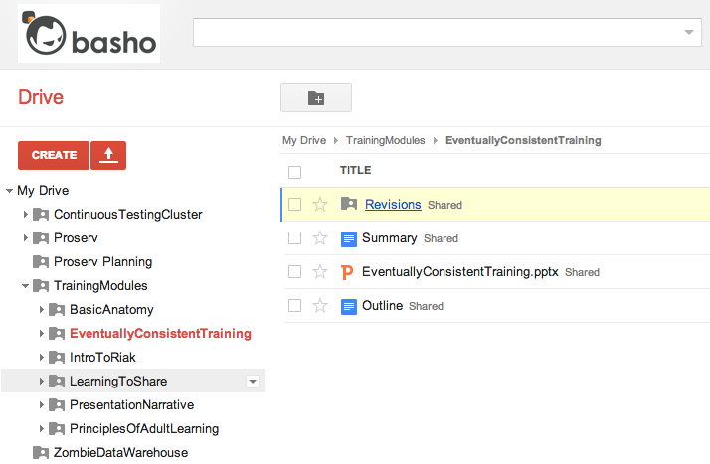

Slide 7
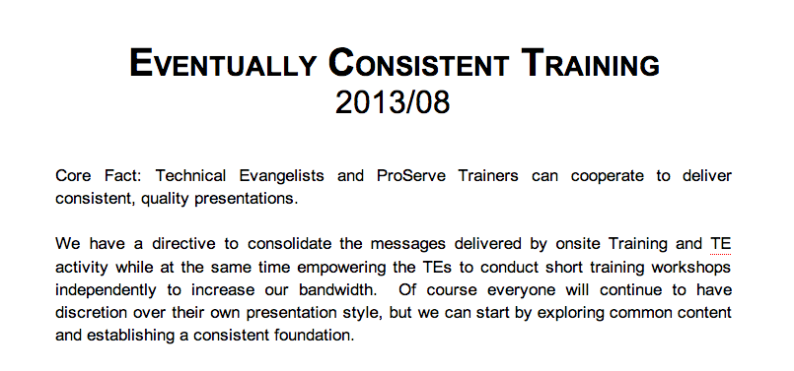

Slide 11
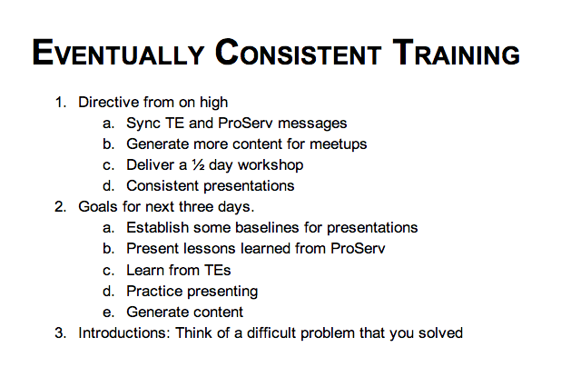

Slide 15

Nathan Äschbacher Director of Masterpiece Theater

