Slide 1

Riak Intro
+ 1.3 Release Update

Slide 2
Us
Shanley Kane
@shanley
shanley@basho.com
@basho
docs.basho.com

Slide 3


Slide 4
What’s in store?
At a High Level
For Developers
Under the Hood
When and Why
Some Use Cases
Commercial Extensions
Latest Release and 1.3

Slide 5
At a High Level

Slide 6
Riak
Amazon-inspired, distributed database
Key/value data model
  with some extras: search, MapReduce, 2i, links, pre- and post-commit hooks, pluggable backends, HTTP and binary interfaces
Written in Erlang with C/C++
Open source under Apache 2 License

Slide 7
Riak’s Design Goals
High-availability: Failure happens. Keep it moving.
Low-latency: Slow is the same as off.
Horizontal Scalability: Ideal for cloud and commodity machines.
Fault Tolerance: Survive serious failure modes.
Ops Friendliness: You’ve got better things to do than shard your database over. And over. And over.
Predictability: It’s plumbing, not a circus.

Slide 8
For Developers

Slide 9
Riak is a database that stores keys against values. Keys are grouped into a higher-level namespace called buckets.

Slide 10
Riak doesn’t care what you store. It will accept any data type; things are stored on disk as binaries.

Slide 11


Slide 12
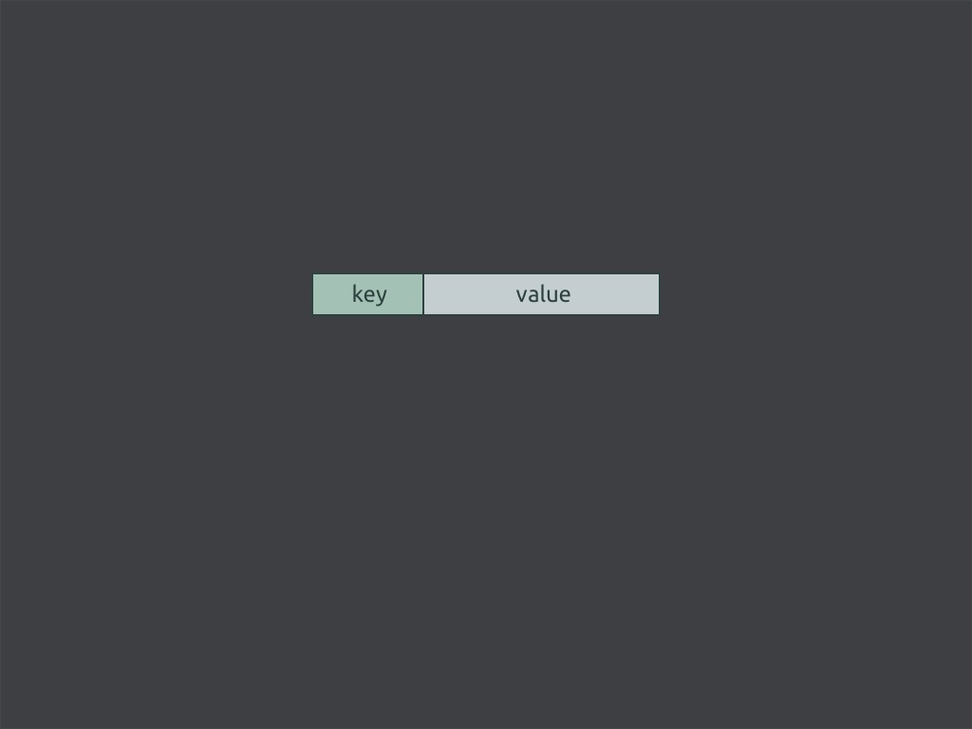

Slide 13
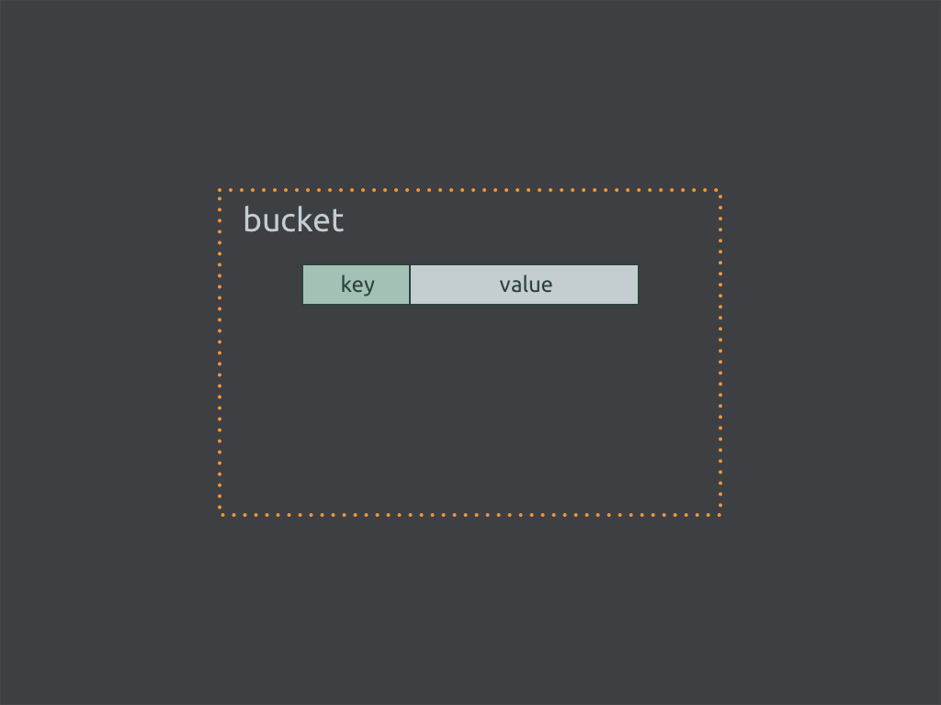

Slide 14
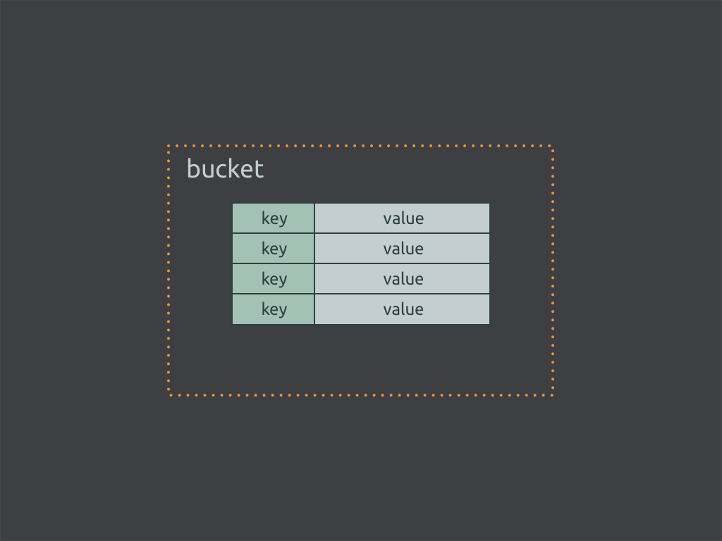

Slide 15
Examples
Application Type | Key | Value
Session | User/Session ID | Session Data
Advertising | Campaign ID | Ad Content
Logs | Date | Log File
Sensor | Date, Date/Time | Sensor Updates
User Data | Login, eMail, UUID | User Attributes
Content | Title, Integer | Text, JSON/XML/HTTP document, images, etc.

Slide 16
Two APIs
HTTP (just like the web)
Protocol Buffers (thank you, Google)

Slide 17
Querying
GET/PUT/DELETE
MapReduce
Full-Text Search
Secondary Indexes (2i)

Slide 18
Client Libraries
Ruby, Node.js, Java, Python, Perl, OCaml, Erlang, PHP, C, Squeak, Smalltalk, Pharoah, Clojure, Scala, Haskell, Lisp, Go, .NET, Play, and more (supported by either Basho or the community).

Slide 19
Under the Hood

Slide 20
Hard problems in databases:
Single points of failure.

Slide 21

Availability
Relational Architecture
master
slave →
slave
Notes:
Here’s the basics

Slide 22
Availability
write
master
slave →
slave
Notes:
Here’s the basics

Slide 23

Availability
write
master
slave →
slave
Notes:
Here’s the basics

Slide 24
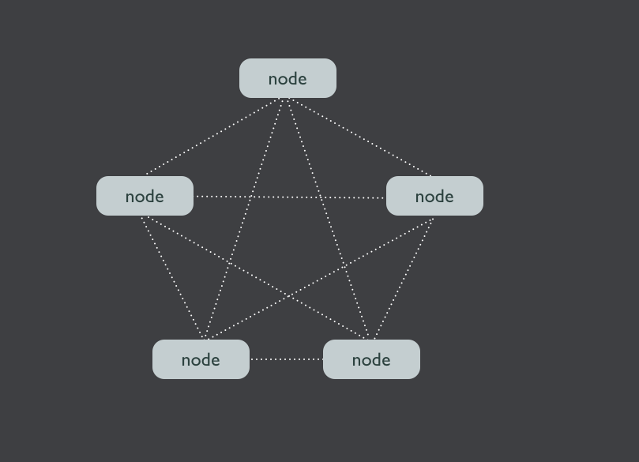
Masterless; deployed as a
cluster of nodes

Slide 25
ALL NODES ARE DECLARED EQUAL.
write
read
write
read
write
read
write
read
write
Notes:
Here’s the basics

Slide 26
Hard problems in databases:
Where to put the data.

Slide 27
Sharding in Relational Systems…
A - D
E - K
L - P
Q - T
U - Z
Notes:
Here’s the basics

Slide 28
It Hurts.
Hot spots
Unevenly spread data and request patterns
Resharding is operationally intensive,
often manual
A - D
E - K
L - P
Q - T
U - Z
Notes:
Here’s the basics

Slide 29
Don’t Shard.
Riak’s Consistent Hashing
Evenly spreads data around the cluster
Automatically rebalances data when machines are added
Notes:
Here’s the basics

Slide 30
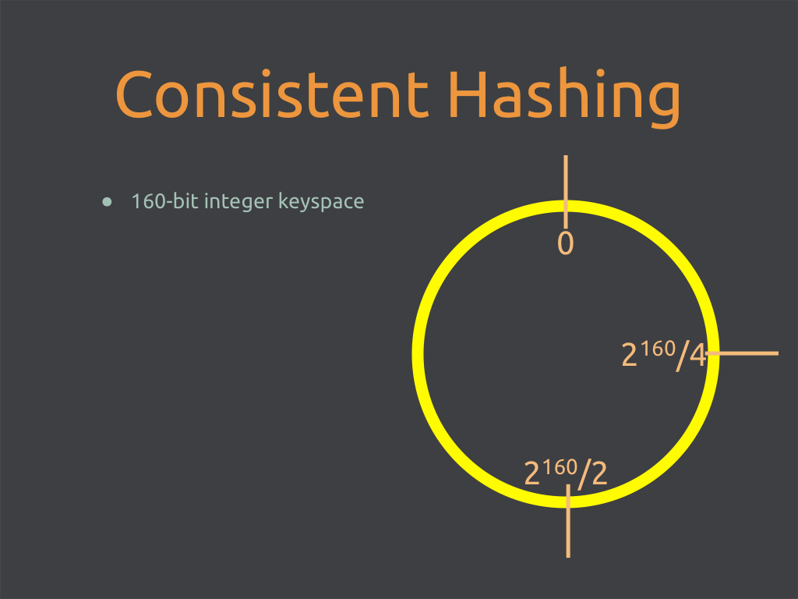

Slide 31
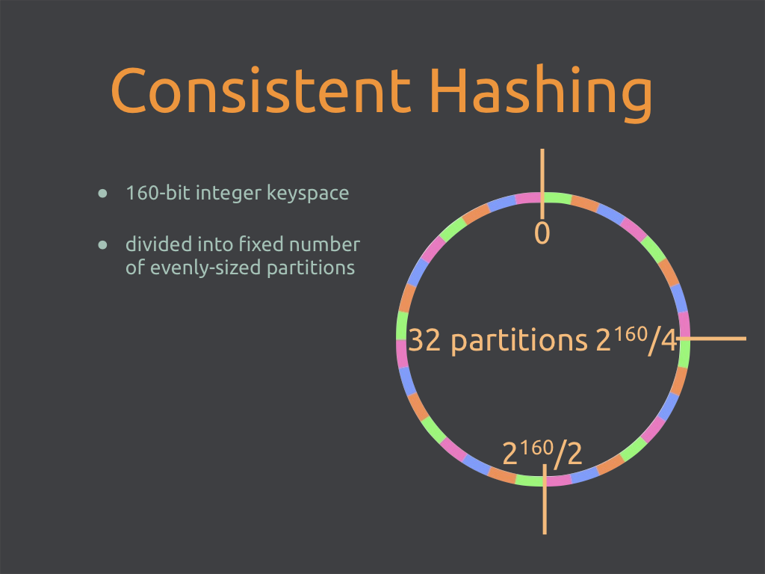

Slide 32
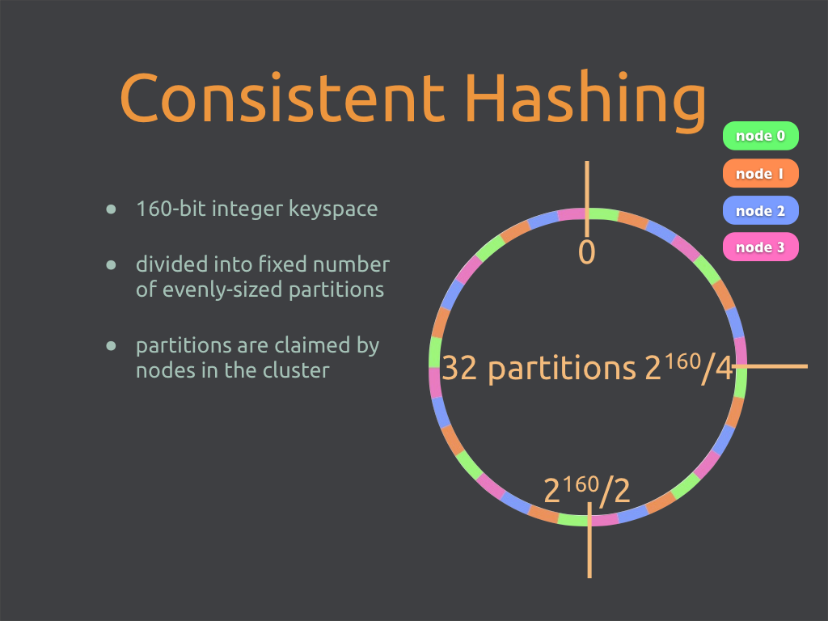

Slide 33
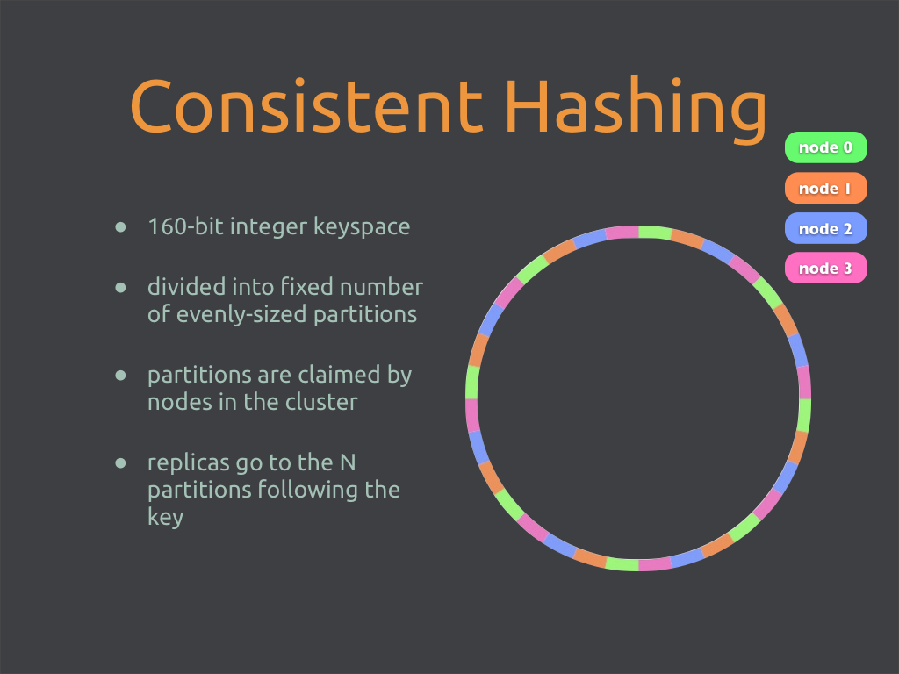

Slide 34
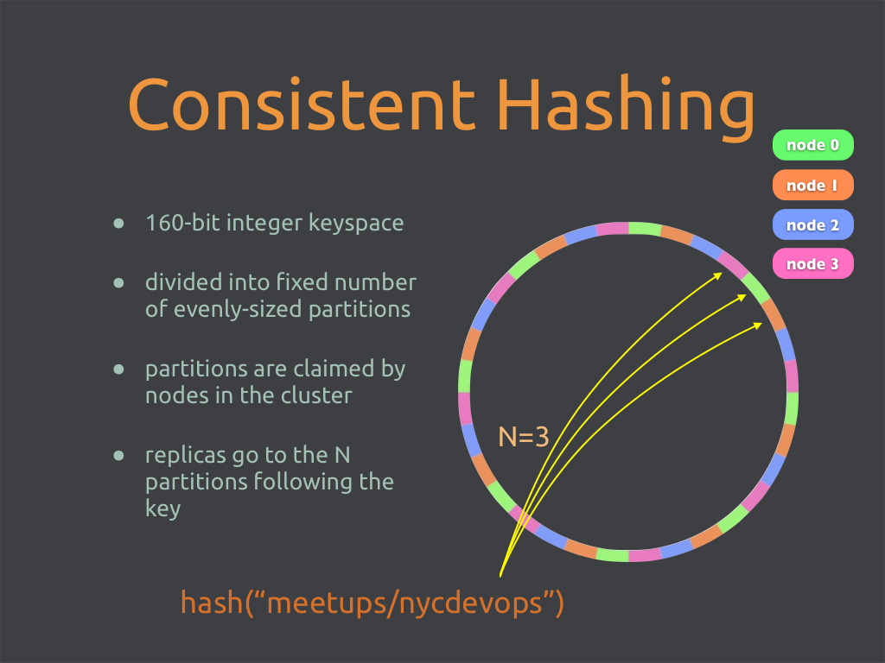

Slide 35
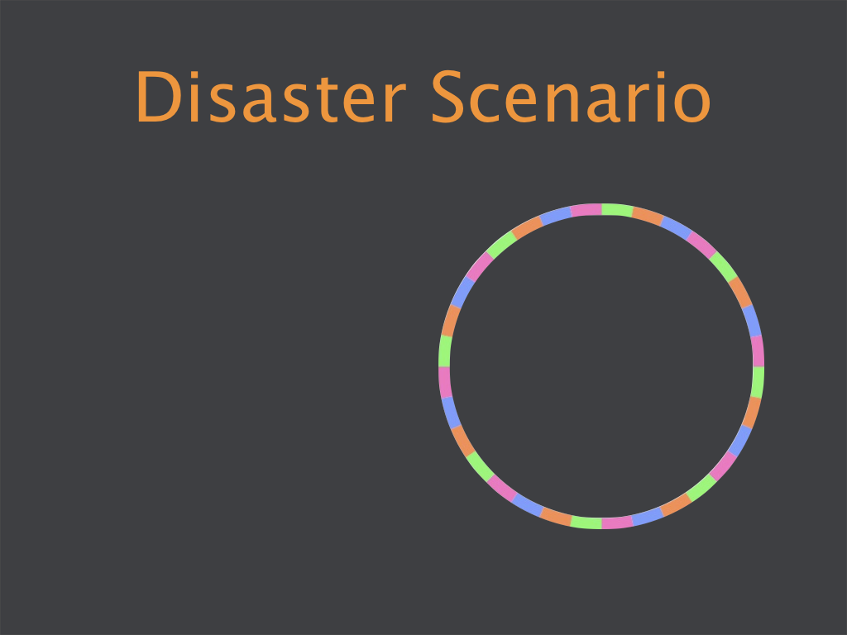

Slide 36
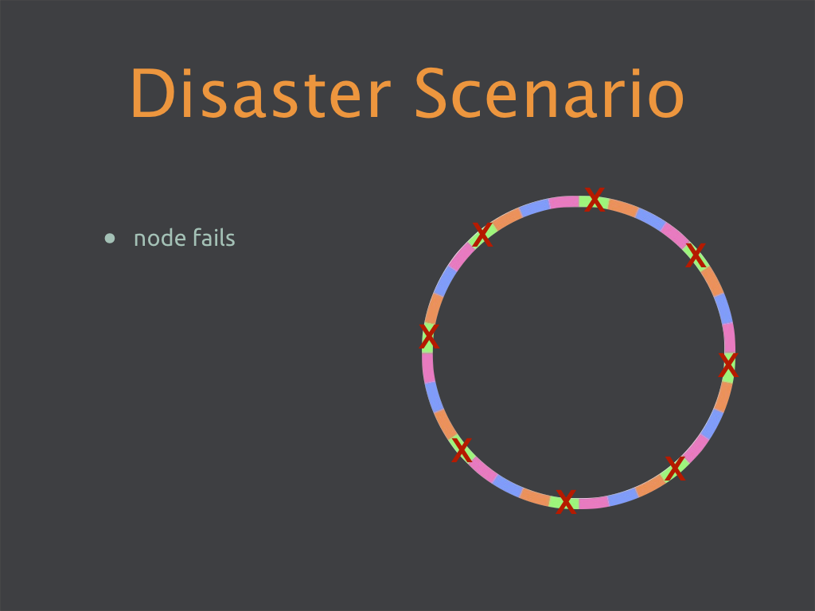

Slide 37
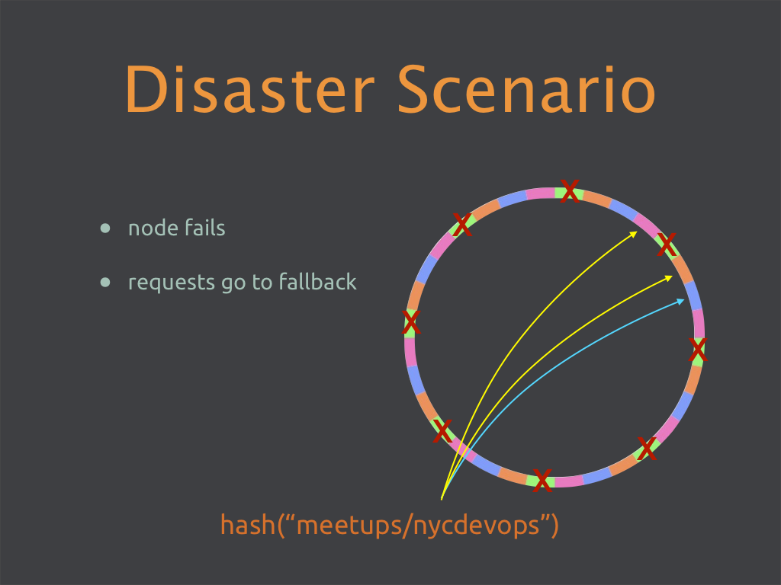

Slide 38
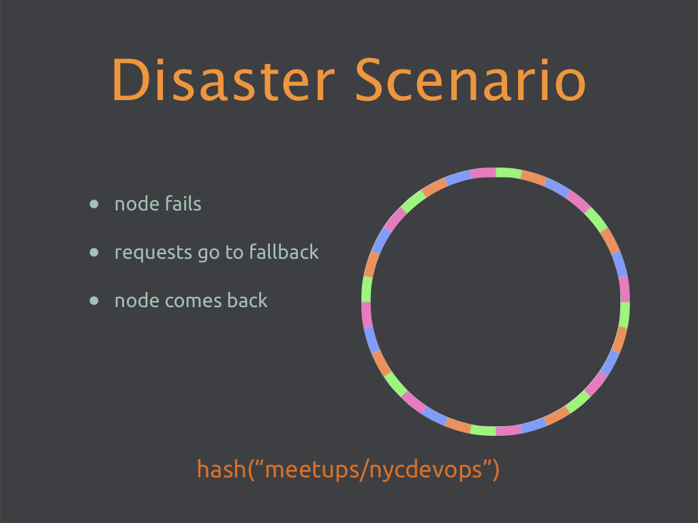

Slide 39
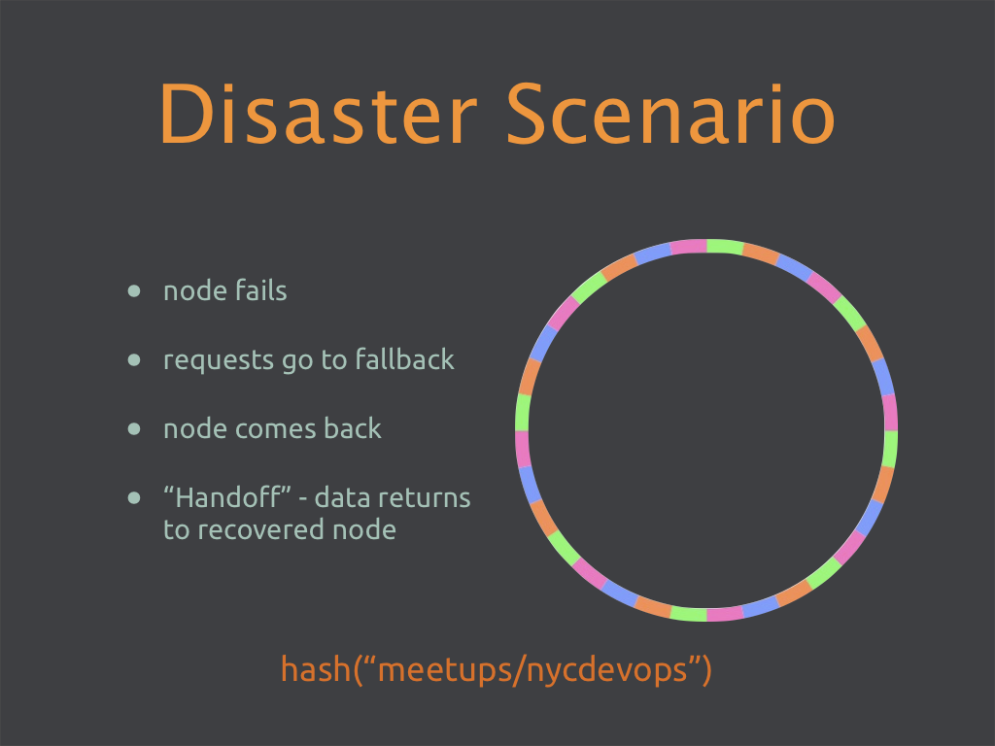

Slide 40
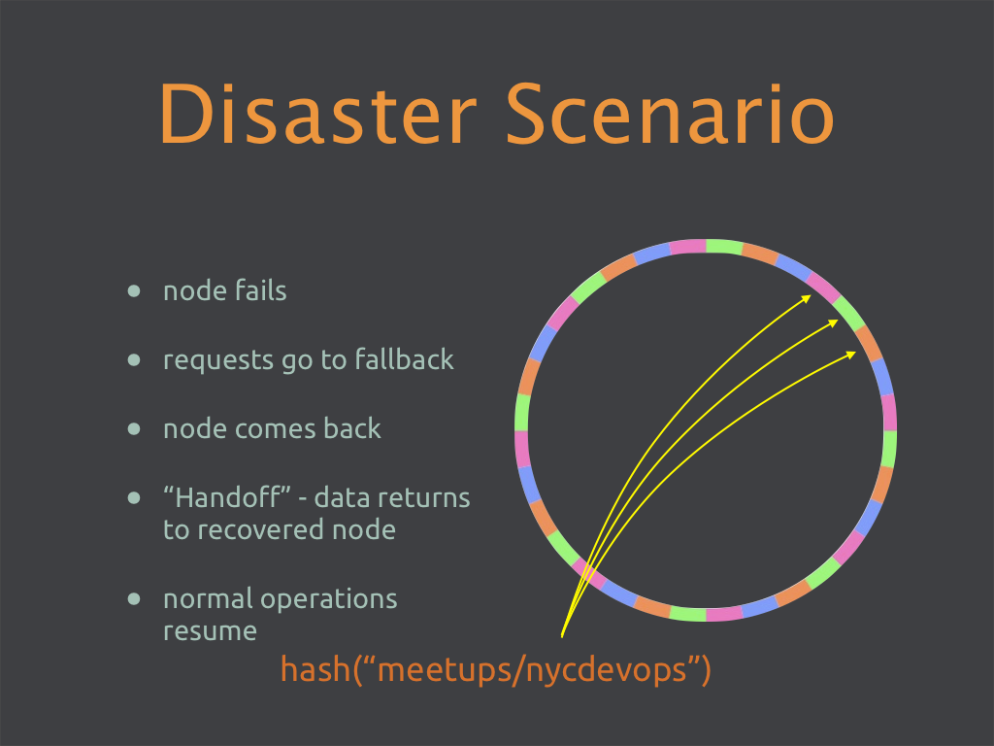

Slide 41
Riak: when and why

Slide 42
When Might Riak Make Sense
When you have enough data to require >1 physical machine (preferably >5)
When availability is more important than consistency (think “critical data”on “big data”)
When your data can be modeled as keys and values; don’t be afraid to denormalize

Slide 43
Cloud infrastructure management
Machine, customer and API data
“Design for failure” architecture
“enStratus relies on Riak to ensure that our cloud infrastructure management platform scales seamlessly, without interruption and performance bottlenecks, while meeting and exceeding internal requirements for high availability and data durability.”
Notes:
Here’s the basics

Slide 44
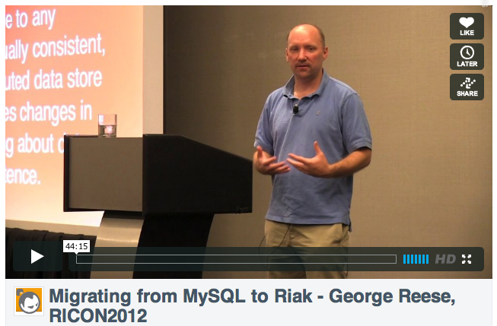
Scaling writes in MySQL became a bottleneck
Master/slave replication made master nodes a single point of failure
Multi-site replication
← vimeo.com/bashotech
Notes:
Here’s the basics

Slide 45

Re-platform of e-commerce platform
Product catalog data
Adding non-relational to the mix
Notes:
Here’s the basics

Slide 46

Challenges: modeling data in a NoSQL world
← ricon2012.com
Notes:
Here’s the basics

Slide 47
Ad Serving
OpenX will serve ~4T ad in 2012
Started with CouchDB and Cassandra for various parts of infrastructure
Now consolidating on Riak and Riak Core

Slide 48

Mobile Apps
Bump – easy to share contact info, photos, other objects
Picked Riak for operational ease of use
“It does what it’s supposed to do; nodes can go down but Riak will still work. It’s great to be able to deal with node failures the next day instead of at 3am.”

Slide 49
Distributed Systems Are Hard Let’s Go Shopping!!
Copious – eCommerce marketplace
Uses Riak to store all registered accounts and tokens for social media login
100s of thousands of keys

Slide 50
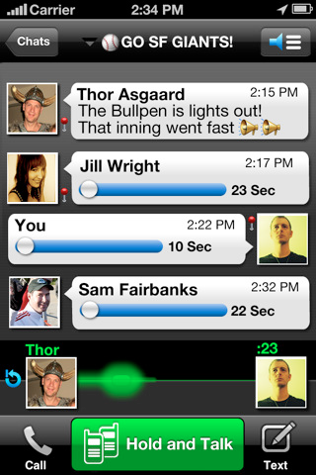
Riak for All Storage: Voxer

Slide 51
Voxer: Initial Stats
11 Riak nodes (switched from CouchDB)
100s of GBs
~20k Peak Concurrent Users
~4MM Daily Request

Slide 52




Slide 53
Voxer: Post Growth
~60 Nodes total in prod
100s of TBs of data (>1TB daily)
~400k Concurrent Users
Billions of daily Requests

Slide 54
Application Essentials….
Session storage
Log files
User data

Slide 55
Riak : Hybrid Solutions
Riak with Postgres
Riak with Elastic Search
Riak with Hadoop
Secondary analytics clusters

Slide 56

Try Us On…
Amazon AMIs
EngineYard beta (more details next week)
Microsoft Azure VM Depot
Riakon.com

Slide 57
Buy Some Software...

Slide 58
Riak Enterprise
Multi-datacenter replication
Real-time or full sync

Slide 59
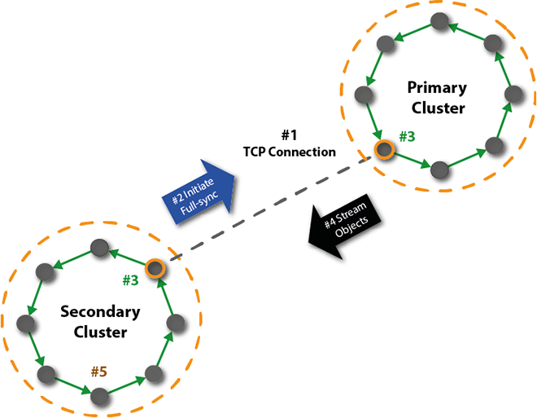
Riak Enterprise: Full Sync
Notes:
A TCP connection is established between the primary and secondary clusters.
The site node in the secondary cluster initiates full-sync replication with the primary by sending a message to the listener node in the primary cluster.
The site and listener nodes iterate each vnode in their respective clusters and compute a hash for each key's object value. The site node on the secondary cluster sends its complete list of key/hash pairs to the listener node in the primary cluster. The listener node then sequentially compares its key/hash pairs with the primary cluster's pairs, identifying any missing objects or updates needed on the secondary.
The listener node streams the missing objects/updates to the secondary cluster.
The secondary cluster replicates the updates within the cluster to achieve the new object values, completing the full-sync cycle.

Slide 60
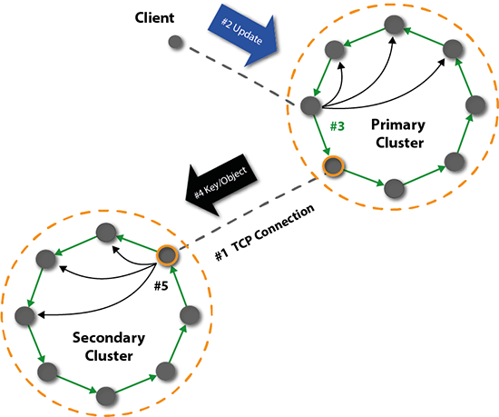
Riak Enterprise: Real-Time Sync
Notes:
The secondary cluster establishes a TCP connection to the primary.
Real-time replication of a key/object is initiated when an update is sent from a client to the primary cluster.
The primary cluster replicates the object locally.
The listener node on the primary cluster streams an update to the secondary cluster.
The site node within the secondary cluster receives and replicates the update.

Slide 61
Riak Cloud Storage
Large object support
S3-compatible API
Multi-tenancy
Reporting on usage

Slide 62
Roadmap Stuff...

Slide 63
New in Riak 1.2
LevelDB Improvements
FreeBSD Support
New Cluster Admin Tools
Folsom for Stats
KV and Search Repair work
Much much more

Slide 64
Riak 1.3
Active Anti Entropy: automatic, constant, self-healing processes
Hash tree exchange, minimal exchange of information
On disk, so it works in large clusters
Updates on writes

Slide 65
Riak 1.3
New look for Riak Control
Extended IPv6 support; protocol buffers and handoff
MapReduce improvements – now with backpressure

Slide 66
Riak 1.3
New improved multi-datacenter replication in Riak Enterprise
TCP connection for each physical node
Easier configuration
Better stats

Slide 67
The Future
CRDTs
Tight Solr integration
Strong consistency
Better faster stronger Riak Control
Lots of other hotness

Slide 68
Riak
docs.basho.com
@basho
github.com/basho

