Slide 1
Recap

Slide 2
Riak
Open Source
Dynamo Inspired
CAP Theorem Influcned
Web Shaped (HTTP API)
Distributed Erlang
OPS Obsessed
A Platform

Slide 3
Riak EDS
SNMP
JMX
Replication
Support

Slide 4
Dynamo Inspired
Key Value Store
Consistent Hashing
Gives tools to Lower Consistency for Availability
Vector Clocks
Quorum
Read-repair and Hinted Handoff
Masterless

Slide 5
CAP Theorem
Consistency
Availability
Partition Tolerant
Pick Two
Tunable CAP Controls
N, R, and W

Slide 6
N, R, W
Quorum
N = Number of Replicas
R = Read Quorum
W = Write Quorum
DR/DW = Durable Read|Write Quorum
R/W Configurable Per Request
Every request contacts all replicas (N)

Slide 7
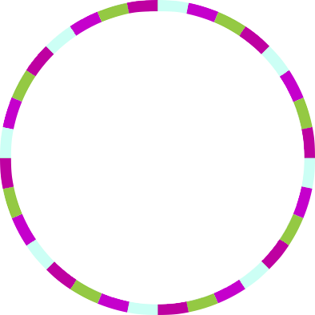
Consistent Hashing & The Ring
node 0
node 1
160-bit integer keyspace
Divided into fixed number of evenly-sized partitions
Partitions are claimed by nodes in the cluster
Replicas go to the N partitions following the key
node 2
0
node 3
`
`
`
32 partitions
2¹⁶⁰/4
N=3
2¹⁶⁰/2
hash(“bucket/key”)
Notes:
R + W > N ensures strong consistency in a cluster,

Slide 8
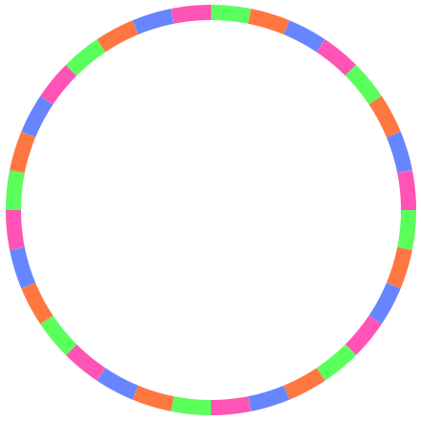
W
put(<<"bucket">>,<<"key">>,
W=2)
(N=3)
ok
X

Slide 9
R
get(<<"bucket">>,<<"key">>,
R=2)
(N=3)
{ok, Object}
X

Slide 10

N=10, R/W = 2
get/put("bucket", "key",
R/W=2)
(N=10)
{ok, Object}
X
X
X
X
X
X
X
X

Slide 11
Hinted Handoff
Node fails
Requests go to fallback
Node comes back
“Handoff” - data returns to recovered node
Normal operations resume
X
X
`
X
`
`
`
`
X
`
X
X
X
X
hash(“bucket/key”)

Slide 12
Anatomy of a Request
get(“bucket/key”)
client
v2
Riak
Get Handler (FSM)
hash(“bucket/key”)
== 10, 11, 12
R=2
v1
v2
get(“bucket/key”)
Coordinating node
Cluster
v1
v2
6
7
8
9
10
11
12
13
14
15
16
The Ring

Slide 13
Read Repair
get(“bucket/key”)
client
v2
Riak
Get Handler (FSM)
R=2
v1
v2
Coordinating node
Cluster
v2
v1
v2
6
7
8
9
10
11
12
13
14
15
16
v1
v2
v2
v1
v2
Notes:
Read repair occurs when a successful read occurs — that is, the quorum was met — but not all replicas from which the object was requested agreed on the value. There are two possibilities here for the errant nodes:
The node responded with a “not found” for the object, meaning it doesn`t have a copy.
The node responded with a vector clock that is an ancestor of the vector clock of the successful read.
When this situation occurs, Riak will force the errant nodes to update their object values based on the value of the successful read.

Slide 14
Riak Architecture
Erlang/OTP Runtime
Riak KV
Client APIs
HTTP
Protocol Buffers
Erlang local client
Request Coordination
get
put
delete
map-reduce
Riak Core
consistent hashing
handoff
gossip
membership
node-liveness
buckets
vnode master
vnodes
JS Runtime
storage backend

Slide 15
Location of Riak
  /etc/riak
  /usr/sbin/riak|riak-admin
  /usr/lib|lib64/riak << Meat
  /var/log/riak << Log Dir
  /var/lib/riak << Data Dir
  /tmp/riak << Sockets

Slide 16
/etc/riak
app.config
  Riak Configuration
  riak_core, riak_kv, bitcask, etc
vm.args
Erlang VM Configuration
-name riak@< ip | hostname>
snmp/agent/*
Several Config Files (agent/community/standard)
OTP SNMP - Mirrors

Slide 17
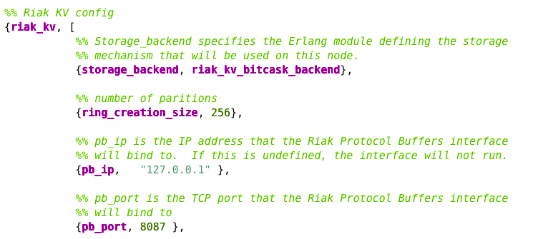
app.config
Interface Binding (http | Protocol Buffers)
ring_creation_size
Backend Configuration

Slide 18
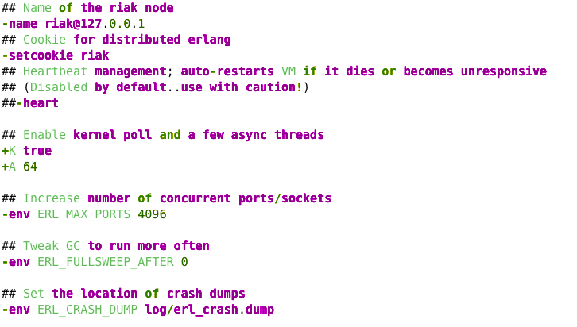
vm.args
-name
Number of Threads
Garbage Collection

