Slide 1
Map Reduce

Slide 2
Overview
Why MapReduce?
MapReduce Basics
Using MapReduce
Examples
Comparisons

Slide 3
Why MapReduce?
Parallel, distributed queries
Easy to write
Easy to run

Slide 4

Key/Value Data
/riak/cat/snowball1
/riak/cat/snowball2
/riak/cat/snowball3

Slide 5

Cluster
catlady@192.168.1.10
catlady@192.168.1.11
catlady@192.168.1.12

Slide 6
MapReduce Basics
Operates over a known set of keys
Runs near the data
Consists of two types of functions
  Map
  Reduce

Slide 7
What is a Map Function?
Function applied to one piece of data
Operates in isolation
Returns a list of results

Slide 8
What can I do with a Map Function?
Filtering
  Filter documents by “tags”
Extracting
  Count words in a document
  Extract links to related data

Slide 9


Map
cross_the_road(cat)
cross_the_road(cat)
cross_the_road(cat)

Slide 10
What is a Reduce Function?
Function applied to a list of results
Merges results from Map phases

Slide 11
What can I do with a Reduce Function?
Aggregate
Sort

Slide 12
Reduce
cross_the_road(cat)
cross_the_road(cat)
sort(cats)
cross_the_road(cat)

Slide 13
Using MapReduce
Define and submit request
  REST
  Protocol Buffers
Review results

Slide 14
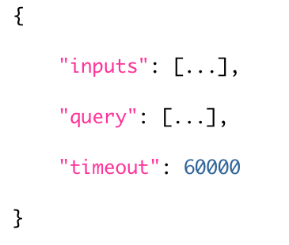
Request (REST)
POST to “/mapred”
Content-Type: application/json
List of bucket/key pairs
List of phase definitions
Timeout in milliseconds

Slide 15
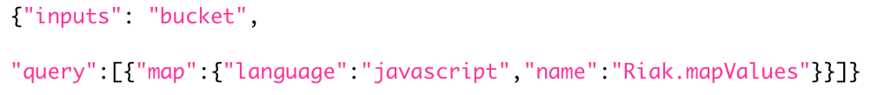
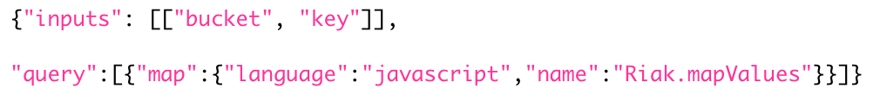
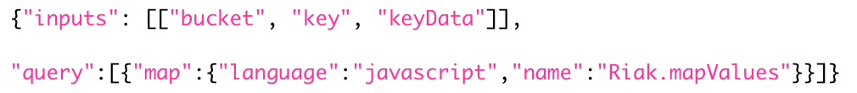
Inputs

Slide 16
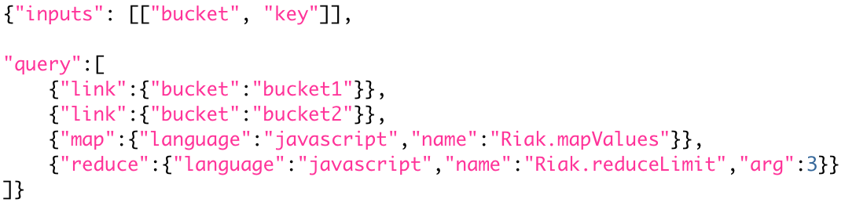
Query

Slide 17
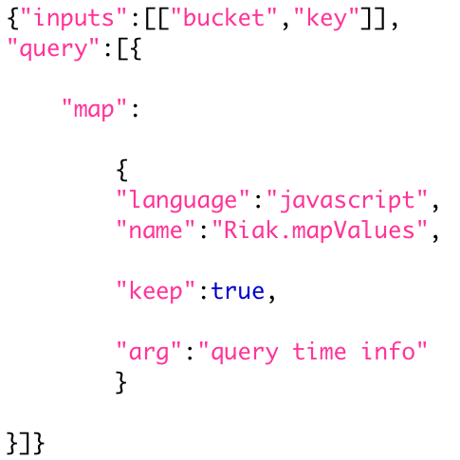
Phase

Slide 18
Phase
Type (map, reduce, link)

Slide 19
Phase
Function (named)

Slide 20
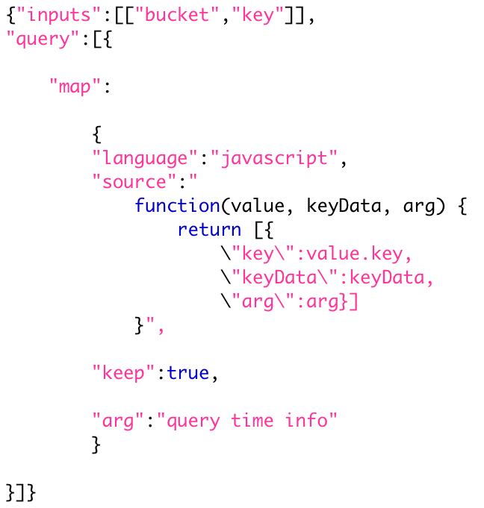
Phase
Function (anonymous)

Slide 21
Phase
Keep (true|false)

Slide 22
Phase
Argument

Slide 23
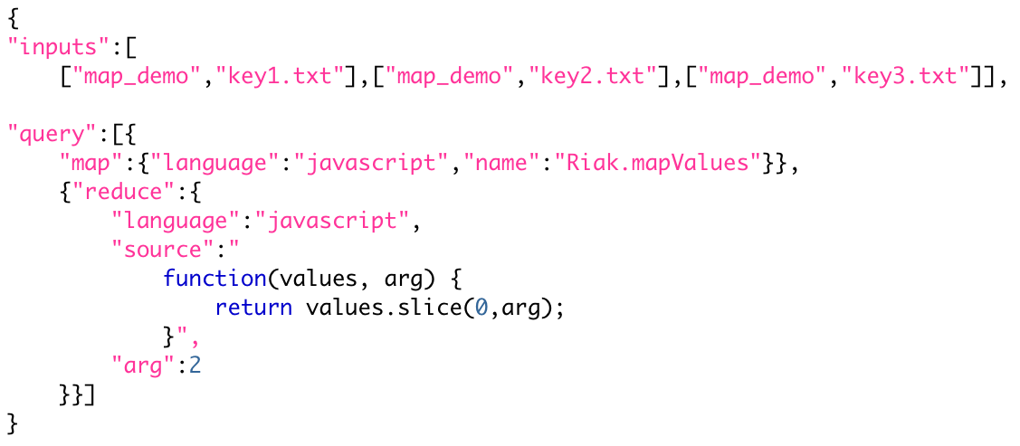
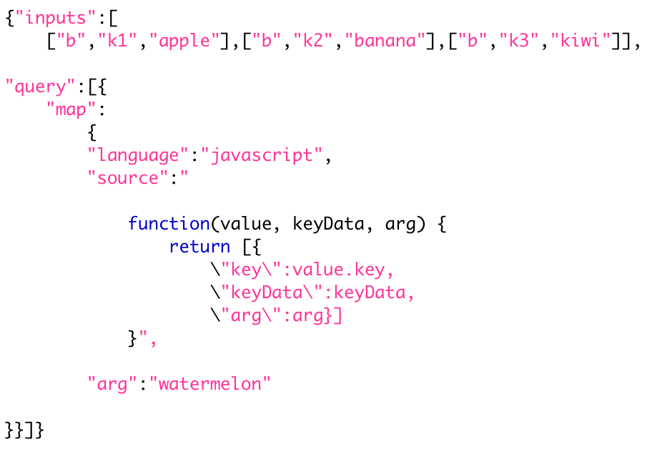
Function Arguments

Slide 24
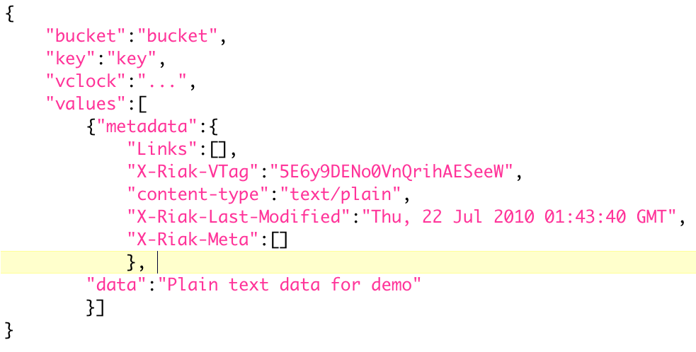
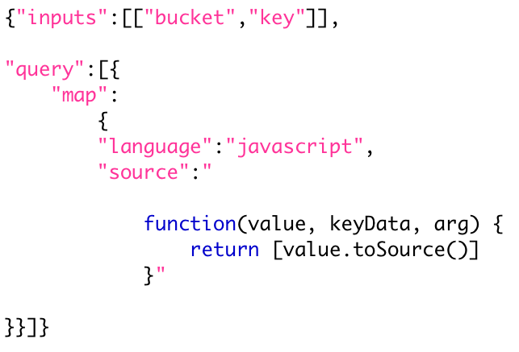
Map - value

Slide 25
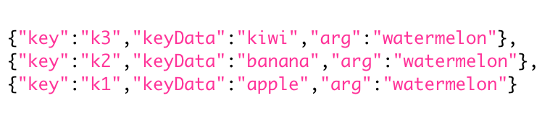
Map - keyData, arg

Slide 26
Reduce - arg

Slide 27
Examples

Slide 28
Map Demo
Count the number of times the word “demo” appears in a set of documents

Slide 29
Demo Data
map_demo/key1.txt Random boring demo data for map demomap_demo/key2.txt More useless demo datamap_demo/key3.txt demo demo demo demo demo

Slide 30
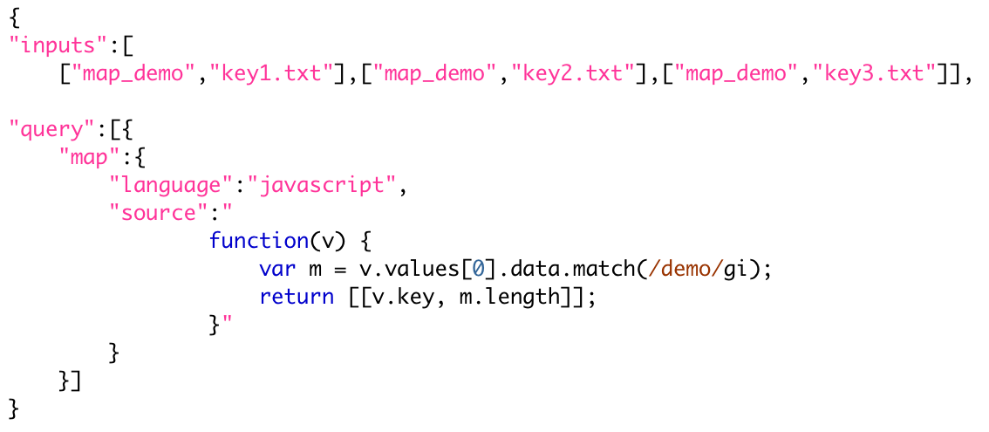
Request

Slide 31
Inputs

Slide 32
Query

Slide 33
Map

Slide 34
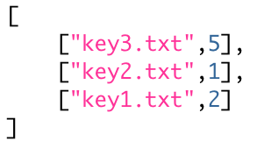
Results

Slide 35
Reduce Demo
Sort documents by the number of times “demo” appears

Slide 36
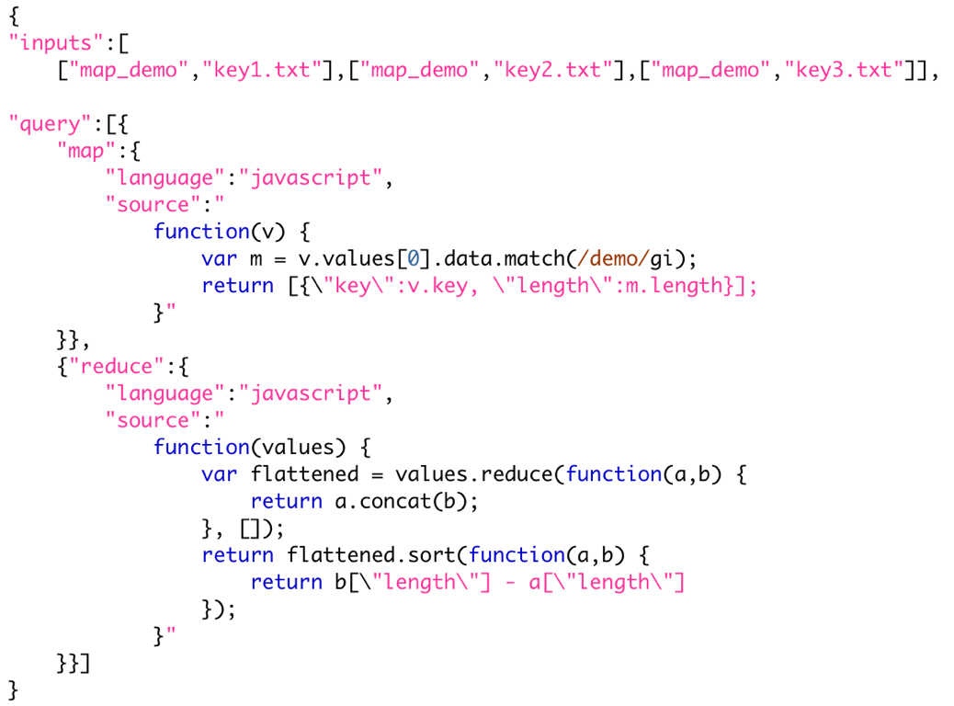
Request

Slide 37
Inputs

Slide 38
Query

Slide 39
Reduce

Slide 40
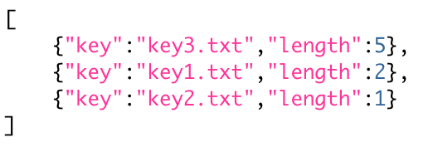
Results

Slide 41
Argument Demo
Enhance “demo” count example to count words matching a regular expression

Slide 42
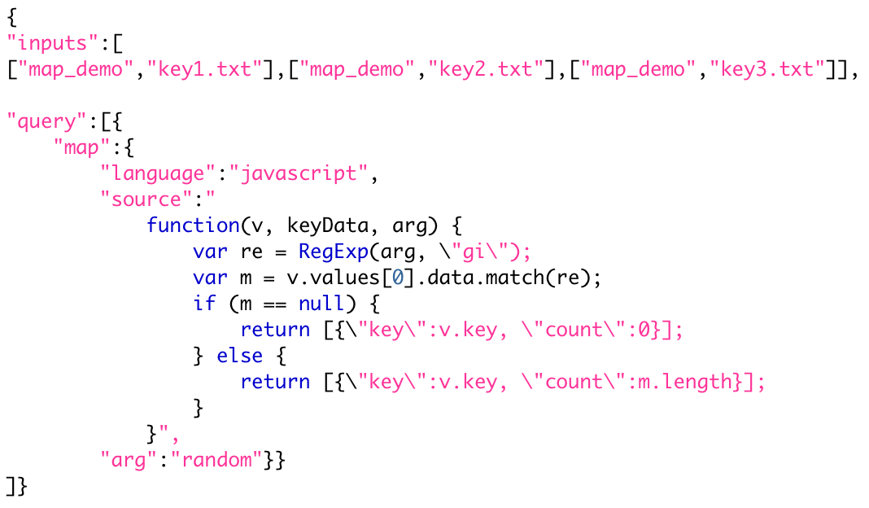
Map with arg

Slide 43
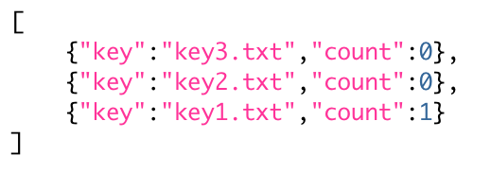
Results

Slide 44
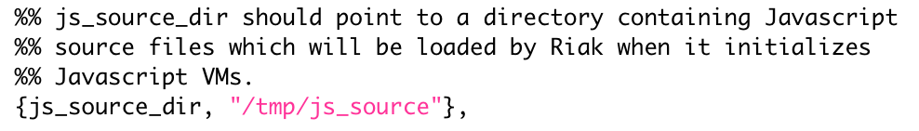
js_source_dir
app.config
$ riak restart

Slide 45
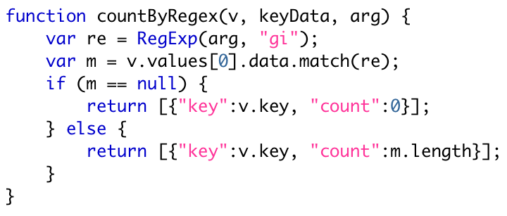
Named Function
/tmp/js_source/count_by_regex.js
$ riak-admin js_reload

Slide 46
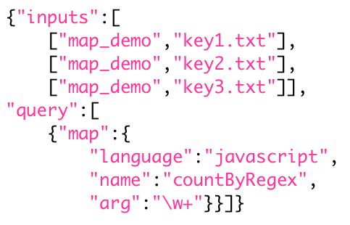
Query

Slide 47
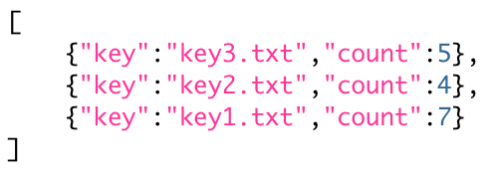
Results

Slide 48
Comparisons

Slide 49
Hadoop (similarities)
Distributed across multiple machines
Provides data locality (HDFS)
  Phases run near the data

Slide 50
Hadoop (differences)
Used for large, long running jobs (hours)
Restarts failed tasks
3 phases (map, combine, reduce)
Notes:
Tasks - individual map processes
Combine - function to run over map results on local nodes before shipping data to reduce operations

Slide 51
CouchDB (differences)
Not distributed across multiple machines
Runs over all docs in a database
Computes cached views for lookups
No query time arguments
2 phase (map, reduce)

Slide 52
MongoDB (differences)
Not run in parallel
Not spread across multiple machines
3 phases (map, reduce, finalize)

Slide 53
Features

Slide 54
Features
Pre/Post Commit Hooks
Link Walking
2i Preview

Slide 56
Pre-Commit Hooks

Slide 57
Pre-Commit Hooks
Javascript or Erlang
Data Validation
Key “Uniqueness”
Breaking Apart Data

Slide 58
Post-Commit Hooks
Erlang Only
Indexing
Update Remote Service
Search Plugin

Slide 59
Links

Slide 60
Link Header
Link: </riak/demo/test1>; riaktag=”userinfo”
bucket
tag
RFC
5988
key

Slide 61
Link-Walking
Asks Riak to traverse a sequence of links via special URL
Filter by bucket/tag
Can return results from intermediate traversals
Response is nested multipart/mixed
(client libs help, but it’s not hard to read)

Slide 62
L/W Example
GET /riak/demo/test1/_,friend,1
Start at demo/test1, follow all links tagged “friend” and return the objects
curl http://localhost:8098/riak/demo/test1/_,friend,1

Slide 63
L/W Example
GET /riak/demo/test1/_,_,_/_,_,1
Start at demo/test1, follow all links, follow all links from those, return everything from the last set
curl http://localhost:8098/riak/demo/test1/_,_,_/_,_,1

Slide 64
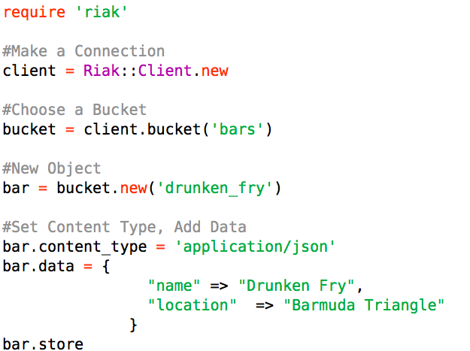
Ruby Code

Slide 65
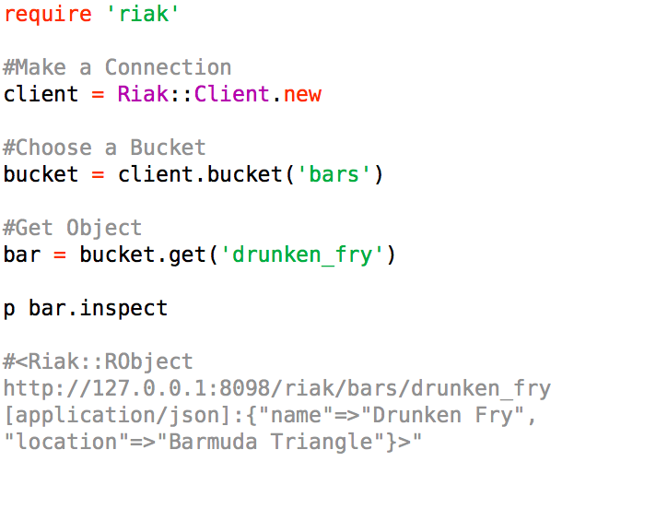
get the data

Slide 66
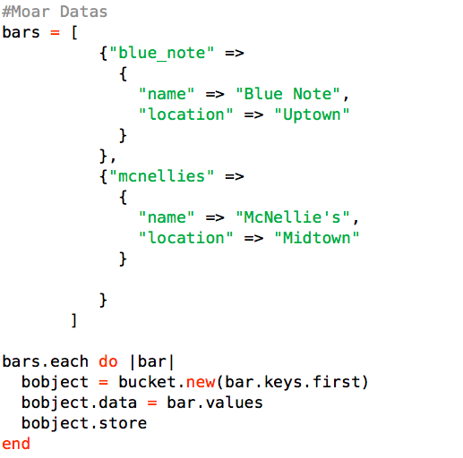
more data

Slide 67
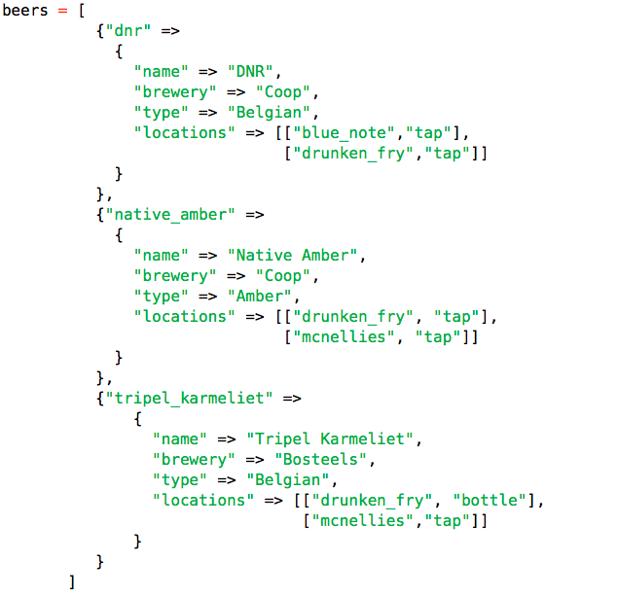
got beer?

Slide 68
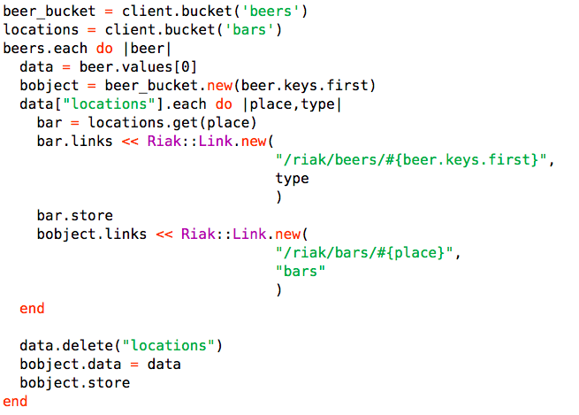
why yes, I do

Slide 69
Link Walking http://localhost:8098/riak/beers/dnr/bars,_,1 http://localhost:8098/riak/bars/blue_note/beers,tap,1 http://localhost:8098/riak/areas/midtown/
/bars,tap,_/beers,_,1

Slide 70
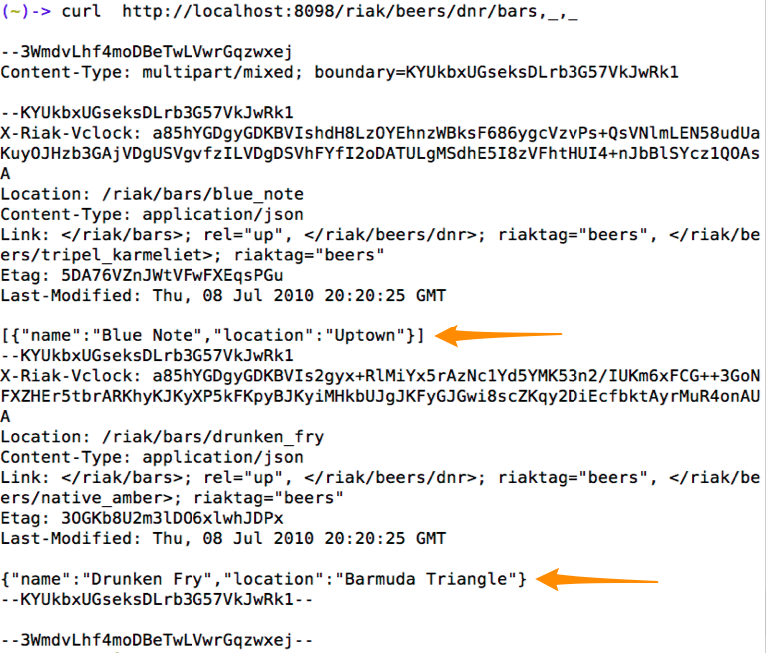
find me a dnr!

Slide 71
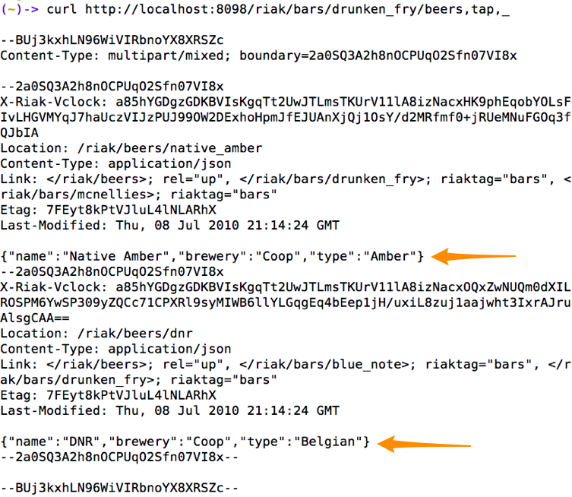
riak-client what does the Fry have on tap?

Slide 72
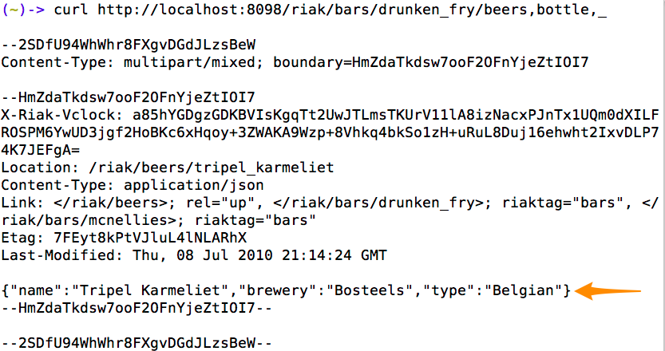
riak-client in a bottle?

