Slide 1
Modeling & Querying

Slide 2
Designing Data
There is no schema! Your application is the schema.
Also gone: tables, foreign keys, integrity constraints, ACID, query planners, SQL

Slide 3
Designing Data
Instead, you get:
  More design fluidity
  Representations that match application
  Easy scaling & operations

Slide 4
Data Shapes
Sparse data (optional/multi-valued)
Richer data structures
Meaningful identifiers
Denormalization & duplication

Slide 5
Analysis
Top 10:
  frequently accessed pages/screens
  slow queries
  indexes
  joins/aggregations

Slide 6
Analysis
What are the...?
  Interdependencies or couplings
  Cardinalities & numeralities of relationships
  Access patterns
  Decomposed data-structures

Slide 7
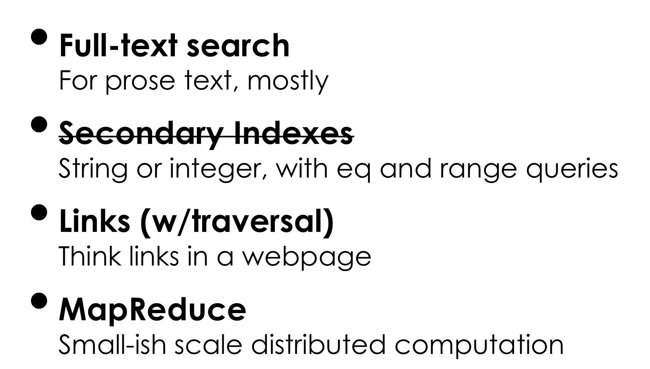
Data Tools in Riak

Slide 8
Example

Slide 9
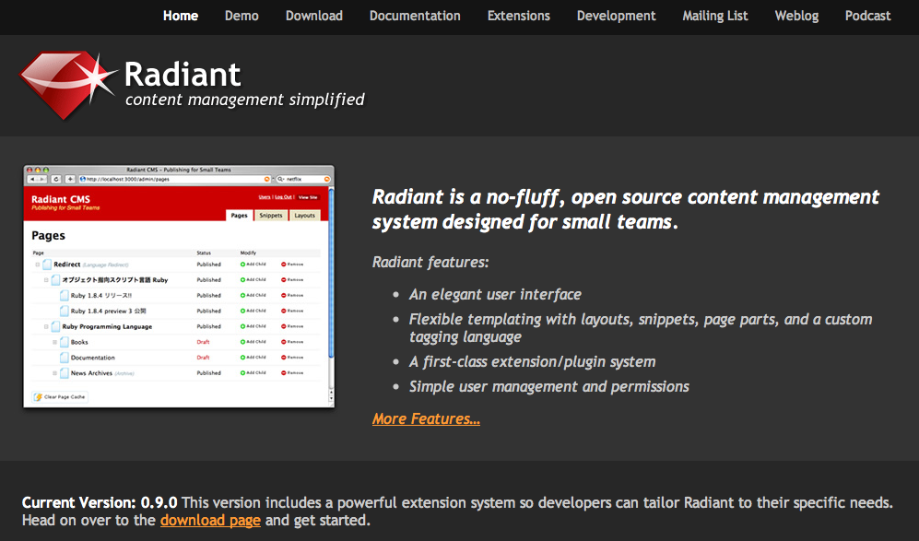
Radiant CMS radiantcms.org

Slide 10
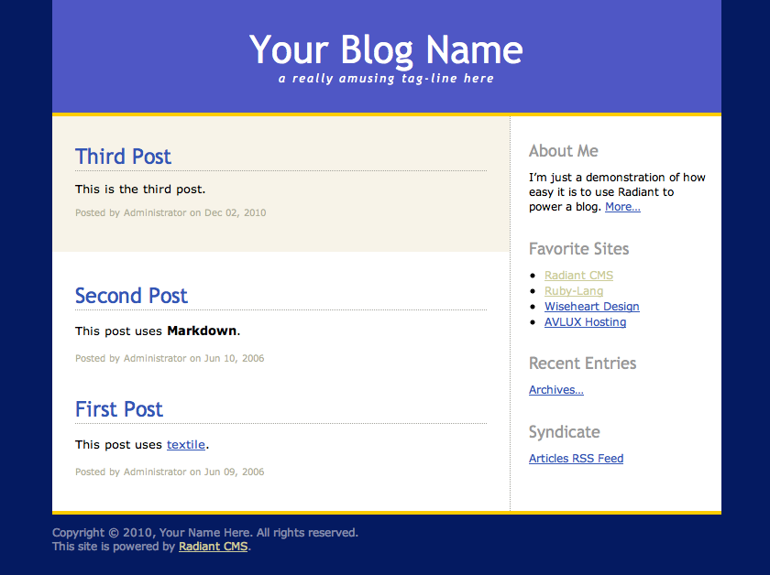
Static sidebar content
Date-organized pages
The “Styled Blog” Template

Slide 11
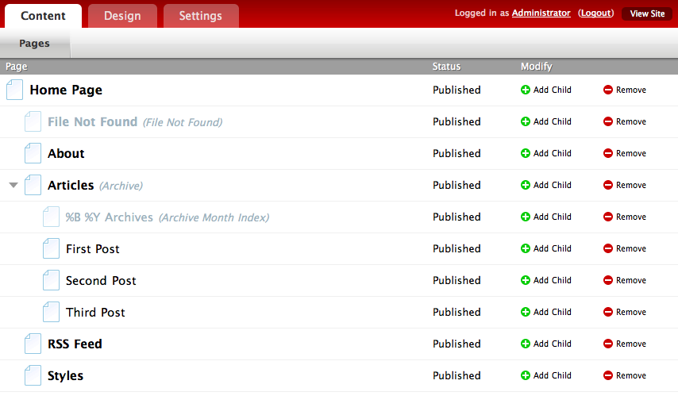
add new pages by parent
special “virtual” pages
hierarchical site structure
Administration UI

Slide 12
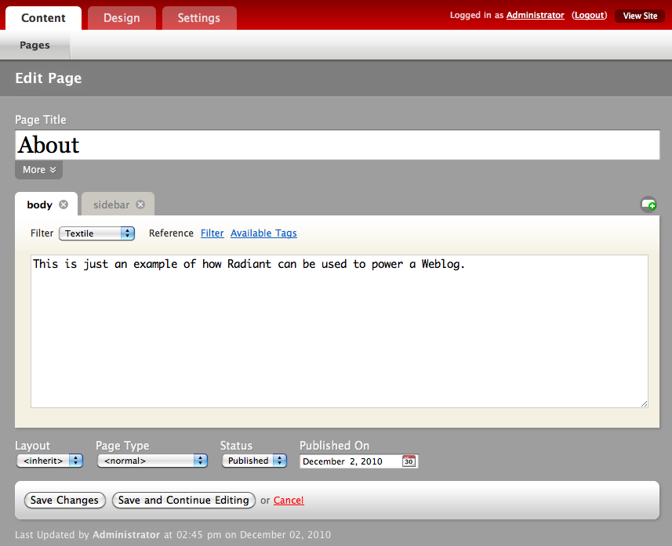
slug, breadcrumb
content blocks
layout

Slide 13
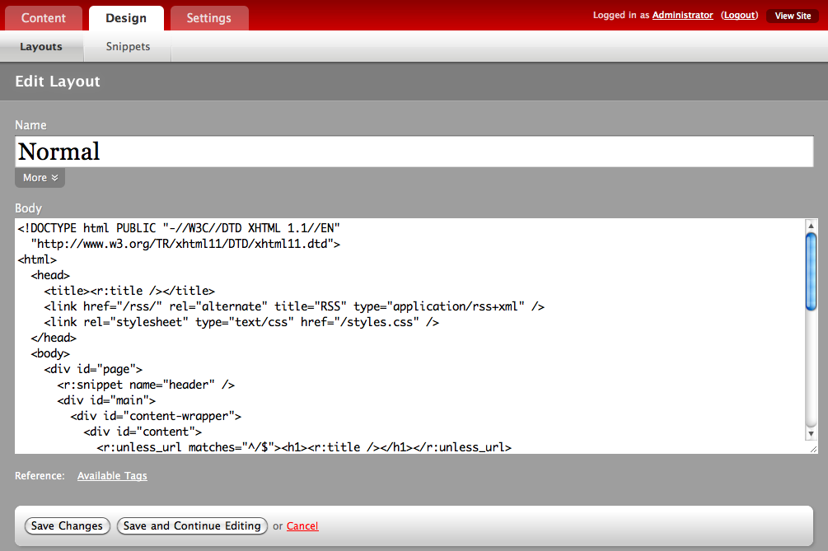
Content-Type
template tags

Slide 14
parent
pages
page_parts
created/modified by
layouts
users
snippets

Slide 15
Converting to Riak

Slide 16
Layouts and Snippets
Layouts and Snippets
are accessed by name
SQL: WHERE name=?
Simple access by key
Simple value structure (content + metadata)
layouts/Main
snippets/top-nav

Slide 17
Users
Normally accessed by login or email: WHERE login=? OR email=?
#1: Login or Email key
  Easy lookup on one, index other
#2: Arbitrary key
  Independent of email/login changes
  Index both
#3: Users-list object
  Fits “small teams” philosophy
  Quick lookup
  (one fetch)
  Bad for large list, still need unique IDs

Slide 18
The Bigger Problems

Slide 19
Page Rendering
Load and render layout in page context
Render parts, snippets via template tags
Iterate over sections of page hierarchy

Slide 20
Rendering Page Parts
Parts are dependent on the page
Compose / Denormalize (part of page)
  Reduces lookups, conceptual unity, no index needed
  Larger objects, no lazy fetching

Slide 21
Denormalized Page
{
title:”Home Page”,
parts:[
{name:”body”,
content:”...”},
{name:”sidebar”,
content:”...”},
],
// ...
}
dependent objects inline

Slide 22
Site Hierarchy
...or, how to find a page (currently)
Start at the root:
WHERE parent_id IS NULL
Check if the current page matches URL
Check children for matching path segment, recurse
Return “not found” page or 404

Slide 23
Site Hierarchy
...or, how to find a page (analysis)
O(log N) queries to find requested page
Index on parent_id speeds retrieval
Traversing/iterating for content generation
Generating URL paths

Slide 24
Site Hierarchy
...or, how to find a page (in Riak)
Blog post:
http://ow.ly/3jDAO
#1 Parent/child links
#2 Material path key
#3 Tree object

Slide 25
#1: Parent/Child Links
A Natural Tree
Easy to understand & implement
Doubly-linked for easy traversal in either direction
Easy to move entire subtrees
A
</riak/pages/C>;
riaktag=”child”
</riak/pages/A>;
riaktag=”parent”
B
C
D
E
F

Slide 26
#1: Parent/Child Links
A Natural Tree
Child order is arbitrary
Still O(log N) traversal
Two writes to add or update
A
B
C
D
E
F

Slide 27
#2: Material Path Key
“Best Guess” discovery
{
title:”D”,
ancestors:[
“B”,
“_root_”
]
}
Use path-to-page as key
Best case: one lookup to find requested page
Ancestor pages listed inside object
“pages” bucket
_root_ (A)
B
C
B/D
C/E

Slide 28
#2: Material Path Key
“Best Guess” discovery
Large update cost for internal nodes
Dynamic URLs hard
Key-filters (0.14) needed for efficient child lists
Need fallback for “misses”
“pages” bucket
_root_ (A)
B
C
B/D
C/E

Slide 29
#3: Tree Object
“Branches and Leaves”
One request to get site structure
Separates content from organization
Intrinsic ordering
Massive structure changes are quick
{
key:”A”,
children:[
{key:”B”,
children:[“D”]},
{key:”C”,
children:[“E”,”F”]}
]
}

Slide 30
#3: Tree Object
“Branches and Leaves”
Large site = large tree object (expensive to transfer)
Some metadata (slug?)will need to be in-tree for efficient traversal
Multiple writers problematic
{
key:”A”,
children:[
{key:”B”,
children:[“D”]},
{key:”C”,
children:[“E”,”F”]}
]
}

Slide 31
Hybrid Solutions
TIMTOWTDI
Material paths for quick lookups, links for relative traversal
Tree object for relative lookups, secondary index for material paths

Slide 32
Key Takeaways
Design for most common access pattern: the key is your index
Denormalize dependent data types
Build richer (or simpler) data structures
Use links and indexes to connect normalized or independent types

Slide 33
Use-Cases

Slide 34
Document Storage
Web-shaped, easy to work with from existing tools and services
Content-management systems
JSON/XML structured data storage w/MapReduce
Notes:
CMS = document repositories

Slide 35
Session Storage
User-sessions map nicely to key-value
Expiration possible when using Bitcask or Memory backends

Slide 36
Multi-Datacenter
Content distribution / edge location
Disaster-recovery / backup
Failover & load-balancing between DCs

Slide 37
E-Commerce
Point-of-sale transaction logs
Shopping carts
Card authorization / token vault
Notes:
Tx logs tend to be write-only, accounting handles reconciliation
Shopping carts are easy to resolve

Slide 38
Time-Series
Time-boxed data (periodic rollups)
MapReduce with secondary indexes for ad-hoc

