Slide 1
Operations
Grant Schofield - Basho Technologies, Inc.

Slide 2
Overview

Slide 3
Riak
Open Source
Erlang (Some C)
Dynamo Inspired
CAP Theorem Influcned
Web Shaped
Distributed Erlang
OPS Obsessed
A Platform

Slide 4
Riak EDS
SNMP
JMX
Replication
Support

Slide 5
Dynamo Inspired
Key Value Store
Consistent Hashing
Sacrifice Consistency for Availability
Vector Clocks
Quorum
Read-repair and Hinted Handoff
Masterless

Slide 6
CAP Theorem
Consistency
Availability
Partition Tolerant
Pick Two
Tunable CAP Controls
N, R, and W

Slide 7
N, R, W
Quorum
N = Number of Replicas
R = Read Quorum
W = Write Quorum
DR/DW = Durable Read|Write Quorum
R/W Configurable Per Request
Every request contacts all replicas (N)

Slide 8

Consistent Hashing & The Ring
node 0
node 1
160-bit integer keyspace
Divided into fixed number of evenly-sized partitions
Partitions are claimed by nodes in the cluster
Replicas go to the N partitions following the key
node 2
0
node 3
`
`
`
32 partitions
2¹⁶⁰/4
N=3
2¹⁶⁰/2
hash(“bucket/key”)

Slide 9

W
put(<<"bucket">>,<<"key">>,
W=2)
(N=3)
ok
X

Slide 10
R
get(<<"bucket">>,<<"key">>,
R=2)
(N=3)
{ok, Object}
X

Slide 11

N=10, R/W = 2
get/put("bucket", "key",
R/W=2)
(N=10)
{ok, Object}
X
X
X
X
X
X
X
X

Slide 12
Hinted Handoff
Node fails
Requests go to fallback
Node comes back
“Handoff” - data returns to recovered node
Normal operations resume
X
X
`
X
`
`
`
`
X
`
X
X
X
X
hash(“bucket/key”)

Slide 13
Anatomy of a Request
get(“bucket/key”)
client
v2
Riak
Get Handler (FSM)
hash(“bucket/key”)
== 10, 11, 12
R=2
v1
v2
get(“bucket/key”)
Coordinating node
Cluster
v1
v2
6
7
8
9
10
11
12
13
14
15
16
The Ring

Slide 14
Read Repair
get(“bucket/key”)
client
v2
Riak
Get Handler (FSM)
R=2
v1
v2
Coordinating node
Cluster
v2
v1
v2
6
7
8
9
10
11
12
13
14
15
16
v1
v2
v2
v1
v2

Slide 15
Riak Architecture
Erlang/OTP Runtime
Riak KV
Client APIs
HTTP
Protocol Buffers
Erlang local client
Request Coordination
get
put
delete
map-reduce
Riak Core
consistent hashing
handoff
gossip
membership
node-liveness
buckets
vnode master
vnodes
JS Runtime
storage backend

Slide 16
System Requirements

Slide 17
Installation
http://downloads.basho.com
http://help.basho.com (EDS Version)
Packages (deb|rpm|pkg)
    Ships with Erlang
Source Build
make devrel

Slide 18
Location of Riak
  /etc/riak
  /usr/sbin/riak|riak-admin
  /usr/lib|lib64/riak << Meat
  /var/log/riak << Log Dir
  /var/lib/riak << Data Dir
  /tmp/riak << Sockets

Slide 19
/etc/riak
app.config
  Riak Configuration
  riak_core, riak_kv, bitcask, etc
vm.args
Erlang VM Configuration
-name riak@< ip | hostname>
snmp/agent/*
Several Config Files (agent/community/standard)
OTP SNMP - Mirrors

Slide 20
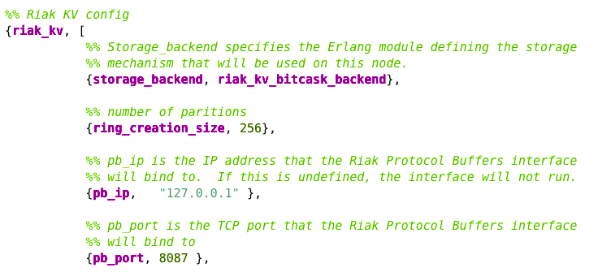
app.config
Interface Binding (http | Protocol Buffers)
ring_creation_size
Backend Configuration

Slide 21
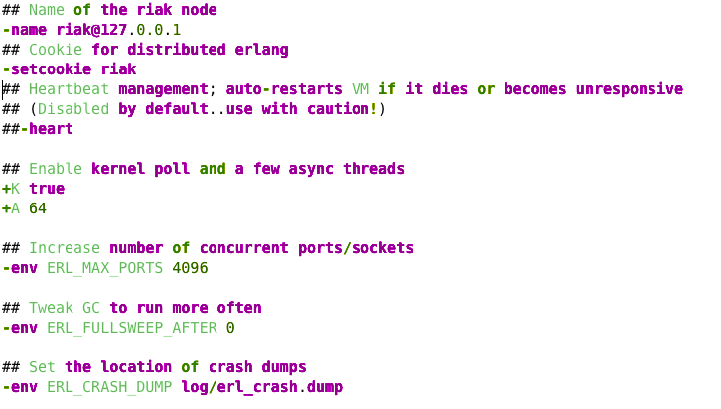
vm.args
-name
Number of Threads
Garbage Collection

Slide 22
Backends
Bitcask
  Fastest
  Append Only, Expiration (Bucket Level with Multi-Backend)
  All Keys in Memory
LevelDB
Ships with 1.0
Very Promising Replacement for InnoDB
InnoStore
Imbedded InnoDB
More Mature Than LevelDB

Slide 23
Load Balancing
HTTP - Any Proxy
Protocol Buffers - Any TCP
Least Connected
Smart Load Balancing?
Proxy can Provide Security

Slide 24
Administration

Slide 25
Starting And Stopping
/etc/init.d/riak
  wraps /usr/sbin/riak
  start | stop | restart | init
/usr/sbin/riak
  Main Riak Daemon Control Command

Slide 26
/usr/sbin/riak
Packages Execute as Riak User (sudo)
star | stop
restart | reboot
ping
console | attach

Slide 27
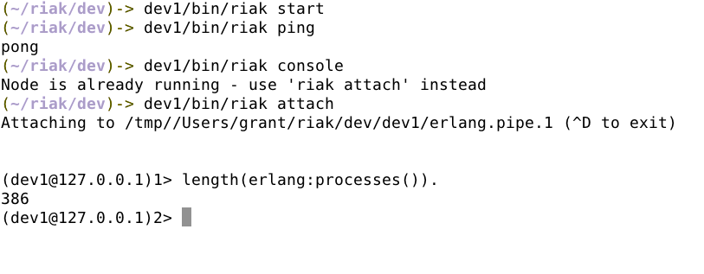
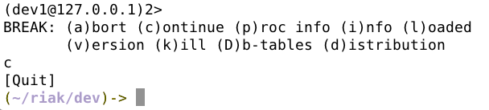

Slide 28
/usr/sbin/riak-admin
join | leave | remove | reip
backup | resotre (cluster or node)
test | status | js_reload
wait-for-service | ringready | transfers
cluster_info (cluster or node)

Slide 29
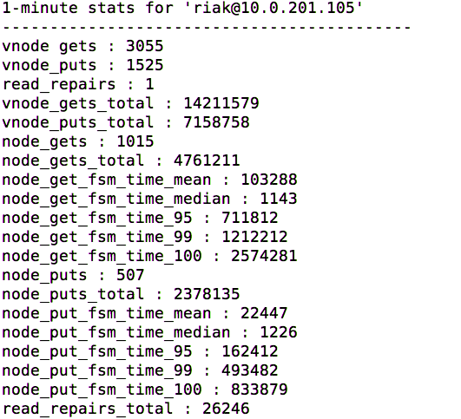
riak-admin status
vnode gets/puts in
the last 60 seconds
read-repairs in the last 60 seconds
total vnode gets/puts
since start
node gets in the
last 60 seconds
total node gets
since start
get_fsm times
in microseconds
node puts in the
last 60 seconds
total node puts since start
put_fsm times
in microseconds
total read-repairs
since start

Slide 30
riak-admin join

Slide 31
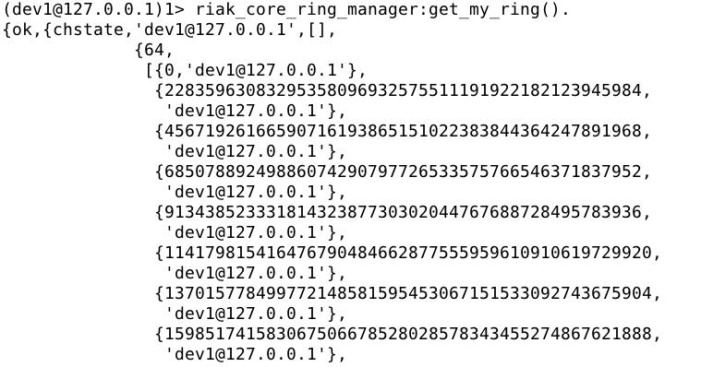
The Ring

Slide 32
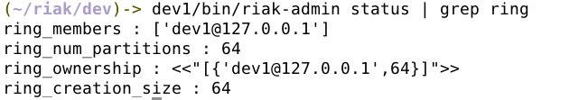
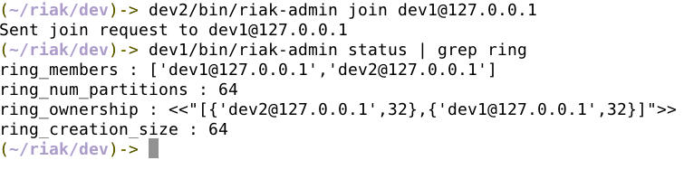
Running the Join

Slide 33
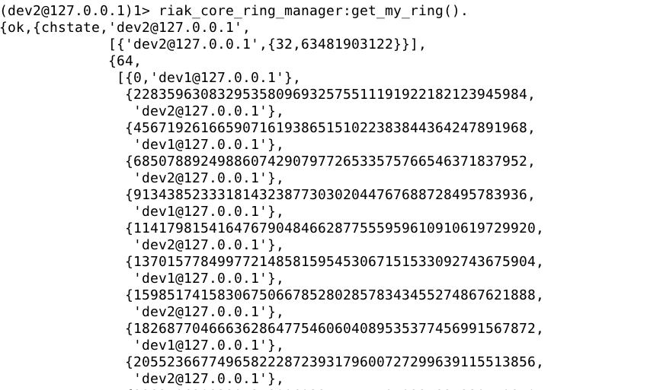
The Ring Now

Slide 34
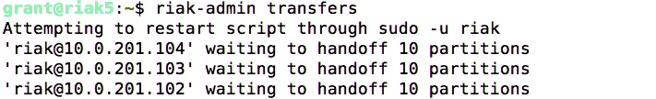
riak-admin transfers
In the Logs.....

Slide 35
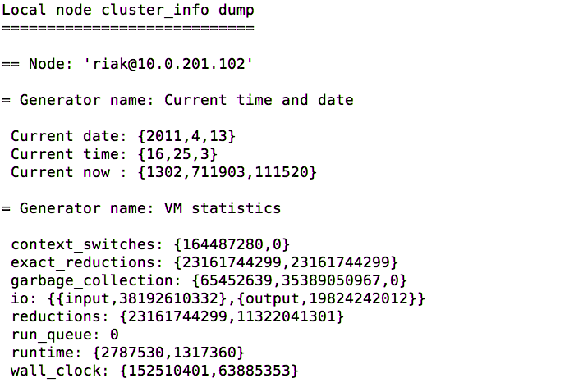
riak-admin cluster_info

Slide 36
Cluster Management

Slide 37
Node Failure
Situation Assessment
Solution Will Vary Depending on Failure and Environment
Moving Data Takes Time
Node Naming Nuances
To Leave or Restore or Read Repair

Slide 38
Situation Assessment
Backend Dependent
Data Size Dependent
Logs
    How did the node exit?
    Unsure? Contact support.
If it isn’t hardware related, does the node start?

Slide 39
Yes?

Slide 40
Awesome!
(still open a ticket and send the logs if it is a new issue, please!)

Slide 41
No?

Slide 42
Not Hardware?

Slide 43
Start with the Last Log
emfile error? -- Permissions? Disk Space?
Is the error in the knowledge base?
Innostore Recovery - innodump/innoload
Bitcask Recovery - Bitcask error? Lockfile?

Slide 44
Hardware?

Slide 45
Hardware Problems
Do you still have the data? - Restore the data and use the same -name for the node in vm.args
No data - run riak-admin remove on bad node, add new node

Slide 46
Caveats
Deletes, currently, require fill quorum - if a node is down deletes won’t be removed from the backend (though the data will not be found)
System will be degraded
Handoff Concurrency
Planning Re-Introduction
Read Repair is Manual

Slide 47
Replication

Slide 48
Terms
Listener
    One Leader Per Cluster (only active node)
    Leader is Chosen and Fails Over
Site - A Remote Cluster That Is Replicated TO
Full-Sync - Comparison of Datasets (Merkle Tree) and Synchronization of Differences

Slide 49
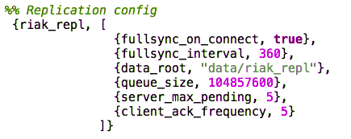
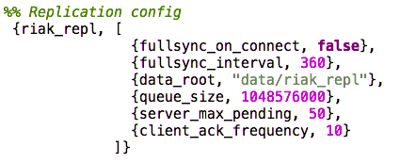
Configuration

Slide 50
TCP Settings

Slide 51
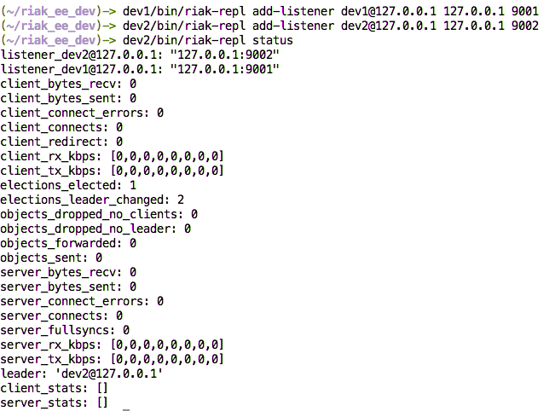
Creating Listeners

Slide 52

Add A Site
repl-status on each leader.....

Slide 53
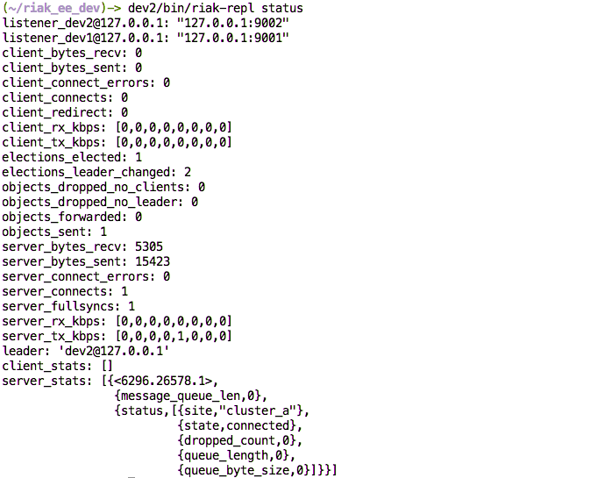

Slide 54
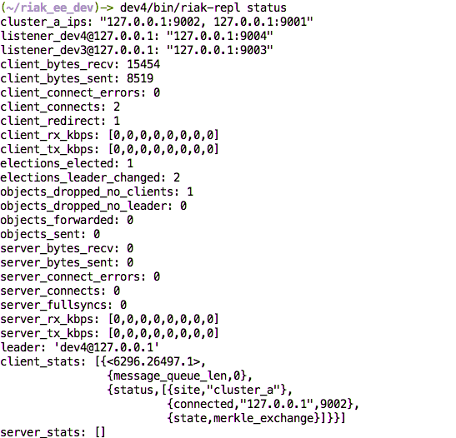

Slide 56
Monitoring

Slide 57
SNMP
Erlang OTP SNMP
v2 and v3
On By Default in EDS (app.config section)
No Traps
Same data as riak-admin status and web Interface (0.14.2 and earlier)
/etc/riak/snmp/agent/conf/

Slide 58
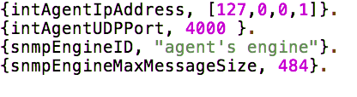
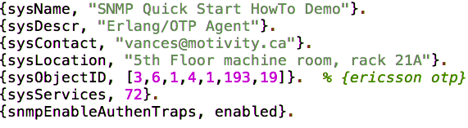
agent.conf
community.conf
standard.conf

Slide 59
JMX
Enable in app.conf
Same data as riak-admin status and web Interface (0.14.2 and earlier)

Slide 60
HTTP Interface
http://riak_host:8098/stats
http://riak_host:8098/ping
Same Data as Other Interfaces
Good End to End Test

Slide 61
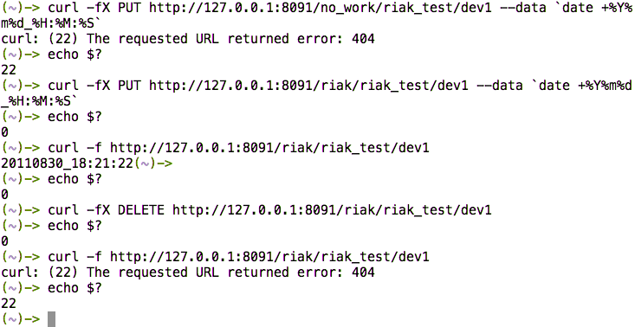
Simple Curl Test

Slide 62
FSM Times
get_fsm times
in microseconds
node puts in the
last 60 seconds
total node puts since start
put_fsm times
in microseconds

Slide 63
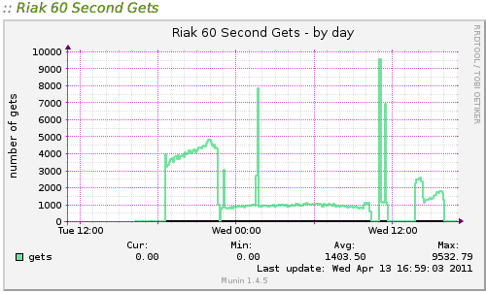
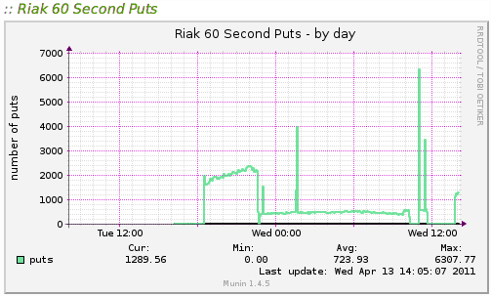
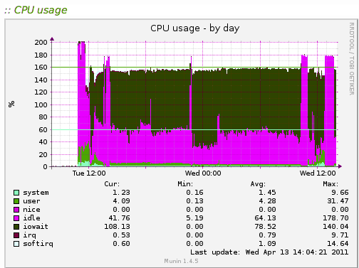
A Basic Bottleneck

Slide 64
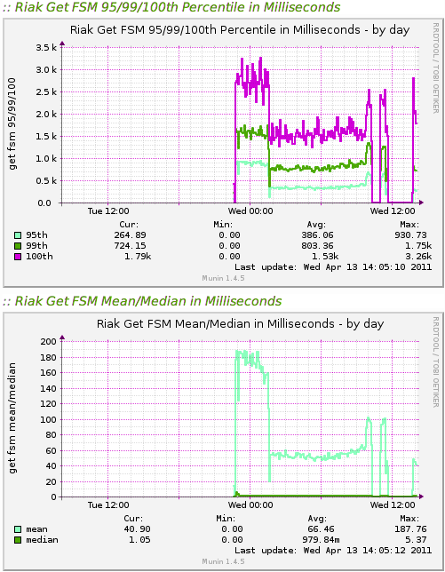
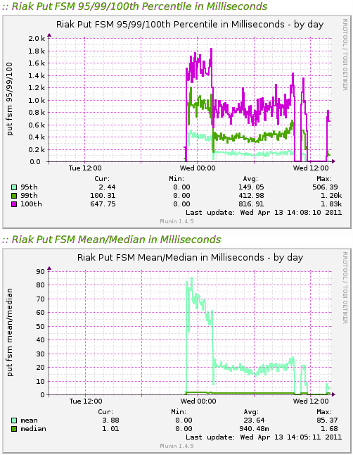

Slide 65
Logging
1.0 - Changes Coming
Not Typical (Does its own Rotation)
/var/log/riak/erlang.log.x
    Console Log
/var/log/riak/sasl-error.log
    Exceptions

Slide 66
SASL Error Logger
Stores Data in /var/log/riak/sasl
Configurable Size
Report Browser Access

Slide 67
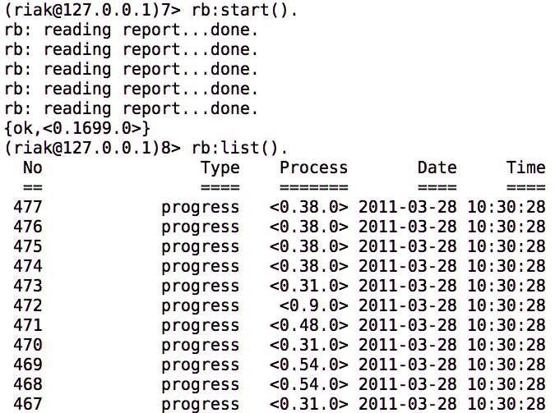
Using rb

Slide 68
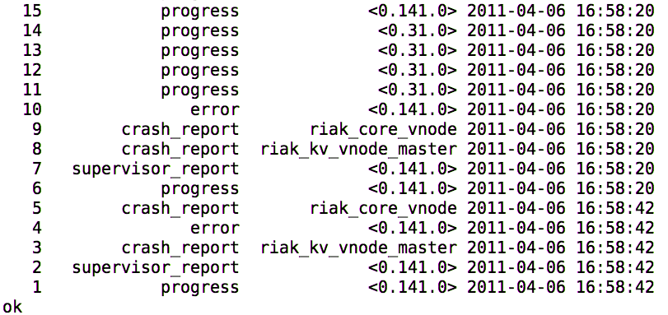
Using rb cont...

Slide 69
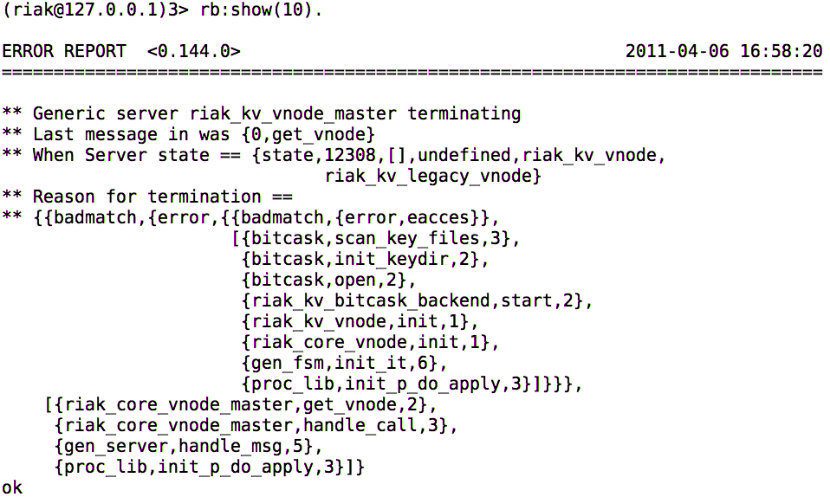
Using rb cont...

Slide 70
Trouble Shooting

Slide 71
Standard Sysadmin Tools
top
iostat
iotop
lsof
strace (ok, not standard)

Slide 72
riak-admin cluster_info

Slide 73
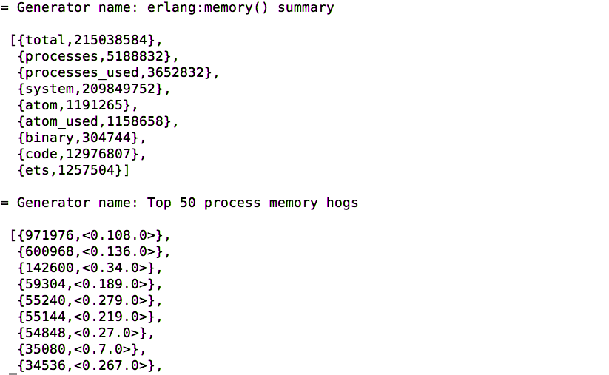
cluster_info cont...
Total Memory Use
<0.108.0>??

Slide 74
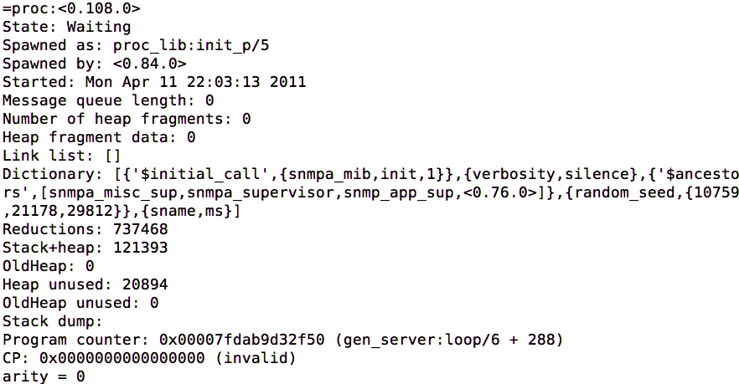
<0.108.0>
snmp process

Slide 75
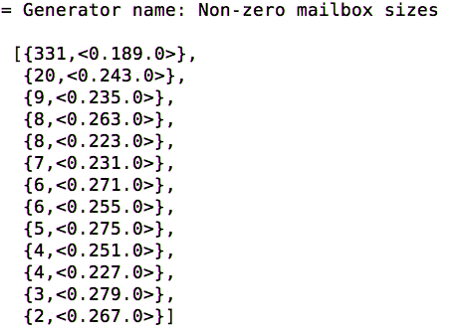
mailboxes
(message queue)

Slide 76
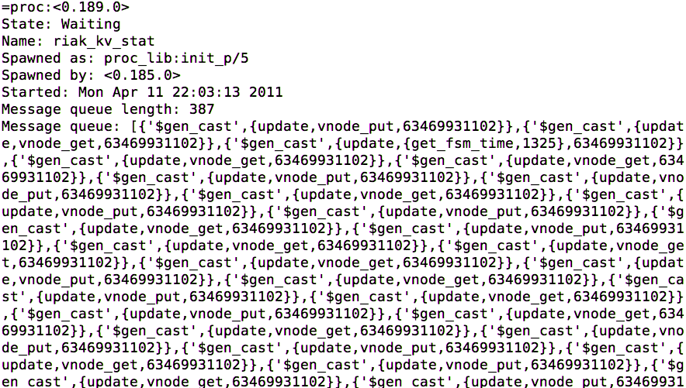
mailboxes cont..

Slide 77
Opening a Ticket
http://help.basho.com
Include Tarball of Log Directory (/var/log/riak)
Include Erlang Crash Dumps
Include Any System Metrics if Relevent

Slide 78
Common Problems
System Limits
Erlang Limits
Open File Limits
Open Port Limits
Number of Processes

Slide 79
Security

Slide 80
Riak Doesn’t Have..
Usernames / Passwords
Multi-Tenancy
ACLs
Every URL will Get a Response

Slide 81
Riak Has...
HTTP SSL Support
Ability to Turn Interfaces Off
Can Bind to Specific IPs and Ports

Slide 82
Security Suggestions
Common Sense Security
Network ACLs
HTTP Proxy or Load Balancing Rules

Slide 83
Maintenance

Slide 84
Backup & Restore
Current Issues -- Speed?
Backup Entire Data Directory
Innostore/LevelDB vs Bitcask
riak-admin backup | restore
For Bitcask Use What Works Best for Your Environment (Snapshots, rsync, Veritas?)

Slide 85
Rolling Upgrades
Stop Riak
Install Package
Start Riak
Wait for Handoff to Complete Before Next Node
Riak Can Run Mixed Versions in a Cluster -- Tested During Development

Slide 86
Hands On

Slide 87
Basho Bench
Installation or
Curl Loading

Slide 88
Basic Querying

Slide 89
Handoff

Slide 90
Metrics Integration

Slide 91
Replication Setup

Slide 92
Planning for Friday

